Slide 1
Lane Line Detection
MD Aawesh Patanwala
111803146
Comp Div-2 T2

Slide 2
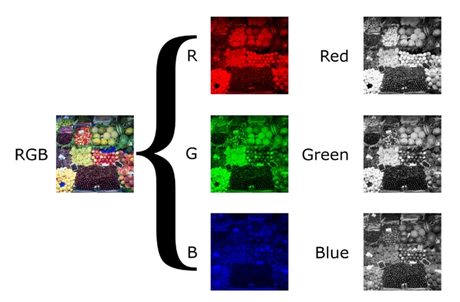
1) Grayscale
We convert our image to grayscale
Treat yellow or white lane lines the same
gray = cv2.grayscale(image)

Slide 3
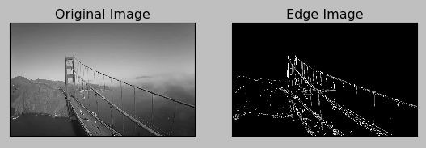
2) Canny Edge Detection
Used to detect boundaries of an image
Uses differential of pixel values
A
High Threshold
B
Low Threshold
C

Slide 4
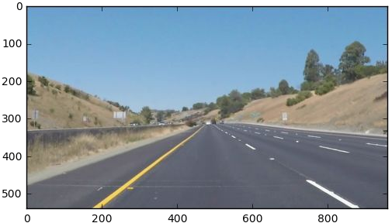
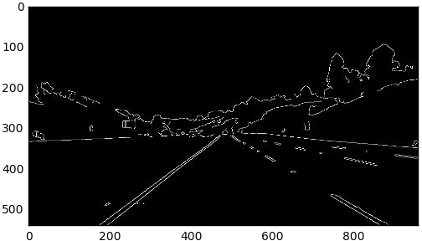
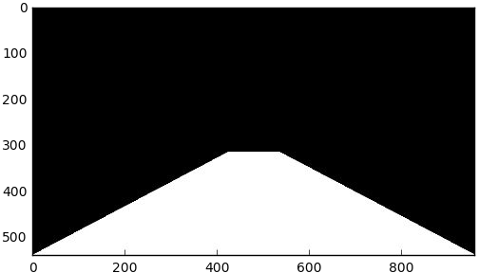

3) Masked Image
We want to narrow down our analysis to a section of the image.
Use bitwise AND to return image only where mask pixels are non-zero.
left_apex
right_apex
y
Apply over edges
left_bottom
x
right_bottom

Slide 5
4) Hough Transform
Goal: To identify straight lines
Rho: Distance of P(pixels). Minimum value of 1. Higher Rho = Increased distance resolution
Theta: angular resolution. Higher theta = higher angular resolution
Threshold : only those lines are returned whole value is > than threshold,
otherwise ignored

Slide 6
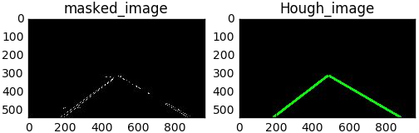
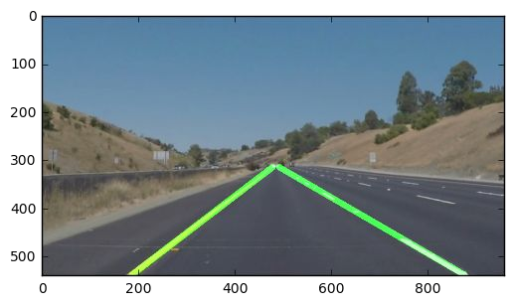
5) Hough Transform
Theta = pi/180
Rho = 1.89
Threshold = 75
min_line_len = 25
max_line_gap = 125
(values dependent on features)
Apply Hough Transform then draw_lines
Onto original image

Slide 7
Thank you
\

