Slide 1

Machine Learning Project
REVIEW 3
RESUME SCREENING AND CANDIDATE CLASSIFICATION USING MACHINE LEARNING
Presented by
Aawesh Kumar Das (24B11CS001)
Bigal Dahal (24B11CS165)
K. Madhu Kiran (24B11CS182)
Department of Computer Science And Engineering

Slide 2




INTRODUCTION
MATCHIX is a Machine Learning and NLP platform that screens resumes, classifies candidates, and matches them to job descriptions.
We have built the full system: a dual-branch matching engine, a three-model benchmark, and a working web application.
For every candidate, recruiters get a fit score and a skill-gap report in seconds instead of hours of manual review.
It selects a candidate from multiple resumes provided according to the specification provided by the recruiter.

Slide 3
PROPOSED SOLUTION
Every resume is scored in two ways, and the results are blended into one score.
Branch 1: Skill Matching
Finds skills using a 73-skill lexicon. Must-have skills count 75% and nice-to-have skills 25%.
Branch 2: Text Similarity
Turns resume and job text into TF-IDF vectors and compares them with cosine similarity.
Matching Engine
Overall Score = 55% Skill Score + 45% Text Score, along with a skill-gap report.

Slide 4
SYSTEM ARCHITECTURE
MATCHIX v3.0: Dual-Branch Pipeline
Resume
PDF, DOCX or TXT
NLP Preprocessing
Clean text, lowercase, remove stop-words
Skill Extraction
73-skill lexicon, must-have vs nice-to-have
Matching Engine
Blends 55% skill score with 45% text score
Overall Score
0 to 100, with fit tier
Job Description
Benchmark, custom or uploaded
Text Embedding
TF-IDF vectors, 10,000 features
Skill Gap Report
Matched, missing required, missing preferred
Resume and job description follow the same path; the two branches meet in the matching engine.

Slide 5
DATASET (MIRRA)
MIRRA Resume-Job Matching Dataset, stored as raw and processed CSV files.
Resumes: 10,000 records
Role, seniority, years of experience, industry, education, skills, summary and experience bullets.
Jobs: 2,500 postings
Title, seniority, industry, must-have and nice-to-have skills, description and requirements.
Ground truth: 75,000 pairs
Each of the 2,500 jobs is linked to its 30 relevant resumes (2,500 × 30).
Data quality check: 0 missing values.

Slide 6
DATA PREPROCESSING
Text Extraction
pdfplumber and python-docx read PDF, DOCX and TXT files.
Cleaning
URLs, email headers, symbols and stray digits are removed.
Normalization
Text is converted to lowercase and common stop-words are dropped.
TF-IDF Vectorization
Clean text becomes sublinear TF-IDF vectors with 10,000 features.
Example
"Built 3 ML models in Python! jane@mail.com" becomes "built ml models python".

Slide 7
MATCHING ENGINE & SCORING
Skill Score
(0.75 × Must-Have + 0.25 × Nice-to-Have coverage) × 100
Text Score
Cosine similarity of resume and job TF-IDF vectors × 100
Overall Score
0.55 × Skill Score + 0.45 × Text Score
Fit Tiers
Top Tier match ≥ 80% , Strong Candidate >70% , Moderate Fit < 50-69% Low <50%.
Skill-Gap Report
Lists matched skills, missing required skills and missing preferred skills.

Slide 8
MODELS USED
Three classifiers were trained on balanced TF-IDF resume–job pairs to judge whether a resume fits a job.
Logistic Regression (Baseline)
A simple linear model that weighs each word feature and outputs a match probability. Fast and easy to interpret.
Random Forest (Bagging)
Many decision trees trained on random samples that vote together. Handles complex patterns and reduces overfitting.
AdaBoost (Boosting)
Builds weak models one after another, each focusing on the mistakes of the previous one.
Random Forest performed best and is the selected model.

Slide 9
APPLICATION MODULES
Dashboard
KPIs, model summary and quick job launcher.
Batch Screening
Upload many resumes and rank them against one job.
1-on-1 Deep Match
One resume vs one job with a 3-column skill-gap view.
Model Comparison
Benchmark bar chart and sortable comparison matrix.
Pipeline Architecture
Interactive flowchart with a live trace of any input.
Built with Python, Flask, scikit-learn, Pandas, pdfplumber and React + Vite.

Slide 10
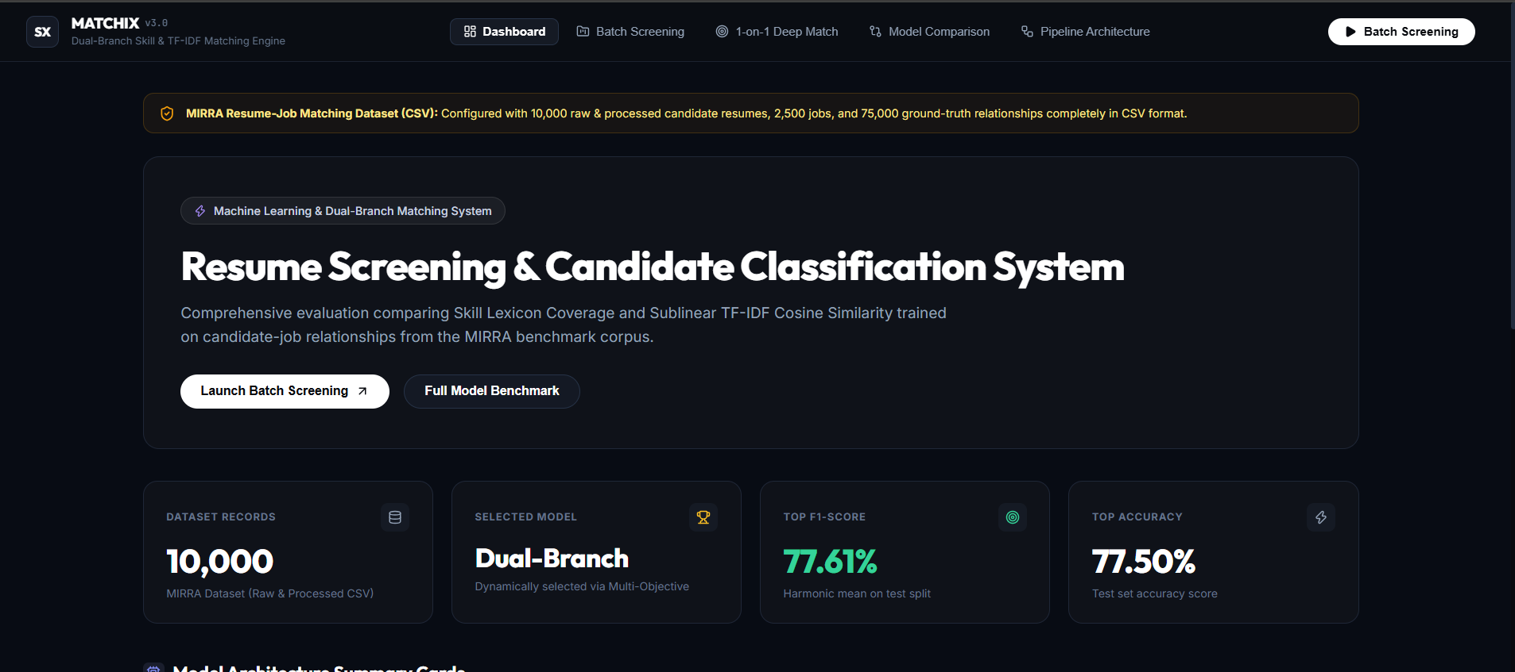
Main Dashboard

Slide 11
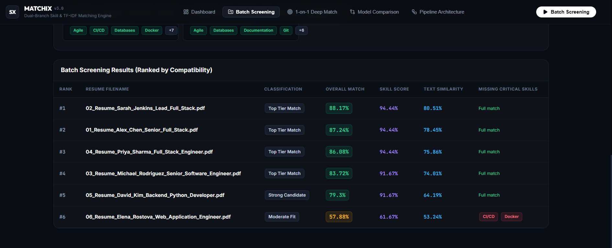
Candidate Ranking

Slide 12
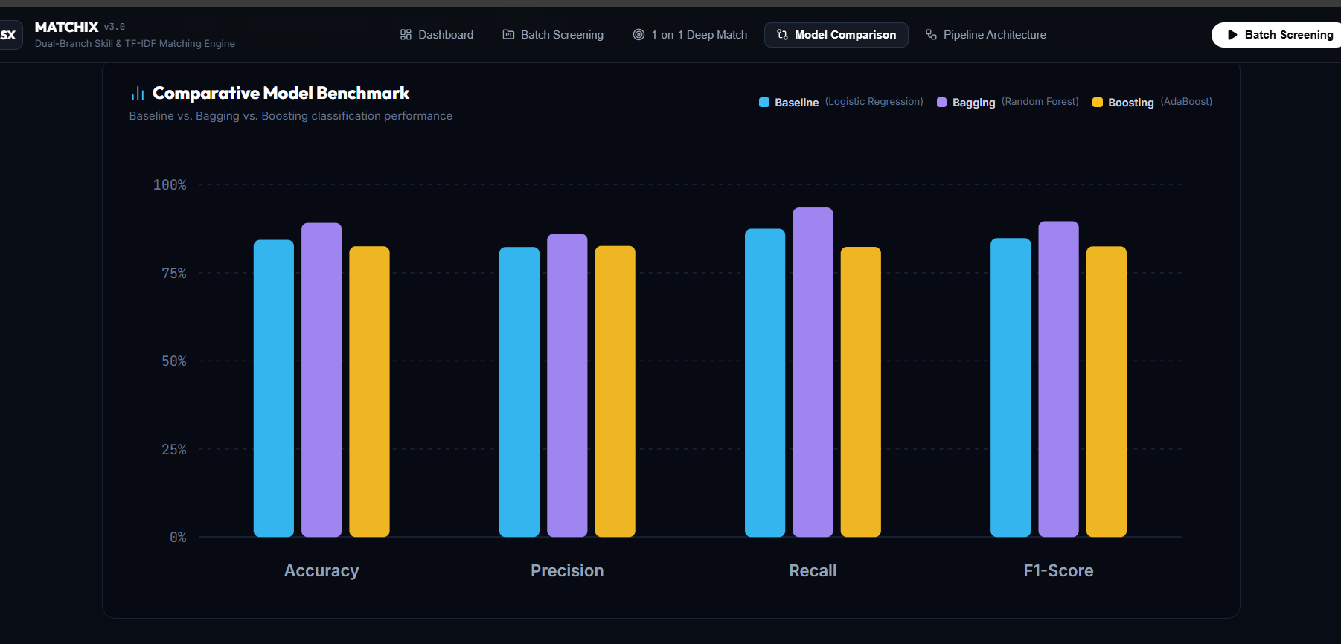
MODEL BENCHMARK
Random Forest (Bagging) scores highest on Accuracy, Precision, Recall and F1-Score.
Baseline is Logistic Regression and Boosting is AdaBoost.

Slide 13
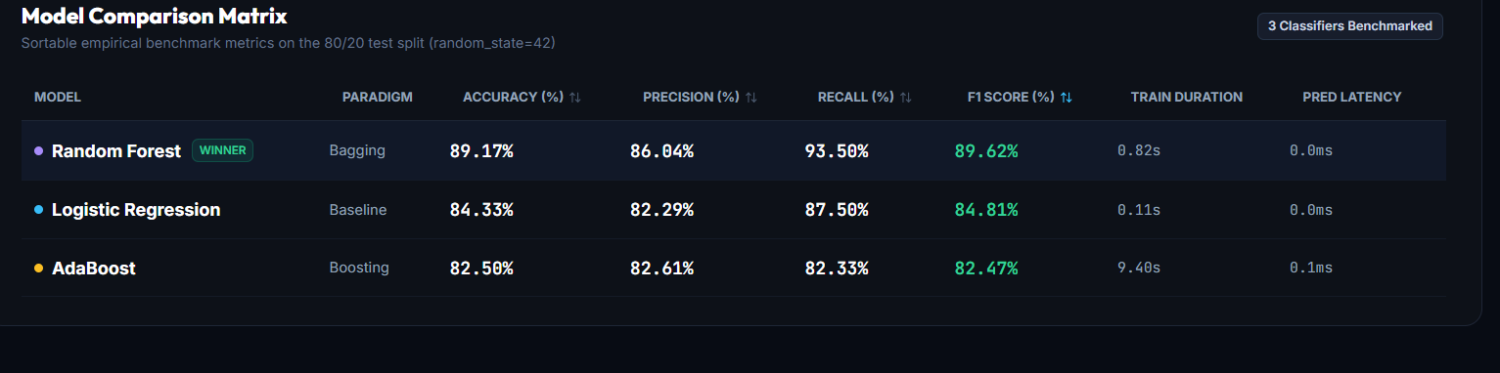
MODEL COMPARISON MATRIX
Random Forest wins with 89.17% accuracy, 89.62% F1 and 93.50% recall.
Logistic Regression trains fastest (0.11 s) and is a strong baseline at 84.81% F1.
AdaBoost is the slowest (9.40 s) and has the lowest F1 (82.47%).
Tested on an 80/20 stratified split with random_state = 42.

Slide 14
CONCLUSION
MATCHIX combines skill matching and TF-IDF text similarity in one dual-branch engine that scores every resume and explains its skill gaps.
Random Forest was the best of three classifiers, reaching 89.17% accuracy and 89.62% F1 on the MIRRA dataset.
The web app supports batch screening and 1-on-1 matching.

Slide 15
THANK YOU

