Slide 1

APPBAY
Bank Data Platform
One trusted set of numbers from every system the bank runs
Collect · Verify · Measure · Act
Client demo · September 2026

Slide 2
HOW IT WORKS, END TO END
Eight Steps From Raw Data to an Approved Number.
Every run follows the same path. The first six steps run automatically in Databricks, in about ten minutes for the current data. The last two involve people: reviewing what the checks found, and approving the fixes.
01
02
03
04
05
06
07
08
Ingest
Standardise
Validate and clean
Detect
Aggregate
Reconcile
Review and approve
Correct and refresh
Data arrives from every source: file drops today, databases and application APIs as connectors are added. Each record is tagged with its source, country and run.
Dates, amounts, currency codes and field names are put into one standard format, whatever system they came from.
More than 25 checks: missing values, invalid codes, impossible amounts, broken links. Failing records are held back with the reason.
Transactions are screened by 9 rules: large amounts, structuring, unusual activity, duplicates and more.
KPIs, portfolio, branch, country and scenario figures are calculated from the verified data only.
What each source sent is compared with what was kept, and the Bank's data with its core banking system. Every gap is recorded.
Each exception becomes a task for the right team. Large decisions need a second approver, and the CFO signs off.
Approved corrections are saved immediately and applied to the data on the next run. The dashboards update.
RAW LAYER
What each source sent, in one standard format
CLEAN LAYER
Verified records + rejection log
BUSINESS LAYER
Flags, KPIs, summaries and reconciliation results
IN THE APP
Results loaded to the app: tasks, approvals, audit trail
1
On-prem
2
Scalability
3
Azure services
4
Security
Your data centre, your control
10 sources today, 1,000 tomorrow
Powered by Azure UAE North
Role-based access, dual approval, audit trail
WHY IT IS BUILT THIS WAY
Nothing disappears silently
Screens stay fast
Runs on arrival or on demand
A rejected record is never deleted. It is logged with the check it failed, counted in the reconciliation and turned into a task.
The heavy work happens in the nightly run. The screens read small, pre-calculated summaries, so they open in seconds.
A run starts when a new file lands, on a daily schedule, or when the CFO presses Refresh Now after approving corrections.

Slide 3
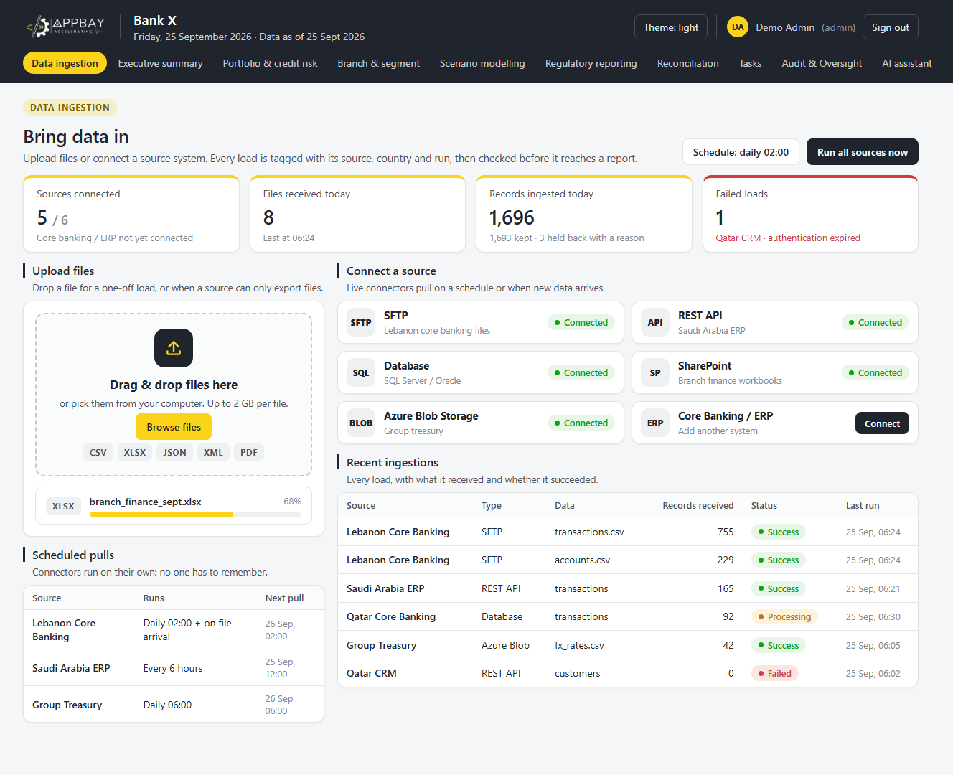

STEP 1
Data Ingestion
Every source, one way in
Multi-source ingestion: core banking, ERP, CRM, databases and spreadsheets.
1
Upload files (CSV, XLSX, JSON, XML, PDF) or connect a live source.
2
Scheduled and automatic pulls, so no one has to remember.
3
Status tracked for every load: records received, success or failure.
4

Slide 4
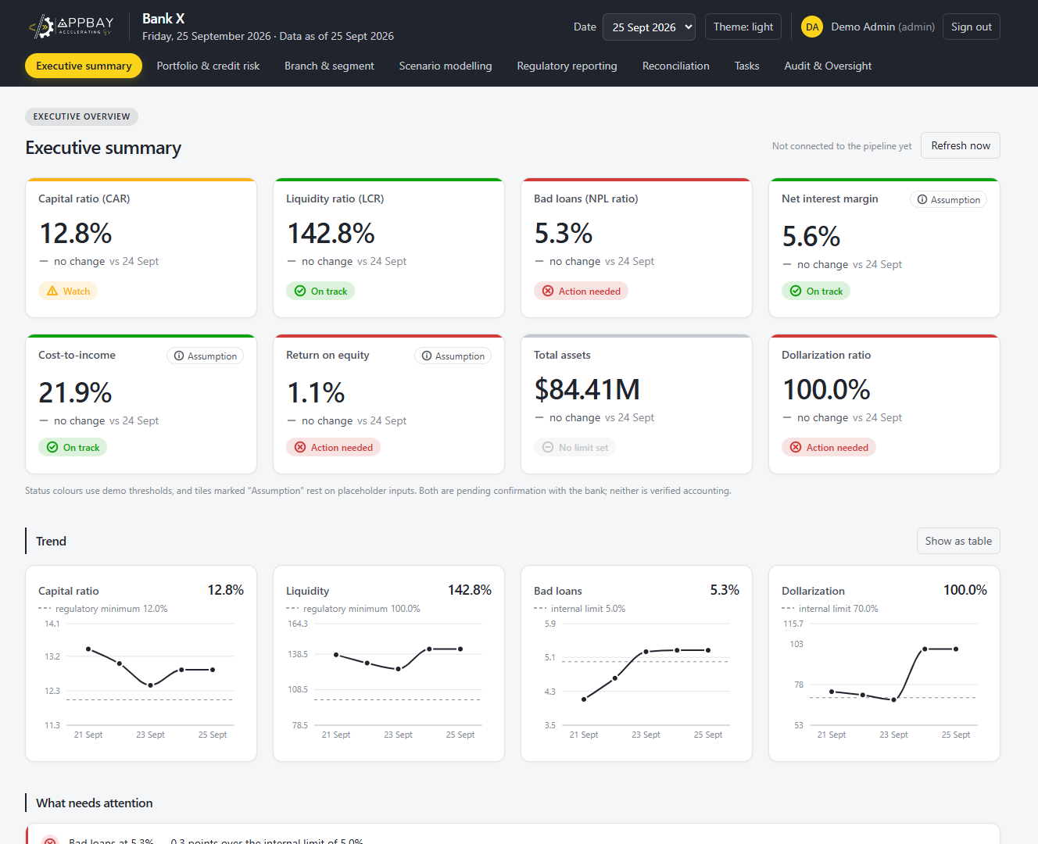
STEP 2
Executive Summary
The bank on one page
Eight KPI tiles, each compared with the previous day and coloured by its limit.
1
Tiles resting on placeholder inputs are clearly marked “Assumption”.
2
Trends plotted against regulatory minimums and internal limits.
3
Refresh now re-runs the pipeline on demand.
4

Slide 5
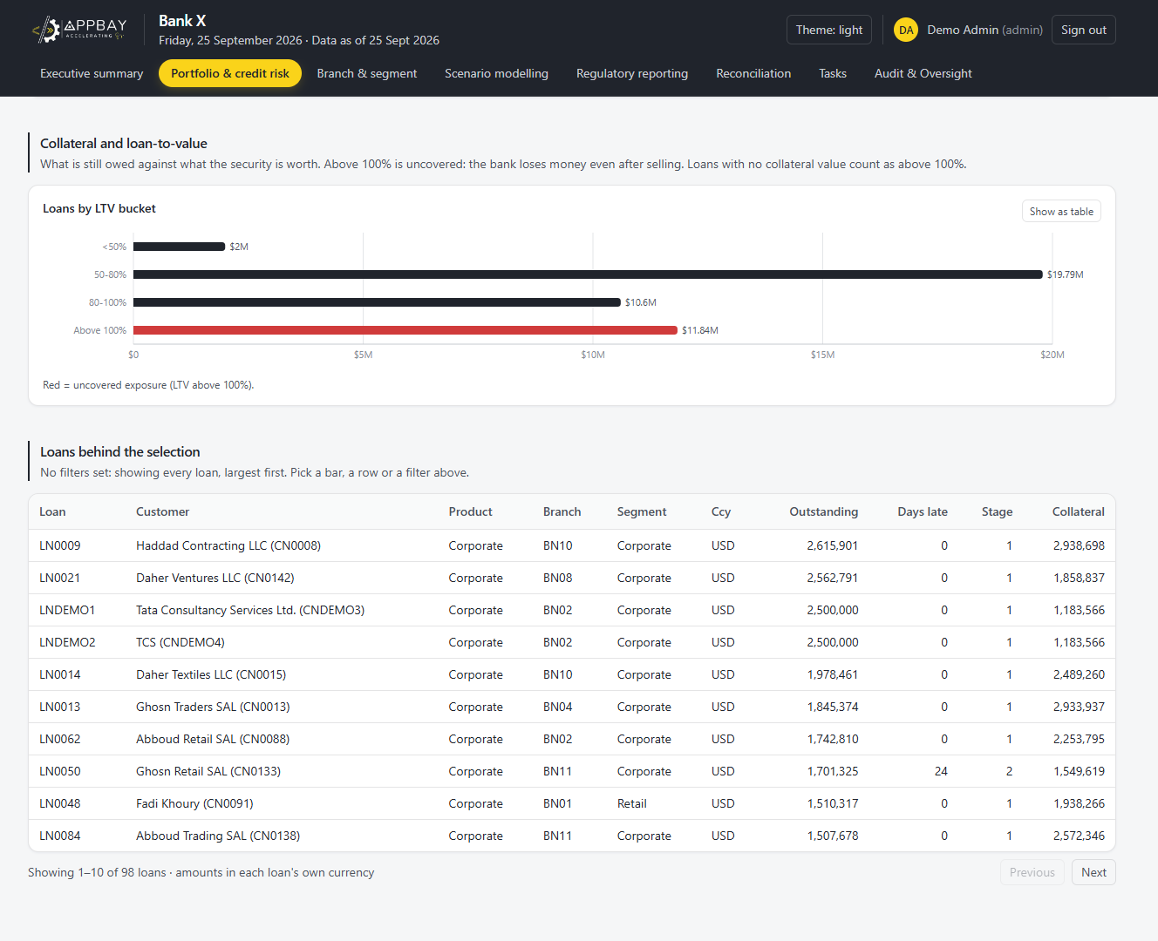
STEP 3
Portfolio & Credit Risk
Where the loan book is exposed
Loans grouped by loan-to-value; red marks exposure above 100%, not covered by collateral.
1
Click a bar or filter to list the loans behind it, largest first.
2
Each loan shows customer, branch, segment, currency, days late, IFRS 9 stage and collateral.
3
Amounts stay in each loan's own currency.
4

Slide 6
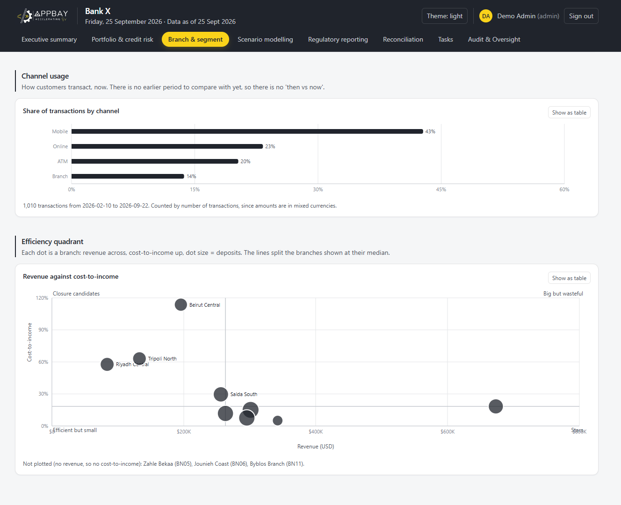
STEP 4
Branch & Segment
How branches and channels perform
Channel usage: the share of transactions by mobile, online, ATM and branch.
1
Efficiency quadrant: each branch by revenue vs cost-to-income, sized by deposits.
2
Stars and closure candidates stand out at a glance.
3
Every chart can also be shown as a table.
4

Slide 7
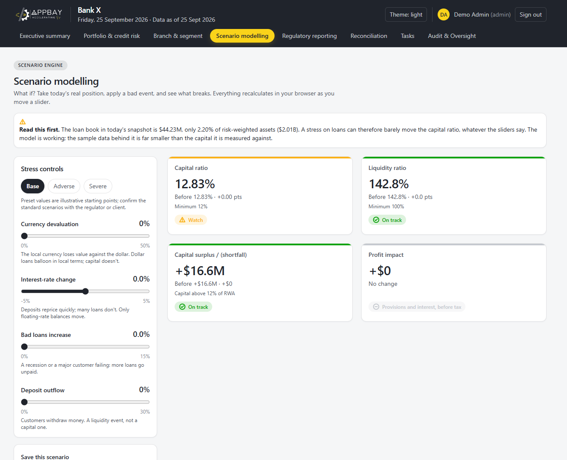
STEP 5
Scenario Modelling
Stress-test before it happens
Start from base, adverse or severe presets, or set your own shocks.
1
Sliders for currency devaluation, interest-rate change and bad-loan increase.
2
Capital, liquidity, surplus and profit recalculate instantly as you move a slider.
3
Every result shown before vs after, against the regulatory minimum.
4

Slide 8
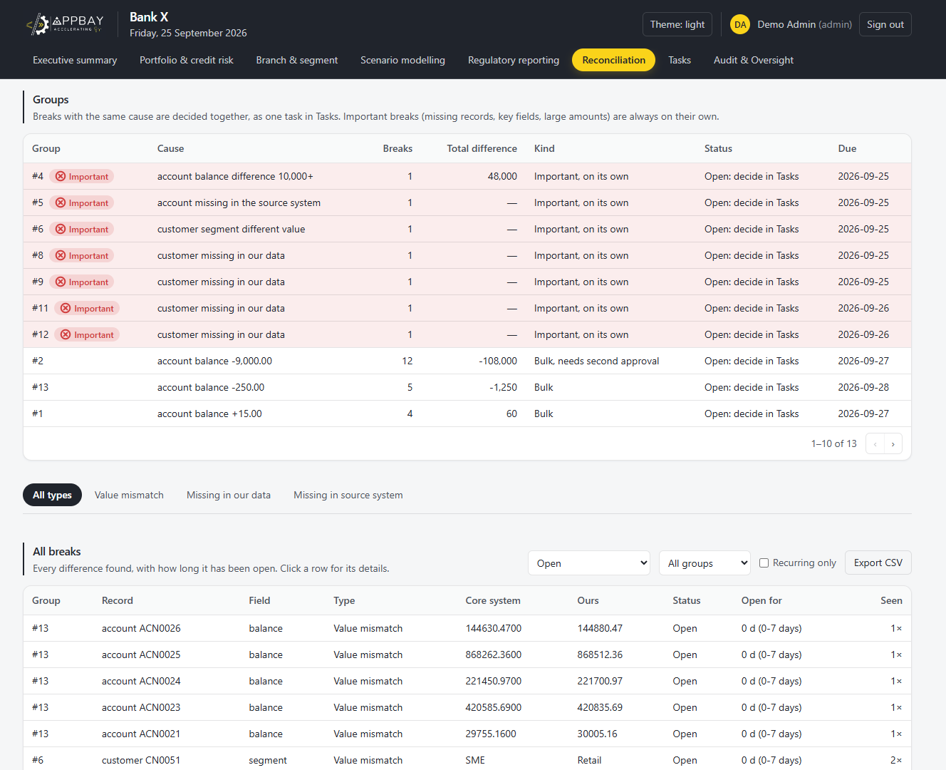
STEP 6
Reconciliation
Breaks grouped by cause
Every difference between the Bank's data and its core banking system, grouped by cause.
1
Important breaks (missing records, key fields, 10,000+) always stand alone, with a one-day deadline.
2
Large bulk groups, such as 12 accounts at −9,000, need a second approval.
3
Each break shows the core value vs ours, how long it has been open, and a CSV export.
4

Slide 9
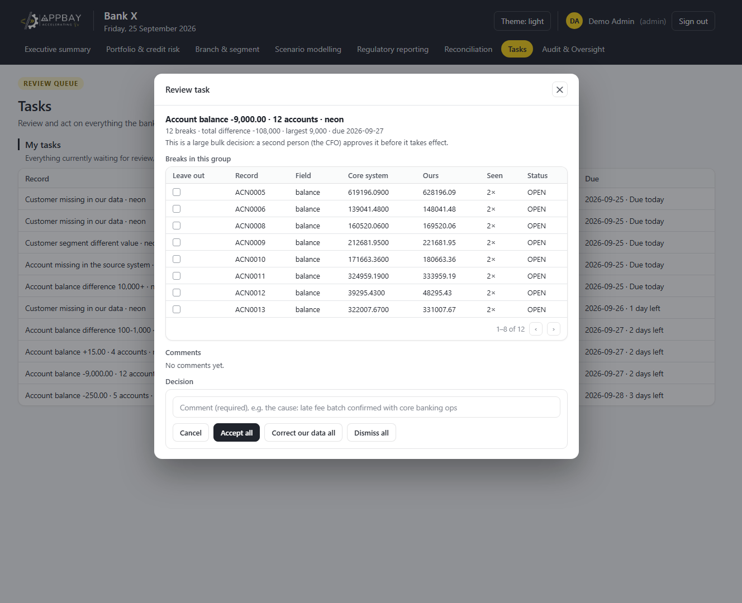
STEP 7
Tasks
One decision for a whole group
Every task has an owner, a severity and a due date, in one review queue.
1
Open a group to see each break side by side: core system vs our data.
2
Leave individual breaks out, then accept, correct or dismiss the rest.
3
A comment is required, and large bulk decisions go to the CFO for approval.
4

Slide 10
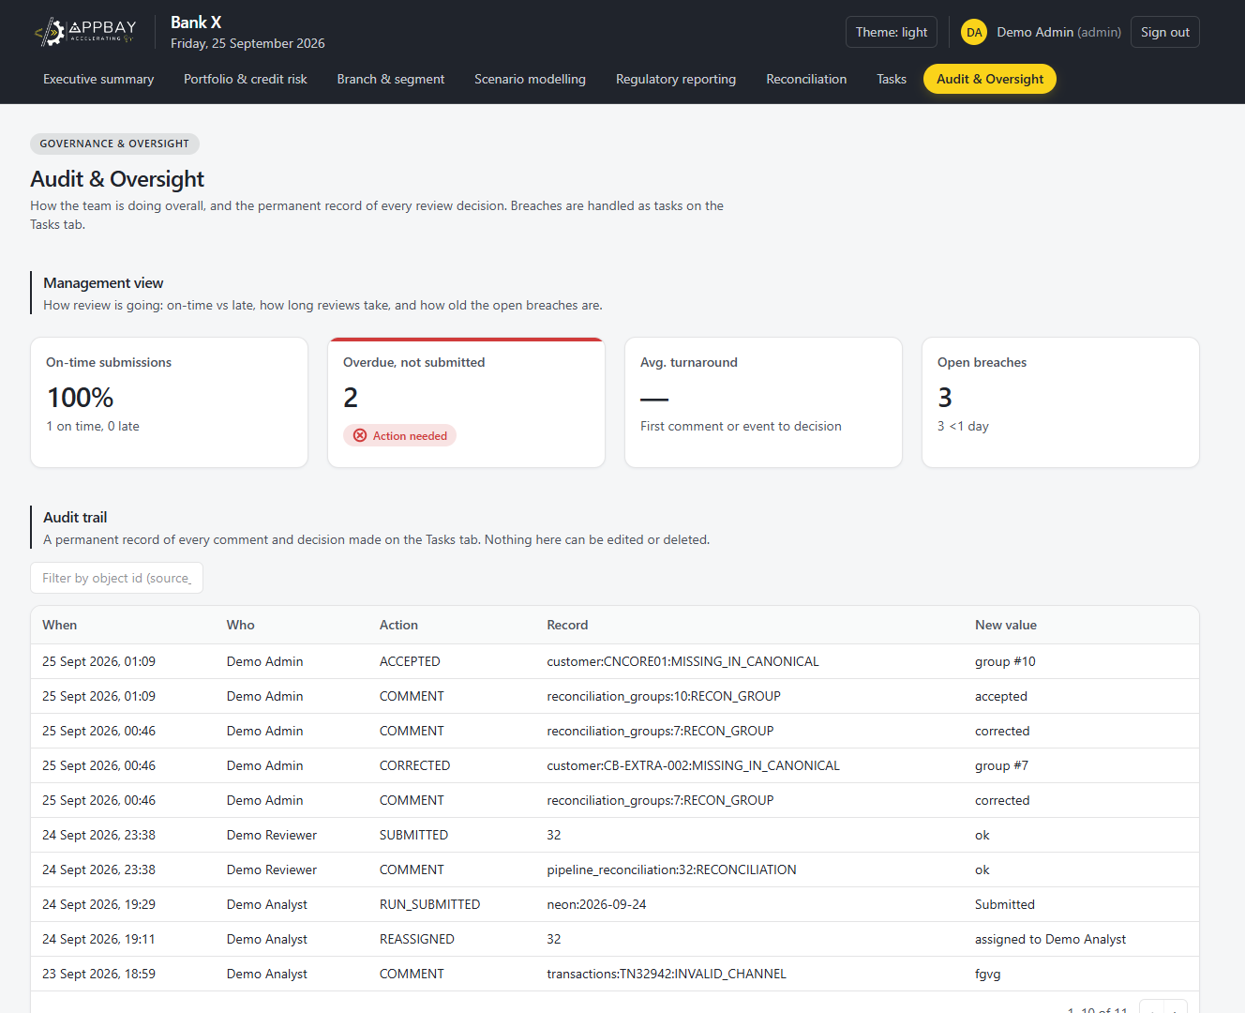
STEP 8
Audit & Oversight
A permanent record of every decision
Management view: on-time submissions, overdue work, turnaround and open breaches.
1
Every comment, correction and decision is recorded with who, when and what.
2
Nothing in the audit trail can be edited or deleted.
3
Filter by record to answer audit and regulator questions in seconds.
4

Slide 11
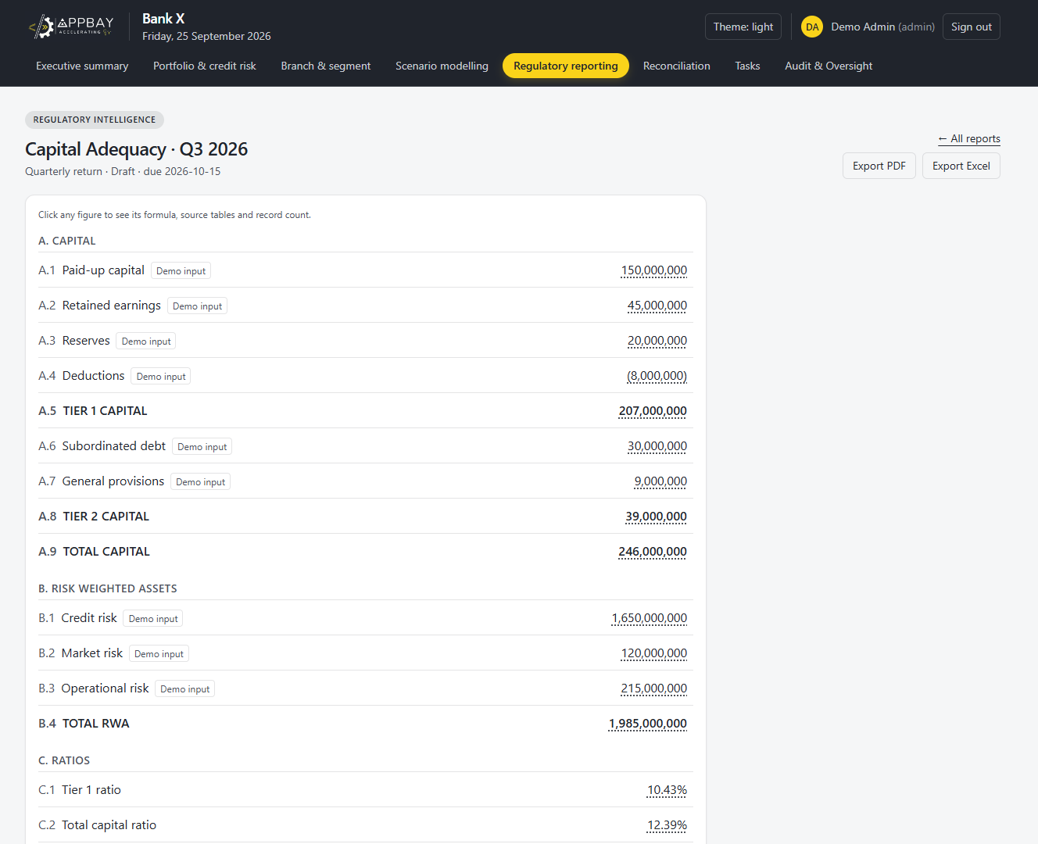
STEP 9
Regulatory Reporting
Returns in the regulator's format
Returns built from the final, approved numbers, e.g. Capital Adequacy Q3 2026 with its due date.
1
Click any figure to see its formula, source tables and record count.
2
Export to PDF or Excel in one click.
3
Demo inputs are labelled until the Bank's own data is connected.
4

Slide 12
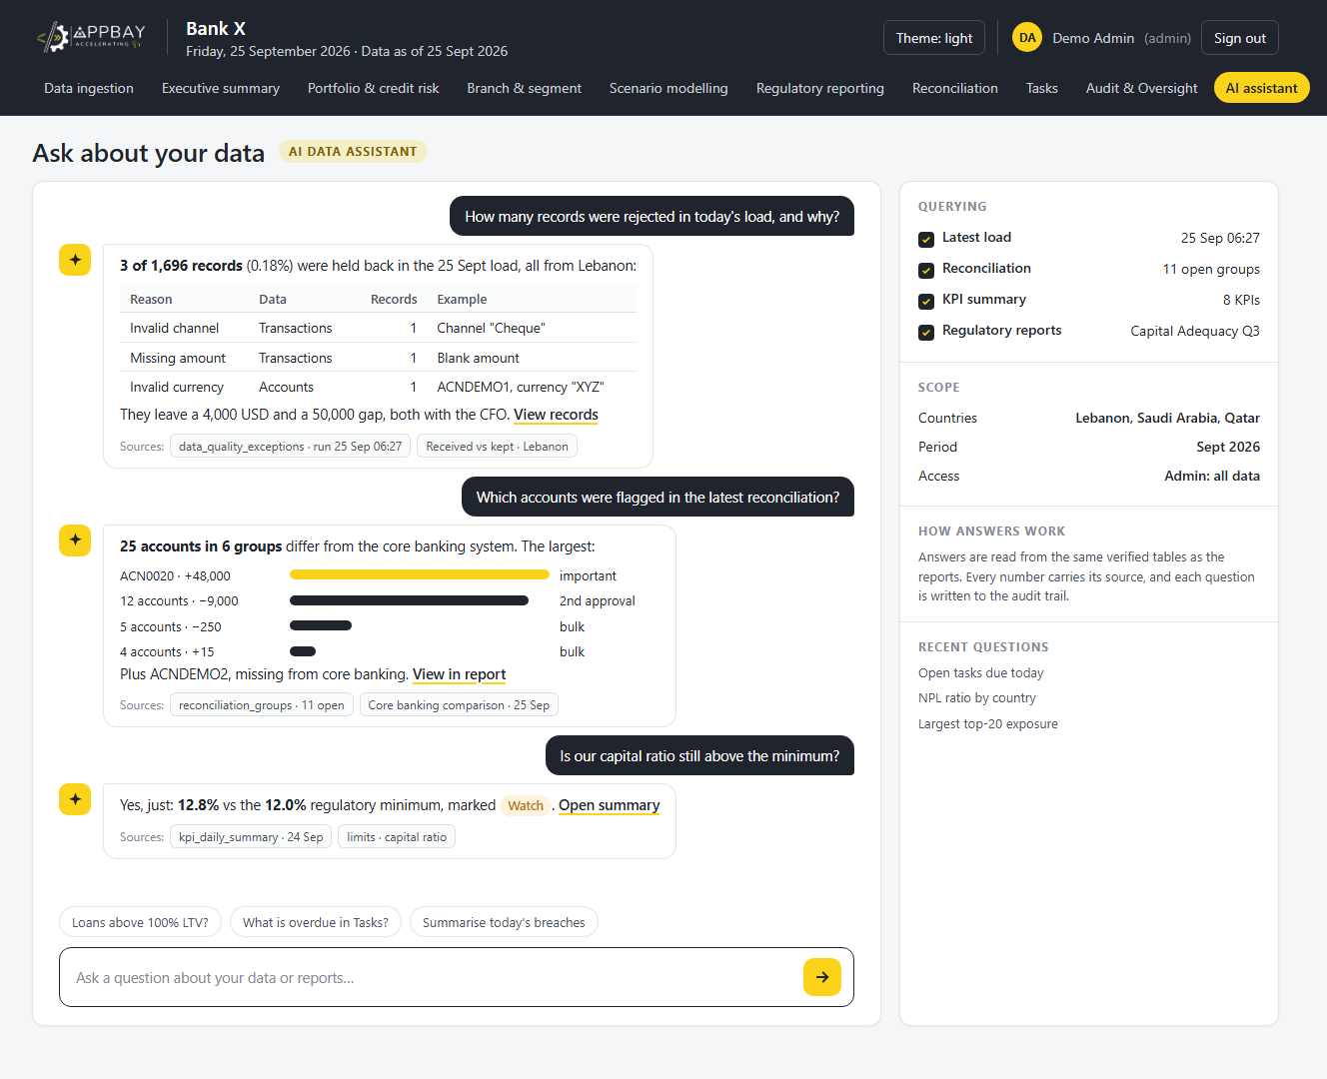
STEP 10
AI Data Assistant
Questions in plain language
Ask about the ingested data and reports in natural language.
1
Instant answers from the same verified tables as the reports.
2
Drill down from an answer to the source records behind it.
3
Every answer shows its sources, for auditability.
4

