Slide 1
PROJECT PRESENTATION
M
Mini Task
Management System
A role-aware web application for creating, assigning, tracking, and completing team tickets.

Slide 2
The system turns scattered tasks into a visible workflow
The problem
The solution
Teams need a simple way to capture work, assign ownership, understand urgency, and see progress without the complexity of a full enterprise tool.
MiniTask provides registration and login, role-based ticket management, searchable ticket lists, detailed ticket views, assignment emails, and a graphical dashboard — all in one lightweight application.
02

Slide 3
Proposed Requirements
Project Title: Mini Task Management System.
Project Description:
The Task Management System is a web-based application used to create, assign, manage, and track tickets/tasks. Users can create tickets, update their status, set priority, and search tickets. Admin can assign tickets to users and monitor ticket progress through a simple dashboard. The system will also send email notifications when a ticket is assigned to a user.
Functionalities:
User login
Role-based access for Admin and User
Create ticket
View all tickets
View ticket details
Update ticket details
Delete ticket
Assign ticket to user
Set ticket priority: Low, Medium, High
Update ticket status: Open, In Progress, Closed
Search ticket by title
Email notification when a ticket is assigned
Dashboard showing total tickets
Graphical representation of tickets by status and priority
02

Slide 4
SCOPE
01
Identity
Registration, login, Admin/User roles
02
Ticket lifecycle
Create, view, details, update, delete
03
Work controls
Assignment, priority, status, due date
04
Discovery
Search by title and filter by status
05
Notification
Real Gmail message when a ticket is assigned
06
Reporting
Counts and charts by status and priority
03

Slide 5
ROLES
ADMIN
USER
View and search every ticket
View and search assigned tickets only
Create tickets and assign any valid user
Create tickets assigned to self
Edit ticket details and delete tickets
Open a ticket to view full details
Move tickets through the workflow
Move Open to In Progress to Complete
View users and delete regular users
Cannot edit or delete ticket records
Cannot delete self or another admin
Cannot access the team-user directory
04

Slide 6
ARCHITECTURE
The same flow supports CRUD operations, dashboard counts, and assignment email.
REST API
Services
React UI
Persistence
Actors
Spring MVC
Controllers
X-User-Id
localhost:8080
Business rules
Role checks
Status flow
Email trigger
MySQL
Routes + pages
localStorage
Axios
localhost:5173
Repositories
JPA/Hibernate
JDBC
Admin
User
users
tickets
Email service
Gmail
Inbox
JavaMailSender
SMTP/TLS
Assigned user
05

Slide 7
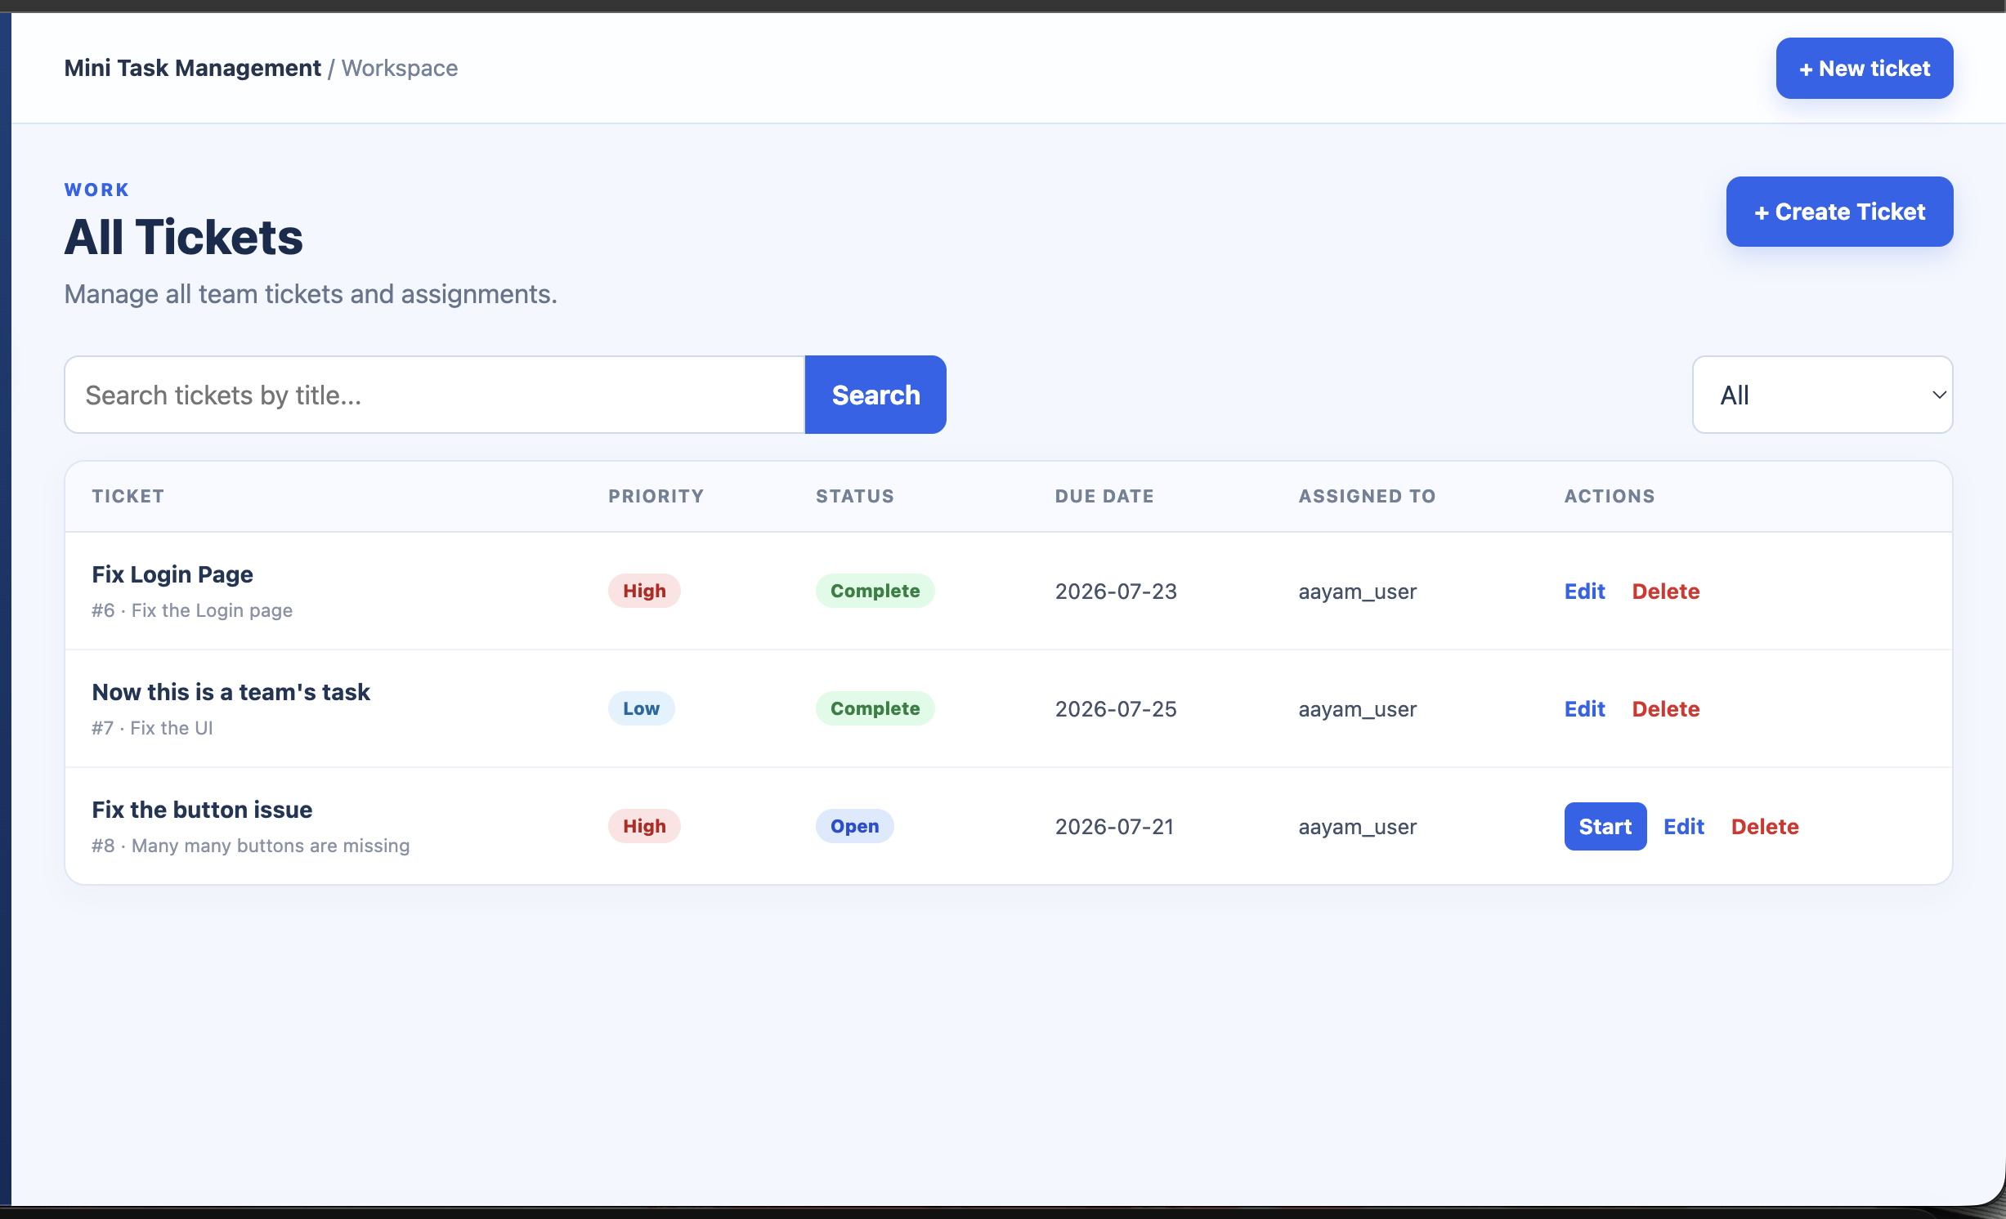
A ClickUp-inspired React interface keeps every action visible
Protected routes after login
Sidebar navigation and responsive layout
Ticket list, details, create and edit pages
Status and priority badges
Admin-only Users page
Axios integrates every page with the API
06

Slide 8
BACKEND LAYERS
Controllers
Services
UserController, TicketController, and DashboardController expose JSON endpoints and translate HTTP inputs into service calls.
UserService, TicketService, and EmailService enforce roles, assignment rules, status transitions, duplicate-email checks, and notification behavior.
Repositories
Entities and ORM
UserRepository and TicketRepository extend JpaRepository and add email, assignee, title-search, status, and priority queries.
User and Ticket entities map Java fields to MySQL tables. Hibernate generates SQL and maintains the schema in update mode.
07

Slide 9
TWO TAABLE MODEL
users
tickets
id — Long, primary key
name — String
email — String, login/search key
password — String, write-only in JSON responses
role — ADMIN or USER
id — Long, primary key
title — String
description — String
priority — Low / Medium / High
status — Open / In Progress / Complete
dueDate — LocalDate
assignedUserId — Long
assignedUserId
The relationship is stored as an assignee ID rather than a JPA entity association.
08

Slide 10
TICKET WORKFLOW
OPEN
IN PROGRESS
COMPLETE
Created state.
The assigned user can select Start Ticket.
Active work state.
The assigned user can select Mark Complete.
Finished state.
Displayed in green across list, details, and dashboard.
Only admins and the assigned user may advance a ticket. Users cannot use full edit or delete operations.
09

Slide 11
REST endpoints map directly to the user journeys
Users /api/users
Tickets /api/tickets
Dashboard
POST /register
POST /login
GET /
DELETE /{id}
Admin ID is supplied in the X-User-Id header for protected operations.
POST /
GET /
GET /{id}
PUT /{id}
PATCH /{id}/status
DELETE /{id}
GET /search?title=...
GET /api/dashboard
Returns total tickets plus counts by status and priority for cards and charts.
10

Slide 12
ASSIGNMENT EMAIL
1. Save ticket
2. Find assignee
3. Send message
4. Deliver
TicketService validates actor, assignee, and status, then stores the record.
UserRepository loads the assigned user's email address.
EmailService builds a SimpleMailMessage through JavaMailSender.
Gmail SMTP sends a real notification to the assigned user's inbox.
Email errors are caught so ticket creation can still complete during an SMTP outage.
11

Slide 13
DASHBOARD
Summary cards
Status chart
Priority chart
Total Tickets
Open
In Progress
Complete
Chart type: Doughnut
Shows the current distribution across Open, In Progress, and Complete.
Chart type: Bar
Compares Low, Medium, and High priority counts.
All values are loaded live from GET /api/dashboard.
12

Slide 14
TECH STACK
Frontend
Backend
Data and tools
React 19
HTML5 + CSS3
Bootstrap 5
React Router
Axios
Chart.js
Vite
Java 17
Spring Boot 4.1
Spring MVC
Spring Data JPA
Hibernate
Java Mail Sender
Maven
MySQL 8
MySQL Workbench
Postman
IntelliJ IDEA
Git + GitHub
Gmail SMTP
13

Slide 15
TESTING PROCEDURES
Postman checks registration, login, ticket CRUD, search, status, dashboard, and user deletion APIs.
Frontend production build confirms React components and routes compile successfully.
Spring context test confirms dependency injection, Hibernate, MySQL, controllers, and services start together.
Manual role testing verifies admin-only edits/deletes and user-only self-assignment behavior.
Real Gmail delivery verifies the assignment-notification integration.
14

Slide 16
PROJECT DEMO INITIATION
Ready now
Recommended future improvements
All required workflows are implemented.
The UI and REST API are integrated.
Email and dashboard features work.
Admin/User behavior is enforced in services.
The project builds and tests successfully.
Replace X-User-Id with Spring Security + JWT.
Hash passwords with BCrypt.
Prevent public ADMIN registration.
Add industry standard Authentication and Authorization
15

Slide 17
MINI TASK MANAGEMENT SYSTEM
PROJECT IS DEMO READY
THANKYOU FOR YOUR PATIENCE……!!!!!
DEMO
READY

