Slide 1
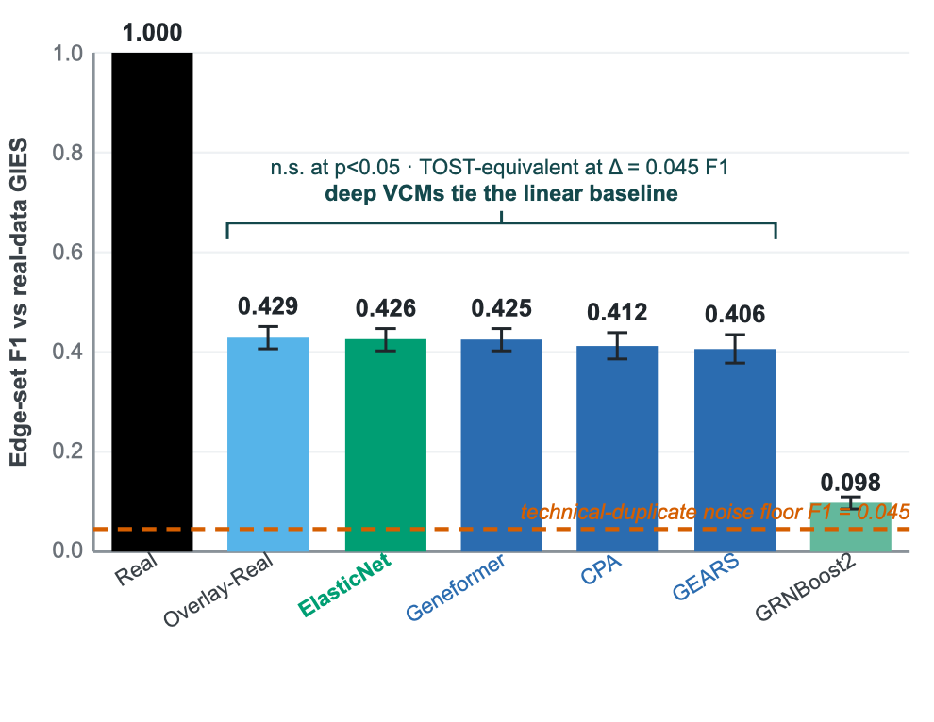
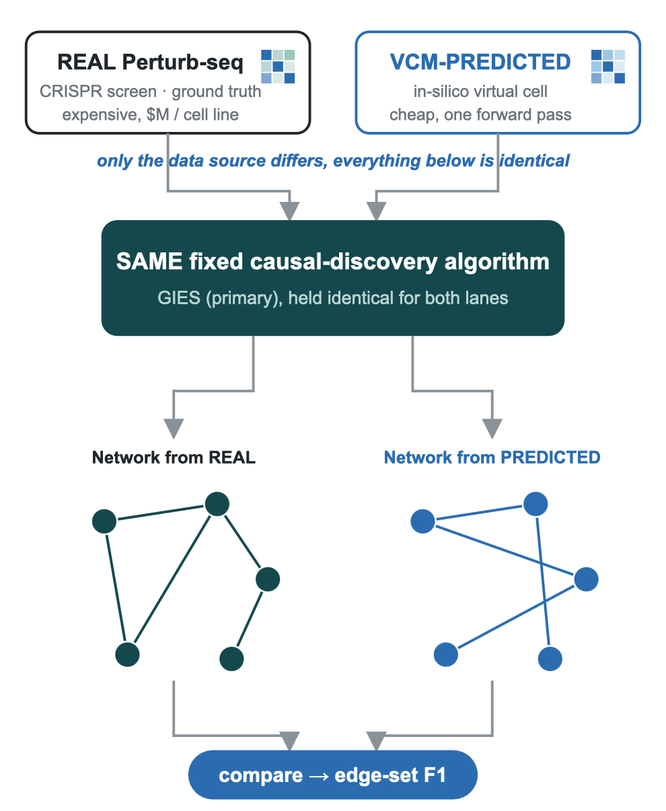
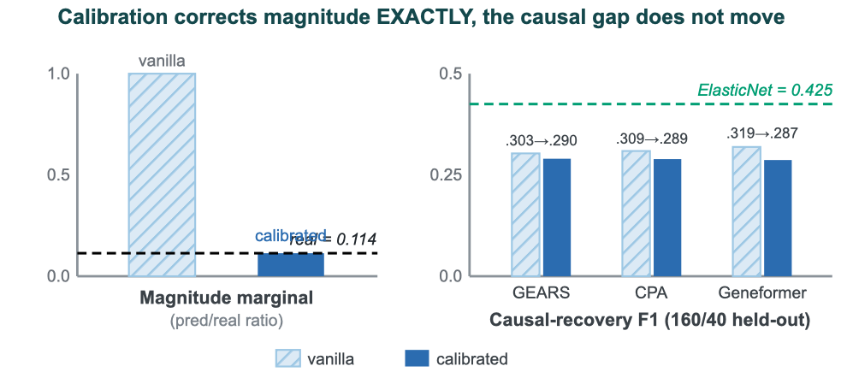
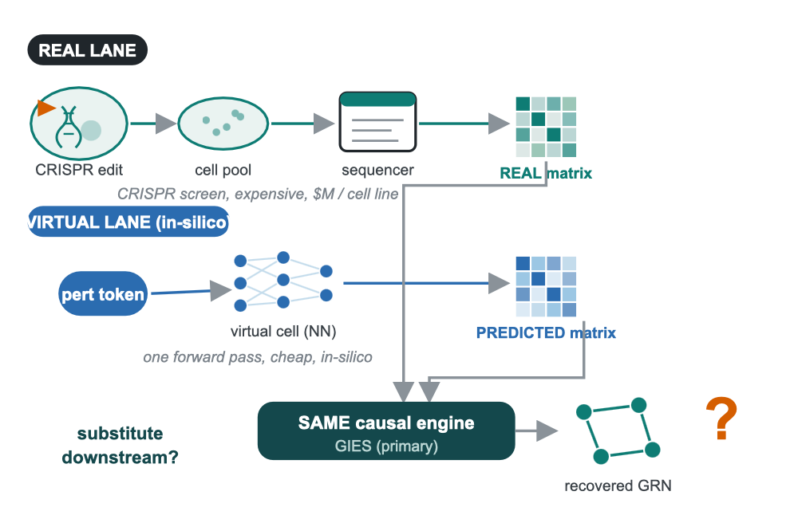
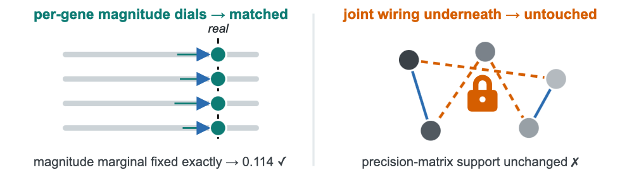
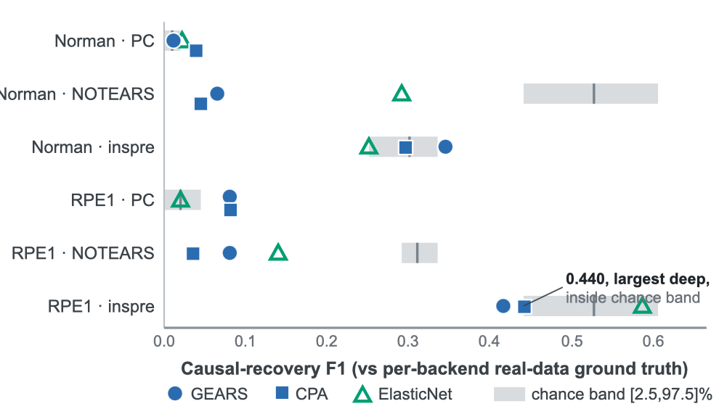
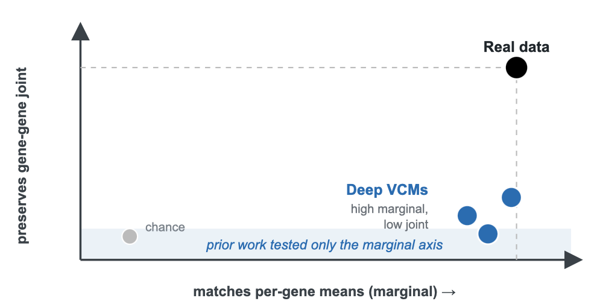
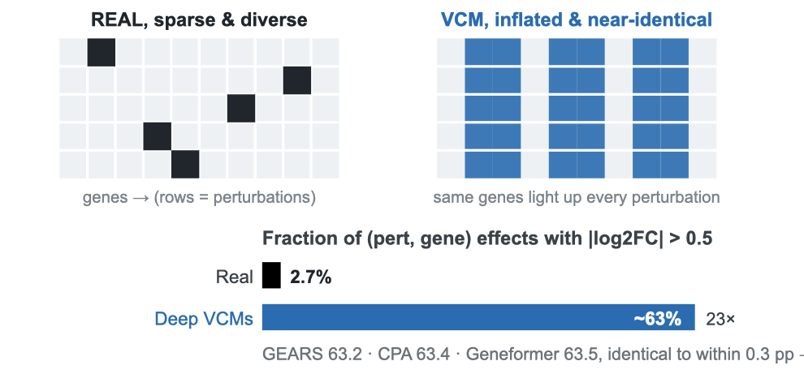
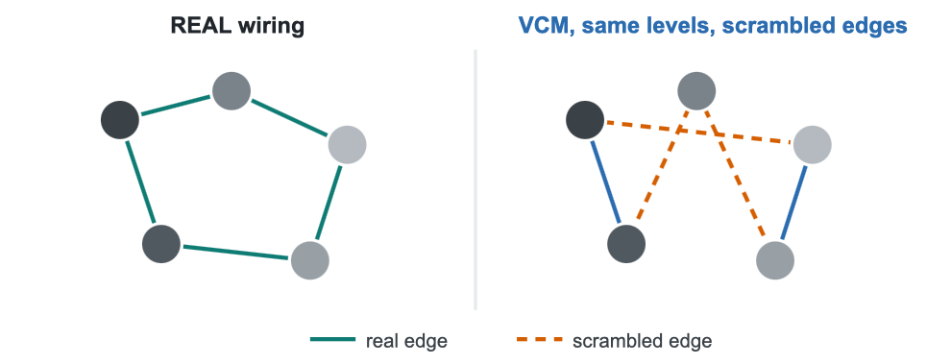
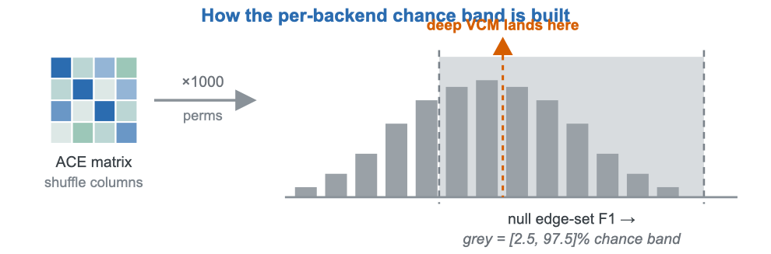
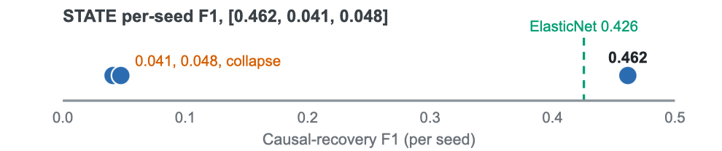
PerturbCausal: Virtual Cell Model Predictions Do Not Substitute for Real Perturb-seq in Causal Network Recovery
Aayan Alwani · William A. Shine Great Neck South High School
ISMB 2026 · ISCB · Washington, D.C. · 13-16 July 2026
01
Background
02
Methods
•
A 104M transformer, a GO-prior GNN, and a conditional VAE all tie a linear regression.
04
Findings & Conclusions
VCMs promise in-silico CRISPR screens
Fixed-algorithm, vary-data-source design
Calibration corrects magnitude, not causality
•
Virtual cell models are marketed as in-silico substitutes for CRISPR screens that cost millions of dollars per cell line.
•
Metric: edge-set F1 of the predicted-data network against the network the same algorithm recovers from real data.
•
Quantile-matching fixes the magnitude marginal exactly (onto real = 0.114), yet held-out 160/40 causal F1 does not close: GEARS 0.303 to 0.290, CPA 0.309 to 0.289, Geneformer 0.319 to 0.287, ending below ElasticNet (0.425).
•
If their predictions were trustworthy, much of perturbation biology could move in-silico.
•
Only the data source varies; the discovery algorithm is held fixed.
Prior work: they fail at per-gene prediction
•
VCMs do not beat simple linear baselines at per-gene expression prediction (Ahlmann-Eltze & Huber 2025, Nat Methods).
•
But per-gene accuracy is a property of the marginal distribution only.
Can a cheap virtual cell replace a real screen, downstream?
Fig 9. Quantile-matching pins the magnitude marginal onto real (0.114) exactly, yet held-out causal F1 barely moves.
Fig 6. Edge-set F1 vs the real-data GIES network (K562, N=200, 5 seeds); 95% CI whiskers.
Holds across backends and datasets
Fig 10. Calibration turns a per-gene dial to fix the ruler; the scrambled wiring underneath is untouched.
Why: an identifiability result
Proposition. Conditional independence is invariant under per-gene monotone (rank-preserving) calibration, so marginal rescaling provably cannot change the recovered graph.
Fig 1. Real and virtual Perturb-seq feed one fixed causal-discovery engine. We ask whether the in-silico lane substitutes for the expensive real lane in the recovered network.
Fig 4. Only the data source varies; the same fixed algorithm (GIES primary) runs on both, and we compare recovered edge sets.
•
The residual is the off-diagonal joint (precision-matrix support) structure, so closing the gap needs a training-time intervention, not post-hoc rescaling.
The payoff is downstream, in the joint structure
Predictors: four deep VCMs and one linear
Fig 7. Deep VCMs vs the per-backend chance band [2.5, 97.5]%, across {RPE1, Norman} by {PC, NOTEARS, inspre}.
•
Drug-target ID, combination prediction, and GRN inference depend on the joint distribution across genes.
•
Largest deep-model F1 across the six cells is 0.440 (CPA, inspre, RPE1), inside the chance band.
The gap is reachable
GEARS · graph neural network
•
A no-GPU learned joint-transform proxy raises held-out CPA causal F1 from 0.424 to 0.535 (+0.111), the first evidence the gap is reachable by a joint operation.
CPA · conditional VAE
•
ElasticNet is strongest in 4 of 6; no deep VCM exceeds it on any backend or dataset.
Geneformer · 104M-parameter transformer
STATE · Arc Institute 2025 foundation model
•
A naive covariance-Frobenius penalty alone fails a pre-registered multi-seed gate (+0.003), so it is the learned joint map, not the raw penalty.
•
Comparator: sparse-linear ElasticNet fit on held-out controls, a deliberately simple baseline.
Mechanism: effect-size inflation is mode collapse
Causal-discovery backends (held fixed)
Conclusions
•
GIES: score-based, interventional (primary).
•
The substitutability gap decomposes into a magnitude marginal (calibration-correctable) plus a joint-distribution residual that calibration cannot reach.
•
inspre (sparse inverse of the ACE matrix), PC (constraint-based), and NOTEARS (continuous optimization).
Fig 2. Two different axes. Deep VCMs sit high on the marginal, low on the joint; prior work tested only the marginal axis.
Datasets and chance reference
•
No deep VCM beats a sparse linear baseline on causal recovery; none reaches real-data quality.
•
Replogle K562 (primary, 200-gene subset), RPE1 (cross-context), and Norman 2019 (cross-paradigm CRISPRa). CRISPRi and CRISPRa.
Fig 8. Real cells respond sparsely and diversely; VCMs light up nearly every gene, near-identically across perturbations.
•
Why ElasticNet ties a 104M transformer: L1 sparsity matches real-response sparsity (56.8% of variance in the leading singular vector).
•
Chance is a per-backend permutation null (shuffle each ACE column across perturbations), giving a [2.5, 97.5] band.
•
Real 2.7% of effects exceed |log2FC| = 0.5; deep models inflate to about 63% (GEARS 63.2, CPA 63.4, Geneformer 63.5), a 23x inflation identical to within 0.3 pp across architectures.
•
Closing the gap is a training-time, not post-hoc, operation.
Fig 3. A model can match every per-gene level (node shading) yet scramble the gene-gene wiring causal discovery reads.
•
CPA inter-perturbation cosine is 0.84 vs real 0.08. inspre probe: CPA and Geneformer recover ZERO edges where real and ElasticNet recover about 12,000.
Limitations
•
Ground truth is internally consistent but not yet externally biologically validated.
The open question, and our contribution
•
Cross-dataset cells are single-seed; N=200 scale.
•
Nobody had tested whether predicted data can substitute for real data downstream in causal-network recovery.
The 2025 foundation model, too
•
STATE single-seed 0.462 beats seed-42 ElasticNet but does not replicate; per-seed F1 is [0.462, 0.041, 0.048].
Selected references
•
This is the first benchmark that does, holding the causal algorithm fixed and varying only the data source.
Fig 5. How the per-backend chance band is constructed.
Ahlmann-Eltze & Huber 2025, Nat Methods
Lotfollahi 2023, Mol Syst Biol (CPA)
Objective: measure how far predicted data can substitute for real data in causal-network recovery, and decompose any gap into a magnitude component and a joint-structure component.
03
Results
Replogle 2022, Cell
Roohani 2024, Nat Biotech (GEARS)
Deep VCMs tie a sparse linear baseline
Norman 2019, Science
Theodoris 2023, Nature (Geneformer)
•
K562, N=200, 5 seeds: no pairwise difference at p<0.05, TOST-equivalent at Δ = 0.045 F1 (CPA +0.014, GEARS +0.020, Geneformer +0.0002).
Hauser & Bühlmann 2012, JMLR (GIES)
Adduri 2025, bioRxiv (STATE)
Brown 2025, Nat Commun (inspre)
Zou & Hastie 2005, JRSS-B (ElasticNet)

