Slide 1
Phase 1: Binding Motif Discovery
ENIGMA Project
Finding Where Mce3R Binds DNA in Mycobacterium tuberculosis
Panagoda et al. 2024 | Computational Biology

Slide 2
The Problem
1.23 Million
Mce3R is a transcriptional repressor that controls cholesterol metabolism genes critical for bacterial survival inside the human host
It binds an unusual ASYMMETRIC operator with two binding sites of dramatically different affinity (Kd = 2.4 nM vs 49 nM)
Antibiotic-tolerant persister cells are a major barrier to TB treatment. Deleting mce3R increases persister frequency (Pandey et al. 2023)
Question: Where exactly does Mce3R bind DNA, and are there other binding sites across the genome?
TB deaths per year

Slide 3
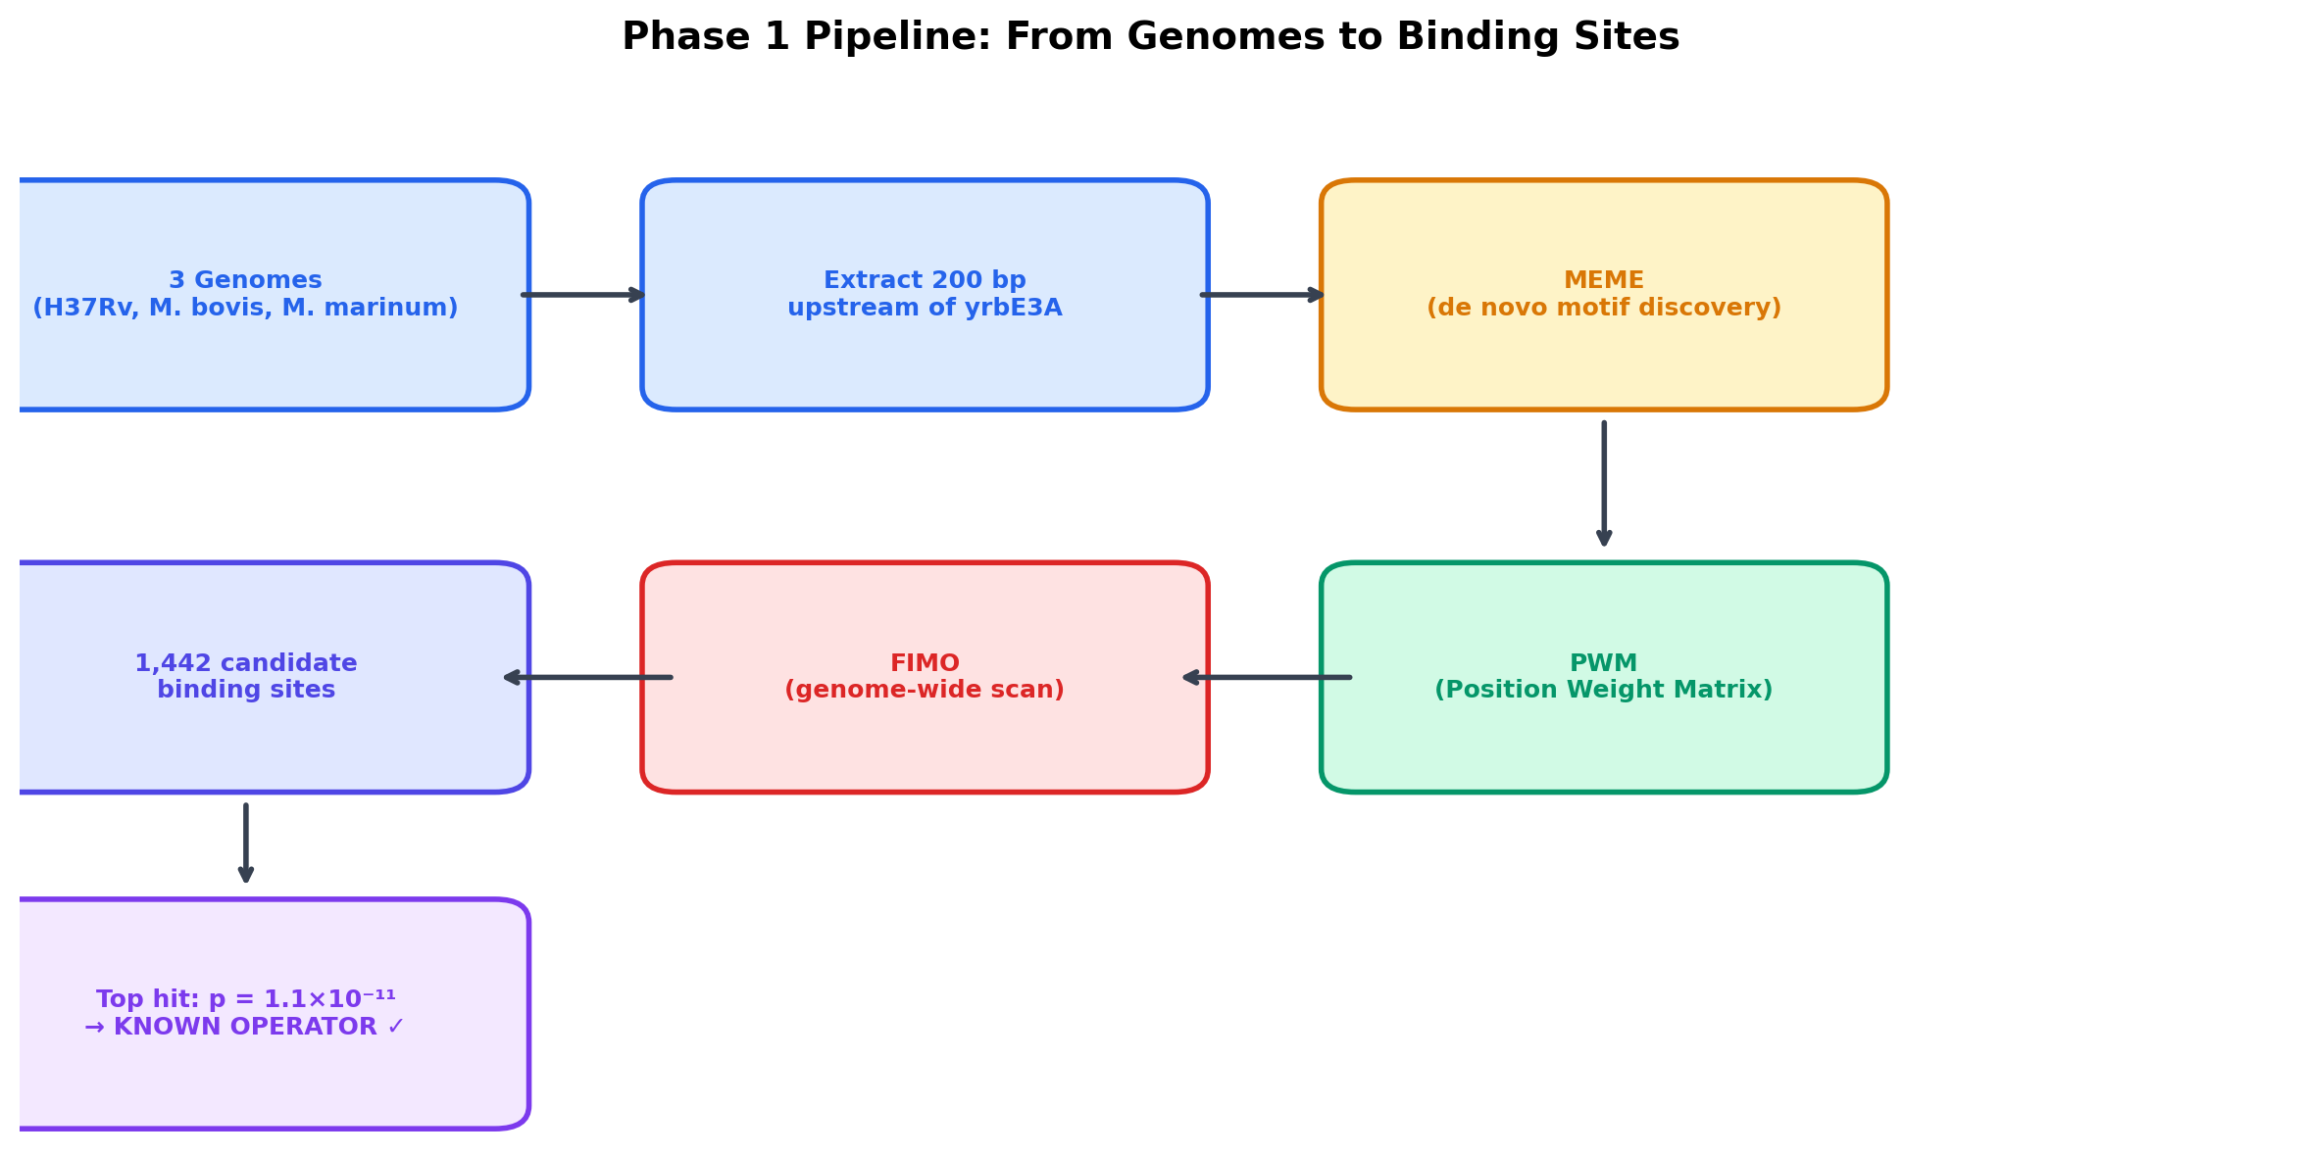
The Pipeline
3 genomes → MEME motif discovery → FIMO genome scan → 1,442 candidate sites

Slide 4
Three Genomes, One Pattern
M. tuberculosis H37Rv
M. bovis AF2122/97
M. marinum M
NC_000962.3
NC_002945.4
NC_010612.1
4,411,532 bp
~4,345,492 bp
~6,636,827 bp
Primary — human TB
Close relative — cattle TB
Distant relative — fish TB
If a DNA pattern is conserved across millions of years of evolution, it is functionally important
Extracted 200 bp upstream of yrbE3A (the regulated gene) from each genome
All three genomes have ~65.6% GC content — important for background model

Slide 5
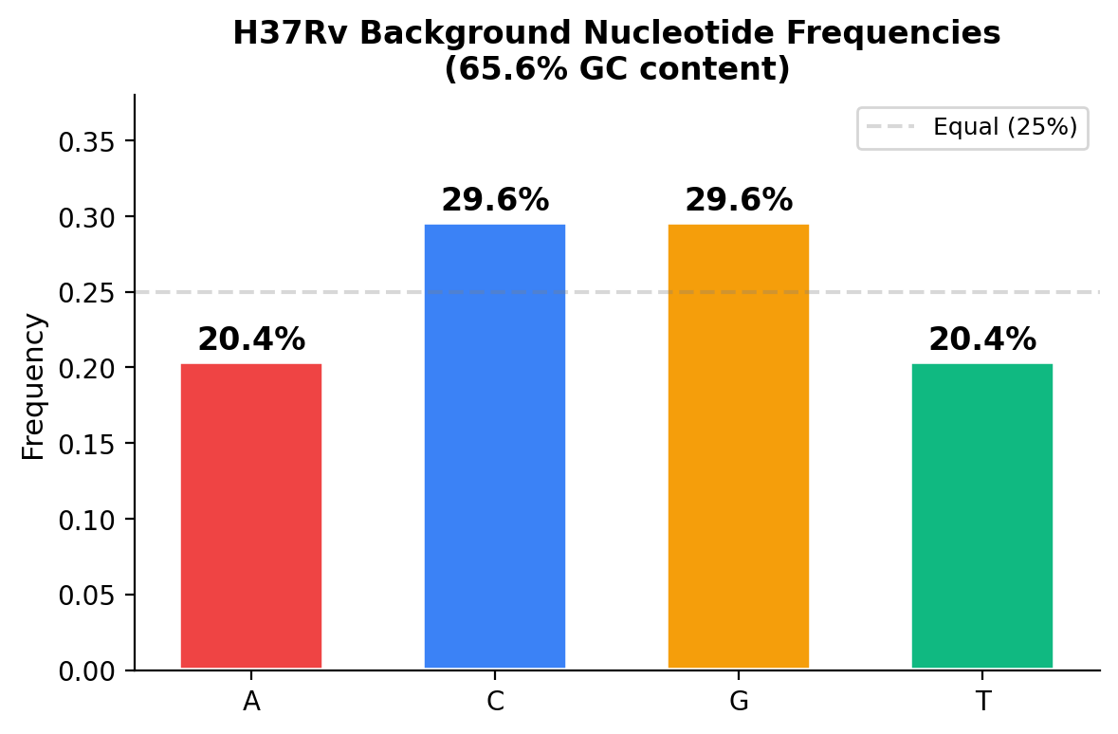
Background: GC Content
The TB genome is 65.6% GC — meaning C and G each appear ~30% of the time, while A and T each appear ~20%. MEME uses these frequencies as the "null model" so it only reports patterns that are more structured than random genome composition. Without this correction, any stretch of A/T-rich DNA would falsely appear significant in a GC-rich genome.

Slide 6
The Operator Architecture
Strong Site
Weak Site
Spacer
Affinity Ratio
Kd = 2.4 nM
Kd = 49 nM
53 bp
20.4×
123 bp operator between mce3R (Rv1963c) and yrbE3A (Rv1964) at H37Rv coordinates ~2,207,477–2,207,699

Slide 7
The Operator Sequence (123 bp)
GCCCCGCGCTATAGGATACTAGCAAGATACATCATAGCCAATATATGCCAGTT
TGCATTGCTATTTACCGATCAGTTGTCCAAGCAATCGCGTATTGGCTATGGA
CATCAGCGGTTCTGCCGC
Source: Panagoda et al. 2024, PDB 9B7Y (cryo-EM structure)
■ Positions 10–35: Weak site
■ Positions 35–88: Spacer
■ Positions 88–113: Strong site

Slide 8
Step 1: MEME — De Novo Motif Discovery
Multiple EM for Motif Elicitation — finds DNA patterns without prior knowledge
Input: 3 orthologous yrbE3A upstream sequences (200 bp each)
Mode: ZOOPS (Zero Or One Occurrence Per Sequence)
Searches both DNA strands (+ and –)
Width range: 6–110 bp
Background: 0-order Markov model using H37Rv GC frequencies
Reports top 5 motifs ranked by E-value (statistical significance)
The Analogy
Like a detective examining 3 crime scenes and asking: "What do these have in common?" MEME compares sequences from 3 species and finds the shared fingerprint — without being told what to look for.
Background Frequencies
A = 20.4% C = 29.6% G = 29.6% T = 20.4%

Slide 9
MEME Results — Discovered Motifs
Motif 1 (8 bp)
Motif 2 (15 bp)
A C A T C A W A
T W T K C A T T G Y T W T Y T
Short conserved core pattern
Longer motif, captures weak site region
IUPAC Ambiguity Codes
W
Weak
A or T
2 hydrogen bonds
K
Keto
G or T
Keto group bases
Y
Pyrimidine
C or T
Single-ring bases
N
aNy
A, C, G, or T
Completely variable

Slide 10
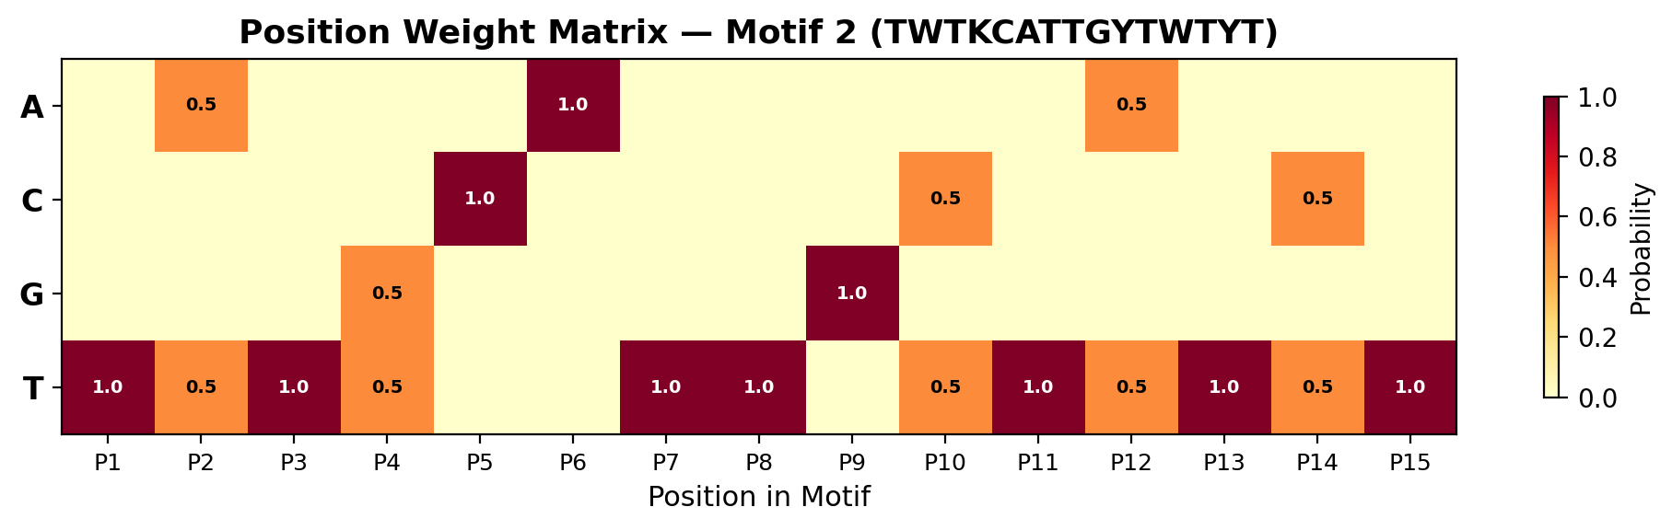
The Position Weight Matrix (PWM)
Each cell = probability (0–1) that the protein wants that base at that position. Dark red (1.0) = absolutely required for binding. White (0.0) = never seen at this position. This matrix is the "search template" that FIMO uses to scan the genome.
The PWM is derived by aligning the motif instances found across species and counting base frequencies at each position. It encodes the protein's DNA-binding preferences as a quantitative probability table.

Slide 11
Step 2: FIMO — Genome-Wide Scan
Find Individual Motif Occurrences — scan all 4,411,532 positions
Takes the PWM from MEME and slides it across every position in the genome
At each position: computes log-odds score (match vs. random background)
Converts score to p-value (probability of seeing this by chance)
P-value threshold: 1×10⁻⁴ (only report if <0.01% chance of random)
Result: 1,442 candidate binding sites across the genome
The Analogy
Like using a metal detector to sweep an entire beach. MEME told us what metal to look for; FIMO finds every buried piece.
1,442
candidate binding sites across the TB genome

Slide 12
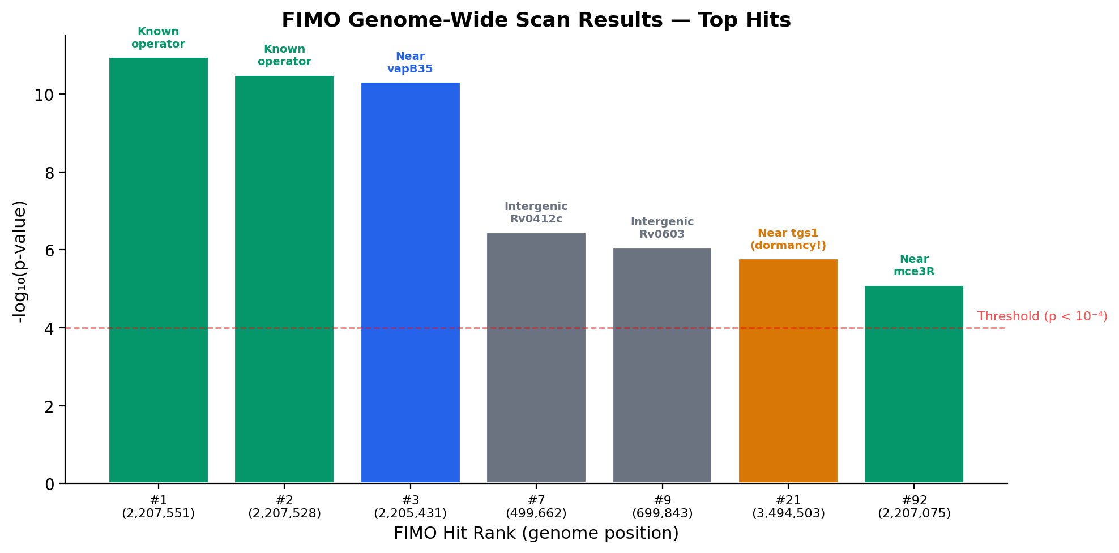
FIMO Top Hits
The #1 and #2 hits land exactly in the known operator region. p = 1.1×10⁻¹¹ means a 1-in-100-billion chance of being random. This validates the entire approach: we rediscovered the known binding site without prior bias. The tgs1 hit (#21) is biologically exciting — it links Mce3R to dormancy and lipid body formation.

Slide 13
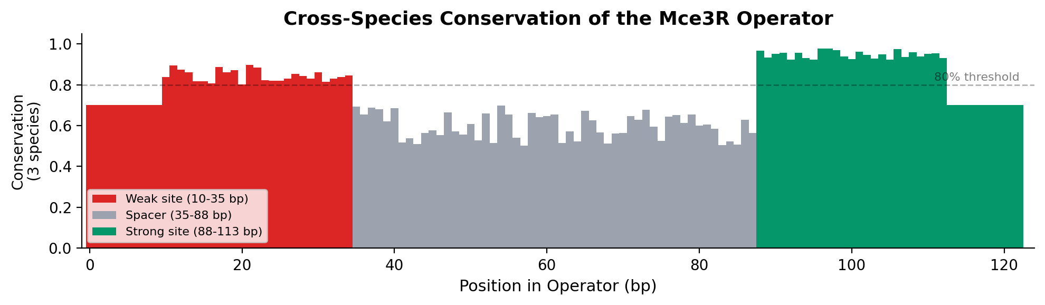
Conservation Across Species
Binding sites (red = weak, green = strong) are more conserved than the spacer region. >80% sequence identity across three species separated by millions of years of evolution. This confirms the operator is under purifying selection — organisms that lost this sequence did not survive.

Slide 14
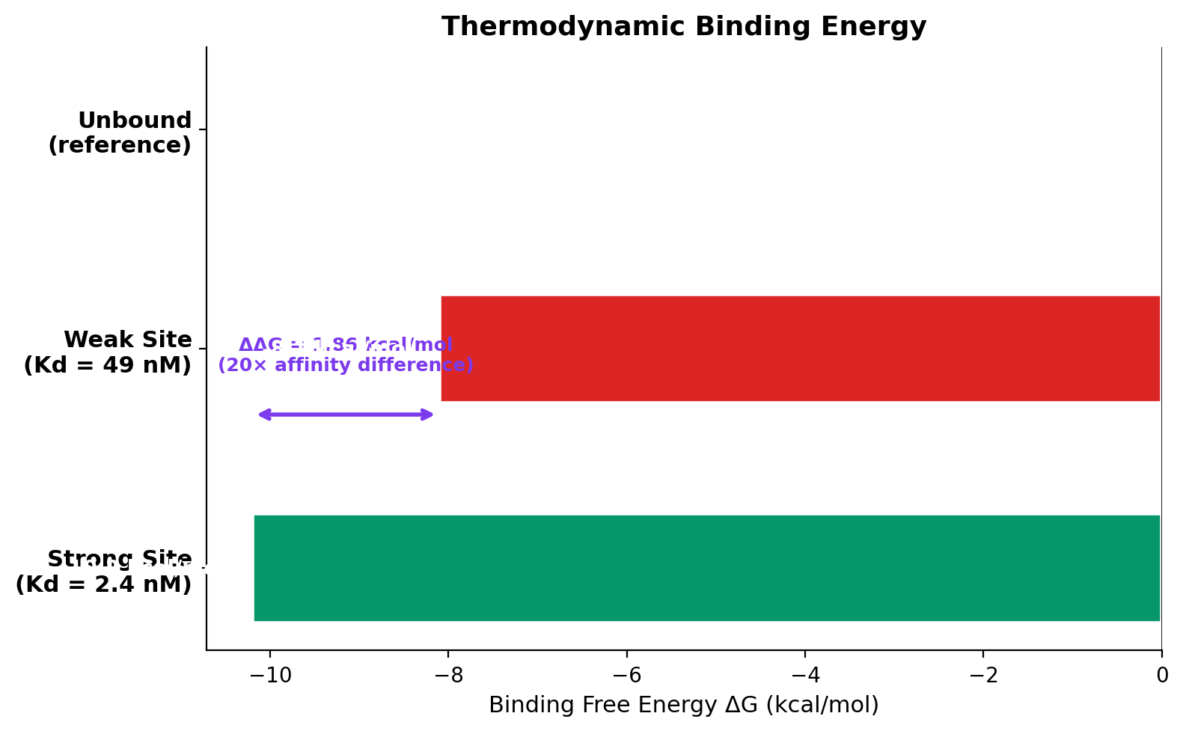
The Energy Connection
ΔG = –RT × ln(Kd)
PWM scores map directly to physical binding energy. R = 1.987 cal/(mol·K) T = 310 K (37°C, body temp) Strong: ΔG = –10.2 kcal/mol Weak: ΔG = –8.1 kcal/mol ΔΔG = 1.86 kcal/mol = 20× affinity difference This asymmetry is the key variable of the entire project.

Slide 15
Key Achievements
1
Validated known operator
Top FIMO hit matches experimental cryo-EM site with p = 1.1×10⁻¹¹
2
De novo discovery
Found the motif without prior bias, purely from cross-species comparison
3
Conservation confirmed
>80% identity across M. tuberculosis, M. bovis, M. marinum
4
1,442 genome-wide sites
Potential secondary Mce3R targets including tgs1 dormancy gene
5
High confidence
P-values from 10⁻¹¹ to 10⁻⁶, far exceeding the 10⁻⁴ threshold

Slide 16
Output Files
predicted_sites.csv
1,442 FIMO-predicted binding sites with coordinates, p-values, scores, sequences
conservation_status.csv
Cross-species conservation analysis for each predicted site
meme.txt / .xml / .html
Complete MEME reports with PWMs, alignments, E-values, consensus sequences
logo1–5.eps
Sequence logos for each discovered motif (forward and reverse complement)
background.model
H37Rv 0-order Markov nucleotide frequency model
phase1_summary.json
Machine-readable summary: timings, counts, sanity check results
Phase 1 completed in ~26.5 seconds with 100% sanity pass rate

Slide 17
What Phase 1 Feeds Into
Phase 2
Stochastic Simulation
Operator architecture → Gillespie SSA with 50,000 cells
Phase 5
Thermodynamic Calibration
PWMs → Berg–von Hippel energy model + MCMC cooperativity inference
Phase 6
Environmental Response
Candidate sites → 4 stress environments + persistence quantification
Phase 7
Publication Figures
Motif logos + site coordinates → Figures 9–14

Slide 18
Summary
Phase 1 computationally rediscovered the Mce3R binding site from scratch, validated it against experimental cryo-EM data, and found 1,442 new candidate targets across the TB genome — including a link to the dormancy gene tgs1.
ENIGMA: Expression Noise In Gene-regulatory Mechanisms and Architecture

