Slide 1
Phase 2: Gillespie Stochastic Simulation
ENIGMA Project
Simulating Single-Cell Gene Expression Noise
4-State Operator Model | 50,000 Cells | 12 Reactions | Numba JIT
Panagoda et al. 2024 | Computational Biology

Slide 2
Why Stochastic Simulation?
~2 mRNA
Gene expression is inherently random -- individual molecules bind and unbind stochastically
With only ~2 mRNA molecules at steady state in TB, each binding/unbinding event creates measurable cell-to-cell variation
Deterministic ODE models compute the average behavior, but cannot capture the noise that drives persistence
Key insight: We need to simulate each molecule individually to measure how operator architecture shapes expression noise
The Gillespie algorithm (SSA) gives exact stochastic trajectories -- every reaction is sampled from the correct probability distribution
molecules at steady state

Slide 3
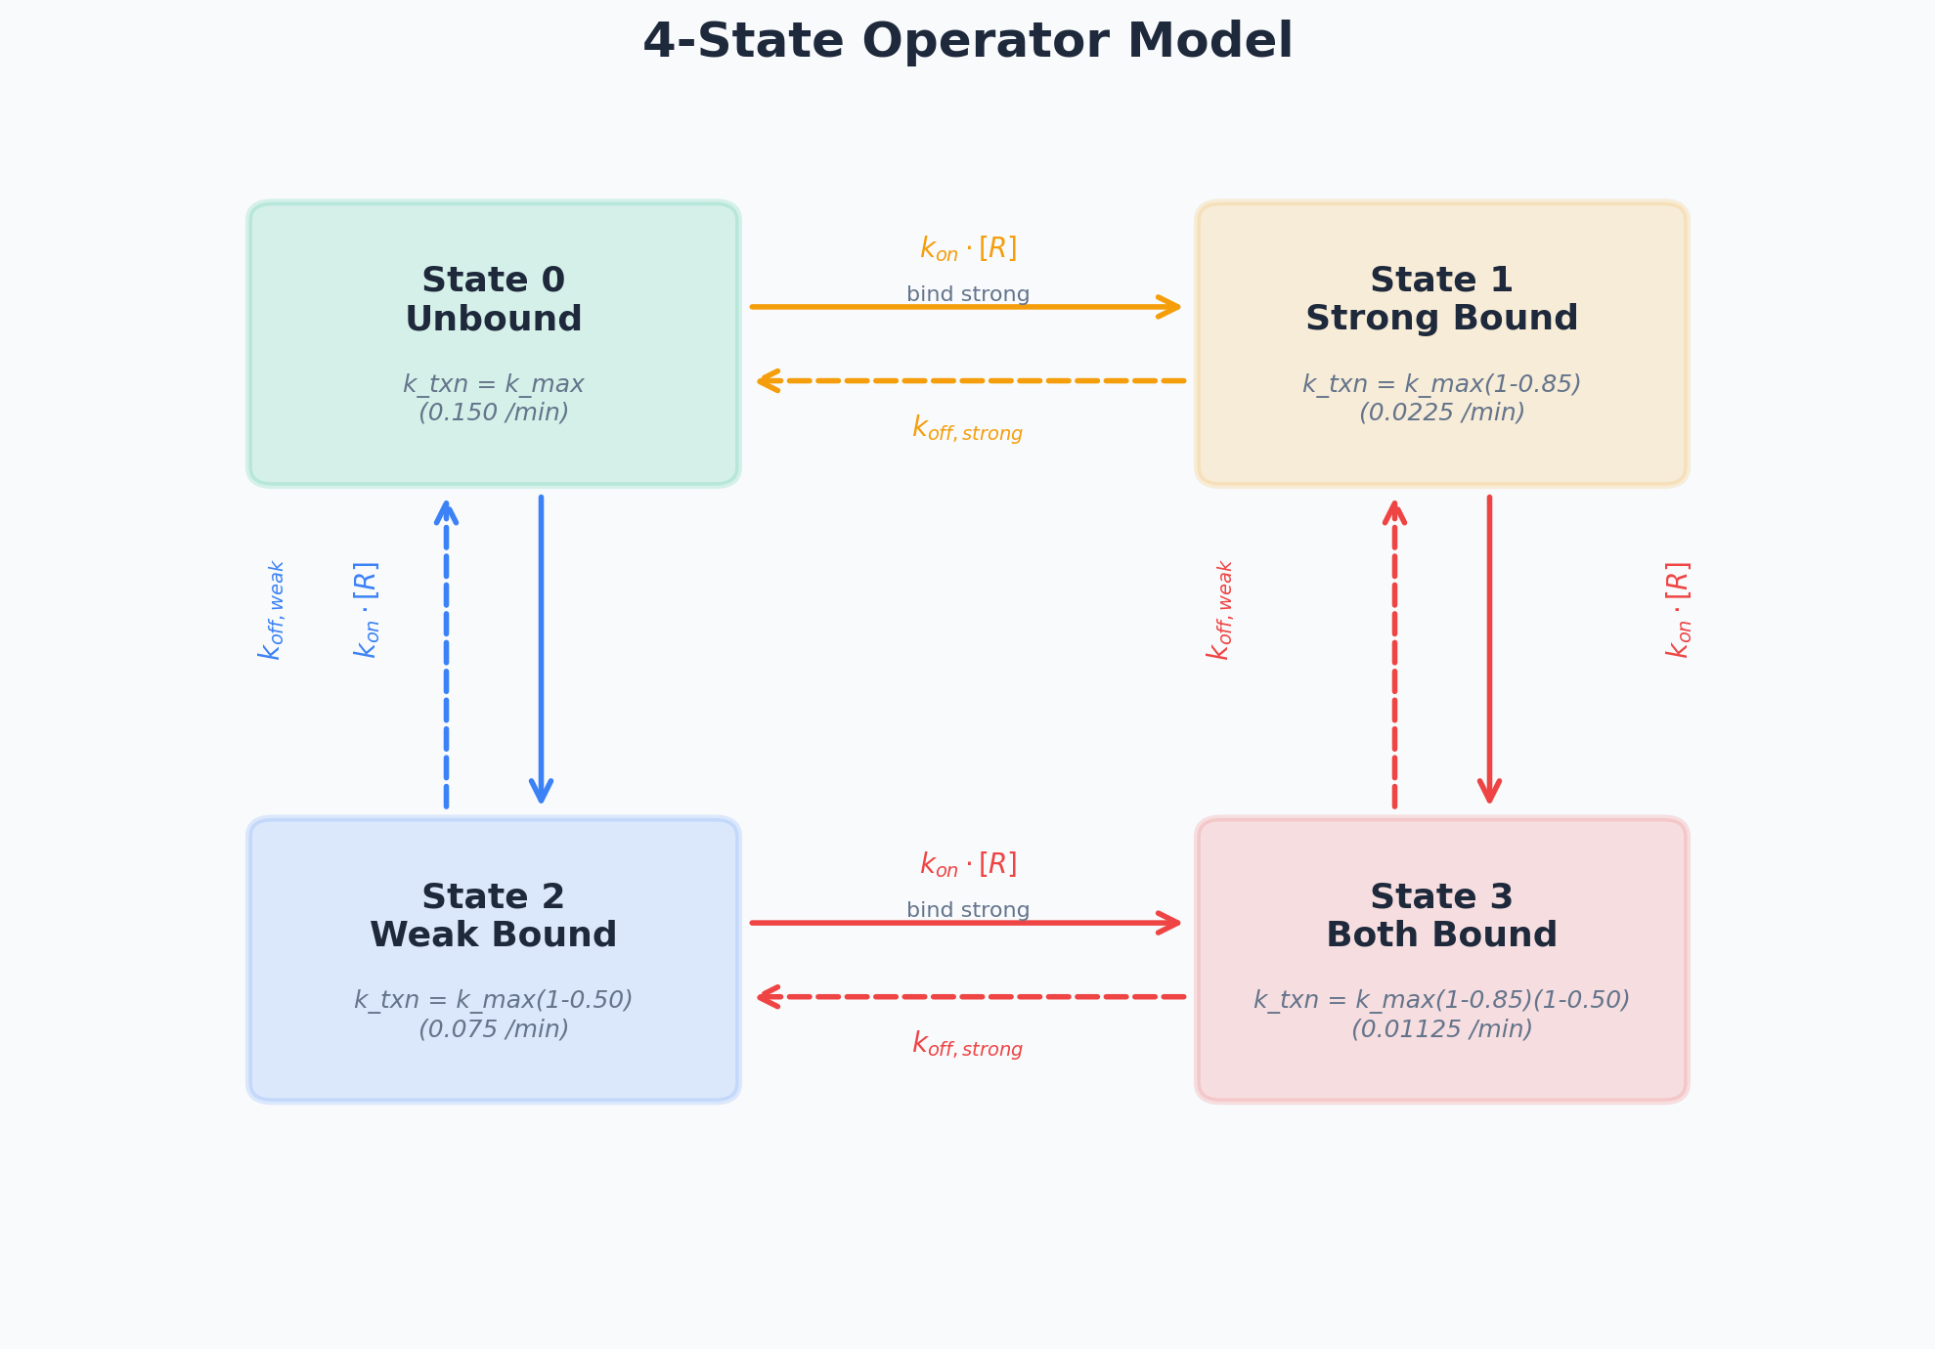
The 4-State Operator Model
State 0: Both sites empty -- full transcription (k_max = 0.15/min)
State 1: Strong site bound -- 85% blocked (k_txn = 0.0225/min)
State 2: Weak site bound -- 50% blocked (k_txn = 0.075/min)
State 3: Both bound -- 92.5% blocked (k_txn = 0.01125/min)
Each state has a different transcription rate, creating state-dependent bursting
8 transitions between states driven by concentration-dependent binding and first-order unbinding

Slide 4
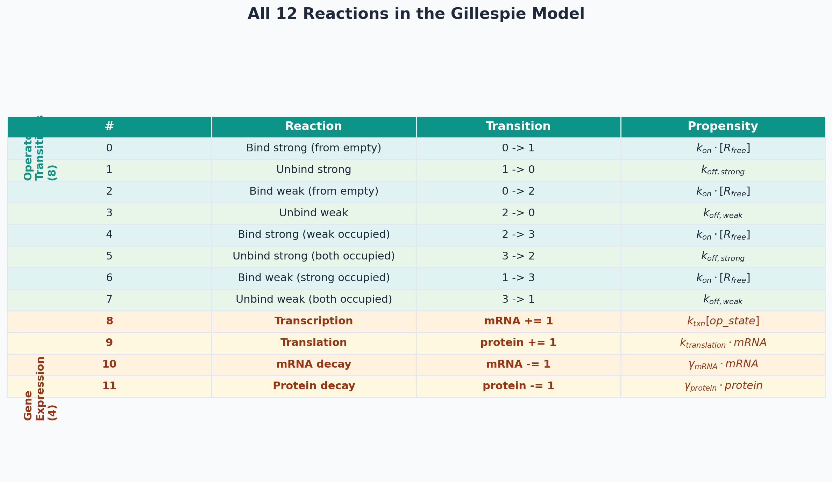
All 12 Reactions

Slide 5
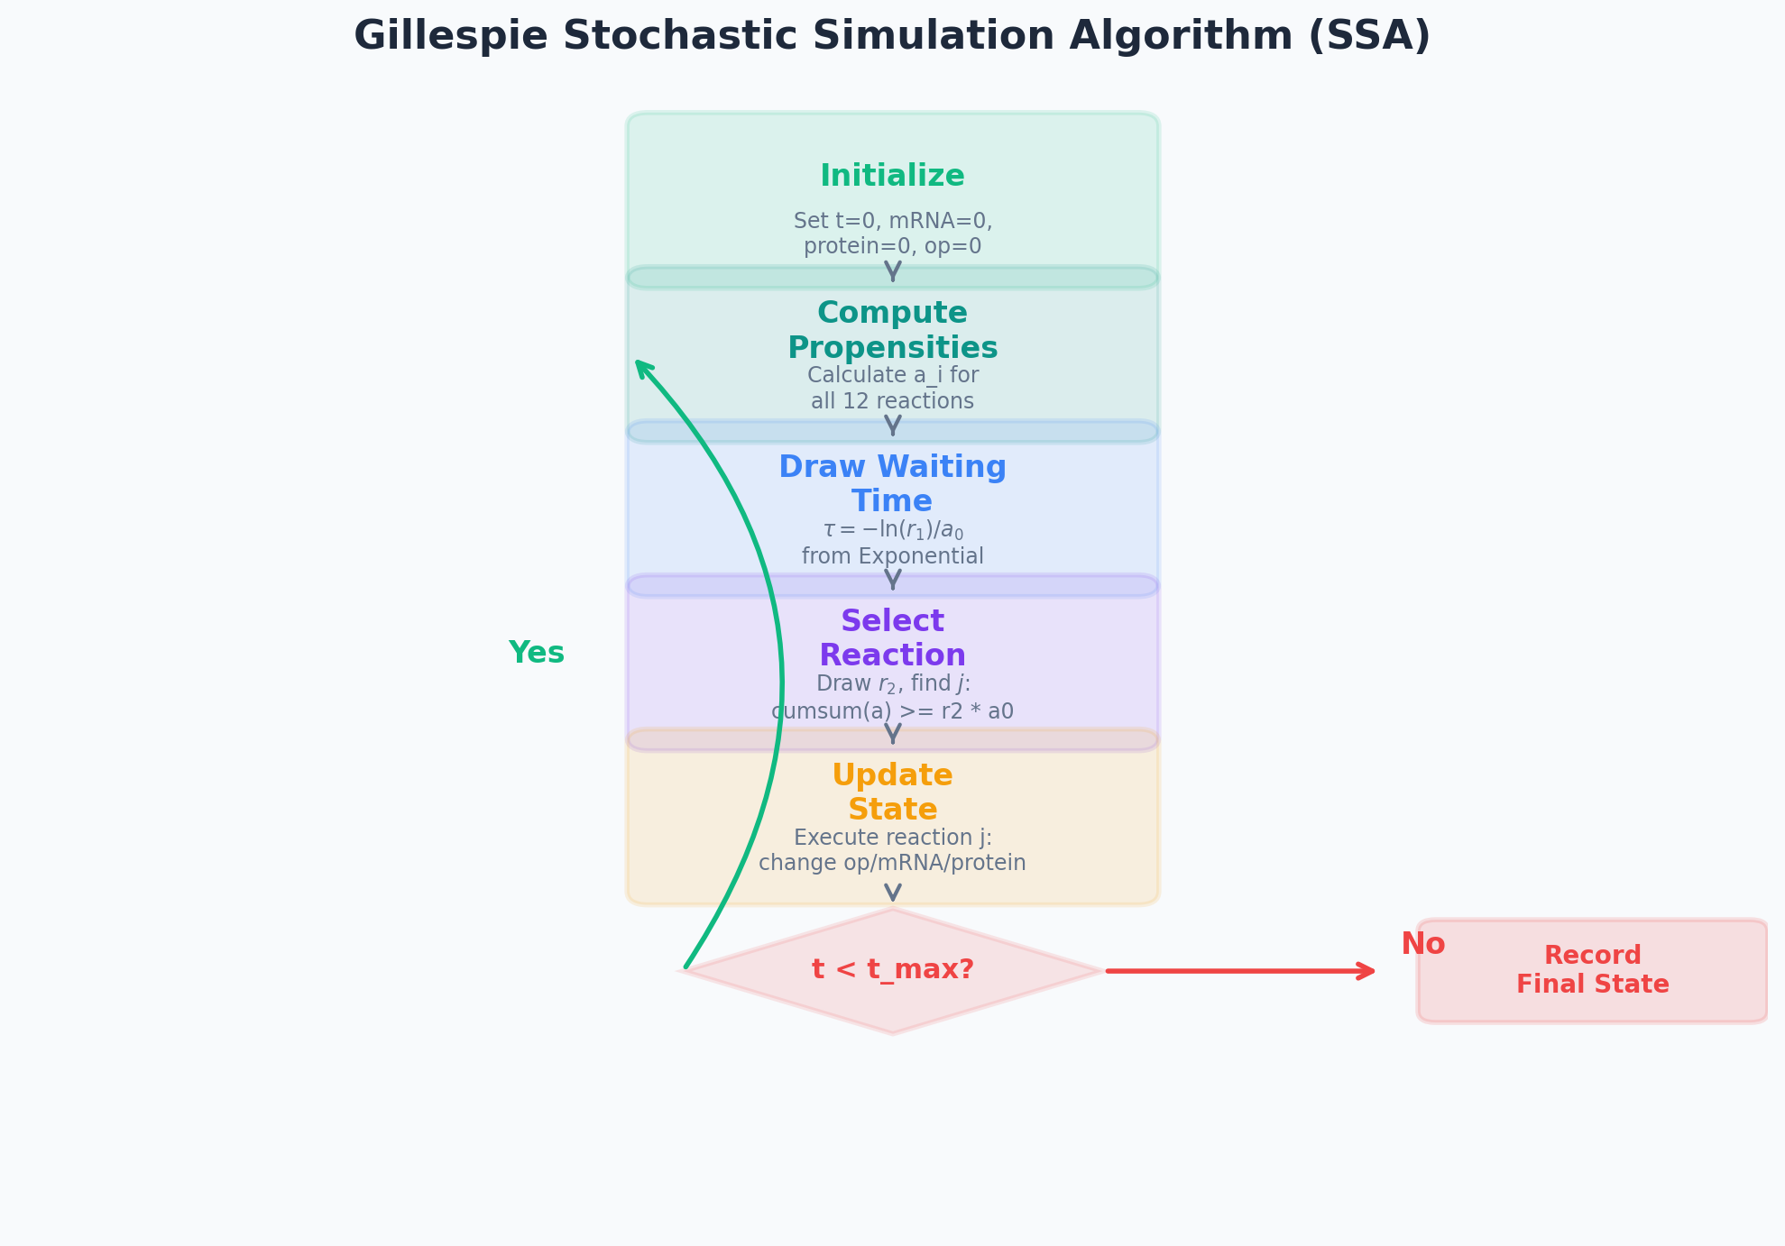
The Gillespie Algorithm (SSA)
Step 1: Compute propensity a_i for each of the 12 reactions based on current state
Step 2: Sum all propensities to get a_total
Step 3: Draw waiting time tau from Exp(a_total) -- time until next reaction
Step 4: Select which reaction fires with probability a_i / a_total
Step 5: Update molecule counts (change operator state, or +/-1 mRNA/protein)
Repeat: Continue until t reaches t_max = 30,000 min (~21 days)

Slide 6
Key Parameters
Parameter | Value | Source
k_max (max transcription) | 0.15 /min | Mtb transcriptomics
k_translation | 0.5 protein/mRNA/min | Taniguchi 2010
mRNA half-life | 9.5 min | Rustad 2013
Protein half-life | 1,500 min (~25 hr) | Taniguchi 2010
k_on (binding rate) | 0.0167 nM^-1 min^-1 | Stormo & Zhao 2010
Kd_strong | 2.4 nM | Panagoda 2024
Kd_weak | 49 nM | Panagoda 2024
block_strong / block_weak | 85% / 50% | Estimated
t_max | 30,000 min (500 hr) | --
t_burn_in | 15,000 min | 10x protein t_1/2
n_cells | 50,000 | --

Slide 7
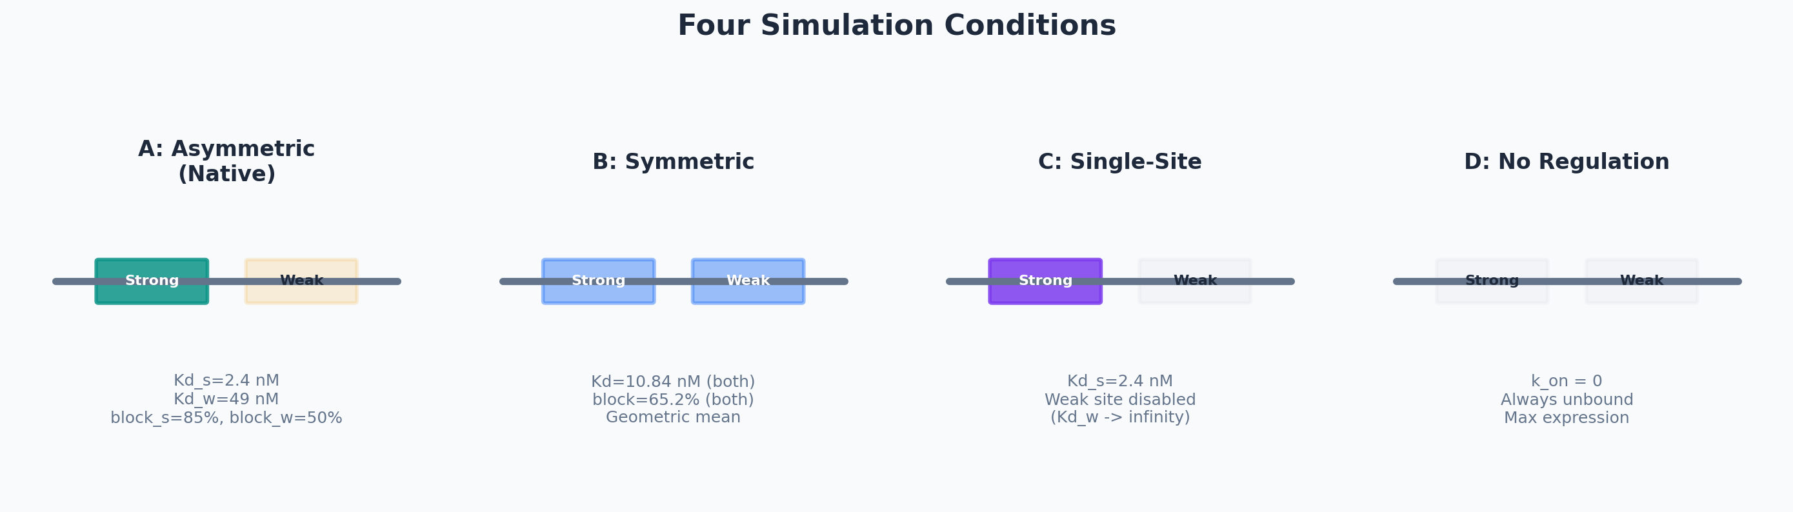
Four Simulation Conditions
A: Asymmetric
B: Symmetric
C: Single-Site
D: No Regulation
Native Mce3R Kd = 2.4/49 nM
Geometric mean Kd = 10.84/10.84 nM
Strong site only Weak disabled
k_on = 0 Always unbound

Slide 8
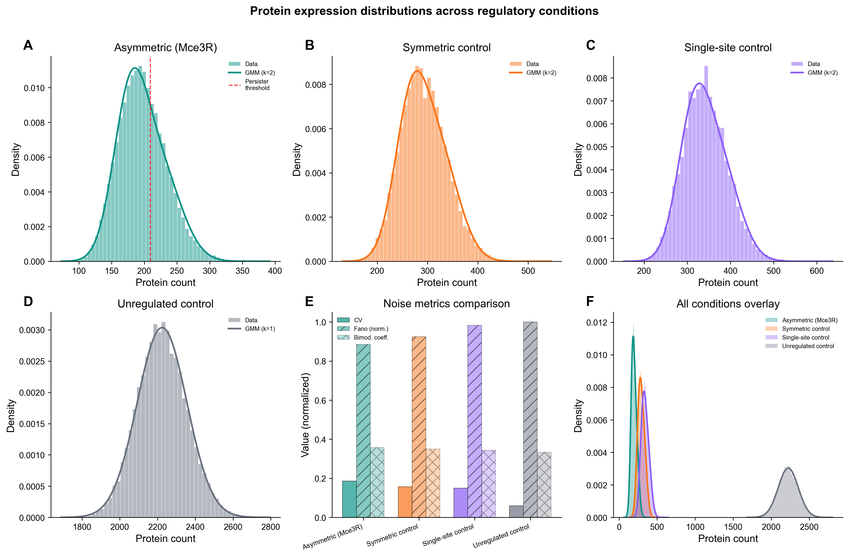
What 50,000 Cells Looks Like
Each histogram shows the distribution of protein levels across 50,000 simulated cells
Condition A: Mean = 197, lowest due to strong repression
Condition B: Mean = 293, higher because symmetric sites are weaker individually
Condition D: Mean = 2,224, the unregulated maximum
The WIDTH of each distribution (CV) is the key noise metric

Slide 9
The Key Result
Asymmetric (Native)
Symmetric (Control)
CV = 0.187
CV = 0.157
Mean = 197 proteins
Mean = 293 proteins
Asymmetric CV is ~19% higher
The native operator produces more noise than an equivalent symmetric design

Slide 10
Why Asymmetry Creates More Noise
The weak site flickers: Kd = 49 nM means rapid binding/unbinding. The weak site is occupied only ~25% of the time, constantly switching between states.
The strong site anchors: Kd = 2.4 nM means the strong site stays bound most of the time, holding the operator in a partially repressed state.
Transcriptional bursting: When the weak site briefly unbinds, transcription rate jumps from 0.01125/min (both bound) to 0.0225/min (strong only) -- a 2x burst.
Wider distribution: This flickering creates cells with very different expression histories. Some cells catch more bursts, others fewer, widening the protein distribution.
Symmetric operators are calmer: With two equal-affinity sites (Kd = 10.84 nM each), both sites flicker at the same rate. The transitions between states are more balanced, producing a narrower distribution.
The biological implication: Higher noise means a larger tail of the distribution -- more cells reach the extreme expression levels that may trigger the persister phenotype.

Slide 11
Numba JIT Acceleration
~10 min
Pure Python Gillespie would take hours to days for 50,000 cells per condition
@numba.njit: Compiles the inner simulation loop to optimized machine code at first call
The simulate_cell() function runs ~100x faster than interpreted Python
First call takes ~30 seconds for JIT compilation; subsequent calls are near-instant
Performance breakdown: Condition A: 42s, Condition B: 36s, Condition C: 390s (weak site flickers constantly), Condition D: 83s
Total Phase 2 runtime: ~593 seconds (~10 minutes) for all conditions + asymmetry sweep
for 200,000 cells (all 4 conditions)

Slide 12
Condition D: The Unregulated Baseline
2,224
0.059
7.77
11.3x
Mean Protein
CV (Noise)
Fano Factor
Fold Repression (D/A)
With k_on = 0, no repressor binds -- the operator is always in State 0 (fully active)
Mean protein = 2,224 serves as the maximum expression reference for all conditions
Fold-change validation: Model predicts 11.3x repression (D/A), compared to experimental ~8.5x from Santangelo 2009
Fano factor = 7.77: Close to theoretical prediction of 1 + burst_size = 1 + 6.85 = 7.85 for unregulated two-stage model

Slide 13
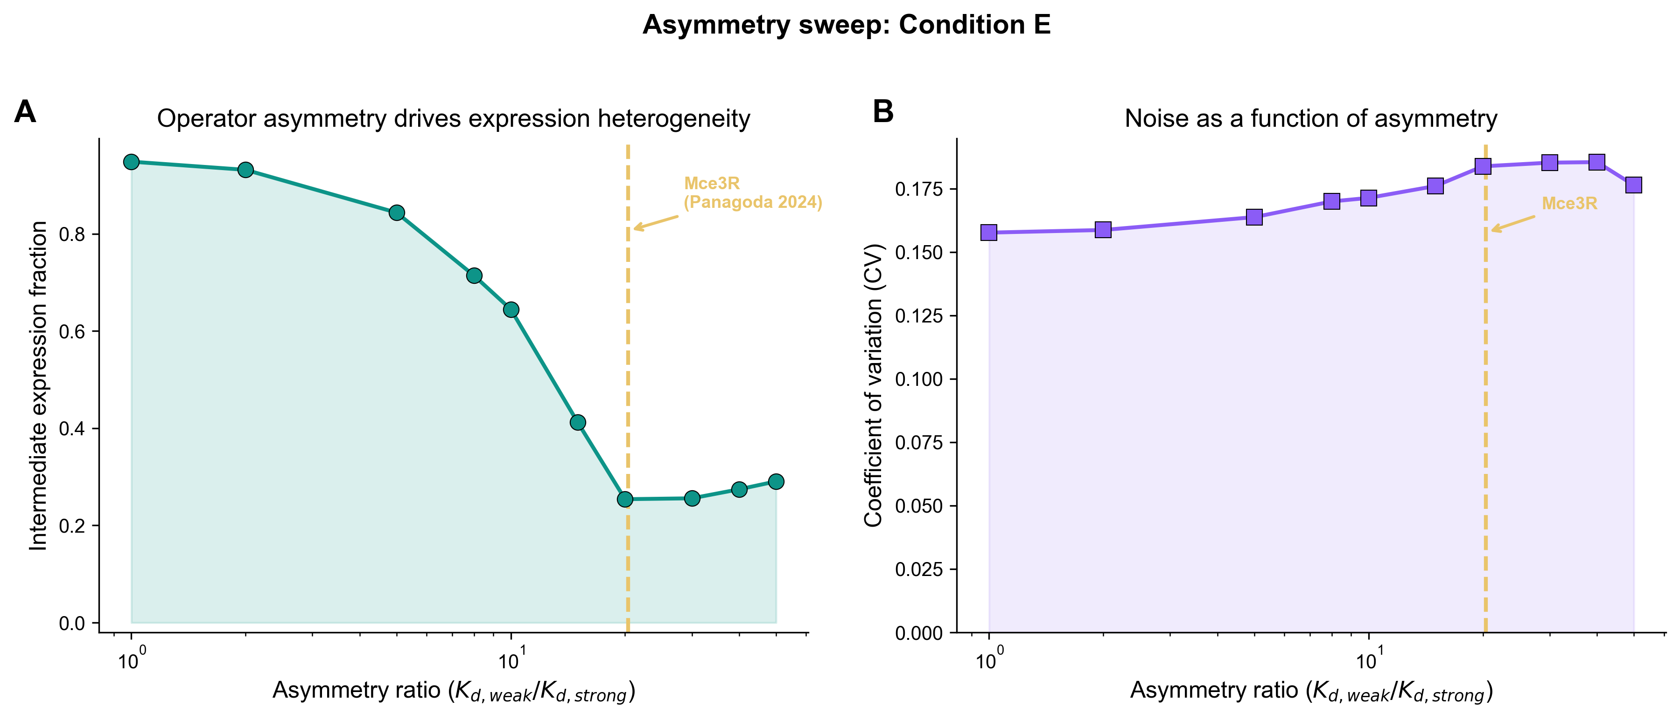
Asymmetry Sweep (Condition E)
Sweep Kd_weak/Kd_strong ratio from 1 (symmetric) to 50 (extreme asymmetry)
Geometric mean held constant at 10.84 nM to isolate the effect of asymmetry
CV increases from 0.158 (ratio=1) to 0.191 (ratio=20)
5,000 cells simulated per ratio point (10 ratios total)
Native Mce3R ratio = 20.4: sits near the peak of the noise curve

Slide 14
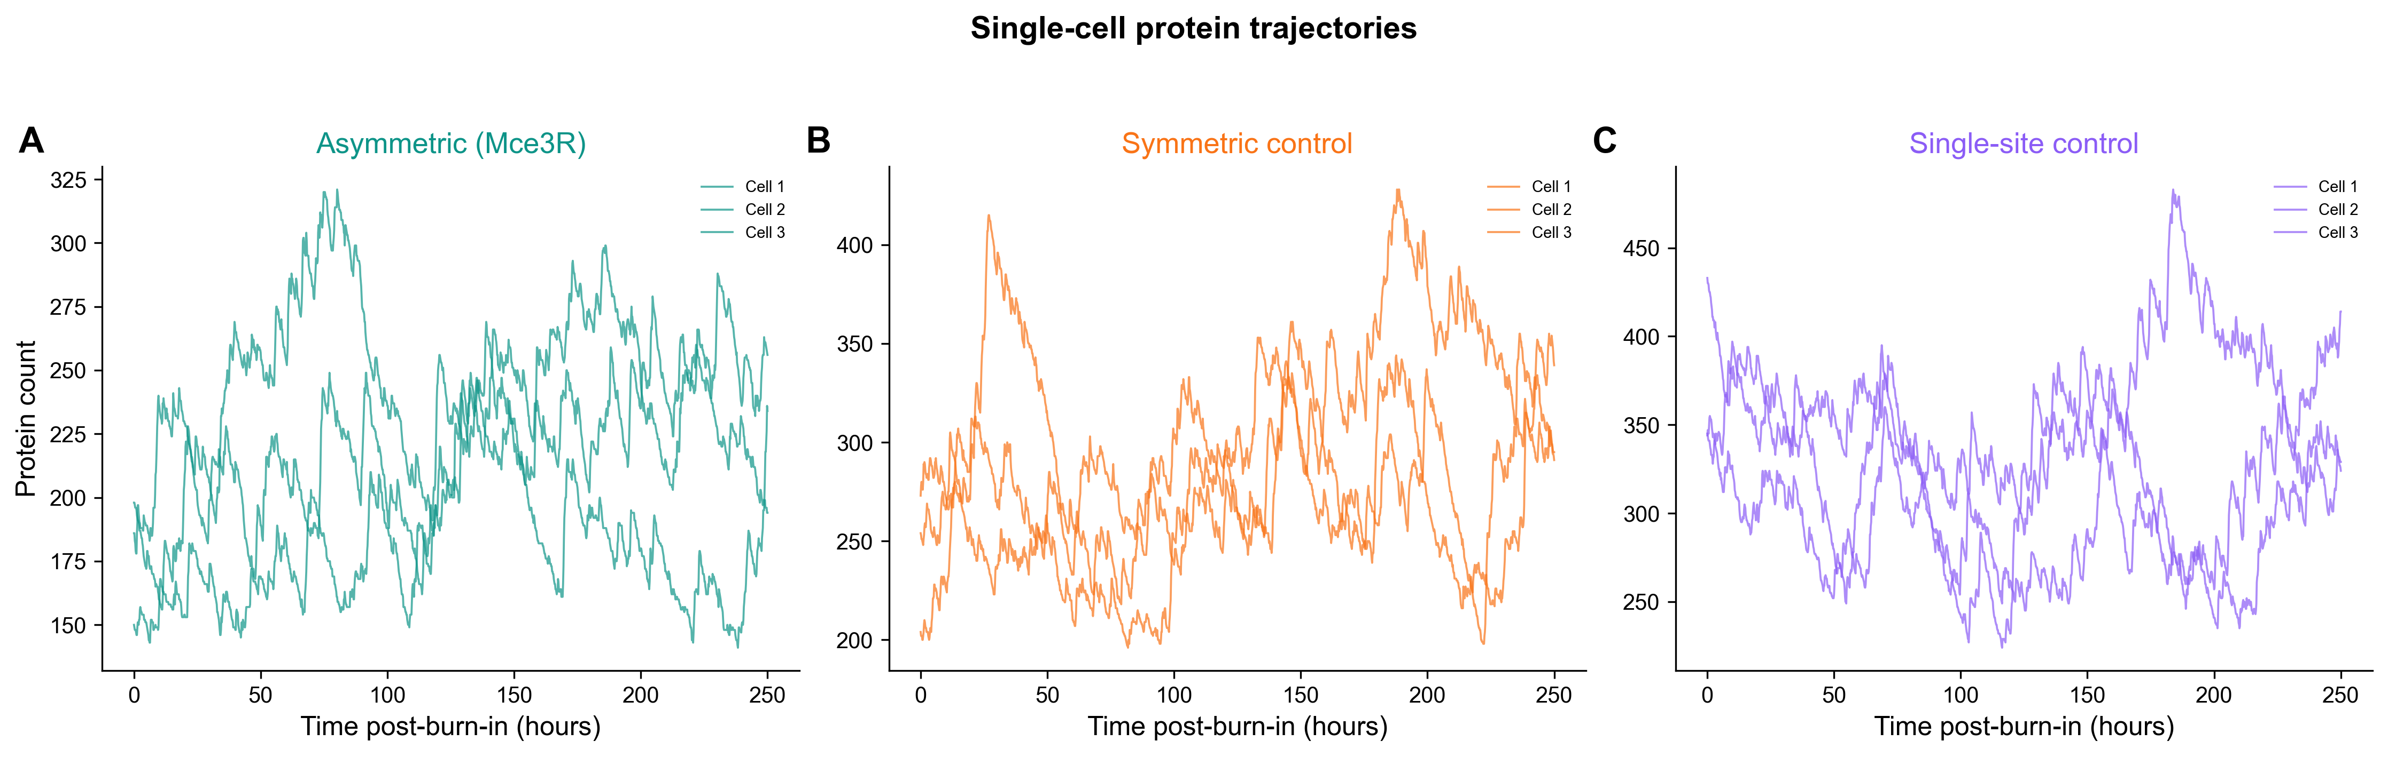
Single-Cell Traces
Individual cell protein levels fluctuate over time as molecules are produced and degraded
Each line is one cell's trajectory recorded every 10 minutes after burn-in
Stochastic bursting is visible as sharp peaks when the operator briefly opens
Cells in the same condition can have very different instantaneous protein levels
This cell-to-cell variation IS the noise that we quantify with CV

Slide 15
Sanity Checks
Mean protein in expected range: Condition A = 197 (expected ~200 for regulated TB gene)
CV > 0 for all conditions: Confirmed -- all simulations show measurable noise
Fano factor > 1 (super-Poissonian): All conditions show Fano 6.87-7.81, consistent with transcriptional bursting
Condition D has highest mean: 2,224 >> 342 >> 293 >> 197 (D > C > B > A), confirming repression hierarchy
Fano(D) ~ 1 + burst_size: 7.77 vs expected 7.85 -- validates the two-stage gene expression model
Reproducibility: All conditions use deterministic seeds (master_seed=42 + condition offset)
All NPZ files saved: condition_A.npz, condition_B.npz, condition_C.npz, condition_D.npz, condition_E_sweep.npz
Numba compilation: JIT compiles successfully on first call, no type errors

Slide 16
Output Files
File | Contents | Size
condition_A.npz | 50,000 protein/mRNA/op_state arrays + 20 traces | Asymmetric (native)
condition_B.npz | 50,000 protein/mRNA/op_state arrays + 20 traces | Symmetric control
condition_C.npz | 50,000 protein/mRNA/op_state arrays + 20 traces | Single-site control
condition_D.npz | 50,000 protein/mRNA/op_state arrays + 20 traces | Unregulated baseline
condition_E_sweep.npz | 5,000 cells x 10 ratios | Asymmetry sweep
phase2_summary.json | Mean, CV, Fano for all conditions | Summary statistics
All output stored in results/phase2/. NPZ files use numpy compressed format for efficient storage of large arrays.

Slide 17
What Phase 2 Feeds Into
Phase 3
Phase 4
Phase 5
Statistical Analysis
Figure Generation
Calibration
Bootstrap CIs, Mann-Whitney tests, GMM fitting, sensitivity analysis
7 publication-quality figures at 300 dpi (matplotlib + seaborn)
Mean protein from Phase 2 becomes the calibration target for thermodynamic model
Phase 2 is the engine: It produces the raw stochastic data that all downstream analyses depend on
The 50,000-cell protein arrays from each condition feed directly into Phase 3 statistical tests and Phase 4 visualizations

Slide 18
Summary
Phase 2 simulated 50,000 individual TB cells for each of 4 operator architectures using exact stochastic simulation (Gillespie SSA), demonstrating that the native asymmetric operator produces ~19% higher expression noise (CV) than an equivalent symmetric design.
50,000
12
4
19%
~10 min
cells per condition
reactions modeled
operator architectures
more noise in asymmetric
total runtime
ENIGMA Project | Mce3R Stochastic Simulation | Phase 2 Complete

