Slide 1
Phase 4: Manuscript Figures
ENIGMA Project — Visualizing the Results
ENIGMA Project | Mce3R Stochastic Gene Regulation

Slide 2
Figure Overview
Fig 1 — Binding Site Architecture: Circular genome plot with FIMO-scored operator sites
Fig 2 — Protein Distributions: Histograms + GMM fits for 4 regulatory conditions
Fig 3 — Asymmetry Sweep: CV and intermediate fraction vs Kd ratio
Fig 4 — Sensitivity Analysis: Tornado plot + heatmap of parameter perturbation effects
Fig 5 — Experimental Validation: Model predictions vs Santangelo 2009 data
Fig 6 — Single-Cell Traces: Individual cell time series for 3 conditions
Fig 7 — BIC Model Comparison: Grouped bar chart of GMM component selection
Fig 8 — Methods Architecture: Computational pipeline diagram across all phases
ENIGMA Project

Slide 3
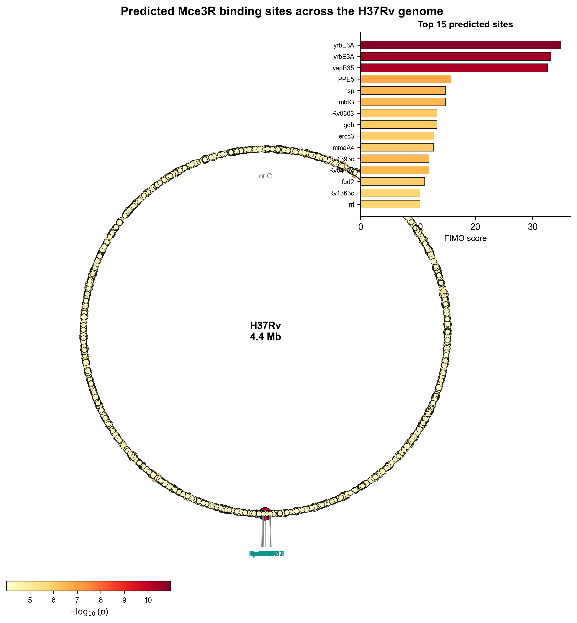
Figure 1: Binding Site Architecture
Circular genome plot of H37Rv with predicted Mce3R binding sites. Inset: top 15 sites ranked by FIMO score.
ENIGMA Project

Slide 4
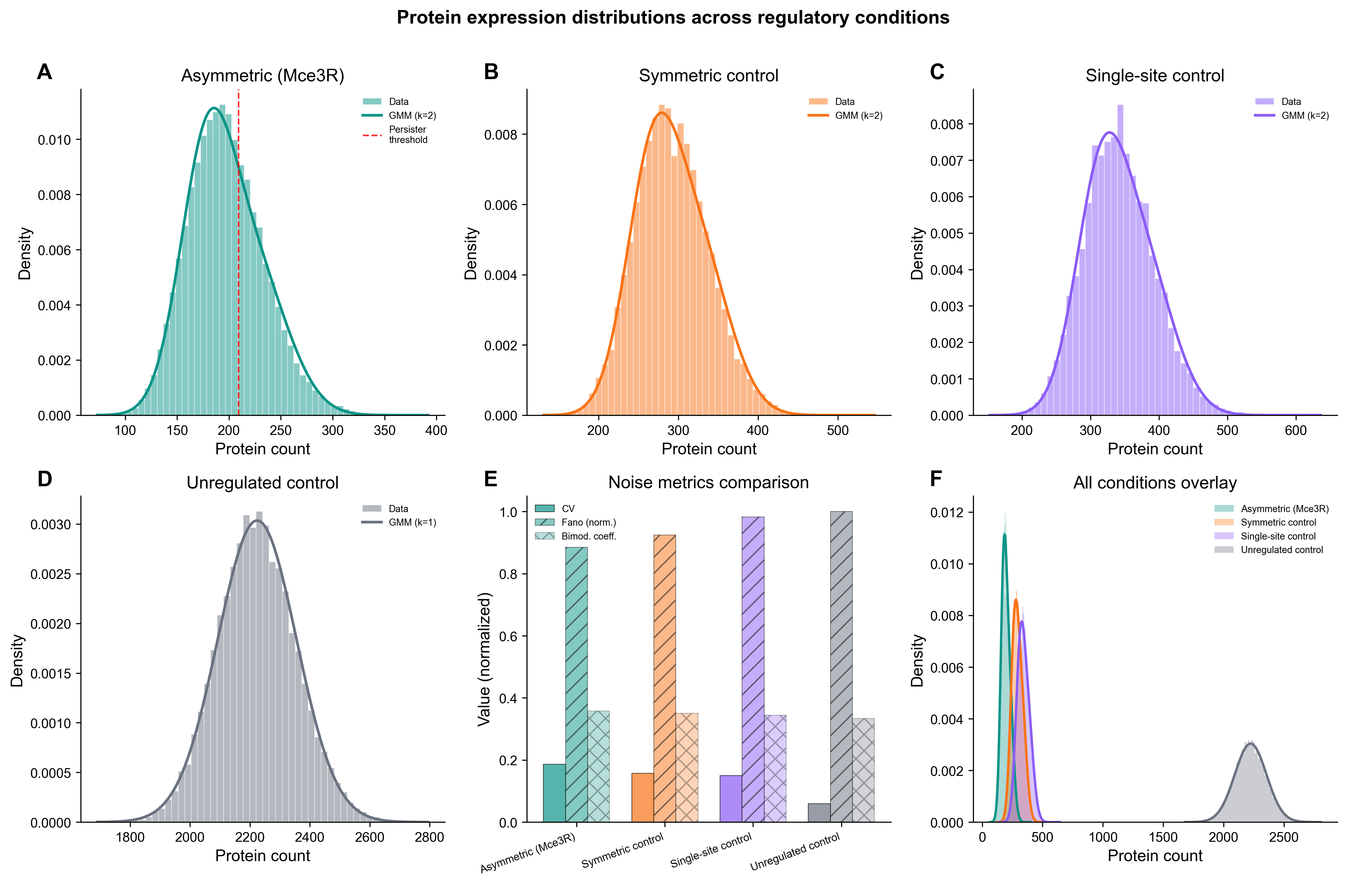
Figure 2: Protein Distributions
2×3 panel: histograms with GMM fits for 4 conditions (A–D), box plot of CV/Fano/bimodality, and density overlay.
ENIGMA Project

Slide 5
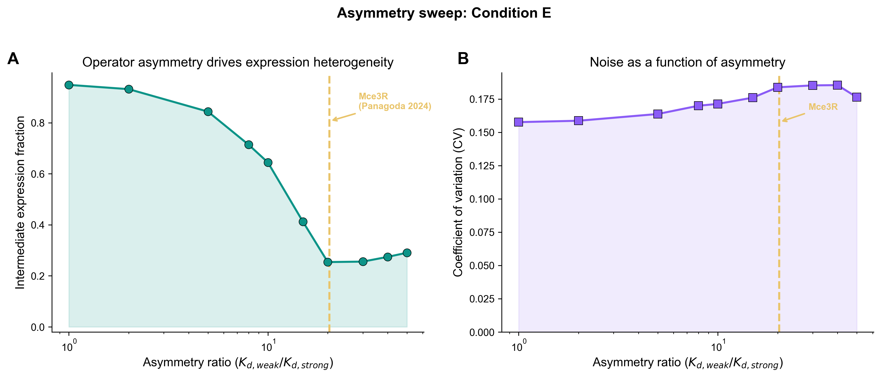
Figure 3: Asymmetry Sweep
Intermediate fraction vs asymmetry ratio (log scale). Gold dashed line marks native Mce3R ratio (~20.4, Panagoda 2024).
ENIGMA Project

Slide 6
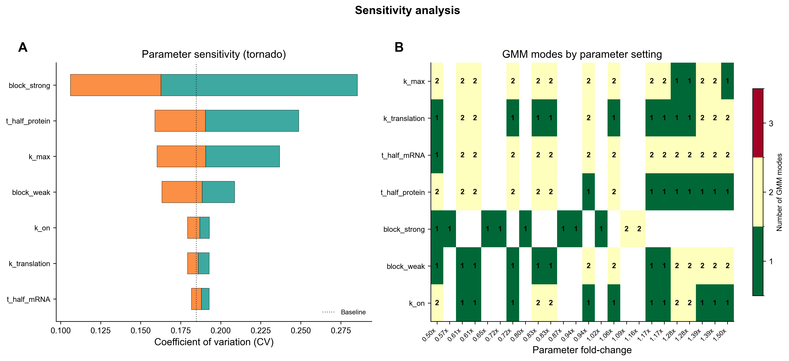
Figure 4: Sensitivity Analysis
Tornado plot of parameter impact on CV (left) and heatmap of fold-change vs parameter showing number of modes (right).
ENIGMA Project

Slide 7
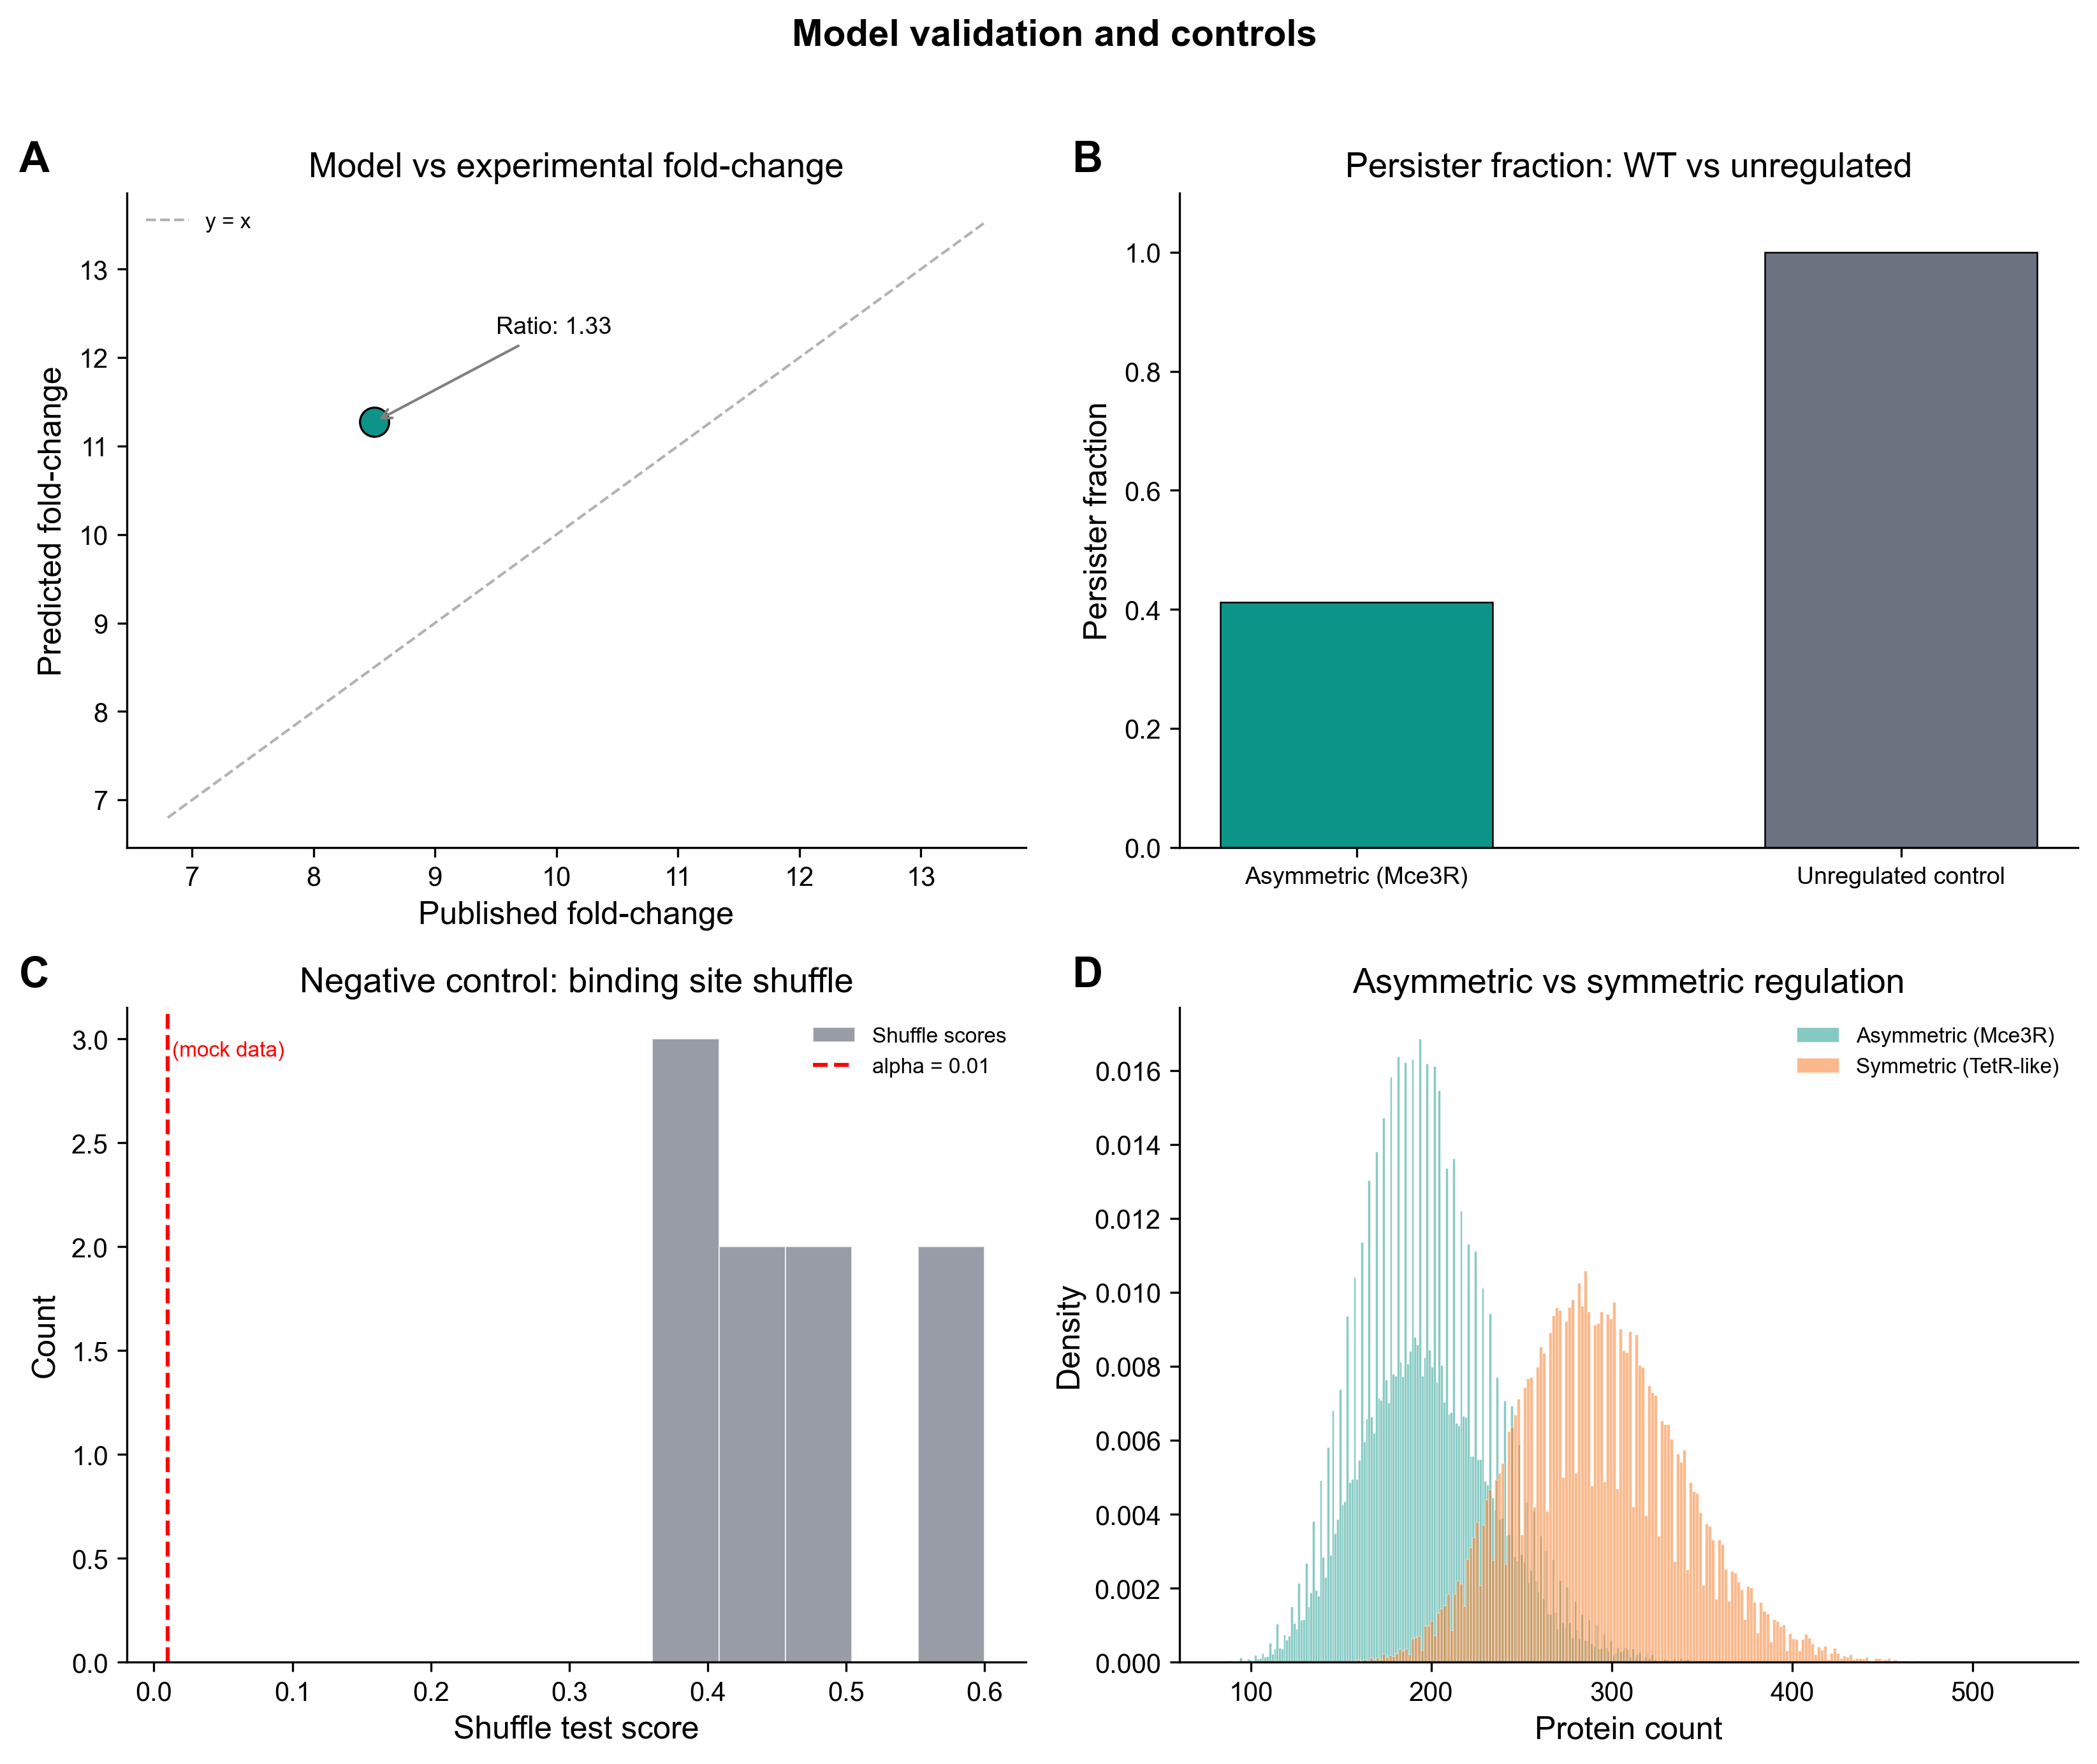
Figure 5: Experimental Validation
Predicted vs published fold-change (A), persister fraction WT vs unregulated (B), shuffle test (C), and symmetric TetR comparison (D).
ENIGMA Project

Slide 8
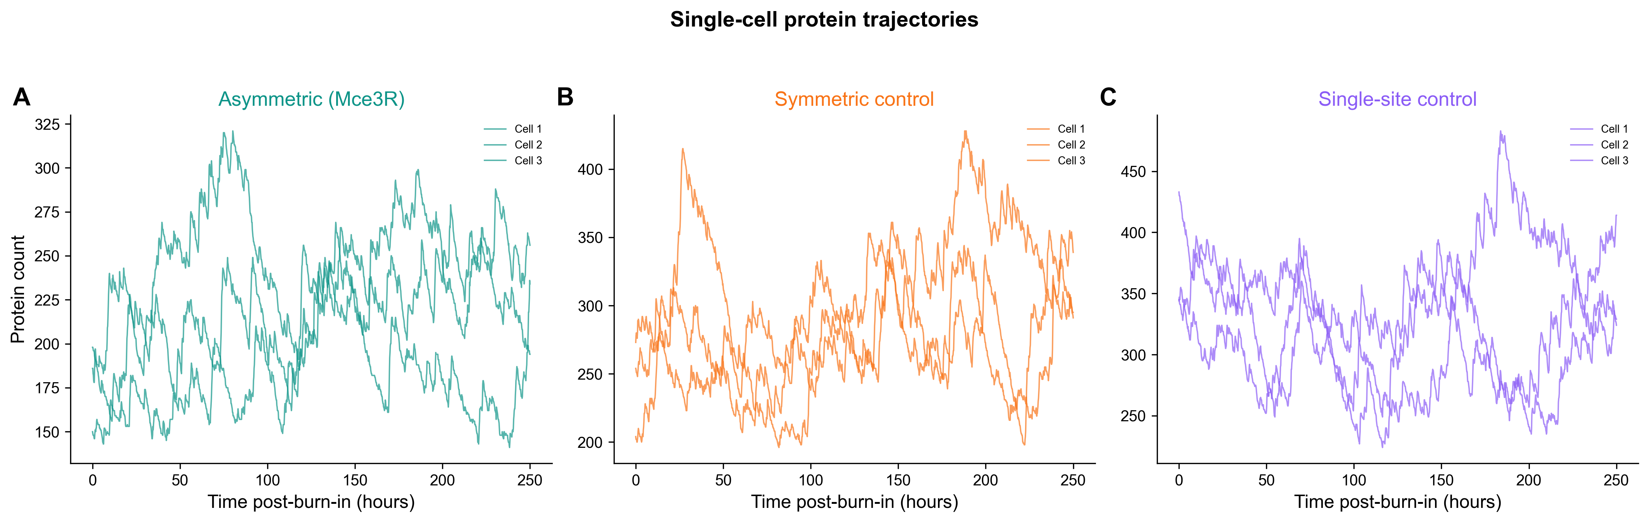
Figure 6: Single-Cell Traces
Time-series traces for 3 representative cells per condition. ~2100 min post-burn-in. Thin lines with transparency.
ENIGMA Project

Slide 9
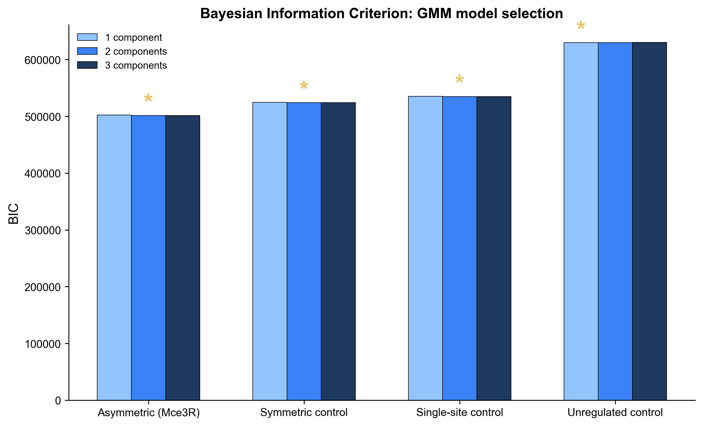
Figure 7: BIC Model Comparison
Grouped bar chart: BIC for 1-, 2-, and 3-component GMMs across conditions A–D. Star marks best (lowest) BIC per condition.
ENIGMA Project

Slide 10
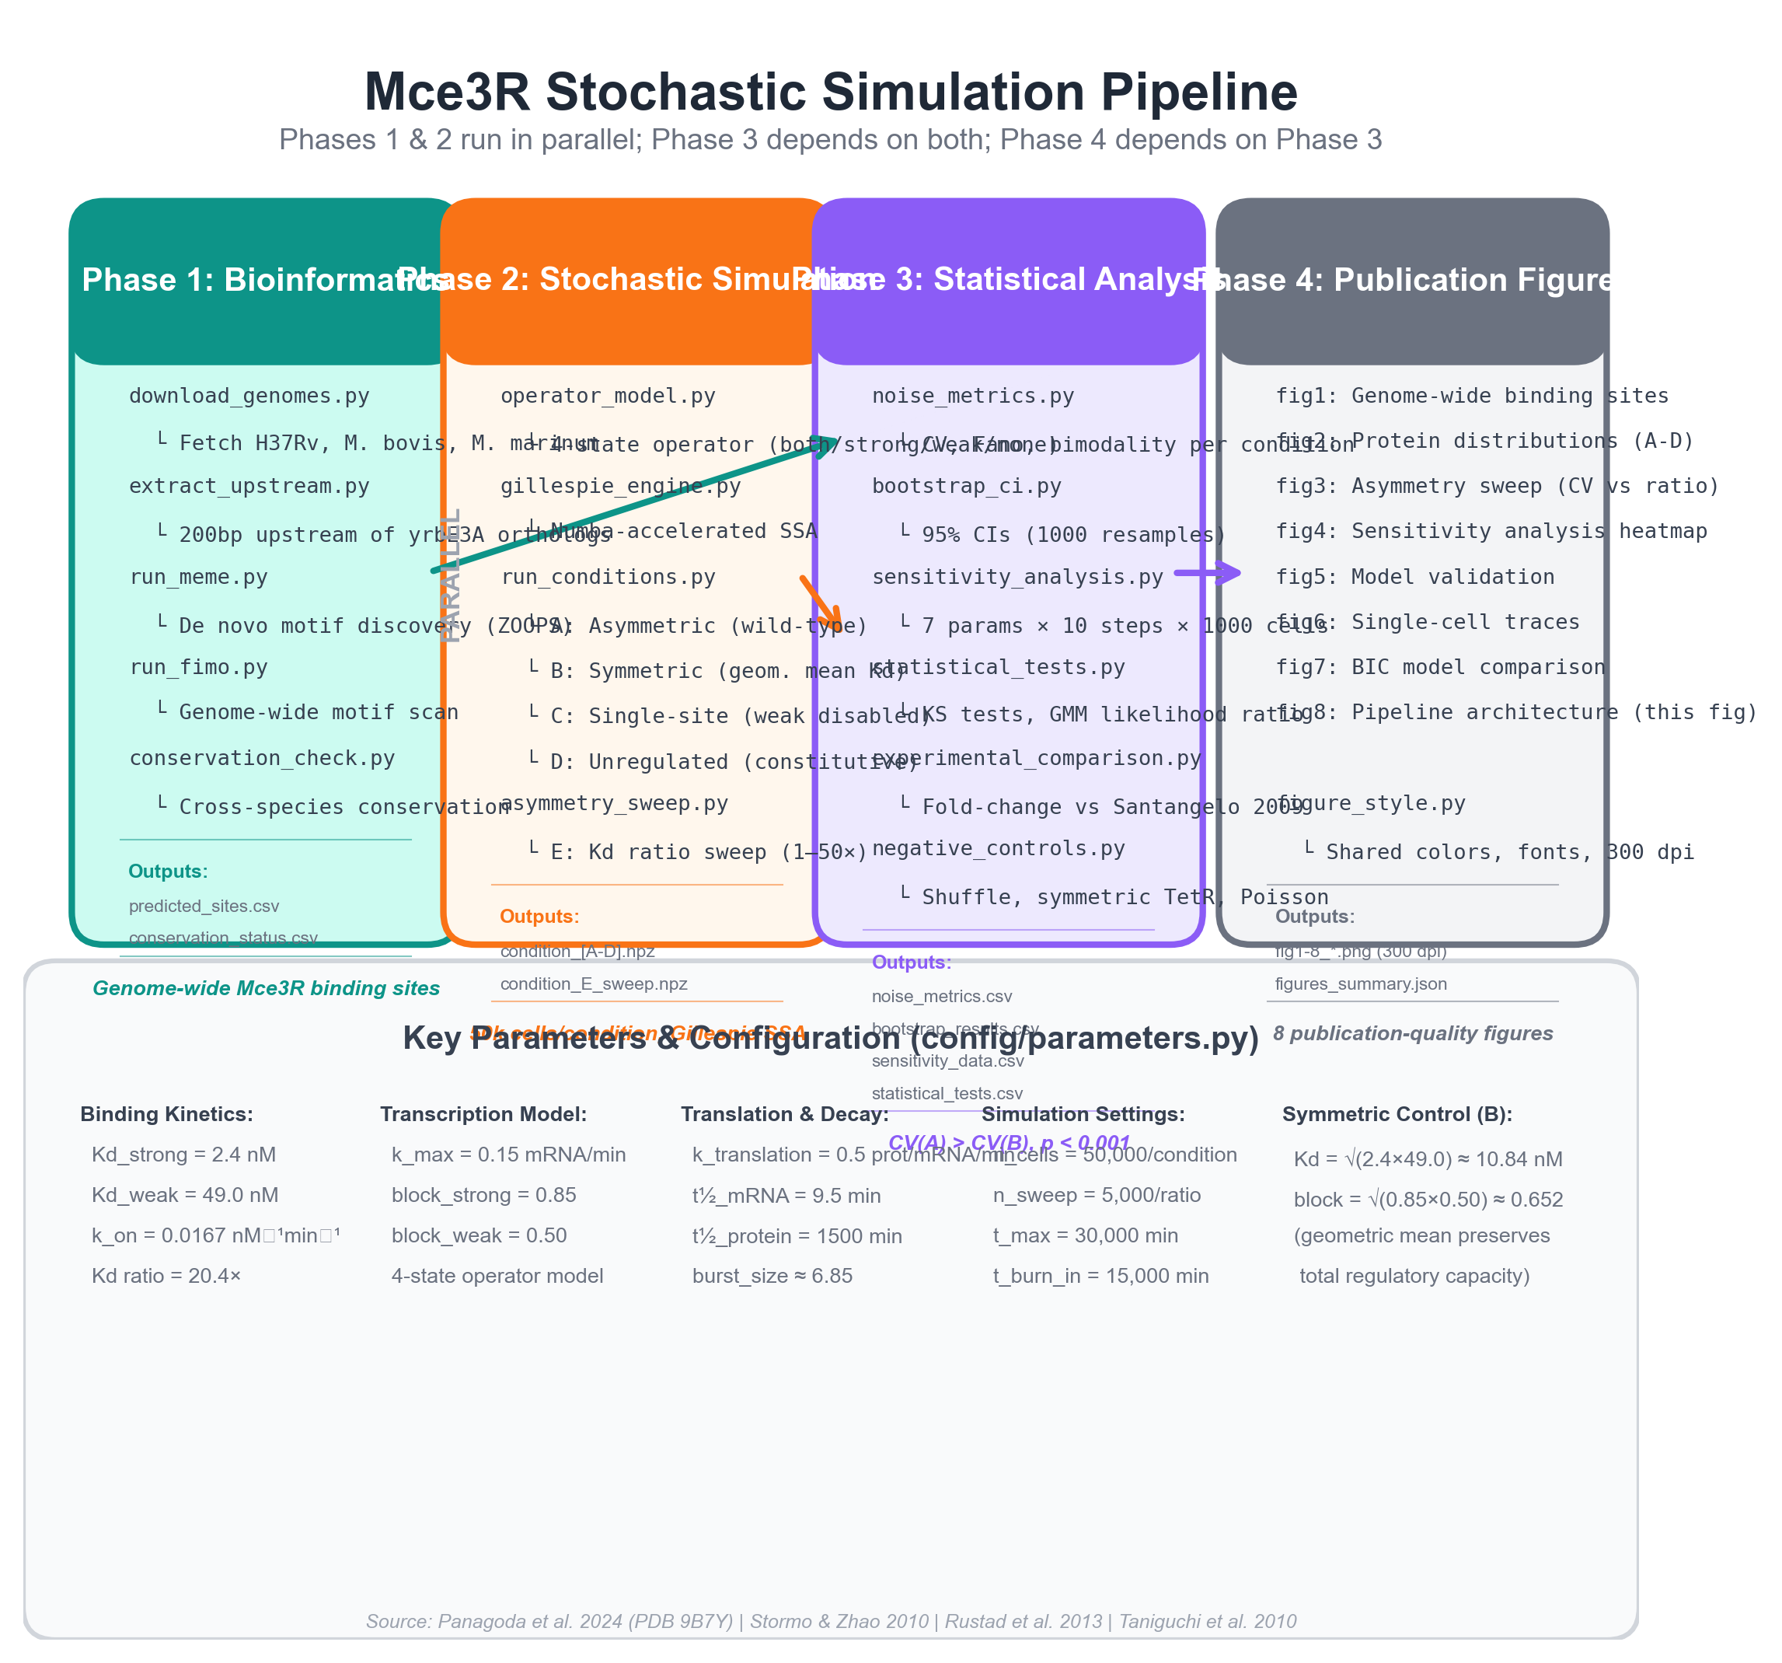
Figure 8: Methods Architecture
End-to-end computational pipeline: Phase 1 (bioinformatics) through Phase 4 (figures). Color-coded by phase.
ENIGMA Project

Slide 11
Design Principles
Consistent color scheme: Teal = asymmetric, Orange = symmetric, Purple = single-site, Gray = unregulated
Resolution: All figures rendered at 300 dpi for publication quality
Panel labels: Bold (A), (B), (C)... in upper-left corner of each sub-panel
Typography: Calibri body, Trebuchet MS headers; 8–12 pt axis labels
Shared style module: figure_style.py enforces uniform aesthetics across all 8 figures
Accessibility: Color-blind-safe palette; patterns supplement color coding
Format: PNG output with transparent-free white backgrounds for journal submission
ENIGMA Project

Slide 12
Phase 4 Summary
8 publication-ready figures spanning binding site architecture through statistical validation. Figures 1–3: From genome-wide binding sites to asymmetry effects Figures 4–5: Robustness checks and experimental grounding Figures 6–7: Single-cell dynamics and statistical model selection Figure 8: Complete methods architecture for reproducibility All figures use a unified visual language defined in figure_style.py.
ENIGMA Project | Mce3R Stochastic Gene Regulation

