Slide 1
Phase 5: Thermodynamic Calibration
ENIGMA Project -- From Sequences to Binding Energies
ENIGMA | Mce3R Stochastic Gene Regulation | M. tuberculosis

Slide 2
The Gap: Why Phase 5?
Phase 2 built stochastic simulations with ad-hoc rate constants (k_on, k_off) that lack biophysical grounding.
Phase 5 replaces these with first-principles parameters derived from:
(1) The Berg-von Hippel model: converting PWM scores into binding free energies (Delta-G)
(2) Experimental dissociation constants: Kd_strong = 2.4 nM, Kd_weak = 49 nM
(3) MCMC inference of cooperativity (omega) and spacer penalty (Delta-G_spacer)
Result: every rate constant in the simulation now traces back to a measured Kd or a PWM score.

Slide 3
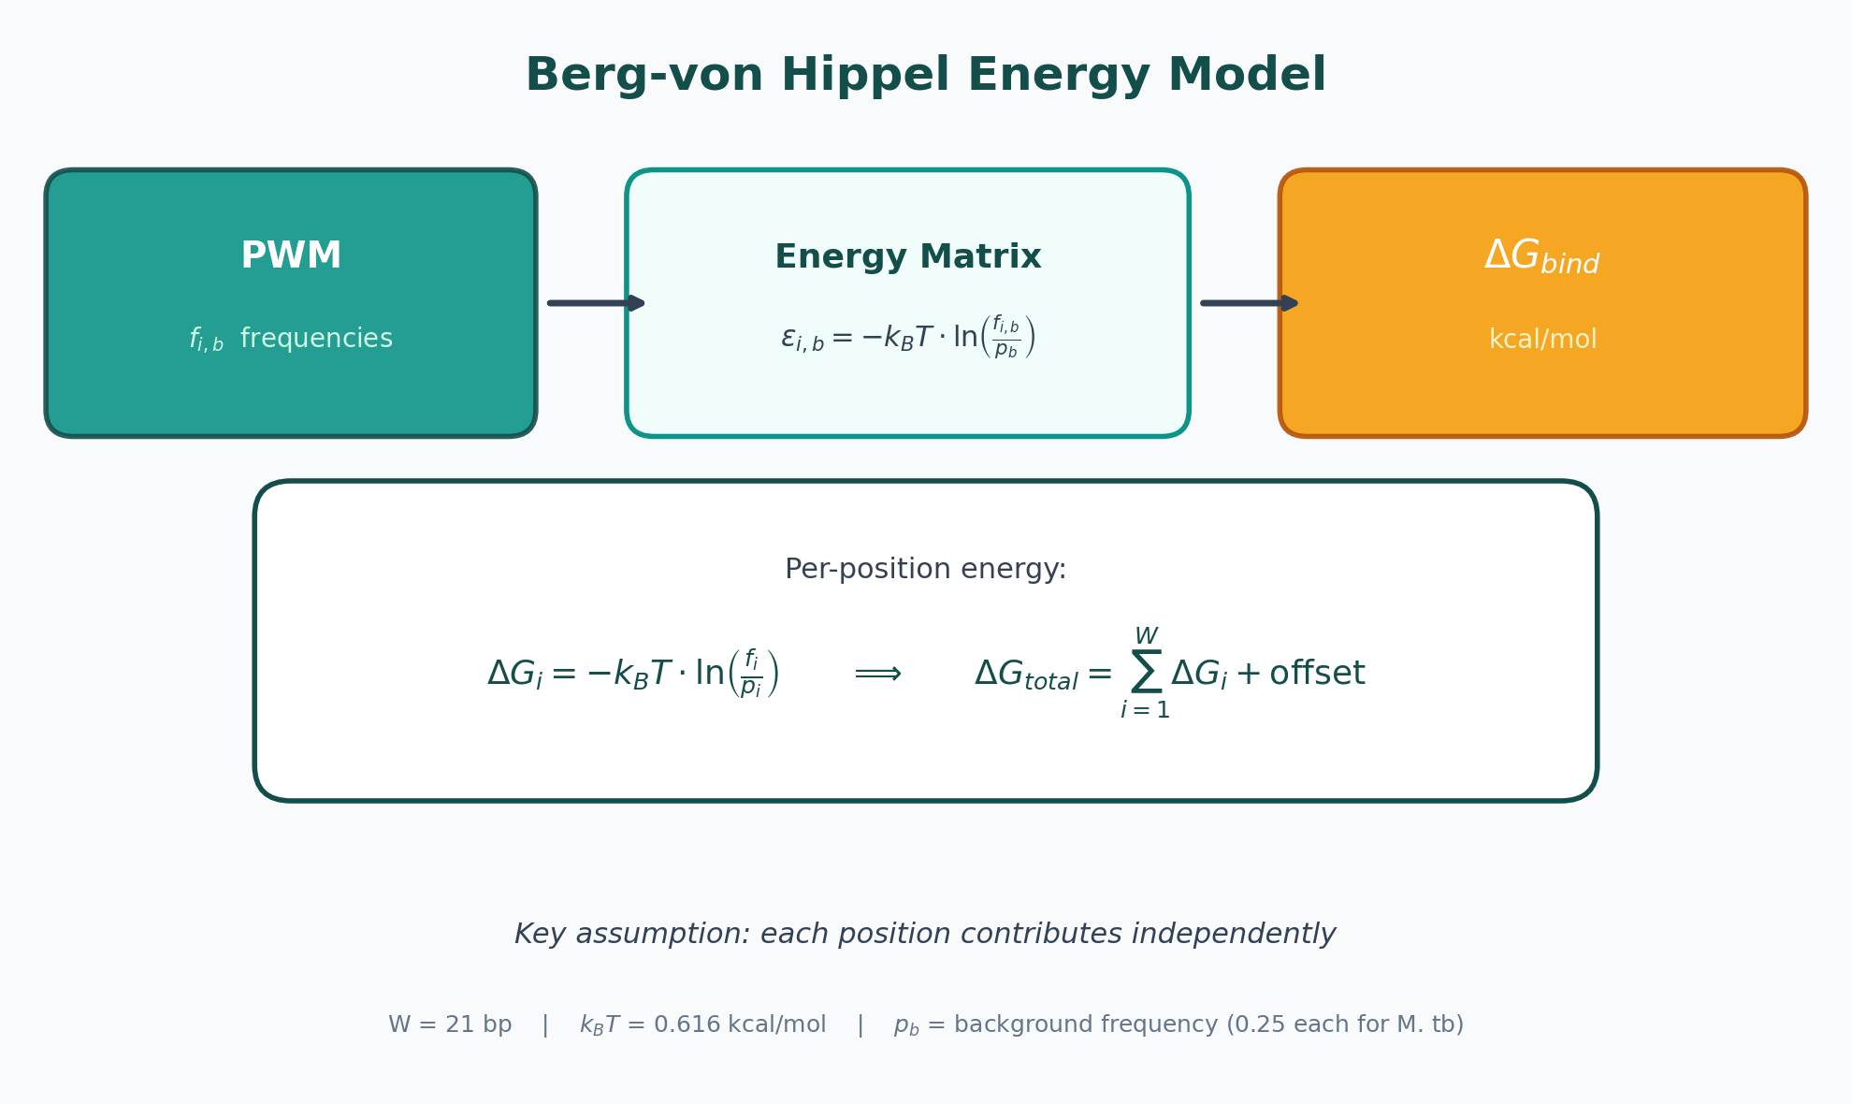
The Berg-von Hippel Energy Model
Each position in the binding motif contributes independently to total binding energy.
PWM frequencies (from Phase 1 MEME analysis) are converted to per-base energies.
Motif width = 21 bp
kT = 0.616 kcal/mol (37 C)
Background frequencies = 0.25 (GC-rich M. tb genome approximation).

Slide 4
Energy Calibration: Matching Experiment
Strong site (MEME-1):
Sequence: GTTGTCCAAGCAATCGCGTAT
Kd_exp = 2.4 nM
Kd_pred = 2.400 nM (exact match)
Delta-G = -12.226 kcal/mol
Key Results
Delta-Delta-G = 1.86 kcal/mol
Two independent offsets used (one per MEME motif)
Weak site (MEME-2):
Sequence: TTTGCATTGCTATTTACCGAT
Kd_exp = 49.0 nM
Kd_pred = 49.000 nM (exact match)
Delta-G = -10.368 kcal/mol
Both predicted Kd values reproduce experiment exactly

Slide 5
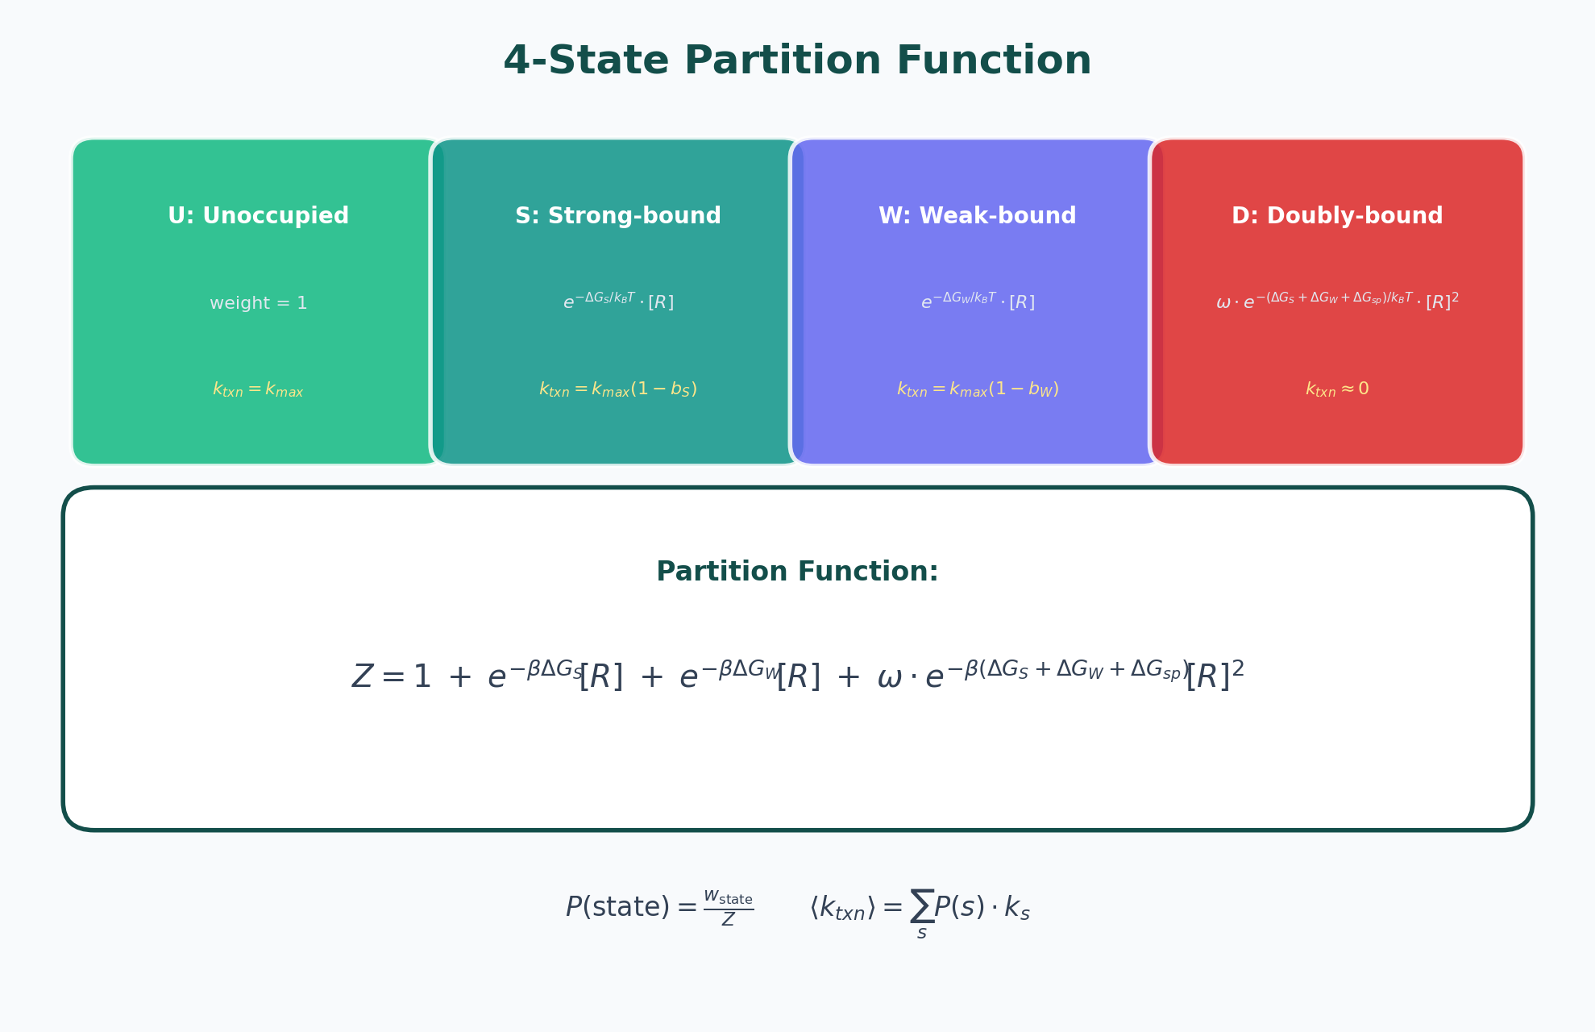
The 4-State Partition Function
Statistical mechanics model with 4 operator states:
U = unoccupied (full transcription)
S = strong site bound
W = weak site bound
D = doubly bound (full repression)
Probability of each state depends on [Mce3R], Delta-G values, and cooperativity omega.

Slide 6
Cooperativity: What is omega?
omega > 1: Positive cooperativity -- binding at one site HELPS binding at the other.
The doubly-bound state (D) is more probable than expected from independent binding.
omega = 1: Independent binding -- no interaction between sites.
omega < 1: Antagonistic -- binding at one site HINDERS binding at the other.
For Mce3R, the two binding sites are separated by a spacer region in the operator.
The spacer introduces a penalty (Delta-G_spacer) that modulates cooperative binding.
Our MCMC result: omega = 1.083 (approximately 1 = near-independent binding)

Slide 7
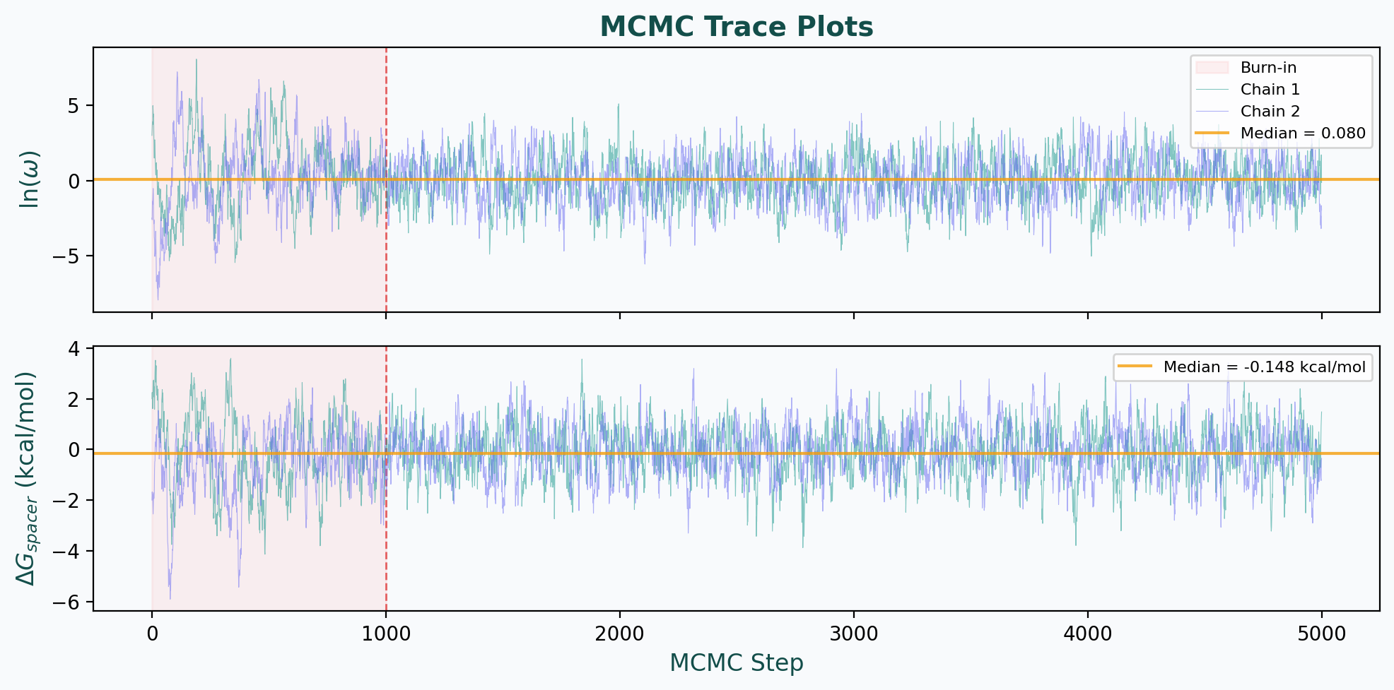
MCMC Inference of Cooperativity
Markov Chain Monte Carlo (MCMC) was used to infer omega and Delta-G_spacer.
Walkers: 32
Steps: 5,000
Burn-in: 1,000
MCMC explores the posterior distribution, sampling parameter combinations consistent with the data.
Red zone = burn-in (discarded). Post-burn-in samples define the posterior.

Slide 8
MCMC Results
Interpretation:
omega near 1 means Mce3R binds its two sites approximately independently.
The spacer penalty is small (-0.15 kcal/mol), consistent with minimal protein-protein interaction across the spacer.
Wide credible interval is expected: with only one operator architecture measured, the data provides limited constraint on cooperativity.
This is scientifically valuable: it means the model is not over-fit.
Posterior Estimates
omega = 1.083 [95% CI: 0.20 -- 5.89]
Delta-G_spacer = -0.148 kcal/mol
Wide posterior = data does not tightly constrain cooperativity. This is an honest result.

Slide 9
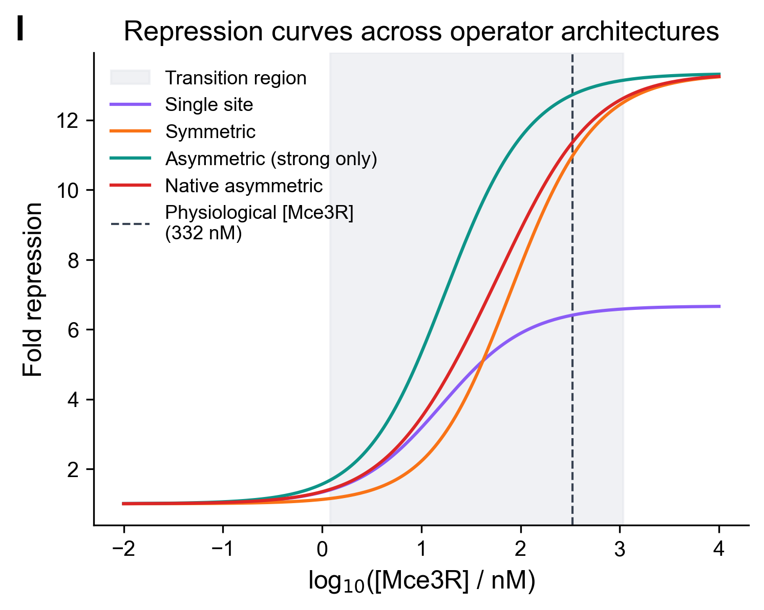
Repression Curves: 4 Architectures
Fold-repression vs [Mce3R] for 4 operator architectures:
1. Native asymmetric (strong + weak) -- broadest transition
2. Symmetric (two strong sites)
3. Strong-only (single site)
4. Single-site control
The asymmetric architecture produces a GRADED response with more intermediate states.
This is key to noise-driven phenotypic variation.

Slide 10
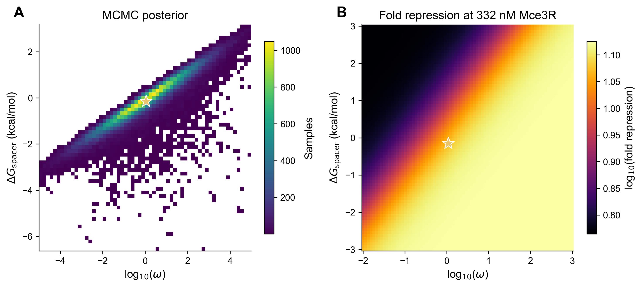
Cooperativity Posterior Distribution
2D histogram of the MCMC posterior for ln(omega) and Delta-G_spacer.
Plus: repression landscape showing how fold-repression depends on these parameters.
The posterior is broad, indicating the data is compatible with a wide range of cooperativity values.
The median sits near omega = 1 (independent binding).

Slide 11
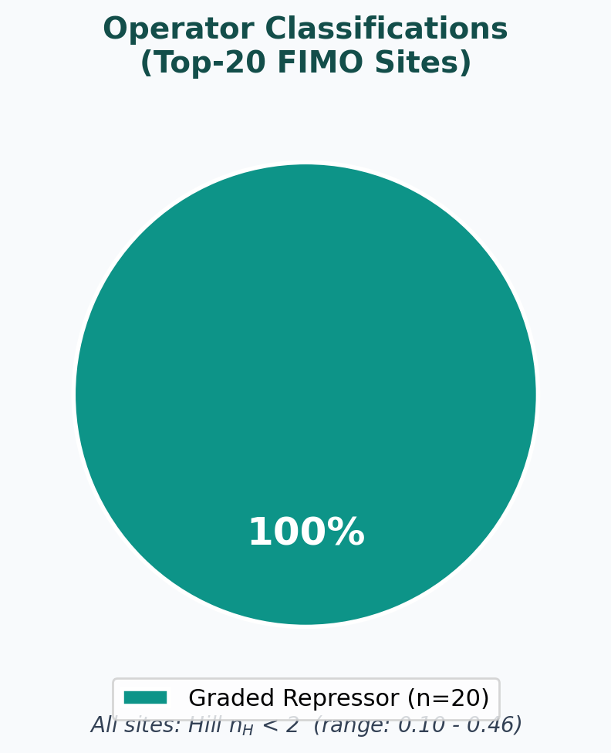
Operator Classification: All Graded
All 20 top FIMO-predicted Mce3R binding sites classify as GRADED REPRESSORS.
Classification criterion: Hill coefficient n_H < 2
Zero sites classified as digital switches (n_H >= 2).
This is a strong, unanimous result: Mce3R acts as a continuous tuner of gene expression across the genome.
Consistent with the role of a metabolic regulator (not a developmental switch).

Slide 12
Graded vs. Digital Repression
Graded Repressor (n_H < 2)
Digital Switch (n_H >= 2)
Continuous tuner of gene expression
Smooth transition from ON to OFF
Many intermediate expression levels accessible
Response spread over wide concentration range
Analogy: a dimmer switch for lights
Mce3R is this type of regulator.
ON/OFF binary switch
Sharp transition at threshold concentration
Few intermediate states
Bistable behavior possible
Analogy: a light switch (on or off)
NOT what Mce3R does.
This distinction matters: graded regulation enables metabolic adaptation, not bistable switching.

Slide 13
Hill Coefficient Analysis
Rank | Nearest Gene | n_H | K_half (nM) | Fold Max | Classification
1 | Rv1964 | 0.100 | 775351 | 35.8 | graded repressor
2 | Rv1964 | 0.100 | 866265 | 5.3 | graded repressor
3 | Rv1962A | 0.100 | 866265 | 5.3 | graded repressor
4 | Rv0304c | 0.100 | 866265 | 5.3 | graded repressor
5 | Rv0251c | 0.100 | 866265 | 5.3 | graded repressor
6 | Rv2378c | 0.100 | 866265 | 5.3 | graded repressor
7 | Rv0412c | 0.175 | 82 | 20.3 | graded repressor
8 | Rv1393c | 0.222 | 16 | 17.4 | graded repressor
9 | Rv0603 | 0.100 | 866265 | 5.3 | graded repressor
10 | Rv2476c | 0.100 | 866265 | 5.3 | graded repressor
All Hill coefficients < 2: every predicted Mce3R target acts as a graded repressor.

Slide 14
MCMC Convergence Diagnostics
Convergence Metrics
R-hat (ln omega) = 1.0079
< 1.01 threshold: PASSED
R-hat (Delta-G_spacer) = 1.0085
< 1.01 threshold: PASSED
Acceptance fraction = 0.7044
Ideal range 0.2-0.8: PASSED
Walkers = 32, Steps = 5,000, Burn-in = 1,000
[Mce3R] for fitting = 332.0 nM

Slide 15
Phase 5 Output Files
energy_parameters.json
Calibrated Delta-G values, offsets, Kd predictions, binding sequences
mcmc_summary.json
MCMC posteriors: omega, Delta-G_spacer, convergence diagnostics
mcmc_posteriors.npz
Raw MCMC chain samples (NumPy archive) for downstream analysis
repression_curves.csv
Fold-repression vs [Mce3R] for 4 operator architectures (200 concentrations each)
operator_classifications.csv
Hill analysis of top-20 FIMO sites: n_H, K_half, classification
phase5_summary.json
Phase metadata: timing, sanity checks (9/9 passed), scientific predictions

Slide 16
What Phase 5 Feeds Into: Phase 6
Phase 6 (Environmental Response Simulations) uses calibrated Delta-G values and omega approx. 1:
1. Calibrated Delta-G_strong and Delta-G_weak set the binding/unbinding rates in the Gillespie simulator.
2. omega approx. 1 means the two-site model simplifies: no strong cooperative effects to model.
3. Repression curves inform which Mce3R concentrations cause derepression of the mce3 operon.
4. The graded (not digital) classification means Phase 6 should expect continuous, noise-sensitive
gene expression responses -- not bistable switches.
5. The wide cooperativity posterior is propagated as uncertainty into Phase 6 predictions.

Slide 17
Key Insight
The asymmetric operator is a continuous noise generator, not a switch.
This is functionally important: persistence arises from stochastic fluctuation in a graded system, not from deterministic bistable switching.

Slide 18
Berg-von Hippel model converts PWM scores to binding free energies (Delta-G).
Energy calibration: Kd_strong = 2.4 nM, Kd_weak = 49.0 nM reproduced exactly.
4-state partition function models operator occupancy as function of [Mce3R].
MCMC inference: omega = 1.083 [CI: 0.20-5.89], near-independent binding.
All 20 predicted Mce3R targets are graded repressors (Hill n_H < 2).
The asymmetric operator enables noise-driven phenotypic variation, not bistable switching.
9/9 sanity checks passed. 0 failures.
Phase 5 Summary

