Slide 1
Phase 7: Extended Figures
ENIGMA Project — Visualizing Phases 5–6
ENIGMA Project | Mce3R Stochastic Gene Regulation

Slide 2
Extended Figure Overview
Fig 9 — Repression Curves: Fold-repression vs [Mce3R] for 4 operator architectures
Fig 10 — Cooperativity Analysis: MCMC posteriors + repression landscape heatmap
Fig 11 — Environmental Distributions: 3×4 grid of histograms across architectures and environments
Fig 12 — Mutual Information: MI (bits) vs concentration for 3 architectures
Fig 13 — Persistence Phase Diagram: Heatmap of persister fractions vs asymmetry ratio and environment
Fig 14 — Two-Species Traces: Mce3R + target protein dynamics with operator state coloring
ENIGMA Project

Slide 3
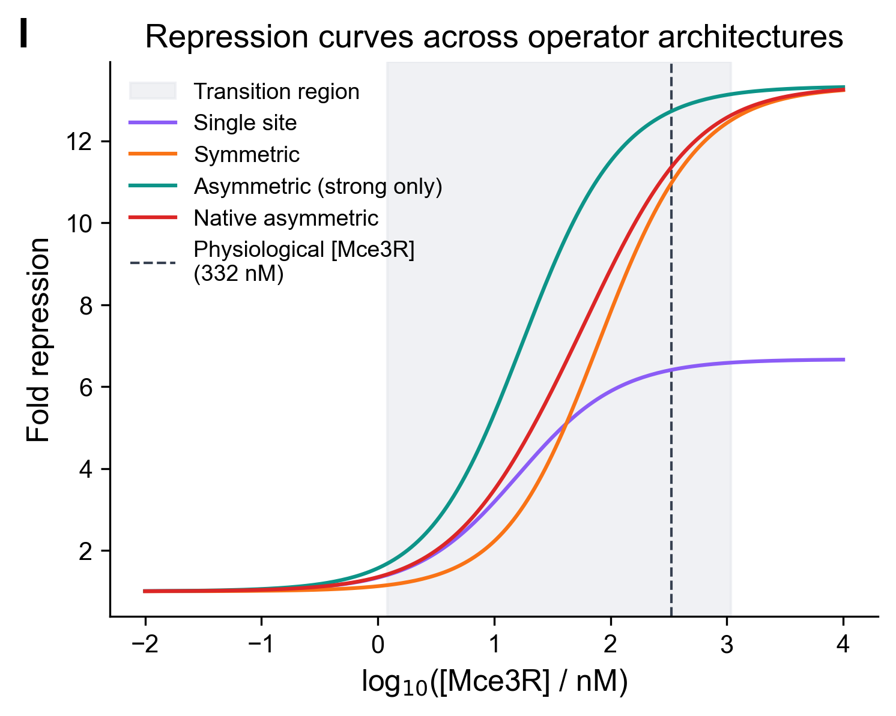
Figure 9: Repression Curves
Fold-repression vs [Mce3R] concentration for asymmetric, symmetric, single-site, and unregulated architectures. Dashed line marks physiological concentration.
ENIGMA Project

Slide 4
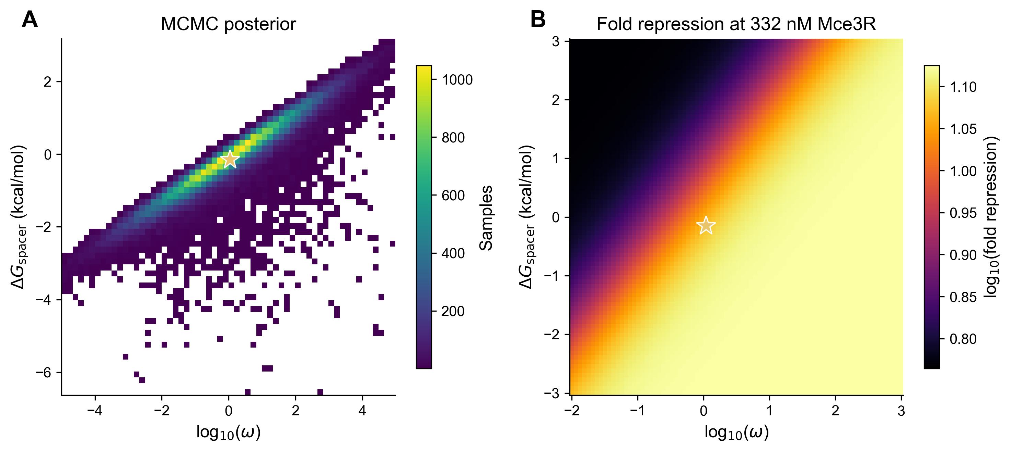
Figure 10: Cooperativity Analysis
Panel A: 2D histogram of MCMC posteriors for log10(ω) and ΔG_spacer. Panel B: Fold repression landscape at 332 nM Mce3R.
ENIGMA Project

Slide 5
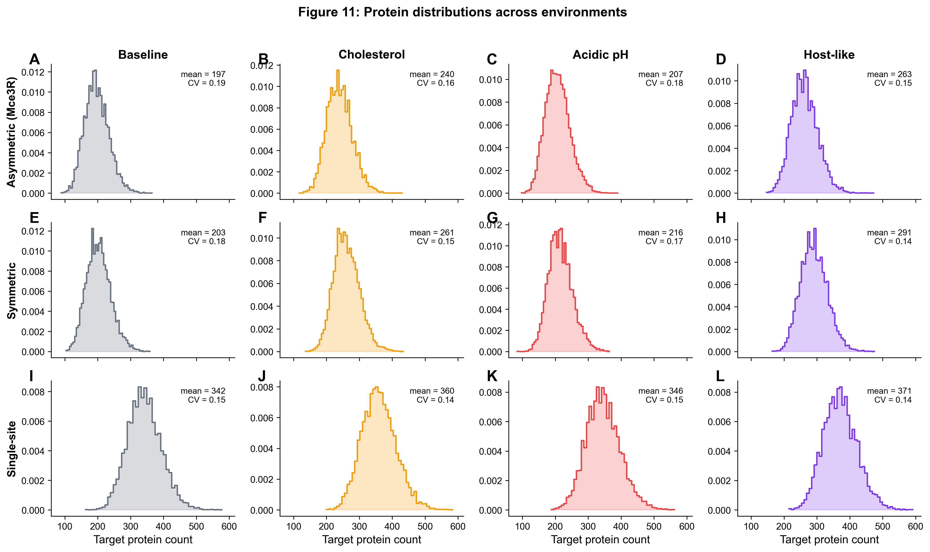
Figure 11: Environmental Distributions
3×4 grid: rows = asymmetric / symmetric / single-site; columns = baseline / cholesterol / acidic pH / host-like. Shows how environment reshapes noise.
ENIGMA Project

Slide 6
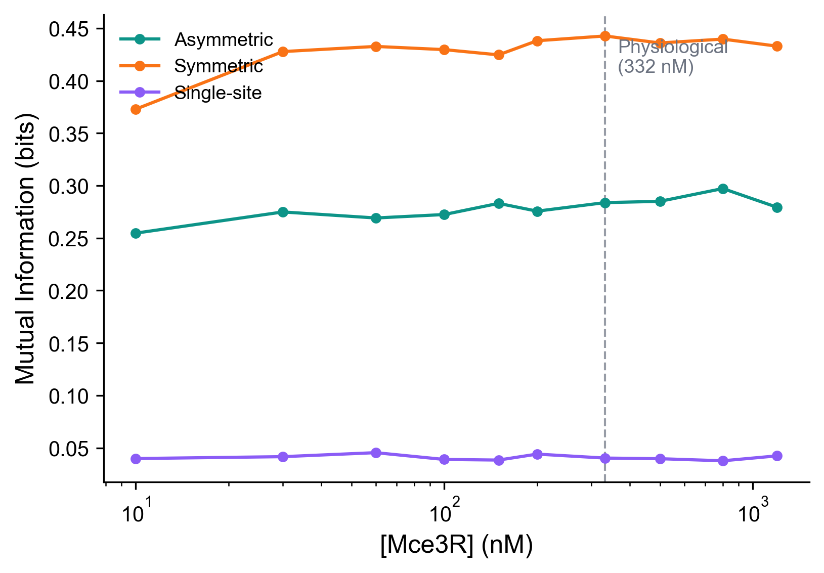
Figure 12: Mutual Information
Mutual information (bits) vs [Mce3R] for 3 promoter architectures. Vertical dashed line at physiological 332 nM.
ENIGMA Project

Slide 7
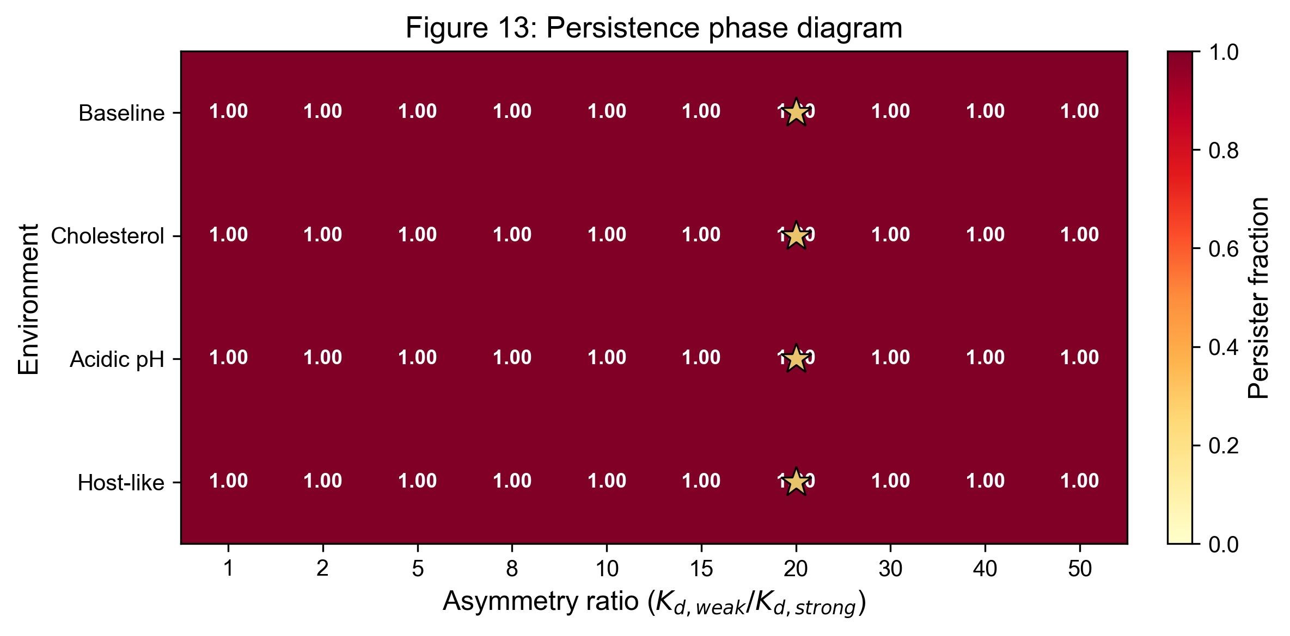
Figure 13: Persistence Phase Diagram
Heatmap: persister fraction vs asymmetry ratio (X) and environment (Y). Star marks the native Mce3R operator position (ratio ~20.4).
ENIGMA Project

Slide 8
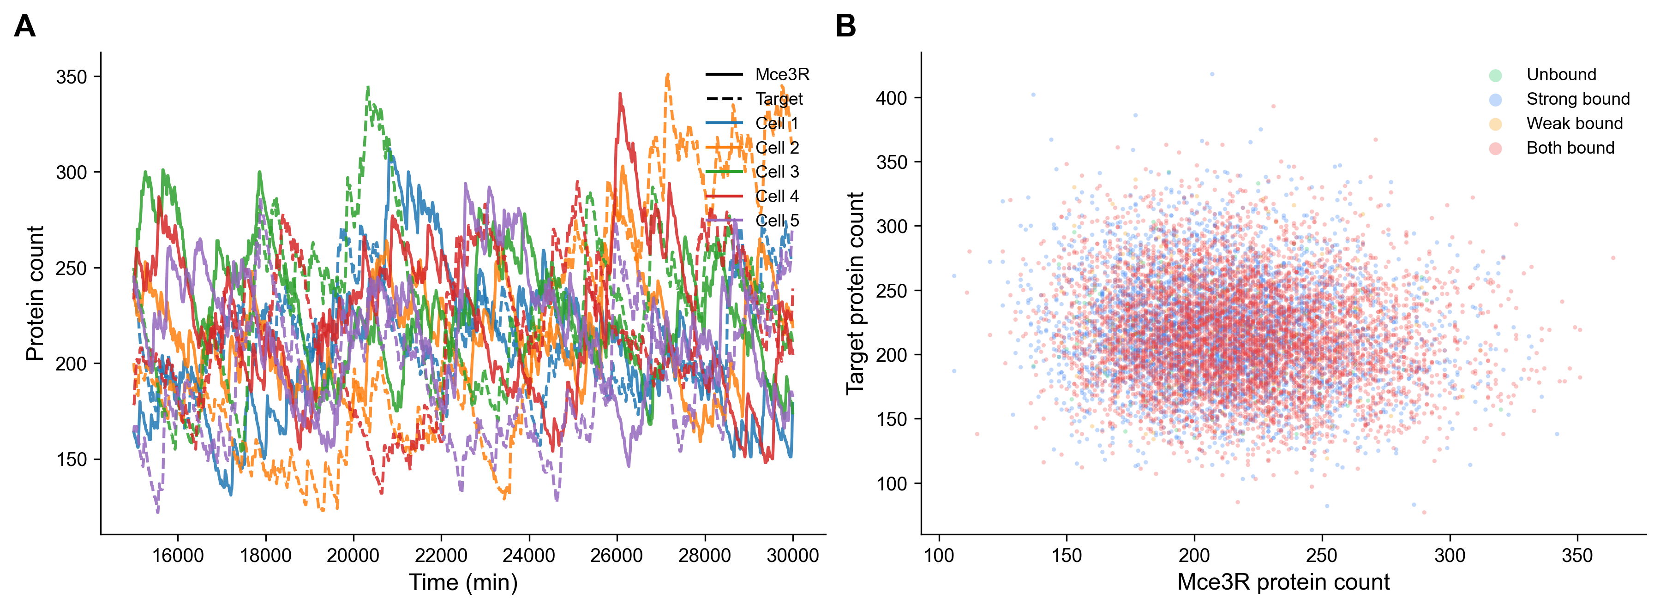
Figure 14: Two-Species Traces
Panel A: Time traces of Mce3R (blue) and target protein (orange) for 5 cells. Panel B: Scatter of Mce3R vs target colored by operator state.
ENIGMA Project

Slide 9
The Extended Story
Thermodynamic foundations (Figs 9–10): Repression curves establish the dose-response, while MCMC posteriors quantify cooperativity between binding sites
Environmental modulation (Figs 11–12): Protein distributions shift dramatically across environments; mutual information reveals which architectures transmit the most signal
Persistence implications (Figs 13–14): Phase diagram maps the landscape of persister fractions; two-species traces show how regulator-target dynamics co-evolve
Narrative arc: From equilibrium thermodynamics through stochastic environments to clinically relevant persistence phenotypes
ENIGMA Project

Slide 10
Phase 7 Summary
6 extended figures visualizing the results of Phases 5–6. Figures 9–10: Thermodynamic repression and cooperativity Figures 11–12: Environmental noise and information theory Figures 13–14: Persistence phenotypes and two-species dynamics Together with the 8 manuscript figures from Phase 4, these 14 figures form a complete visual narrative of Mce3R stochastic gene regulation in M. tuberculosis.
ENIGMA Project | Mce3R Stochastic Gene Regulation

