Slide 1
Finding Mce3R Binding Sites
Identifying where the Mce3R repressor binds across M. tuberculosis
Aayan Alwani

Slide 2
Background
— Mce3R (Rv1963c) is a TetR-family transcriptional repressor in M. tuberculosis H37Rv
— Panagoda 2024 (PDB 9B7Y) solved its structure — the binding site is unusually asymmetric
— Strong half-site: Kd = 2.4 nM
— Weak half-site: Kd = 49.0 nM
— 20.4-fold affinity difference
— To study how architecture affects regulation, we need to find every binding site

Slide 3
A five-step computational pipeline
— 1 · download_genomes.py → retrieve 3 reference genomes
— 2 · extract_upstream.py → extract 200 bp upstream of each gene
— 3 · run_meme.py → discover binding motif
— 4 · run_fimo.py → scan genome for matches
— 5 · conservation_check.py → validate across species

Slide 4
Step 1 — Download reference genomes
phase1_pipeline/download_genomes.py
— NCBI Entrez download
— H37Rv + M. bovis + M. marinum
— FASTA + GenBank + GFF3 per species
— Three species enables cross-species validation

Slide 5
Step 2 — Extract regulatory regions
phase1_pipeline/extract_upstream.py
— ~4,000 protein-coding genes parsed from GFF3
— 200 bp upstream extracted per gene
— Strand-aware, circular-genome-aware
— Five specific intergenic regions also extracted (Kabir 2021 protocol)

Slide 6
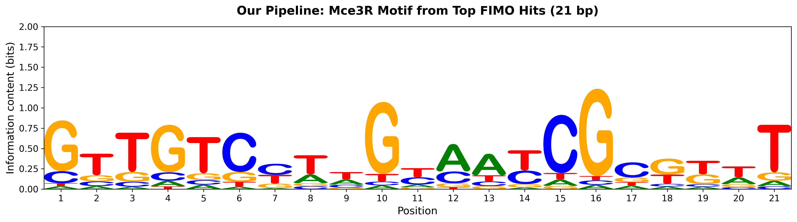
Step 3 — Discover the binding motif
phase1_pipeline/run_meme.py
— MEME Suite (Bailey 2009)
— Run on 3 yrbE3A ortholog sequences
— ZOOPS mode, widths 20–30 bp, both strands
— No palindrome constraint — Mce3R binds asymmetrically

Slide 7
Step 4 — Scan the genome (FIMO)
— 1,442 candidate binding sites identified
— Top 2 hits match the cryo-EM binding sites at yrbE3A (Panagoda 2024)
Rank | Gene | p-value | Score
1 | Rv1964 (yrbE3A) | 1.1e-11 | 34.9
2 | Rv1964 (yrbE3A) | 3.1e-11 | 33.2
3 | Rv1962A (vapB35) | 4.8e-11 | 32.6
4 | Rv0304c (PPE5) | 1.5e-07 | 15.8
5 | Rv0251c (hsp) | 3.0e-07 | 14.8
6 | Rv2378c (mbtG) | 3.4e-07 | 14.8
7 | Rv0412c | 3.5e-07 | 11.9
8 | Rv1393c | 3.5e-07 | 11.9

Slide 8
Step 5 — Conservation across species
phase1_pipeline/conservation_check.py
— Top 50 sites checked in M. bovis and M. marinum
— 50 / 50 conserved in M. bovis
— 44 / 50 conserved in both species
— Conservation across divergent species supports biological function

Slide 9
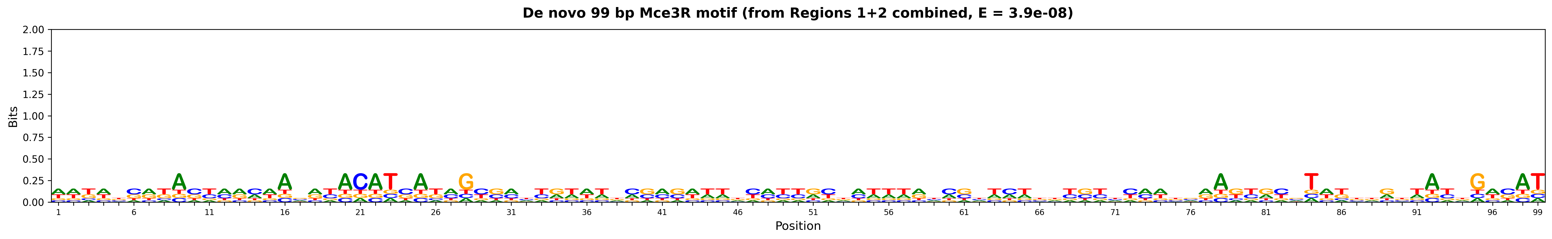
Extended MEME recovers a longer 99 bp motif
— Per Dr. Balázsi: the Panagoda 2024 123 bp operator is not the only gold standard
— Re-ran MEME on Regions 1 + 2 combined with -maxw 120 -mod anr (Eram Kabir 2021 protocol)
— Result: a 99 bp motif, E = 3.9 × 10⁻⁸ — ~4 orders of magnitude better than Eram’s best (E = 2.8 × 10⁻⁴)
— Eram’s 49 bp motif is contained within the 99 bp motif at 100% identity
— Three sites: two in Region 1 (mce3R–yrbE3A), one in Region 2 (echA13–Rv1936)

Slide 10
A second regulatory region confirmed
Region 2 · echA13 (Rv1935c) – Rv1936 · 224 bp
— Original 21 bp FIMO scan missed it (1 weak hit, rank 1422)
— The extended 99 bp MEME search found a strong hit in Region 2
— First computational recovery of this region with a matching motif
Region | Position | Strand | p-value | Eram 49 bp
1 | 684 | + | 1.6e-45 | 100% identity
1 | 238 | + | 2.3e-44 | 73% identity
2 | 62 | − | 4.2e-45 | 67% identity

Slide 11
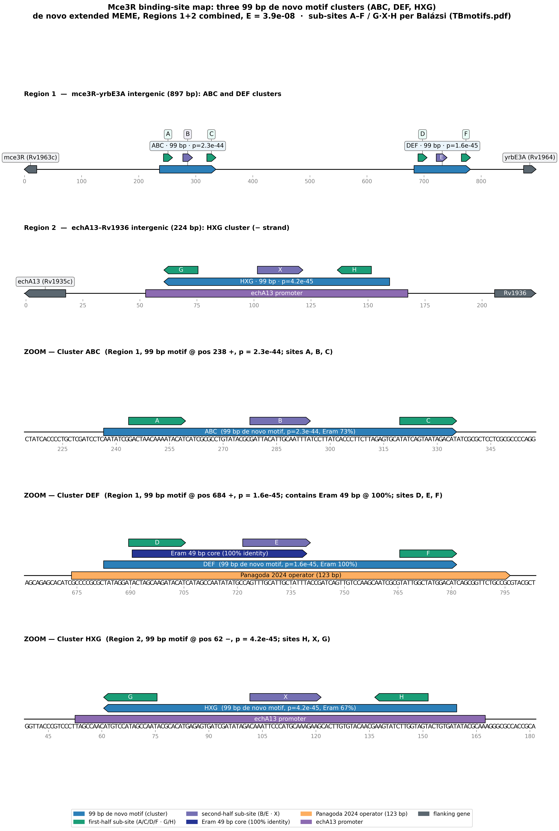
Three 99 bp motif clusters — ABC, DEF, HXG
— The 99 bp motif occurs three times; each occurrence is one of three suspected binding clusters in Dr. Balázsi’s annotated schematic (TBmotifs.pdf)
— ABC mce3R–yrbE3A, proximal (near mce3R): 99 bp at position 238 (+), p = 2.3 × 10⁻⁴⁴; sub-sites A, B, C
— DEF mce3R–yrbE3A, distal (near yrbE3A): 99 bp at position 684 (+), p = 1.6 × 10⁻⁴⁵; contains the 49 bp core at 100% identity; sites D, E, F
— HXG echA13–Rv1936, minus strand: 99 bp at position 62 (−), p = 4.2 × 10⁻⁴⁵; sub-sites H, X, G
— Every sub-site core matches a published instance exactly (0 mismatches); equivalence A = C = D = F = rcH = rcG and B = D = X

Slide 12
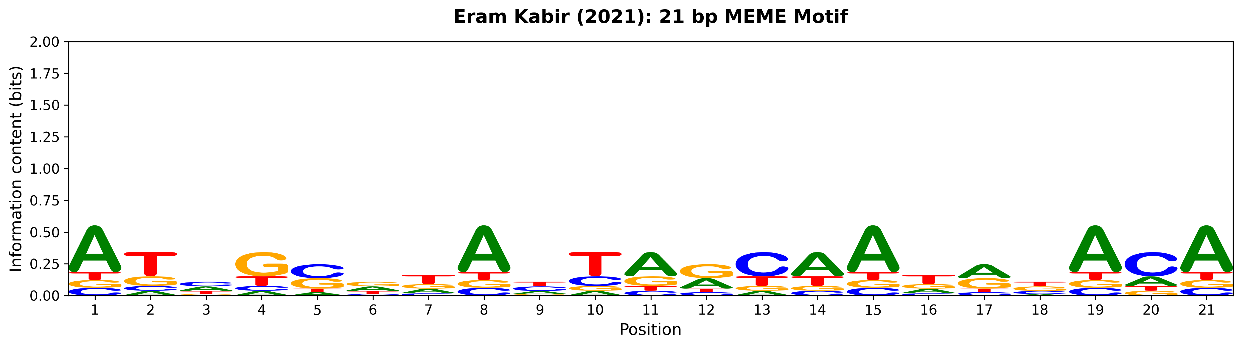
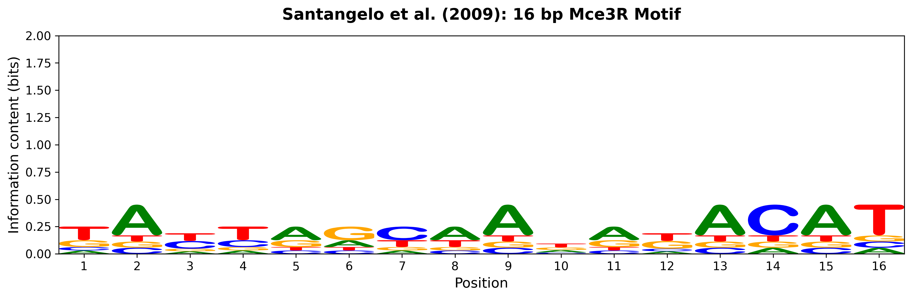
Multiple independent analyses converge on the same region

Slide 13
Novel candidates & what’s next
— Rank 3 — Rv1962A (vapB35): adjacent toxin–antitoxin locus
— Rank 4 — Rv0304c (PPE5): PE/PPE family
— Rank 6 — Rv2378c (mbtG): mycobactin biosynthesis
— Rank 38 — Rv1963c: the mce3R gene itself (autoregulation)
Next steps
— Apply the 99 bp PWM genome-wide via FIMO for a broader search
— Examine the remaining three intergenic regions (3, 4, 5)
— Cross-validate novel candidates with published ChIP-seq data

