Slide 1
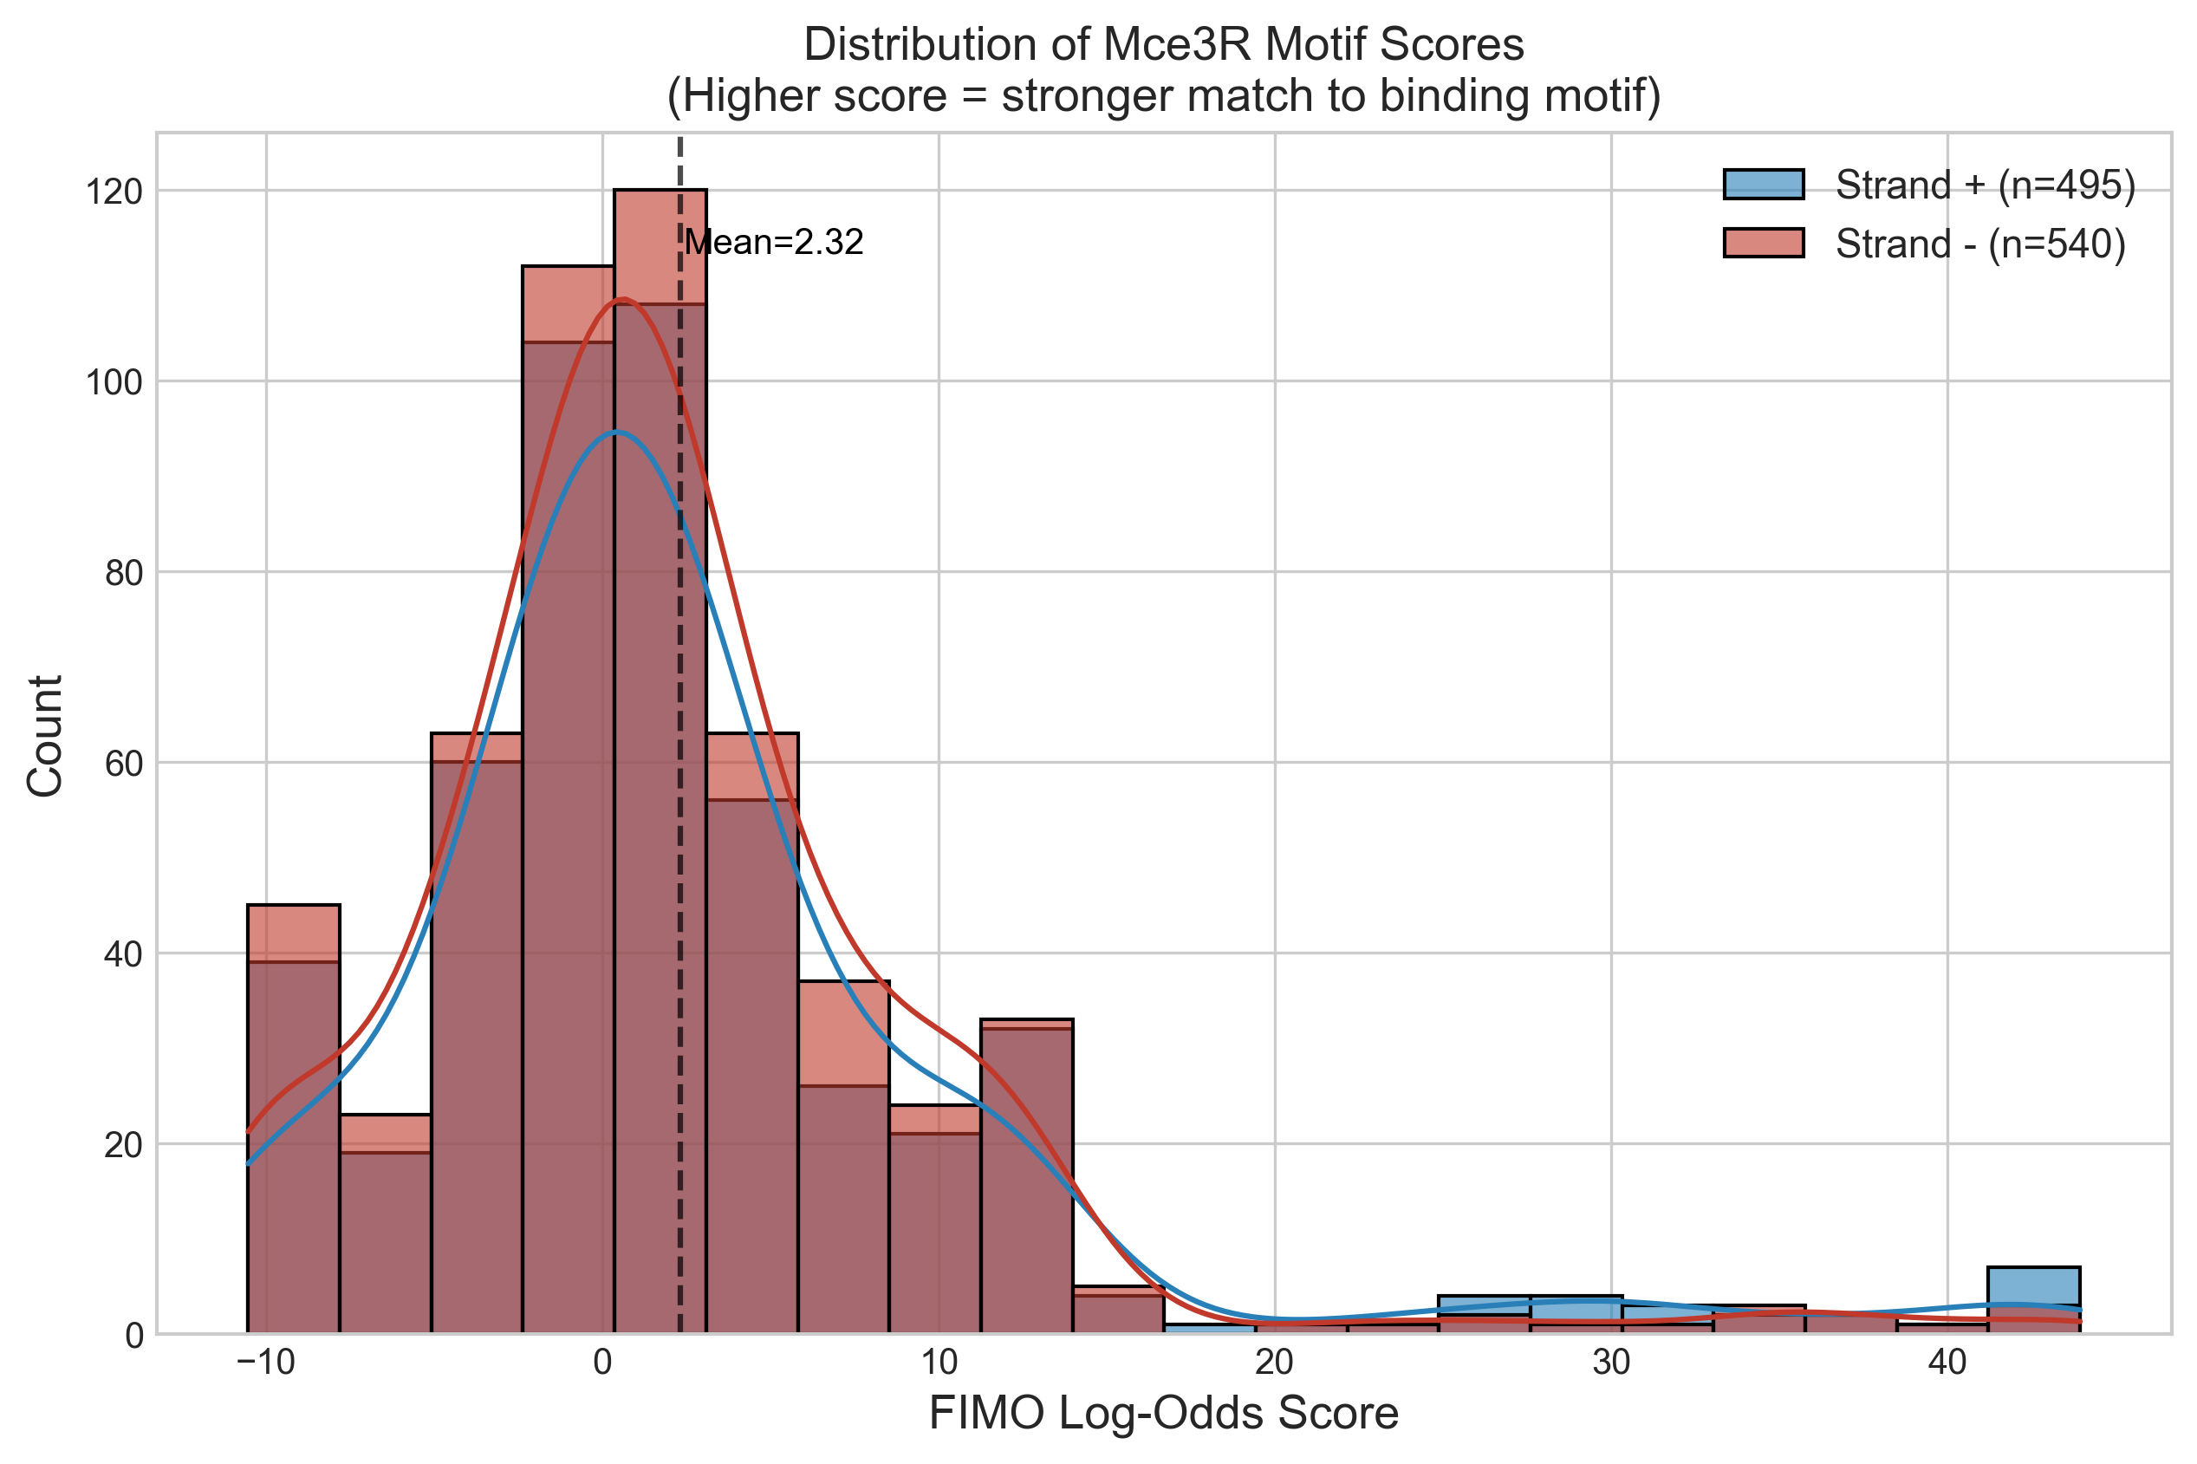
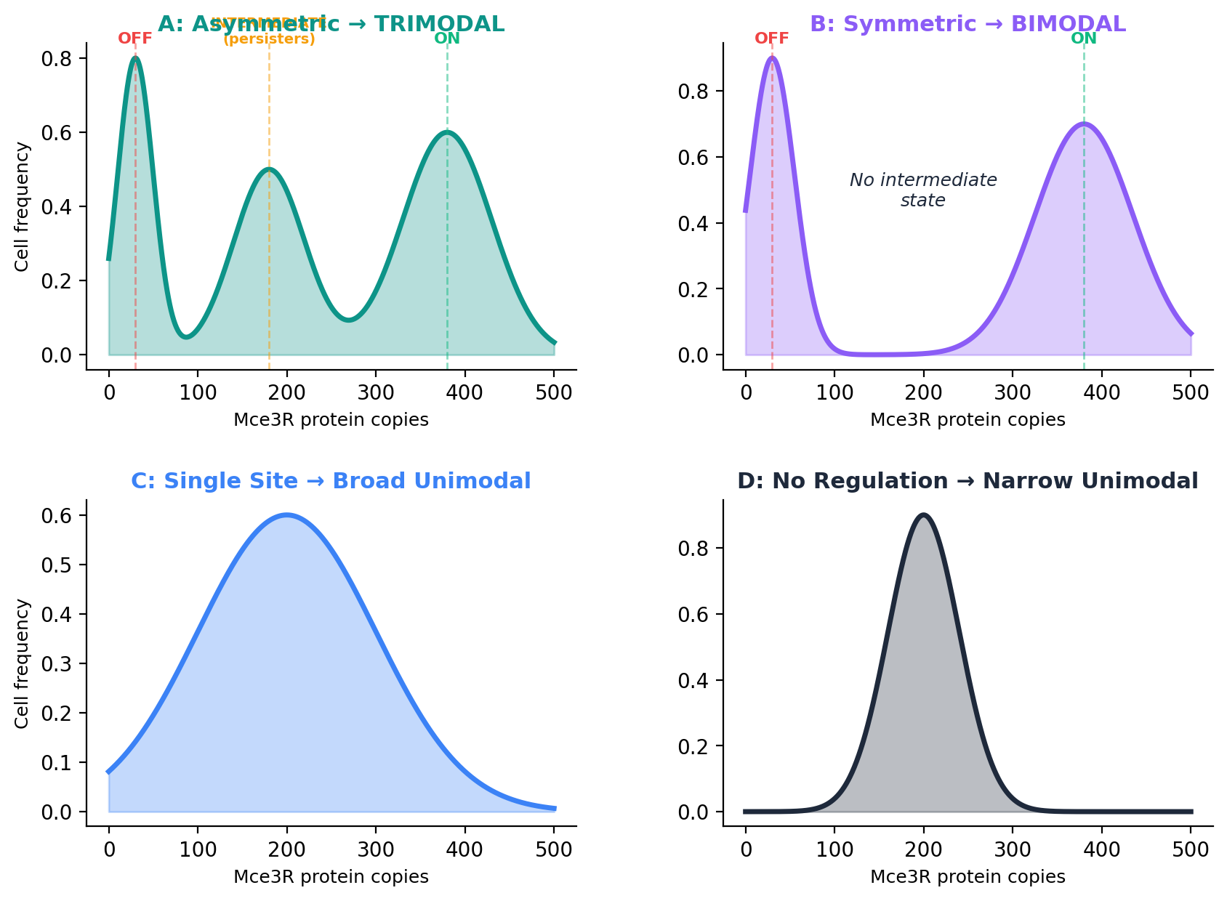
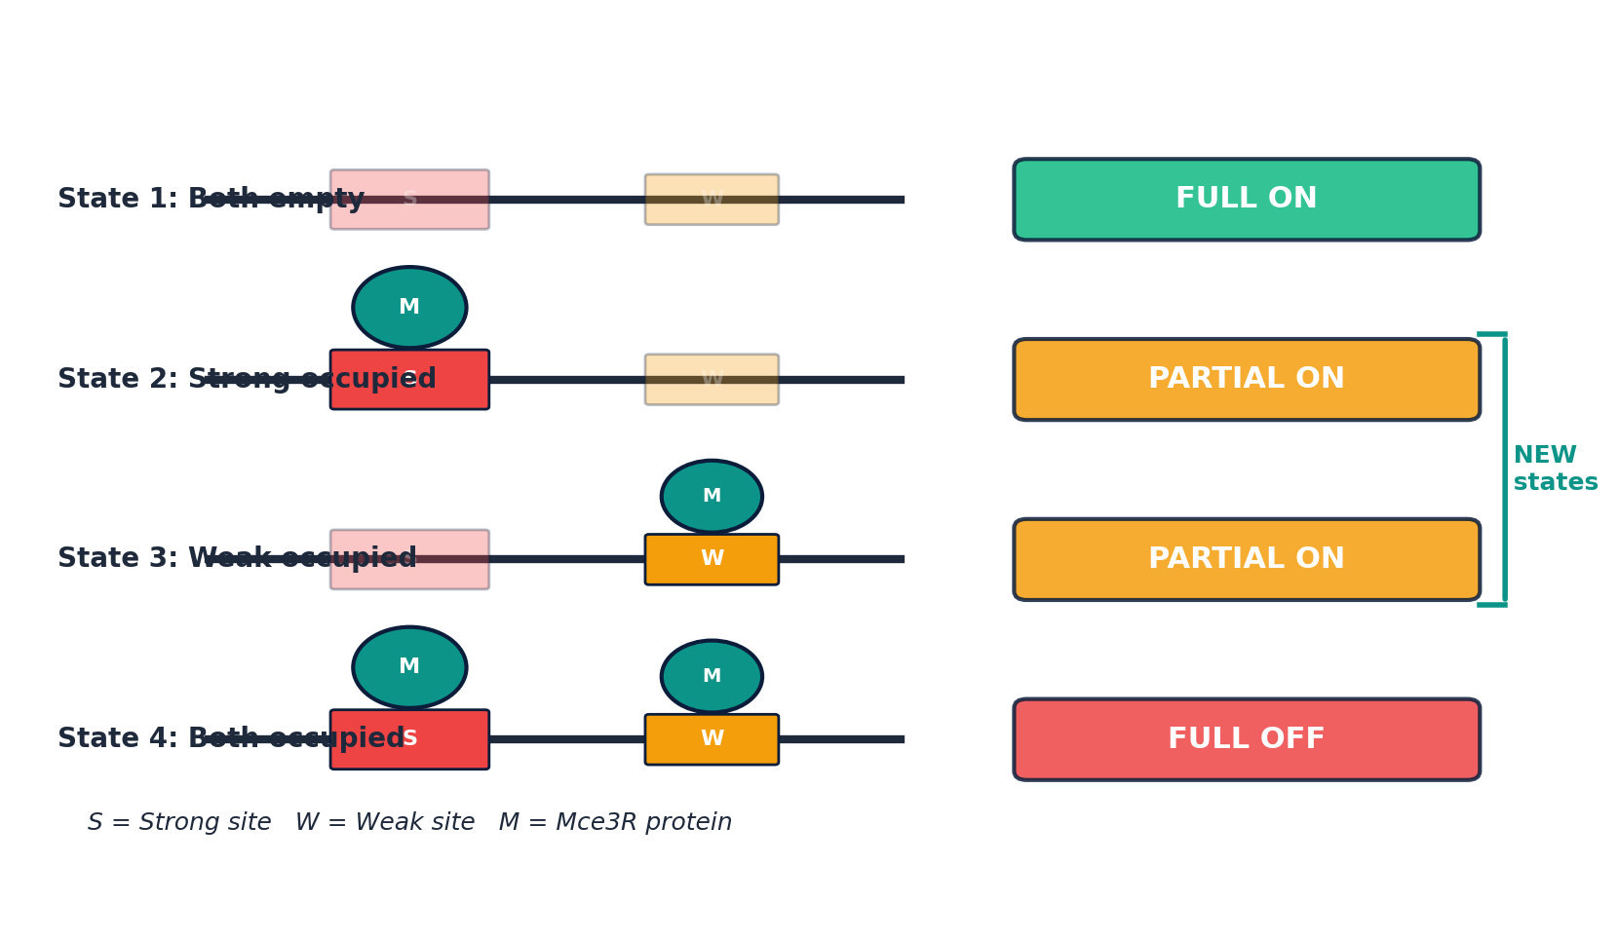
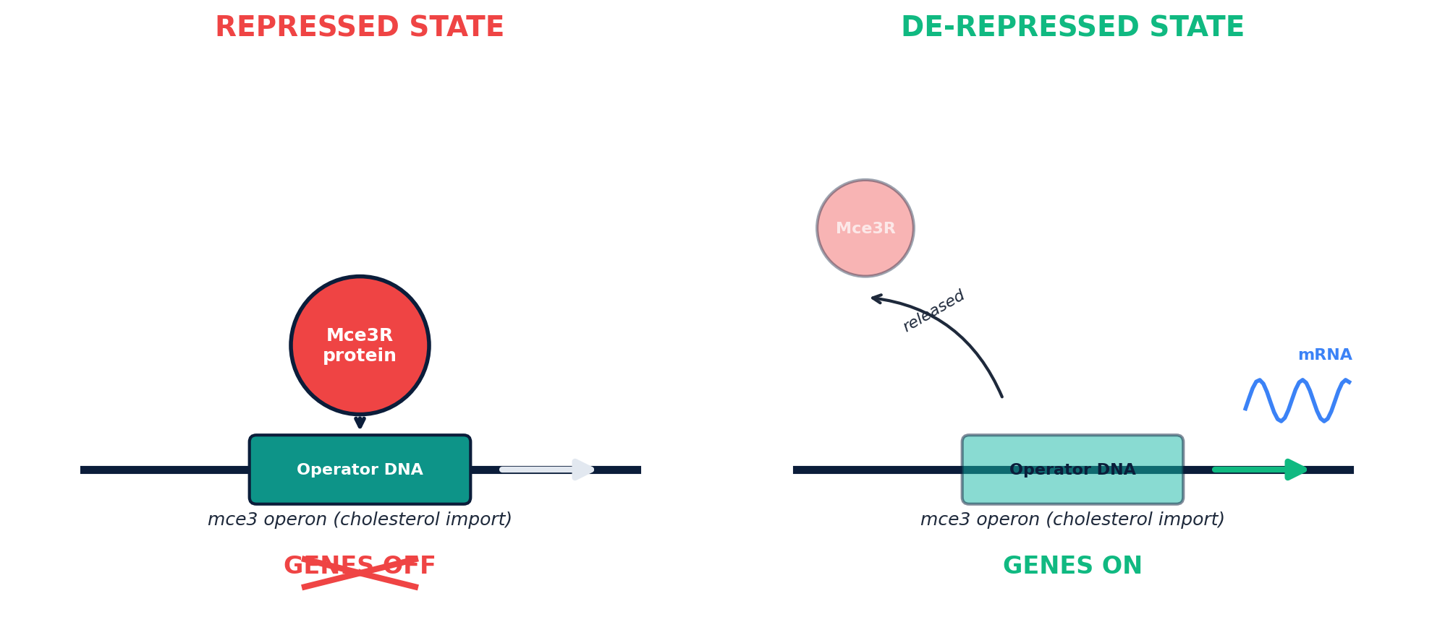
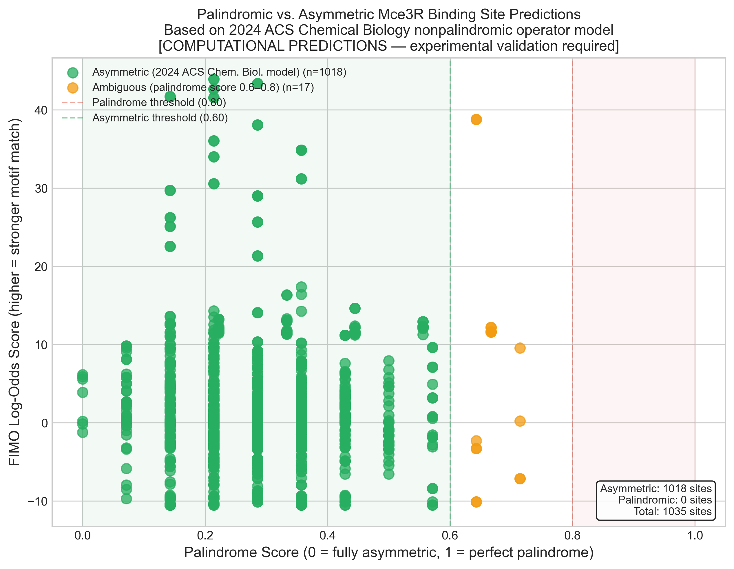
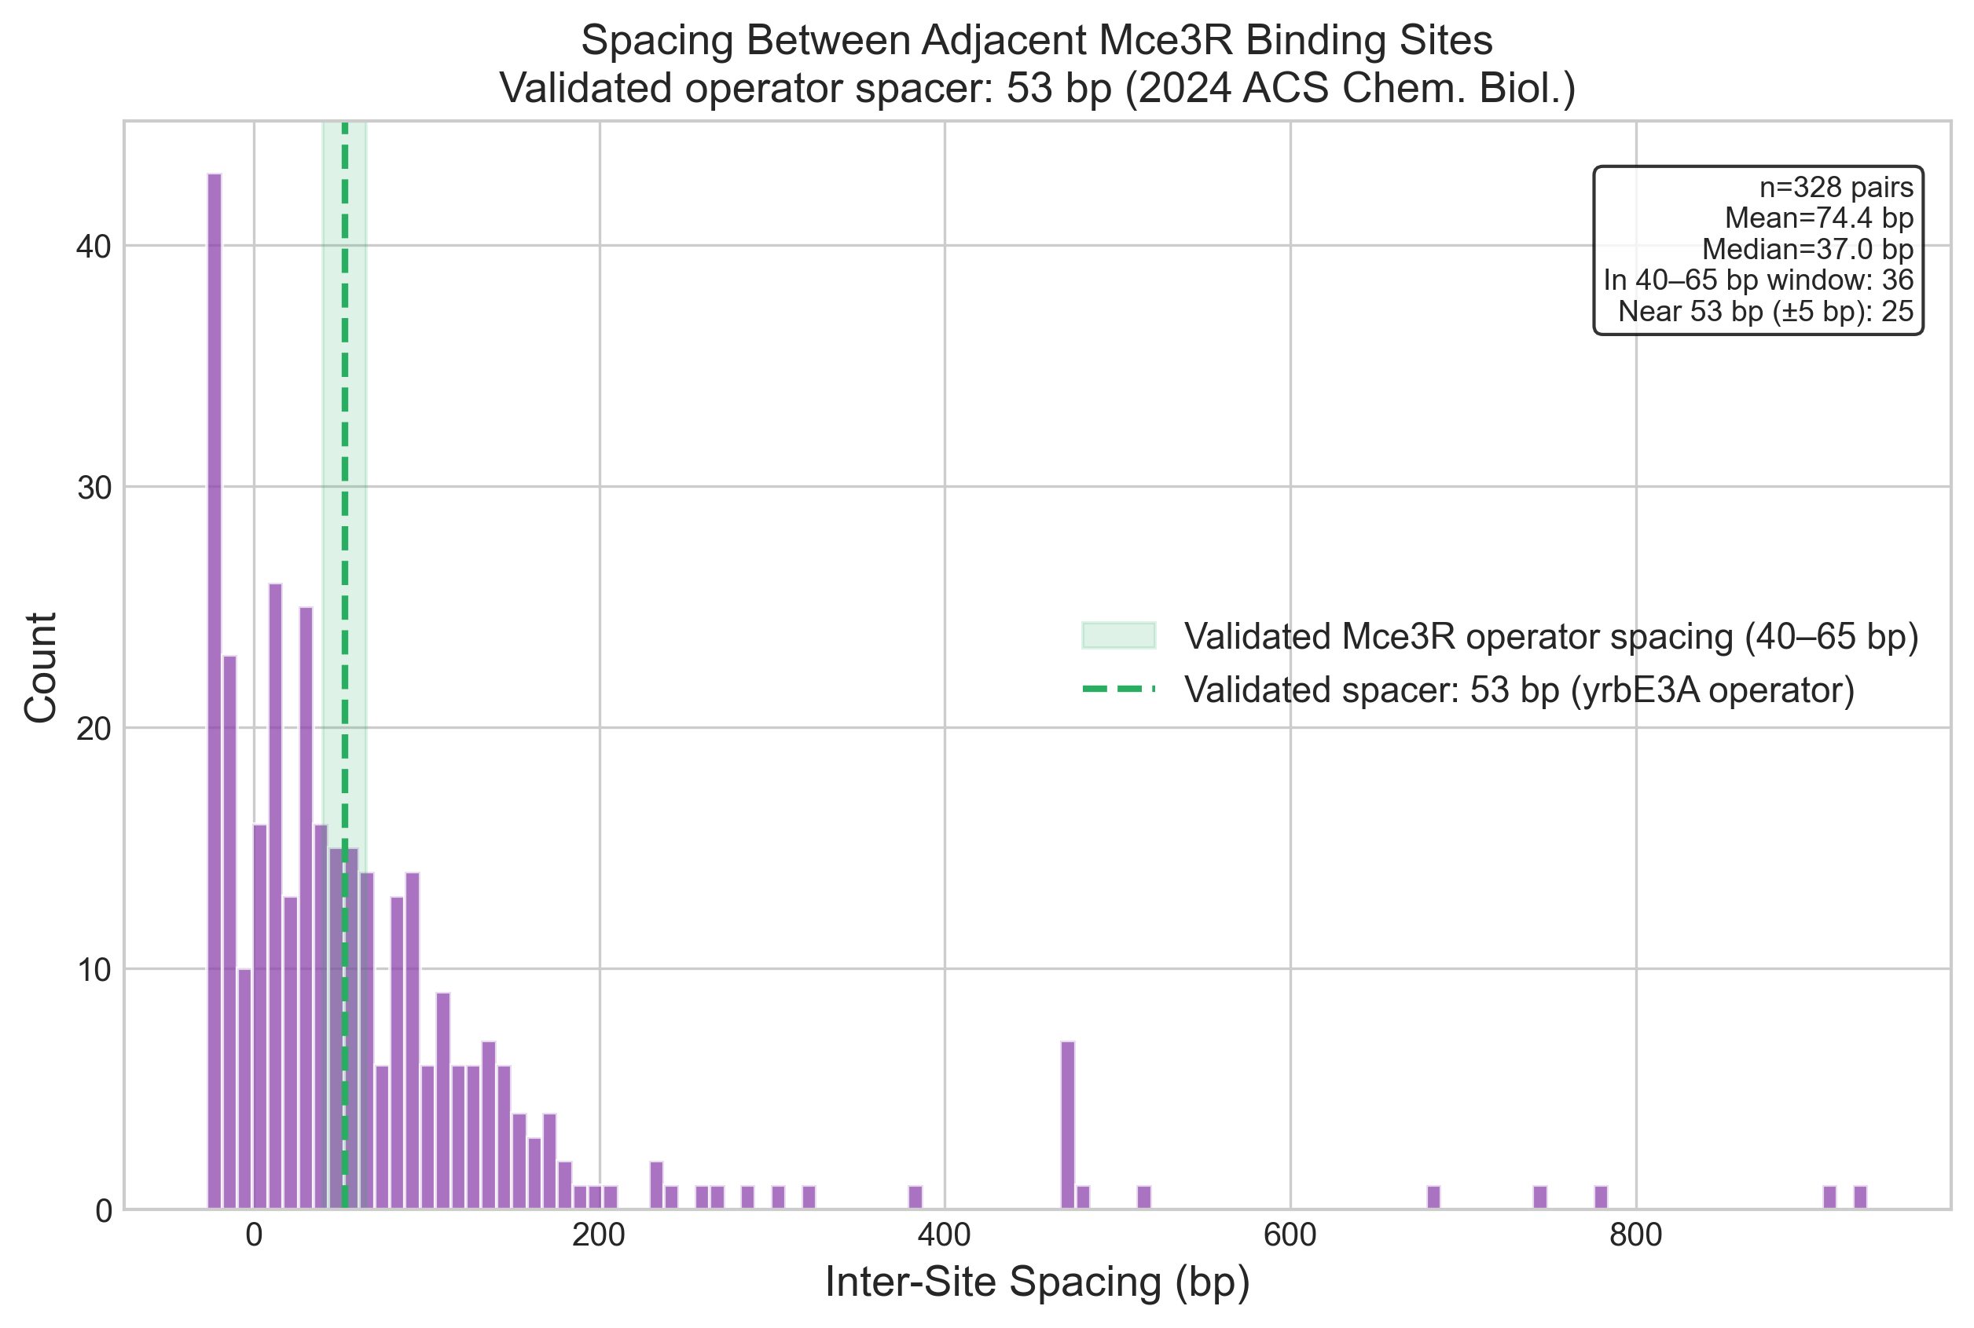
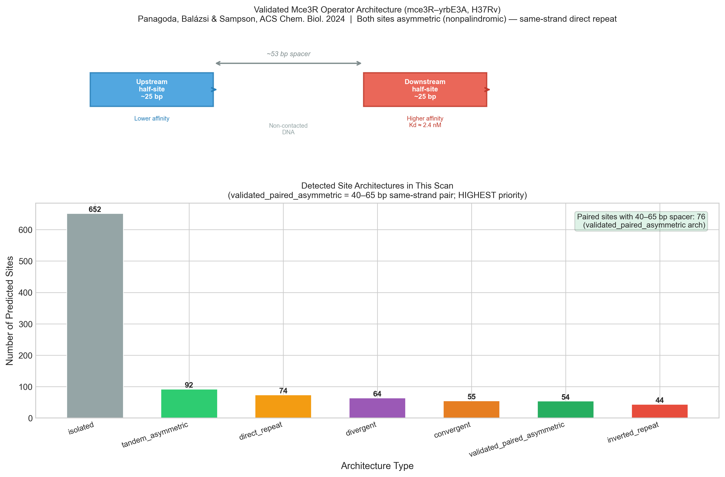
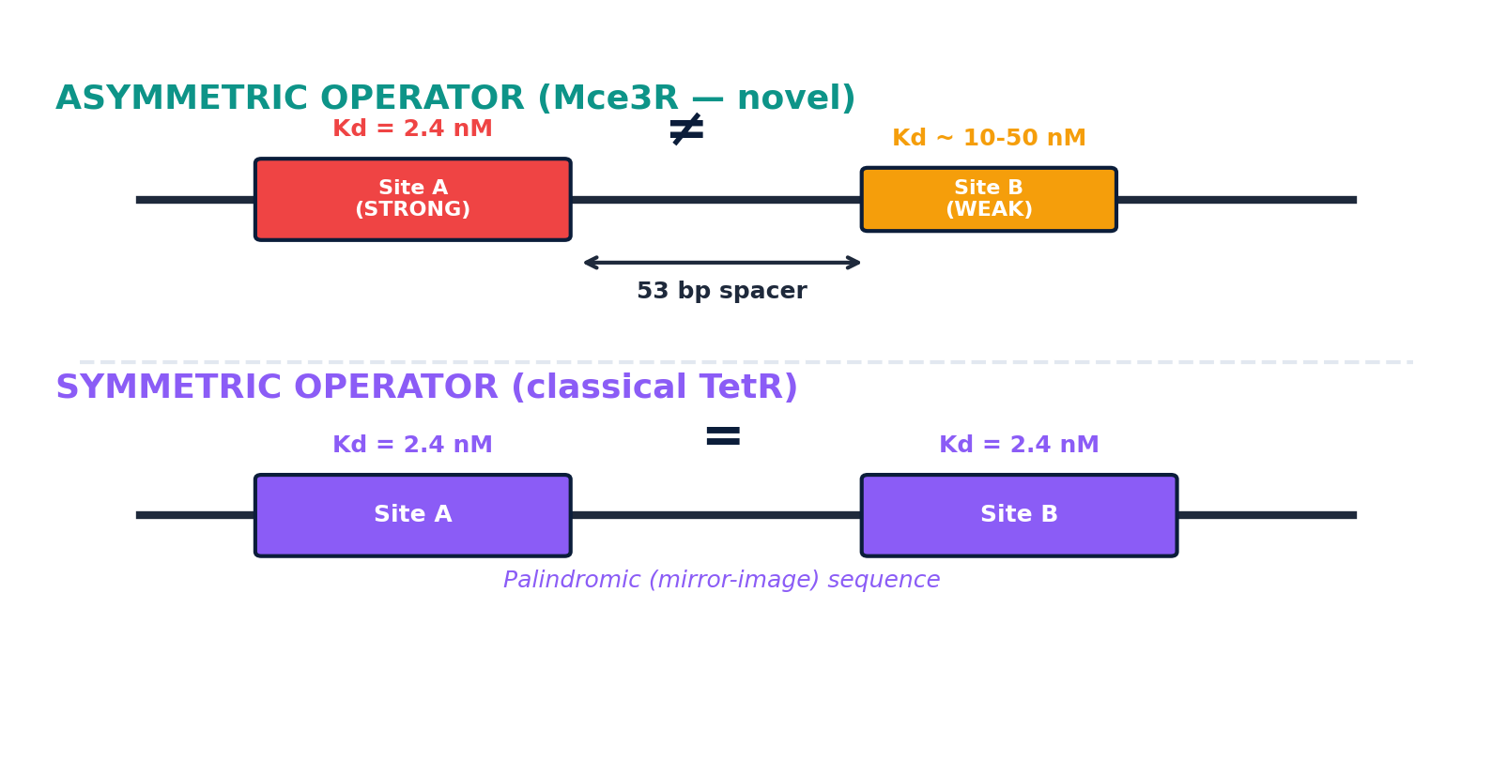
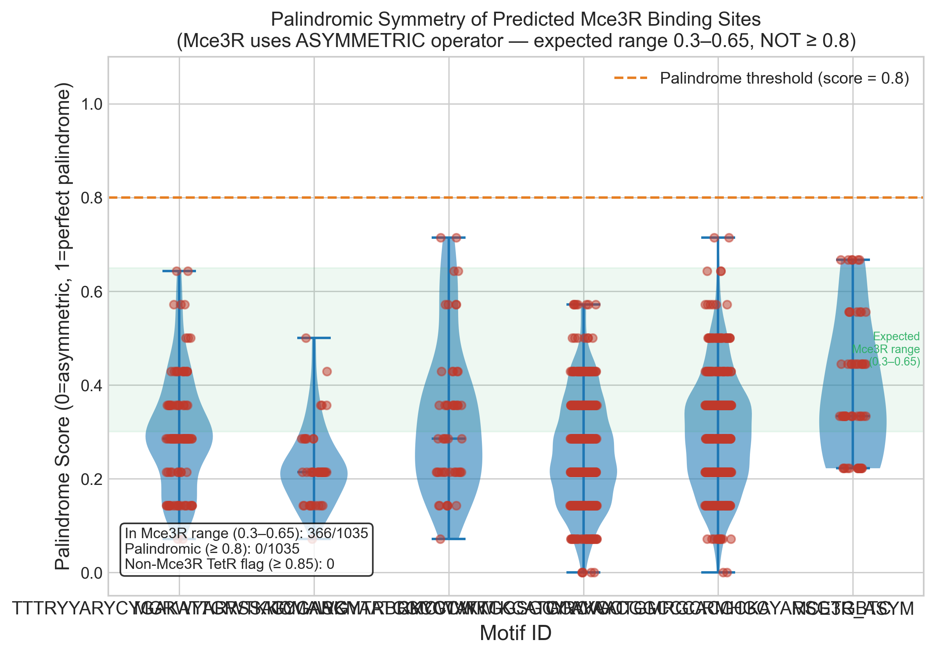
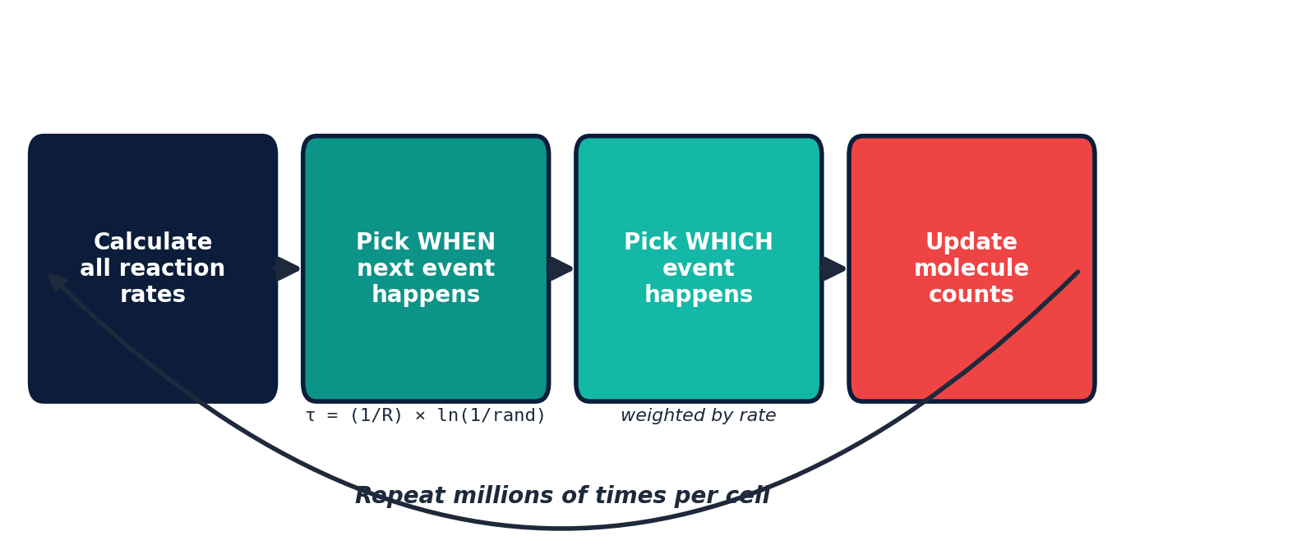
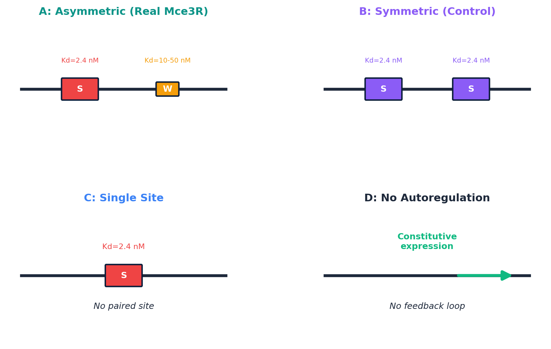
Stochastic Gene Expression Noise in the Mce3R Autoregulatory Circuit as a Driver of Antibiotic Persistence in Mycobacterium tuberculosis
Aayan Alwani
Great Neck South High School, Great Neck, NY
BACKGROUND
COMPUTATIONAL PIPELINE (AIM 1 — COMPLETED)
KEY FINDING
TB kills 1.3 million people/year (WHO 2024)
Treatment: 6-9 months due to persister cells
Persisters survive antibiotics without resistance mutations
Caused by random gene expression noise
Mce3R: TetR-family repressor of cholesterol survival genes
Mce3R deletion increases persister frequency (Srivastava 2023)
Scanned 2,351 promoters across M. tuberculosis H37Rv
MEME Suite: de novo motif discovery with grid-search width optimization (w=20-28)
FIMO: genome-wide scanning with dual motif models (palindromic + asymmetric)
Composite scoring: FIMO + architecture + asymmetry + biological prior
Figure 4. Composite score distribution across 451 predicted binding sites.
PIPELINE RESULTS
451 predicted Mce3R binding sites
6 Tier 1 (known) | 23 Tier 2 (plausible) | 422 Tier 3
Top hit: IGR_Rv1963c_Rv1964 (known operator) — validates pipeline
5 sites with validated paired asymmetric architecture (40-65 bp)
98% of sites prefer asymmetric model over palindromic
Figure 1. Mce3R repression mechanism. Figure created by student author.
Figure 10. Predicted protein distributions. Asymmetric operators produce trimodal distributions; intermediate state = persisters. Figure created by student author.
THE ASYMMETRIC OPERATOR
Asymmetric operator: 3 peaks (OFF / INTERMEDIATE / ON)
Symmetric operator: 2 peaks only (OFF / ON)
The INTERMEDIATE state is the persister subpopulation
Predicted persister fraction (~0.1-1%) matches experiments
2024 cryo-EM at 2.51 A (Panagoda, Balazsi & Sampson)
Two 25 bp non-palindromic half-sites, 53 bp spacer
Downstream: Kd = 2.4 nM (strong); upstream: weaker
First asymmetric operator in TetR family (unprecedented)
Figure 5. 98% of predicted sites prefer the asymmetric binding model.
VALIDATION
Cross-referenced with Santangelo 2009 microarray
Cross-referenced with persister transcriptomics (Keren 2011)
Negative controls PASS: no hits at mce1/mce2/mce4
Pipeline validates: top hit is the known operator
Figure 6. Inter-site spacing. Vertical line = validated 53 bp.
Figure 7. Validated paired asymmetric operator architecture.
STOCHASTIC MODELING (AIM 2)
Gillespie stochastic simulation (SSA) of Mce3R circuit
6 reactions: transcription, translation, mRNA degradation,
protein dilution, Mce3R binding, Mce3R unbinding
Parameters from published data:
Kd = 2.4 nM | mRNA t1/2 = 5 min | doubling = 20 hrs
10,000 virtual cells per condition
Figure 2. Asymmetric vs. symmetric operator architecture. Figure created by student author.
Figure 11. Palindrome score distribution confirms non-palindromic architecture.
HYPOTHESIS
Figure 8. Gillespie algorithm. Figure created by student author.
NOVEL TARGETS DISCOVERED
Asymmetric binding sites create a THREE-STATE gene expression system (OFF / INTERMEDIATE / ON) that generates more persisters than symmetric sites (OFF / ON only)
THE FOUR SIMULATIONS
eccA3
ESX-3 secretion — 54 bp spacing
choD
Cholesterol oxidase — First step in cholesterol degradation
icl1
Isocitrate lyase — Glyoxylate shunt
vapC33
Toxin-antitoxin — Directly linked to persistence
CONCLUSIONS
Asymmetric operator architecture produces trimodal noise (novel)
Intermediate expression state is a "persistence dimmer switch"
Mce3R regulates a broader network than previously known
DNA binding site shape controls persister frequency
FUTURE DIRECTIONS
Figure 9. Four operator architectures tested. Figure created by student author.
Experimental: EMSA on top targets in M. smegmatis
Flow cytometry: measure noise with fluorescent reporters
Therapeutic: design noise suppressors to reduce persisters
Figure 3. Four operator microstates. Intermediate states (2,3) only exist because sites have different strengths. Figure created by student author.
ACKNOWLEDGMENTS
Dr. Gabor Balazsi, Stony Brook University
Dr. Nicole S. Sampson, University of Rochester
Great Neck South High School
REFERENCES
Panagoda et al. 2024, ACS Chem. Biol. 19:2580 Santangelo et al. 2009, Microbiology 155:2245 Srivastava et al. 2023, Microbiol. Spectrum 11:e00235 Balazsi et al. 2011, Cell 144:910 Balaban et al. 2004, Science 305:1622 Quigley & Lewis 2022, Microbiol. Spectrum Gillespie 1977, J. Phys. Chem. 81:2340

