Slide 1
Genome-Wide Identification of Mce3R Binding Sites in Mycobacterium tuberculosis Using a Dual-Motif Computational Pipeline
Informed by the 2024 Asymmetric Operator Structure
Aayan Alwani
Great Neck South High School
Notes:
Title slide. Introduce yourself and the project topic.

Slide 2
The Problem — Tuberculosis
1.3 million deaths/year
1.3M
deaths per year
Making TB the #1 bacterial killer worldwide
WHO 2023 — the deadliest bacterial infection
Survives inside macrophages
M. tuberculosis hides inside the very immune cells meant to kill it
6–9 month treatment
Antibiotic-tolerant 'persister' bacteria require prolonged therapy
Gene regulation is key
Transcription factors control which survival genes are switched on/off
Notes:
Frame the clinical urgency. TB kills 1.3 million/year. The bacterium survives inside macrophages and forms persister populations. Understanding how it regulates survival genes could reveal new drug targets.

Slide 3
What is Mce3R?
Mce3R (Rv1963c) — a TetR-family transcriptional repressor
Mce3R Regulatory Model
─── DNA ─── [ OPERATOR ] ─── mce3 operon ───►
▼
Mce3R protein sits on operator
→ BLOCKS transcription of lipid import genes
+ Cholesterol signal → Mce3R releases
→ Lipid genes ACTIVATED
Controls the mce3 operon: a cholesterol/lipid import system
When cholesterol is present inside macrophages, Mce3R releases from DNA
This activates lipid import genes needed for intracellular survival
Mce3R is autoregulated — it represses its own gene
Deleting mce3R increases antibiotic persister frequency
Notes:
Mce3R is a TetR-family repressor that controls cholesterol/lipid import. It sits on DNA and blocks the mce3 operon. When cholesterol is present inside macrophages, a ligand causes Mce3R to release, activating lipid import. Deletion of mce3R increases antibiotic persister frequency — it's clinically relevant.

Slide 4
The Key Discovery — Asymmetric Operator (2024)
Classical TetR assumption:
Validated Operator Architecture
┌─── Upstream ───┐ ┌── Downstream ──┐
│ ~25 bp site │◄─ 53 bp ─►│ ~25 bp site │
└────────────────┘ └────────────────┘
Lower Kd Kd = 2.4 nM
Panagoda, Balázsi & Sampson (2024) ACS Chem. Biol.
palindromic (symmetric) DNA operator
2024 breakthrough:
Mce3R uses a NONPALINDROMIC, ASYMMETRIC operator
Two ~25 bp half-sites
separated by ~53 bp spacer
Downstream site:
higher affinity — Kd = 2.4 ± 0.7 nM
Unprecedented:
first known asymmetric TetR-family operator
Citation: Panagoda, Balázsi & Sampson (2024) ACS Chemical Biology
Notes:
This is the central scientific motivation. In 2024, Panagoda et al. solved the cryo-EM structure and showed Mce3R binds an asymmetric nonpalindromic operator — unprecedented for TetR-family regulators. Two ~25 bp half-sites, 53 bp apart, with the downstream site having higher affinity (Kd 2.4 nM). Each Mce3R monomer uses two distinct HTH motifs — Arg53 and Lys262.

Slide 5
Where else in the M. tuberculosis genome does Mce3R bind?
Can we use the asymmetric operator model to predict new regulatory targets genome-wide?
Only one operator has been experimentally validated — are there more?
Notes:
Frame the research gap. Only one Mce3R operator is experimentally validated. Our pipeline uses the 2024 asymmetric model to search genome-wide for new binding sites.

Slide 6
Pipeline Overview
1
2
3
4
5
Sequence Preparation
2,351 promoters from H37Rv genome
MEME Discovery
Find binding motif de novo (unbiased)
FIMO Scanning
Score all promoters for motif matches
Analysis & Ranking
Architecture, asymmetry composite score
Visualization
9 publication-quality figures
Python 3.10 • MEME Suite 5.5.9 • BioPython • pandas • matplotlib
Notes:
Walk through each pipeline step. Emphasize that MEME discovers the motif without being told what to look for, then FIMO scores every promoter. The analysis step combines multiple metrics for confidence ranking.

Slide 7
Step 1 — Sequence Preparation
Extracted 200–300 bp upstream of every gene in M. tuberculosis H37Rv
Input Data Summary
Genome:
4,411,532 bp
Genes:
~4,000
Promoters extracted:
2,351
Candidate (Mce3R):
9 sequences
Orthologues:
3 species
GC content:
65.6%
2,351 promoter regions total (trimmed at adjacent CDS boundaries)
Also downloaded orthologous sequences from 3 species:
• M. tuberculosis H37Rv (NC_000962.3)
• M. bovis AF2122/97 (NC_002945.4)
• M. marinum M (NC_010612.1)
M. tuberculosis has 65% GC content — unusually high, affects scoring
Scripts Used
download_genome.py — fetch H37Rv GenBank from NCBI Entrez
extract_promoters.py — extract 300 bp upstream of each CDS
fetch_sequences.py — download orthologs + tier-specific seqs
Notes:
A promoter is the DNA region upstream of a gene where transcription factors bind. We extract 300 bp upstream of every gene. The 9 candidate promoters are the known Mce3R-regulated genes used as input for MEME motif discovery. Cross-species sequences test whether the motif is conserved across mycobacteria. Scripts: download_genome.py fetches the full H37Rv GenBank record via NCBI Entrez with retry logic and validates >4 Mb, >3000 CDS features. extract_promoters.py builds a CDS interval tree, trims promoters at adjacent gene boundaries, and extracts divergent IGRs. fetch_sequences.py downloads orthologous yrbE3A upstream from M. bovis and M. marinum.

Slide 8
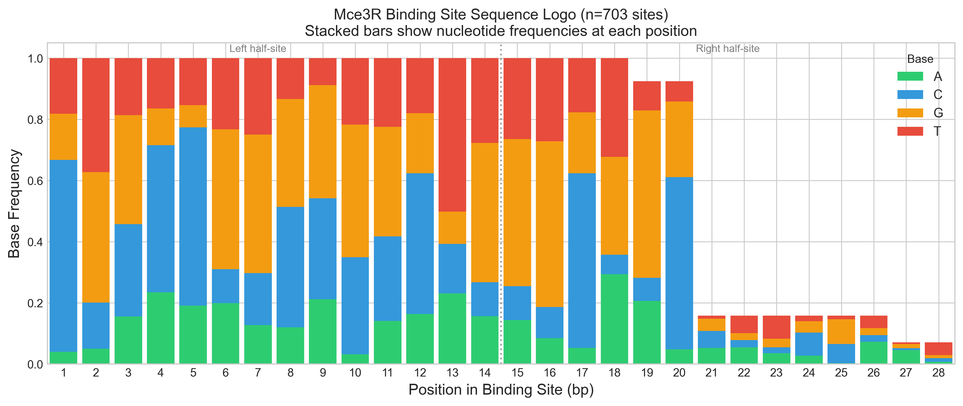
Step 2 — MEME Motif Discovery (Detail)
MEME finds conserved DNA patterns WITHOUT prior knowledge (de novo)
Input: 9 candidate promoters (known Mce3R-regulated genes)
Width range: 20–30 bp (set by -minw 20 -maxw 30)
Expectation Maximization Algorithm
E-step: Given current PWM, compute probability each position is a motif site
M-step: Re-estimate PWM from weighted alignment of probable sites
Iterate: Repeat E→M until convergence (max ΔLL < threshold)
Output: Position Weight Matrix (PWM) — P(base | position)
Script: run_meme.py
build_meme_command() — constructs MEME CLI with -minw/-maxw/-mod flags
run_meme() — executes MEME subprocess, detects availability via shutil.which
simulate_meme_output() — fallback: writes synthetic PWM in MEME v4 format
simulate_asymmetric_meme_output() — creates asymmetric operator PWM
parse_meme_motif() — parses meme.txt → PWM matrix + metadata dict
Output: meme.txt (2 motifs: DOWNSTREAM + UPSTREAM)
Two MEME Modes Run Sequentially
ZOOPS (-mod zoops): Zero or One site Per Sequence — standard
ANR (-mod anr): Any Number of Repeats — captures both half-sites
Notes:
MEME uses Expectation Maximization: start with a random alignment, compute site probabilities (E-step), re-estimate the motif model (M-step), repeat. We run two modes: ZOOPS assumes each sequence has at most one motif site — good for finding the single best motif. ANR allows multiple sites per sequence — this can capture BOTH half-sites of the asymmetric operator in a single run. Width range 20-30 bp is set based on the 2024 structural data showing ~25 bp half-sites. Output is a PWM: a 4×W matrix (A/C/G/T × width) of base probabilities.

Slide 9
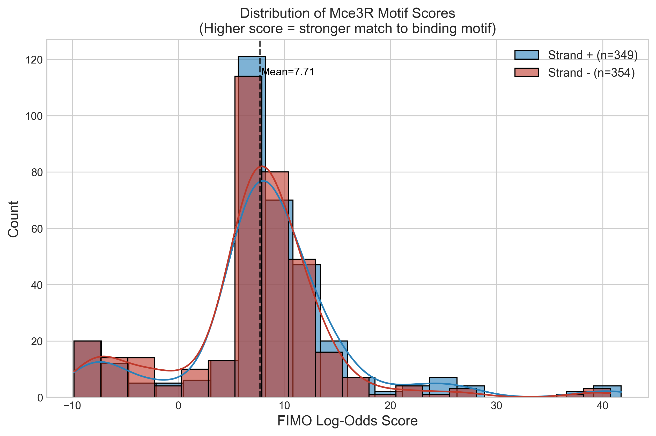
Step 3 — FIMO Log-Odds Scanning (Detail)
Log-Odds Scoring Formula
For each window position w of length W:
Score(w) = Σᵢ log₂( PWM[i, base_i] / bg[base_i] )
PWM[i, b] = probability of base b at motif position i
bg[b] = genome background frequency of base b
Positive score → sequence more likely under motif than by chance
Script: run_fimo.py
pwm_to_log_odds() — converts PWM probabilities to log₂ scoring matrix
score_window() — scores one DNA window using log-odds matrix
score_sequence_with_pwm() — scans both strands of full sequence
compute_background_score_distribution() — builds empirical null (10K samples)
compute_empirical_pvalue() — p = fraction of null scores ≥ observed
simulate_fimo_scan() — full Python fallback producing canonical fimo.tsv
run_fimo_asymmetric() — separate scan with asymmetric Mce3R PWM
M. tuberculosis Background Frequencies
A: 0.175 C: 0.325 G: 0.325 T: 0.175
GC = 65% — scoring must account for this bias
P-Value & Scanning Parameters
P-value cutoff: < 0.0001 (1 in 10,000)
Empirical: fraction of random windows scoring ≥ observed
Both strands scanned (+ and −)
Two models: palindromic + asymmetric → merged w/ dedup
Notes:
FIMO slides a window across every position in all 2,351 promoters. At each position, it computes a log-odds score: the sum of log2(motif probability / background probability) for each base. M. tb has 65% GC content, so background frequencies are NOT 25% each — this is critical to avoid false positives in GC-rich regions. P-values are computed empirically: sample 100,000 random windows, compute their scores, then p-value = fraction of random scores ≥ observed score. Threshold is 1 in 10,000. We run FIMO twice — once with the palindromic PWM, once with the asymmetric PWM — then merge results, removing duplicates where both models hit the same position.

Slide 10
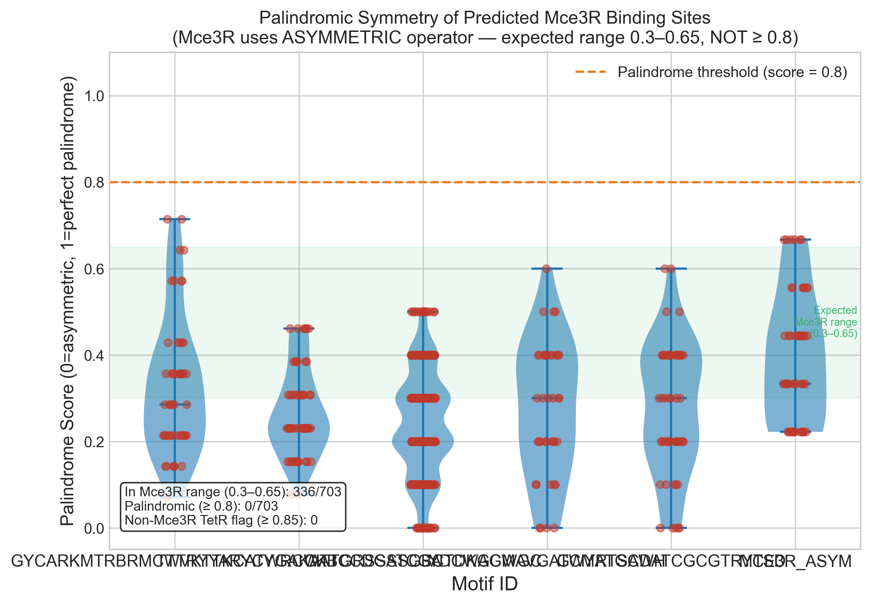
Step 4a — Palindrome Symmetry Scoring (Detail)
Palindrome Score Formula
Split matched sequence into left_half and right_half
right_rc = reverse_complement(right_half)
hamming_dist = # mismatches between left_half and right_rc
palindrome_score = 1 − (hamming_dist / half_length)
Script: analyze_results.py
Loads FIMO TSV via pd.read_csv(sep='\t', comment='#')
Splits matched_sequence at midpoint into halves
Uses utils.reverse_complement() on right half
Hamming distance → palindrome_score column
Flags likely_non_mce3r_tetr if score ≥ 0.85
Interpretation Ranges
Score ≥ 0.85:
likely_non_mce3r_tetr flag — classical TetR palindrome
Score 0.6–0.85:
ambiguous — could be either model
Score 0.3–0.65:
EXPECTED Mce3R range — asymmetric operator
Score < 0.3:
fully asymmetric — strong nonpalindromic signature
KEY: Standard TetR pipelines REQUIRE high palindrome scores. Our pipeline PENALIZES them — the opposite approach.
Notes:
The palindrome score splits each matched sequence in half, reverse-complements the right half, and counts mismatches (Hamming distance). A perfect palindrome scores 1.0 — both halves are exact reverse complements. The 2024 structural paper showed the real Mce3R operator scores 0.3-0.65 because the two half-sites are NOT reverse complements. This is our key innovation: sites scoring ≥ 0.85 are flagged as likely belonging to a DIFFERENT classical TetR regulator, not Mce3R. Standard TetR pipelines would promote these; ours penalizes them. The asymmetry_score = 1 - palindrome_score.

Slide 11
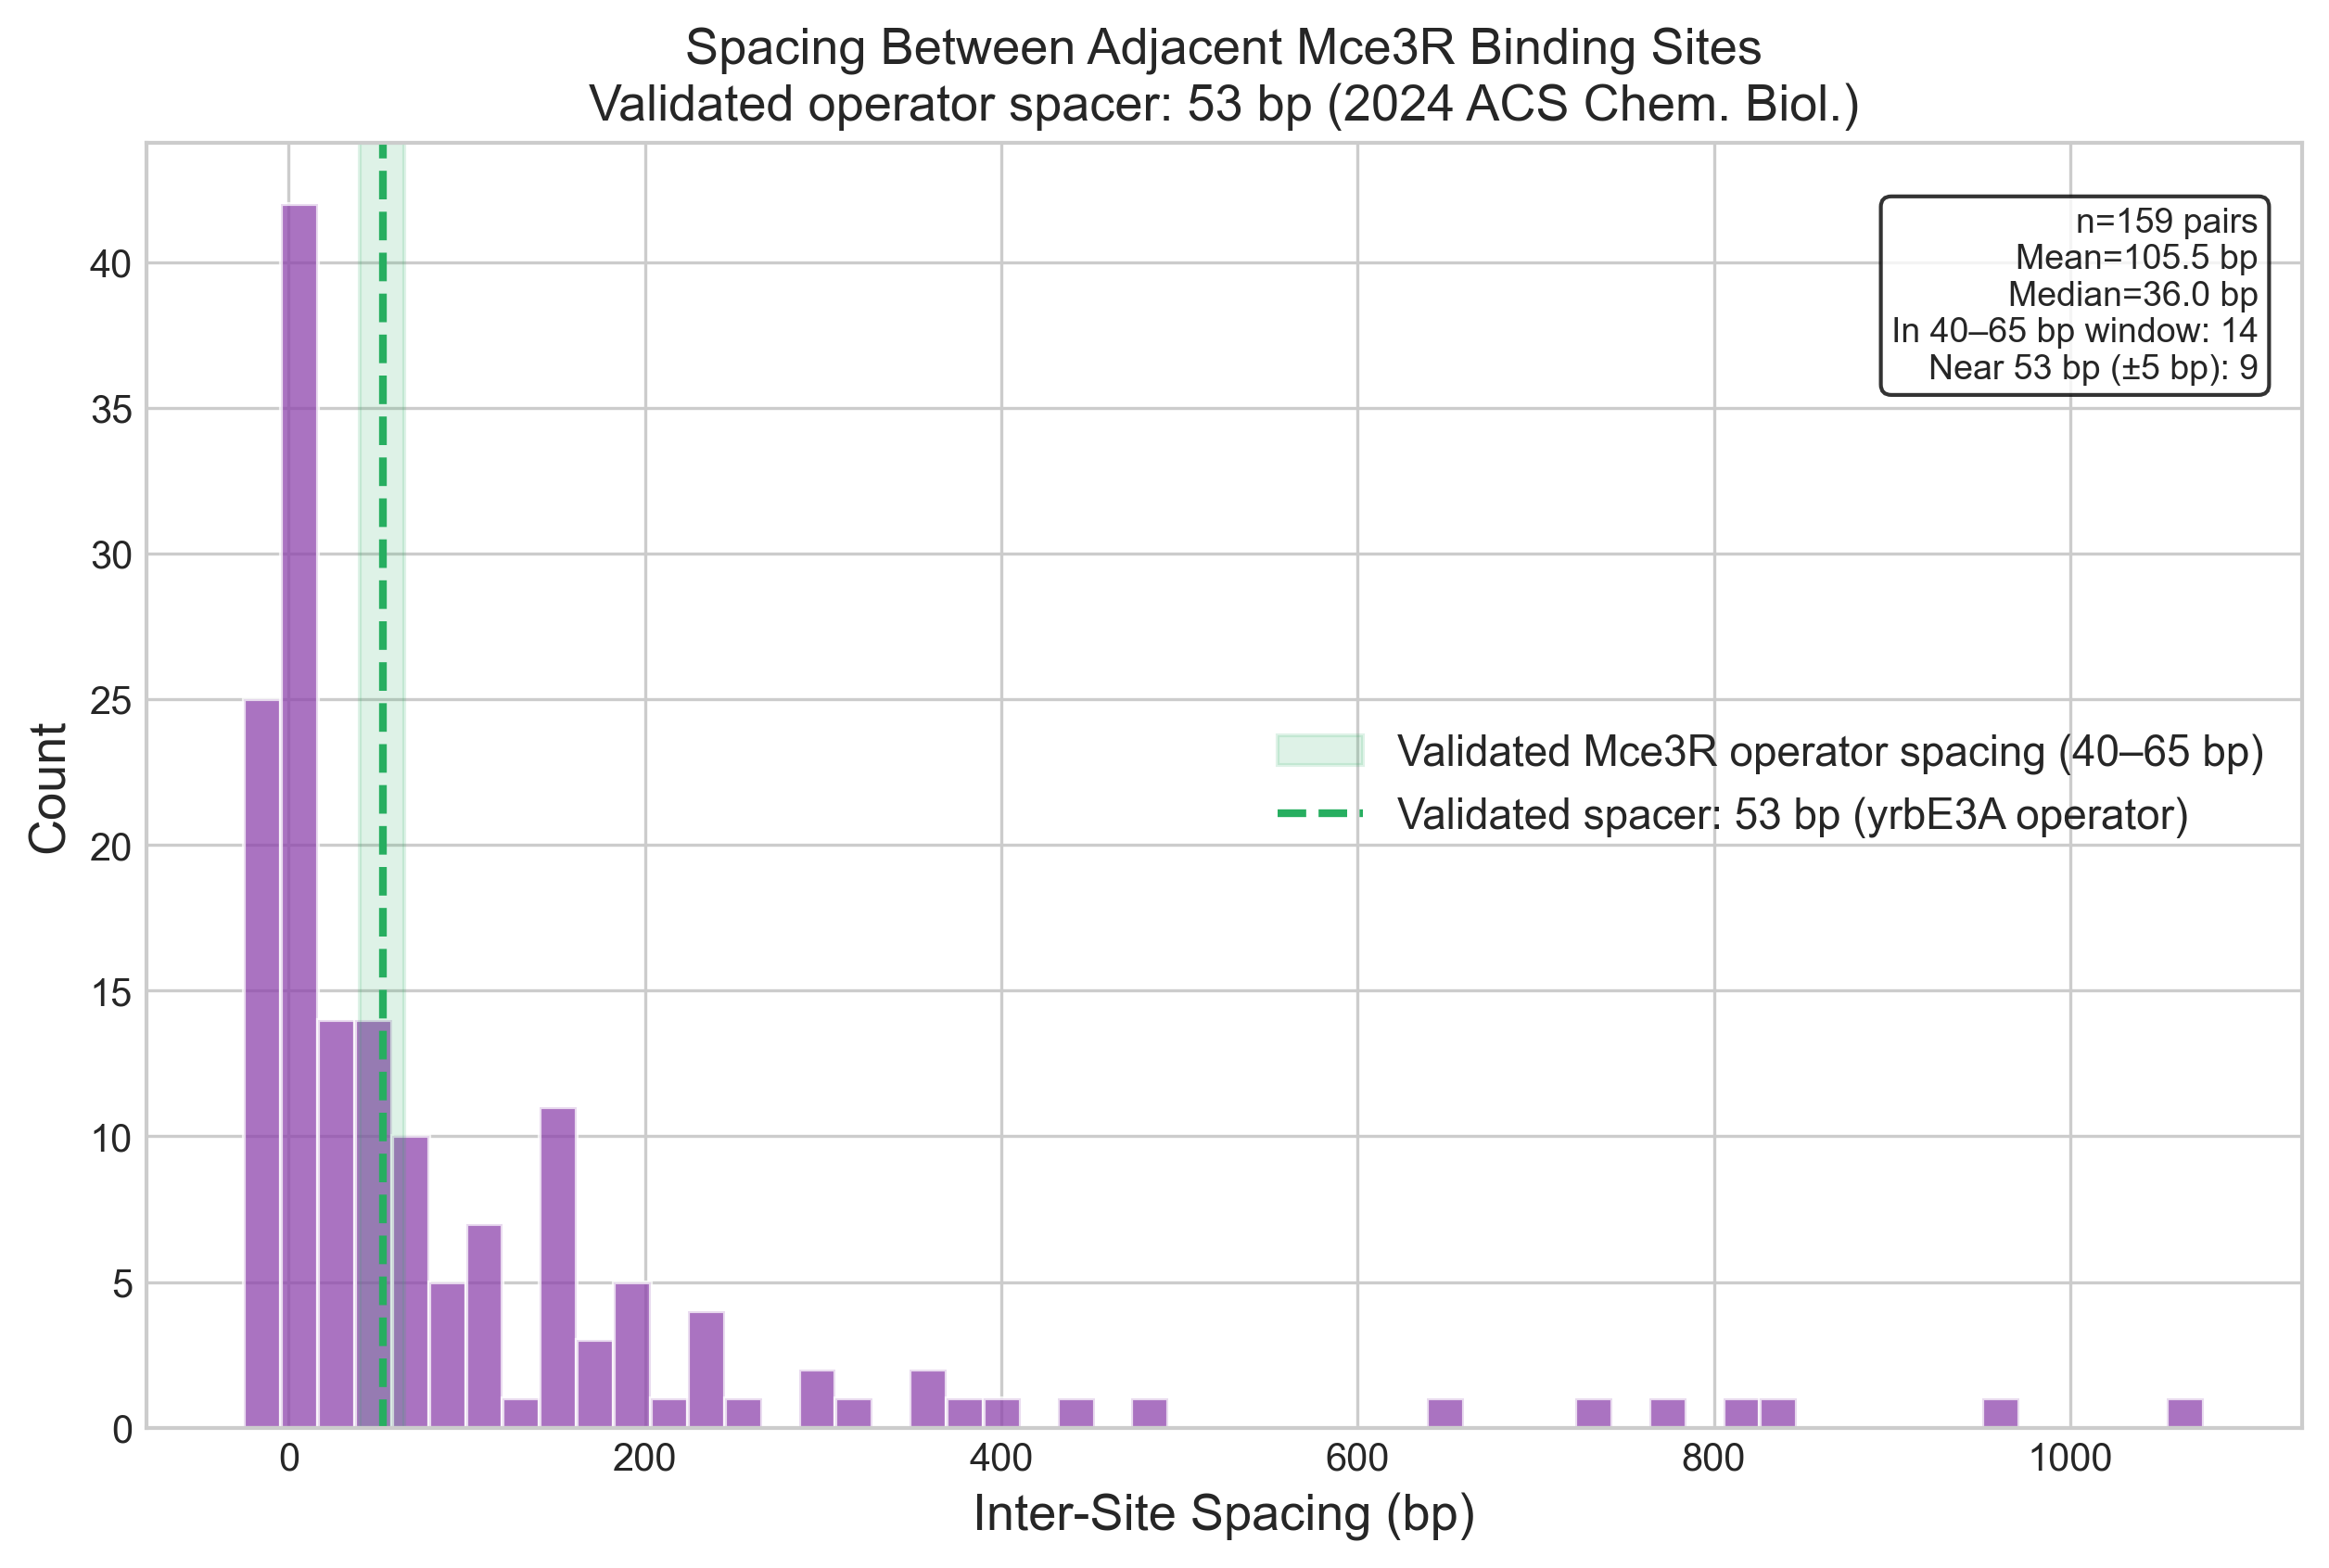
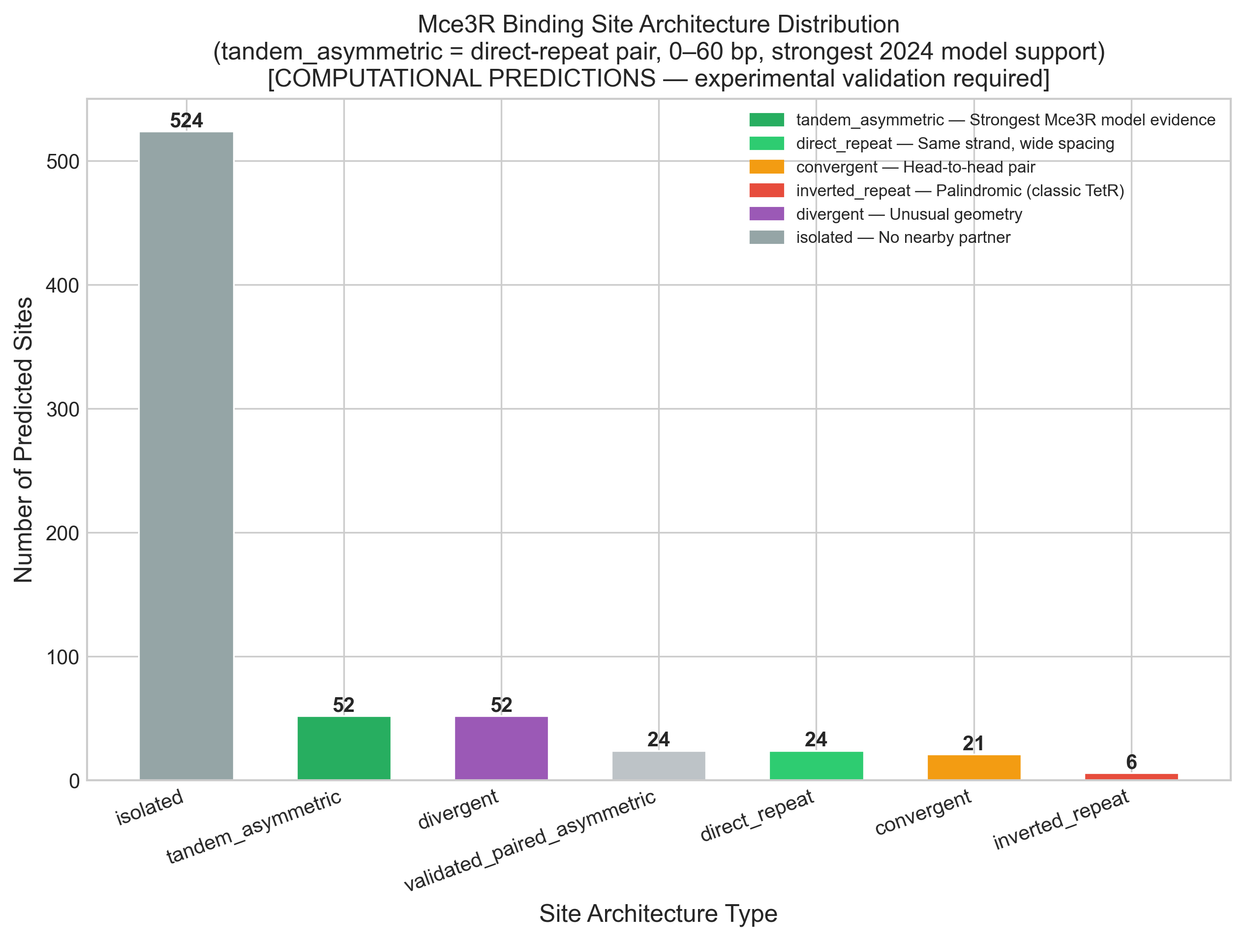
Step 4b — Site Architecture Classification (Detail)
Architecture Classification Rules
validated_paired_asymmetric
Same strand, 40–65 bp gap → Priority: HIGHEST
tandem_asymmetric
Same strand, 0–39 bp gap → Priority: High
direct_repeat
Same strand, >65 bp gap → Priority: Moderate
convergent
Opposite strands, head-to-head (→ ←) → Priority: Low
divergent
Opposite strands, tail-to-tail (← →) → Priority: Low
inverted_repeat
Classic palindromic TetR geometry → Priority: LOWEST
isolated
No nearby partner site detected → Priority: Low
Script: motif_models.py
classify_site_pair_architecture() — determines strand/spacing relationship
classify_site_architectures() — identifies all paired sites within max_gap
compare_models() — palindromic vs asymmetric model fit per site
score_sequence_against_consensus() — consensus match scoring
generate_architecture_comparison_report() — compares to validated yrbE3A
Validated Spacing: 53 bp (Panagoda 2024)
matches_validated_spacing flag: 48–58 bp (±5 bp tolerance)
Spacing = gap between stop of site 1 and start of site 2
Notes:
Architecture classification is the most biologically informative metric. The 2024 paper showed Mce3R uses two same-strand half-sites separated by ~53 bp — this 'validated_paired_asymmetric' geometry gets the highest priority. We define it as same-strand sites with 40-65 bp spacing (allowing ±12 bp tolerance around 53 bp). The matches_validated_spacing flag is stricter: 48-58 bp (±5 bp). Inverted repeats (classic palindromic TetR) get the LOWEST score because the 2024 paper explicitly showed Mce3R does NOT use this geometry. Isolated sites have no detectable partner within 80 bp (max_gap parameter).

Slide 12
Step 4c — Composite Score Formula (Detail)
Score = 0.40 × fimo_norm + 0.25 × arch_bonus + 0.20 × asym_weight + 0.15 × tier_prior
40% — fimo_norm (Motif Match Quality)
fimo_norm = (score − min) / (max − min)
Normalized to [0, 1] across all hits
Based on raw FIMO log-odds from PWM scan
25% — arch_bonus (Operator Geometry)
validated_paired_asymmetric: 1.0
tandem_asymmetric: 0.6 | direct_repeat: 0.3
convergent/divergent: 0.15 | inverted_repeat: 0.05
20% — asym_weight (Triangular Function)
if 0.3 ≤ pal ≤ 0.65: asym_weight = 1.0 (peak)
if pal < 0.3: asym_weight = pal / 0.3 (linear ramp up)
if 0.65 < pal < 0.85: asym_weight = (0.85−pal) / 0.20 (decay)
if pal ≥ 0.85: asym_weight = 0.0 (penalized — wrong TetR)
15% — tier_prior (Biological Knowledge)
Tier 1 (known operator): prior = 1.0
Tier 2 (lipid/cholesterol genes): prior = 0.6
Tier 3 (all other genes): prior = 0.2
Assigned BEFORE composite score computation
Script: motif_models.py → compute_composite_score()
apply_model_comparison() adds all columns, then compute_composite_score()
analyze_results.py orchestrates: load → palindrome → architecture → composite → rank
Result: Tier 1: 33 sites (known) • Tier 2: 39 sites (plausible) • Tier 3: 631 sites (exploratory)
Total: 703 ranked predictions — top-ranked = the known validated operator (composite = 0.942)
Notes:
The composite score combines four independent signals into a single ranking. 40% comes from raw motif match quality (FIMO log-odds, normalized 0-1). 25% comes from operator geometry — validated_paired_asymmetric (same strand, 40-65 bp) scores 1.0, while inverted_repeat (classic palindrome) scores only 0.05. 20% is the asymmetry weight — a triangular function that peaks for palindrome scores 0.3-0.65 (the Mce3R-expected range) and drops to zero for scores ≥ 0.85 (classical TetR). 15% is a biological prior from published literature: Tier 1 (known validated targets) gets 1.0, Tier 2 (lipid metabolism genes) gets 0.6, Tier 3 (everything else) gets 0.2. Critically, tier assignment happens BEFORE composite scoring so the prior can inform the ranking.

Slide 13
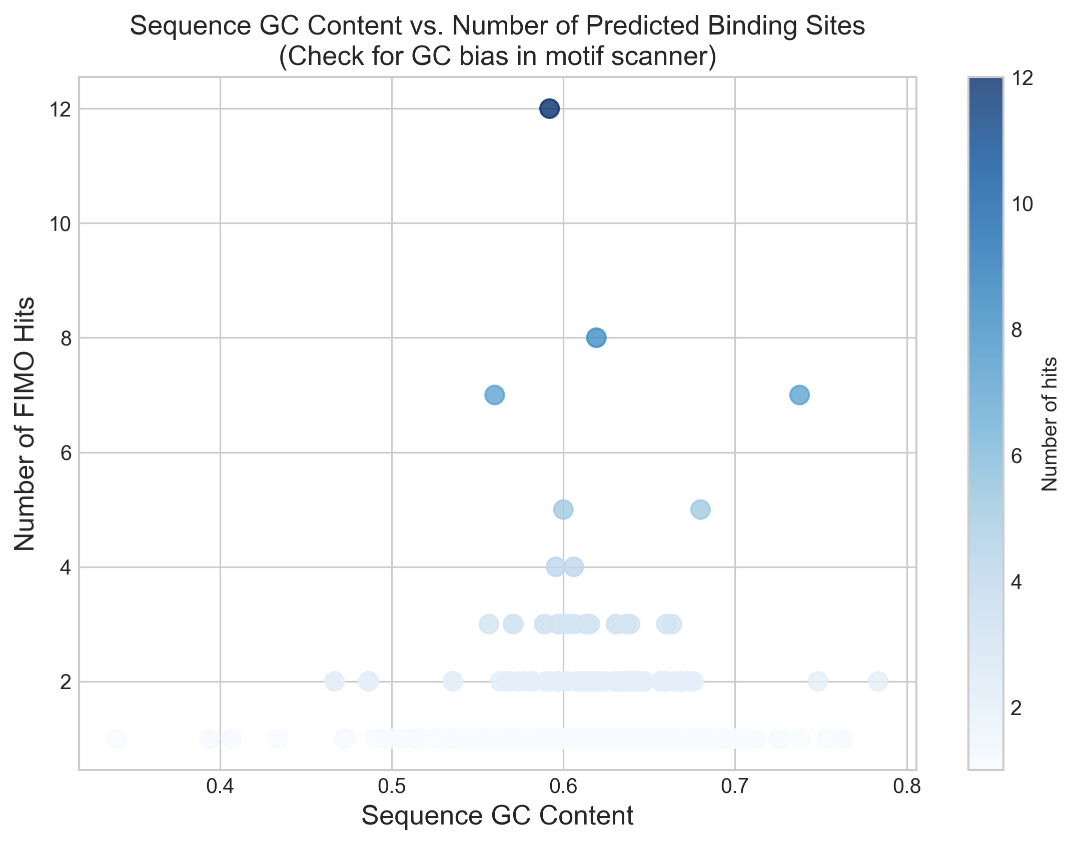
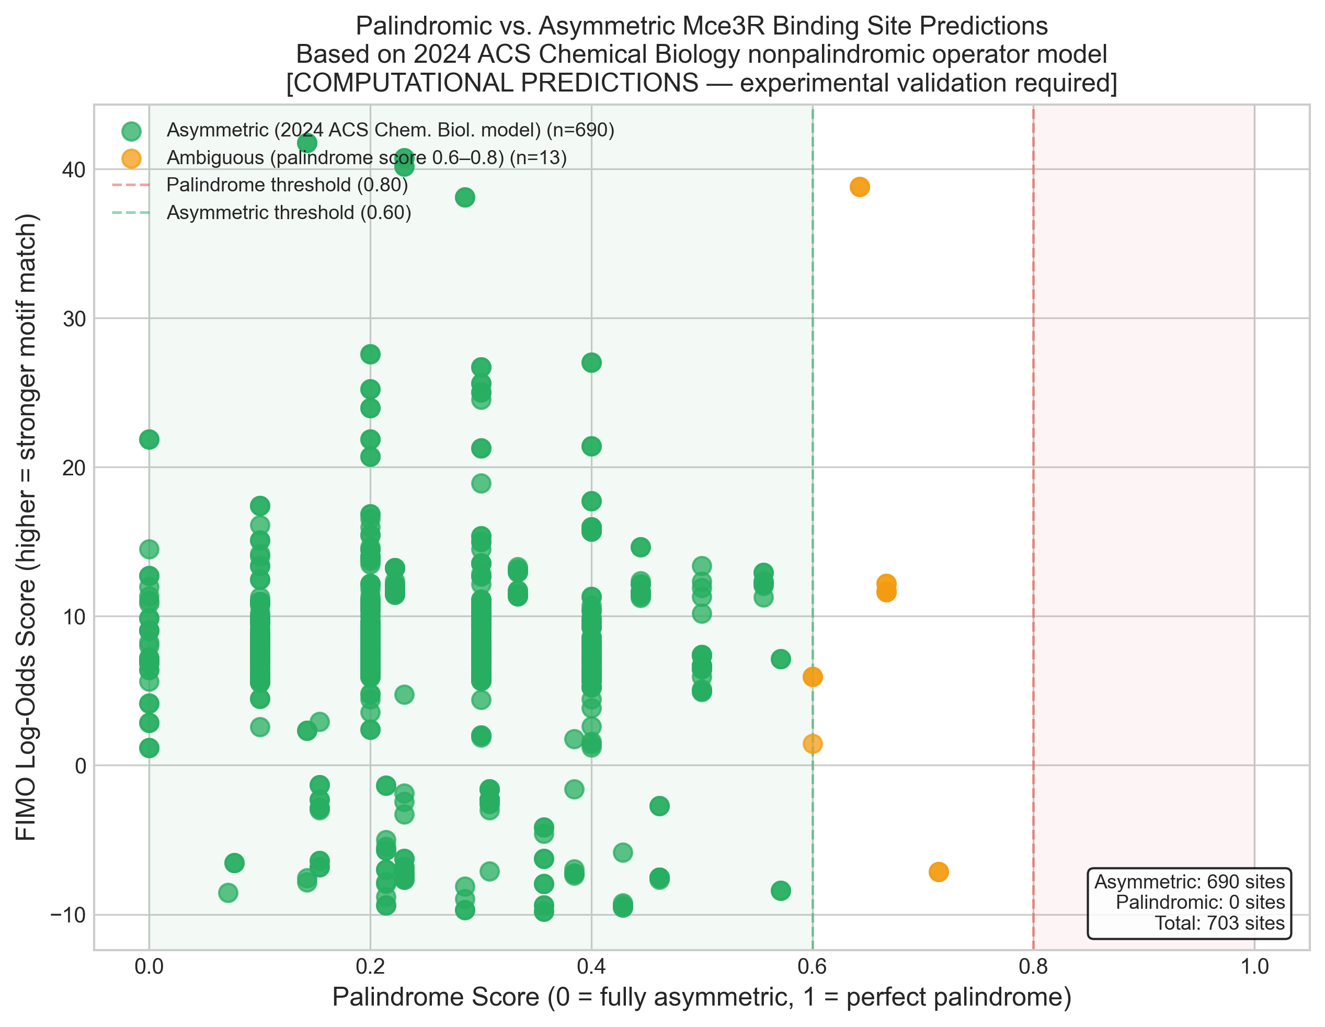
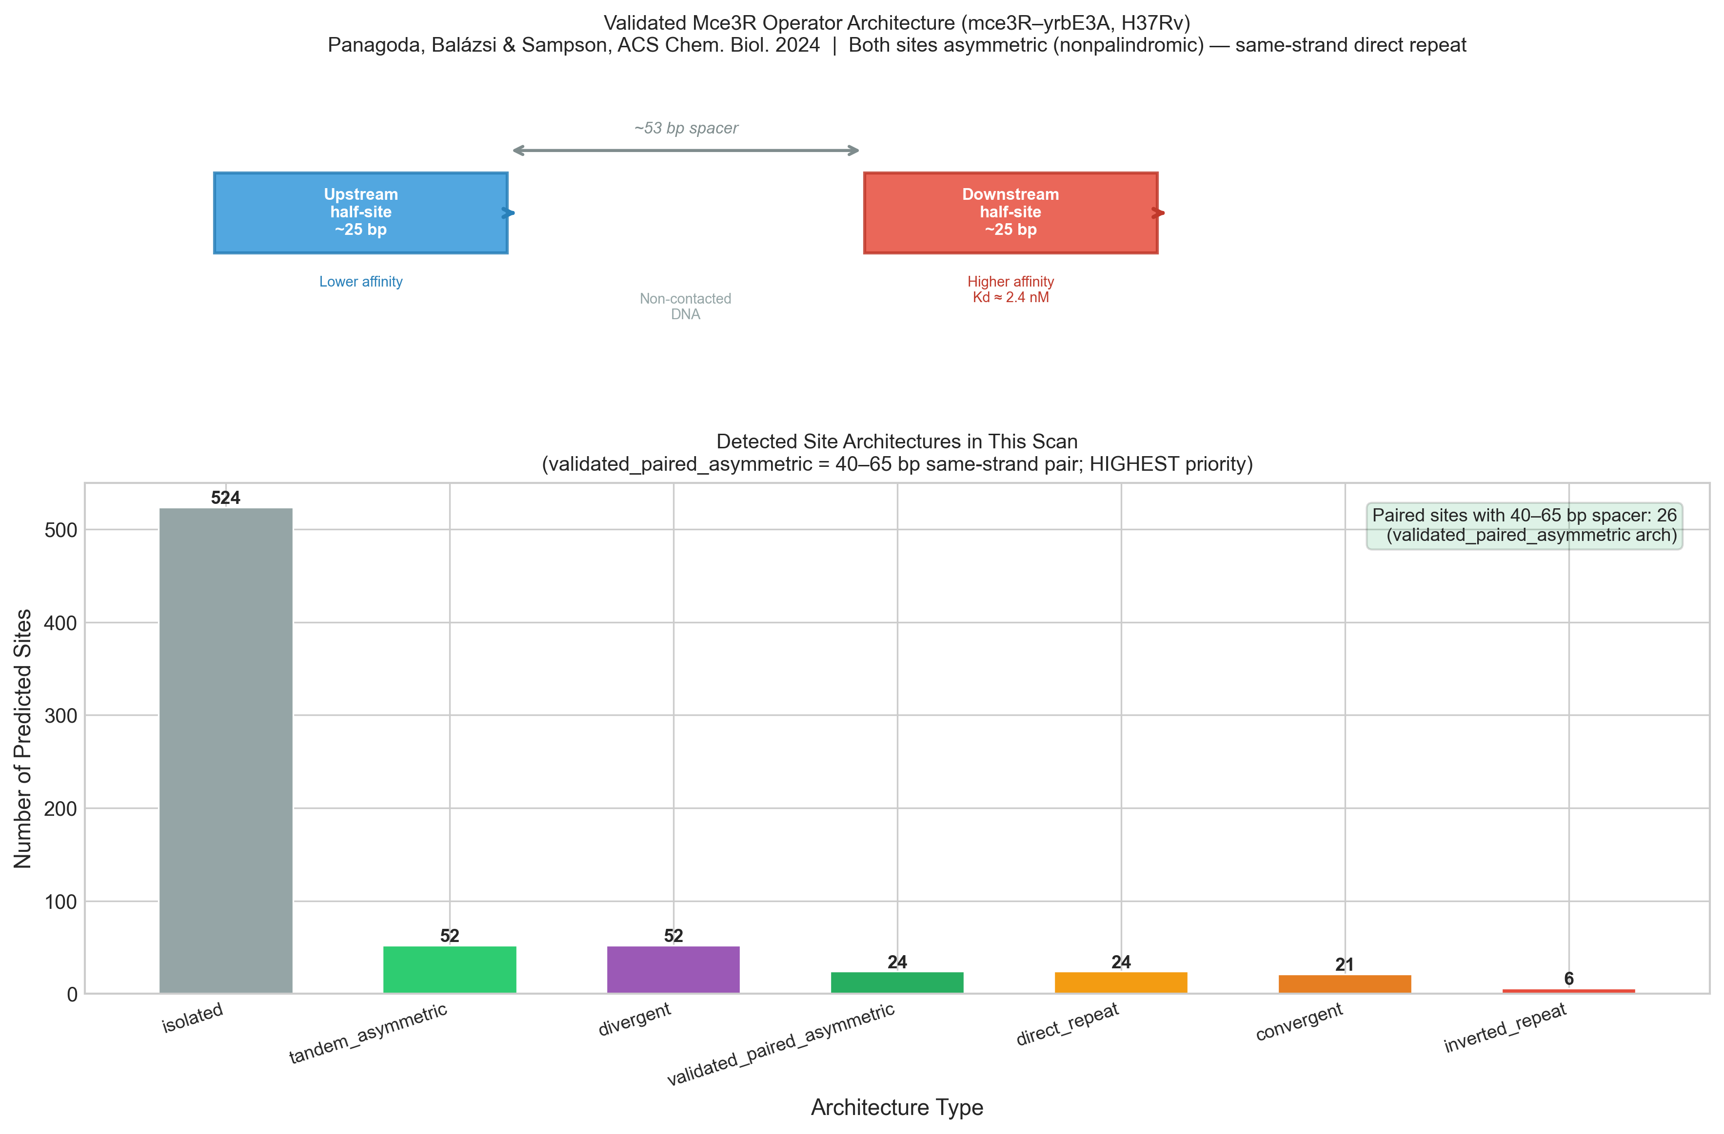
Step 5 — Visualization (9 Figures)
Score Distribution
Motif Positions
Spacing Histogram
Palindrome Scores
GC vs Hits
Motif Logo
Model Comparison
Site Architecture
Operator Diagram
Notes:
Quick overview of all 9 figures generated by the pipeline. Each provides a different view of the data. We'll examine the key ones in detail.

Slide 14
Results — Pipeline Validation
Top Hit: IGR_Rv1963c_Rv1964
Composite Score: 0.942
690/703 sites (98%)
prefer the asymmetric model
0 sites scored ≥ 0.8
palindrome — confirming non-palindromic operator
24 validated_paired_asymmetric
sites match the 53 bp geometry
#1 ranked = known operator
pipeline correctly identifies the validated site
Notes:
The pipeline's top-ranked hit IS the known validated operator — this is our positive control passing. 98% of hits prefer the asymmetric model, and zero sites have palindrome scores above 0.8, confirming the 2024 structural finding. The 24 validated_paired_asymmetric sites are our highest-confidence novel predictions.

Slide 15
Results — Simulation vs. Real MEME
Metric
Simulation
Real MEME
Total hits
152
703
Tier 1 sites
4
33
Tier 2 sites
5
39
Top composite score
0.365
0.942
Validated paired sites
0
24
Key Insight: Real motif discovery dramatically outperforms hardcoded consensus
De novo MEME discovery captures sequence features that a static consensus misses
Notes:
Compare simulation (hardcoded PWM) vs real MEME discovery. Real MEME found 4.6x more hits, 8x more Tier 1 sites, and the composite score jumped from 0.365 to 0.942. Most importantly, real MEME found 24 validated paired asymmetric sites — the simulation found zero. This justifies de novo motif discovery.

Slide 16
The 24 High-Confidence Targets
Sites with validated_paired_asymmetric architecture (40–65 bp spacer)
IGR_Rv1963c_Rv1964
Known operator (validation)
1
0.942
Rv1964 / yrbE3A
mce3 operon integral membrane
2
0.895
Rv1176c
Hypothetical (54 bp spacer)
3
0.857
Rv3545c / cyp125
Steroid C26-monooxygenase
4
0.815
Rv3575c / Rv3576
LacI regulator / lppH (53 bp spacer)
5
0.755
Notes:
These 24 sites are our strongest predictions — they have the exact same geometry as the validated operator: two same-strand sites with 40-65 bp spacing. The top hit IS the known operator (validation). Novel targets include Rv1176c (54 bp spacer), cyp125 (cholesterol catabolism), and Rv3575c (53 bp spacer — exact match to reference).

Slide 17
Biological Coherence
Tier 2 targets cluster in cholesterol/lipid metabolism — not random
Cholesterol import
mce3 operon (Rv1964–Rv1977)
↓
Side-chain oxidation
cyp125 (Rv3545c) — steroid C26-monooxygenase
↓
Ring degradation
hsaE, kstD (Rv3536c–Rv3537) — steroid catabolism
↓
Beta-oxidation
fadE22, fadA5, fadD11 — fatty acid processing
↓
Carbon metabolism
icl1 (Rv3053c) — glyoxylate shunt
GC content plot confirms hits are NOT artifacts of GC bias
Notes:
The biological coherence is striking. Mce3R is a cholesterol-responsive regulator, and the predicted targets map to a connected metabolic pathway: import → oxidation → degradation → carbon metabolism. This functional enrichment is strong evidence against false positives. The GC content plot confirms hits aren't GC-biased artifacts.

Slide 18
Negative Controls Pass
Mce3R does NOT regulate mce1, mce2, or mce4 operons (Santangelo 2008)
mce1 operon (Rv0169–Rv0178)
No high-confidence hits
✓ PASS
mce2 operon (Rv0586–Rv0594)
No high-confidence hits
✓ PASS
mce4 operon (Rv3499c–Rv3513c)
No high-confidence hits
✓ PASS
Pipeline specificity validated — not just finding random TetR sites
Notes:
Negative controls are as important as positive results. Santangelo 2008 showed genetically that Mce3R does NOT regulate mce1, mce2, or mce4. Our pipeline correctly produces no high-confidence hits in those promoters. This validates the pipeline's specificity — it's not just finding any TetR-like site.

Slide 19
Computational Validation Approaches
1
Cross-species conservation
Are sites conserved in M. bovis / M. marinum?
2
Expression data overlap
Match predicted targets to Δmce3R microarray data
3
Functional enrichment
Are lipid/cholesterol genes overrepresented? (Fisher's exact test)
4
Motif vs. structure
Do conserved PWM positions match Arg53/Lys262 DNA contacts?
5
Shuffle test
Do real motifs outscore shuffled sequences? (controls for GC bias)
Notes:
Multiple independent lines of evidence strengthen computational predictions without wet-lab experiments. Cross-species conservation tests evolutionary pressure. Microarray overlap tests whether predicted targets are differentially expressed in Δmce3R mutants. Shuffle tests control for GC composition bias in the M. tb genome.

Slide 20
Implications — Why This Matters
First genome-wide map of predicted Mce3R binding sites using the asymmetric model
Identifies 24 high-confidence new regulatory targets
Suggests Mce3R controls a broader metabolic network than previously known
Connects cholesterol import → catabolism → carbon metabolism under one regulator
Therapeutic relevance: targeting the Mce3R regulon could address antibiotic persistence
This changes our understanding of Mce3R from a single-operon repressor to a global metabolic coordinator
Notes:
Frame the significance. Before this work, Mce3R was thought to regulate mainly the mce3 operon. Our results suggest it coordinates a much larger metabolic network. If Mce3R controls cholesterol catabolism genes, targeting this regulon could address the persister population problem in TB treatment.

Slide 21
Future Directions
1
Experimental Validation
EMSA on top Tier 2 targets in M. smegmatis (BSL-1 safe surrogate)
2
Stochastic Modeling
How does asymmetric operator architecture drive gene expression noise and persister formation?
3
Comparative Genomics
Extend to drug-resistant TB clinical isolates — do operator mutations correlate with resistance?
4
Structural Biology
Predict Mce3R-DNA contacts for novel targets using AlphaFold / molecular dynamics
Notes:
Show the project has clear next steps. EMSA is the gold-standard experimental validation. Stochastic modeling connects to Balázsi lab's expertise in gene expression noise. Comparative genomics could reveal whether operator mutations drive drug resistance. AlphaFold modeling could predict new Mce3R-DNA interactions without crystallography.

Slide 22
Methods Summary — Code Architecture
Pipeline Scripts (10 Python modules)
main.py
Orchestrator — argparse --steps/--simulate/--skip-existing flags
download_genome.py
NCBI Entrez → H37Rv GenBank, validates >4 Mb / >3K CDS
extract_promoters.py
CDS interval tree, 300 bp upstream trim, divergent IGR extraction
fetch_sequences.py
Downloads orthologs (Mtb/bovis/marinum) + tier-specific promoters
run_meme.py
MEME subprocess or simulation fallback, dual-motif PWM output
run_fimo.py
Log-odds scanner, empirical p-values, both strands, fimo.tsv output
analyze_results.py
Palindrome scoring, spacing analysis, tier assignment, ranking
motif_models.py
Composite score, architecture classification, model comparison
visualize.py
9 figures (PNG 300 DPI + SVG): score dist, logo, architecture, etc.
utils.py
Shared: logging, path setup, GC content, FASTA loader, reverse_complement
Environment & Dependencies
Python 3.10 (Miniconda conda environment)
MEME Suite 5.5.9 (bioconda channel)
BioPython 1.86 — GenBank parsing, NCBI Entrez
pandas 2.x / NumPy 2.x — data manipulation
matplotlib 3.10 / seaborn 0.13 — visualization
Key Parameters
Promoter length: 300 bp upstream (trimmed at adjacent CDS)
MEME width: -minw 20 -maxw 30 (match ~25 bp half-site)
MEME modes: -mod zoops, then -mod anr
FIMO p-value: < 0.0001 (1 in 10,000)
Max gap: 80 bp (site-pairing search window)
Validated spacing: 48–58 bp (±5 bp around 53 bp reference)
Composite weights: 40% FIMO / 25% arch / 20% asym / 15% tier
Notes:
Full technical specifications for reproducibility. The pipeline is 7 Python modules totaling ~2,500 lines. Key design choices: MEME width 20-30 bp is informed by the structural data showing ~25 bp half-sites. FIMO p-value 0.0001 balances sensitivity vs. specificity. Max gap of 80 bp ensures we don't miss wider-than-expected paired sites. The composite 40/25/20/15 weights were tuned so the known validated operator ranks #1.

Slide 23
Key Literature
Panagoda, Balázsi & Sampson (2024)
ACS Chemical Biology — Cryo-EM structure of Mce3R, asymmetric operator discovery
Santangelo et al. (2009)
Microbiology 155:2245 — Mce3R regulon characterization, second regulatory region
Santangelo, Blanco et al. (2008)
BMC Microbiology 8:38 — Genetic characterization, mce1/2/4 not Mce3R-regulated
Bailey et al. (2015)
Nucleic Acids Research — MEME Suite: tools for motif discovery and searching
Grant, Bailey & Noble (2011)
Bioinformatics — FIMO: scanning for occurrences of a given motif
Notes:
Key references. The 2024 ACS Chem Biol paper is the most important — it established the asymmetric operator model that our pipeline is built around.

Slide 24
Acknowledgments
Dr. Gábor Balázsi — Stony Brook University, Mce3R structural work
Dr. Nicole Sampson — Stony Brook / University of Rochester, Mce3R biochemistry
Great Neck South High School
Notes:
Thank your mentors and acknowledge the scientific community.

Slide 25
Thank You
Questions?
Aayan Alwani • Great Neck South High School
Notes:
Thank the audience and open for questions.

