Slide 1

Aspect-Based Sentiment Index Forecasting Using Deep Learning Networks on Uber Reviews
Under the Guidance of:
Prof. Sourish Dasgupta

Slide 2
PROBLEM STATEMENT
Most sentiment analysis systems provide only an overall polarity of user feedback, which obscures the specific areas driving customer satisfaction or dissatisfaction. This limits a company’s ability to take focused, data-driven action. This project addresses that gap by applying Aspect-Based Sentiment Analysis (ABSA) to Uber reviews, enabling the extraction of sentiments tied to individual service components like drivers, app performance, and pricing. By combining ABSA with time-series forecasting, the project empowers Uber to track sentiment trends over time and make targeted improvements where it matters most.

Slide 3
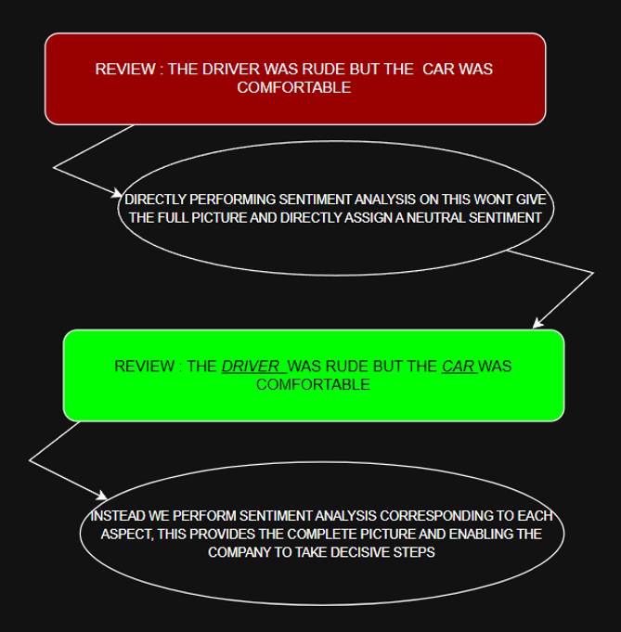

Slide 4
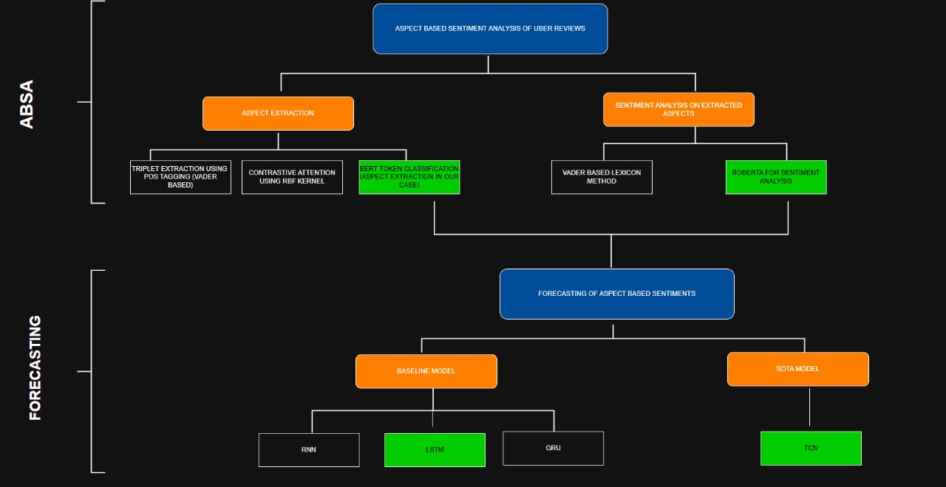
END TO END SOLUTION PIPELINE

Slide 5
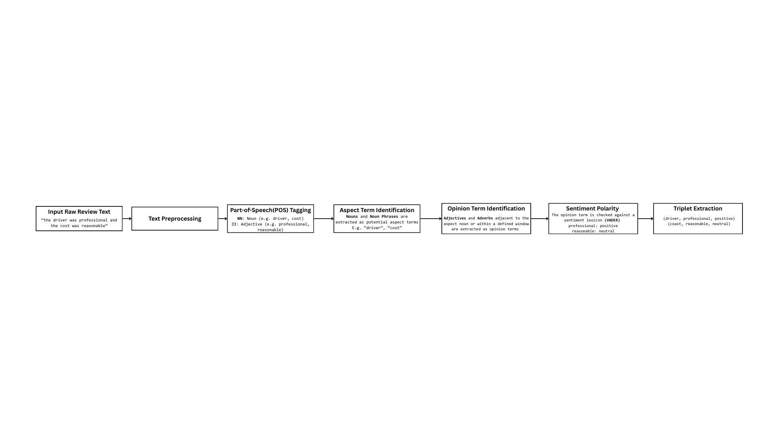
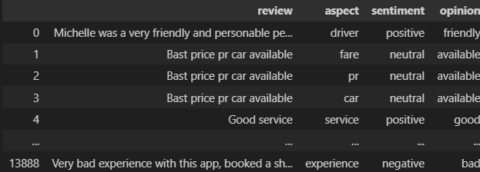
ASPECT EXTRACTION METHOD 1: TRIPLET EXTRACTION – (WHAT, HOW AND WHY )USING POS-TAGGING
WHAT :ASPECT HOW : SENTIMENT WHY :OPINION

Slide 6
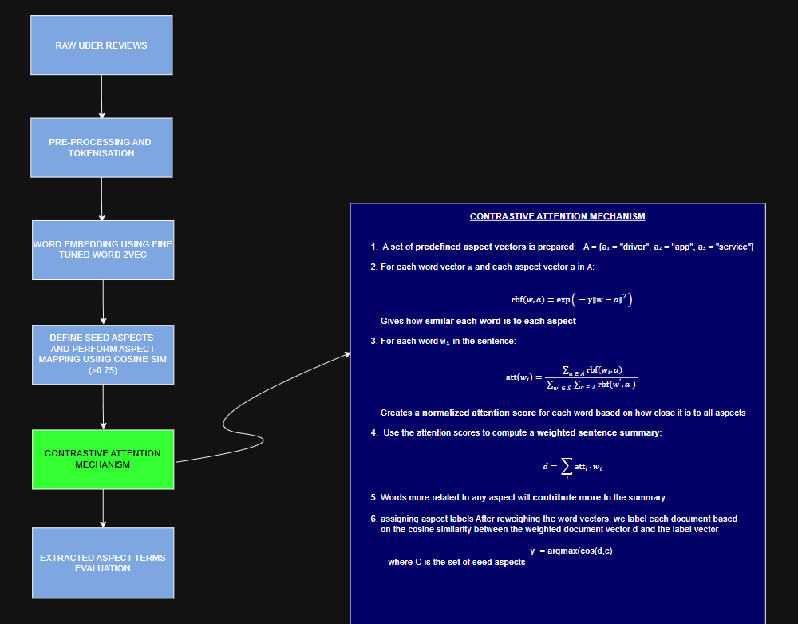
CONTRASTIVE ATTENTION USING RBF KERNEL FOR ASPECT EXTRACTION

Slide 7
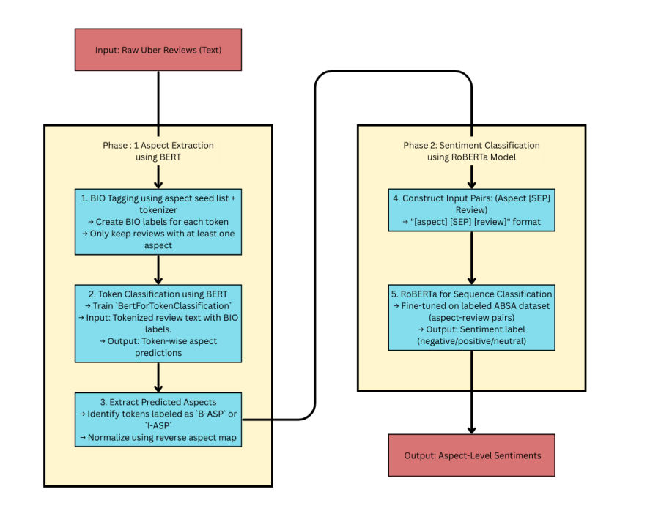
BERT BASED ASPECT EXTRACTION (TOKEN CLASSIFICATION) AND SENTIMENT ANALYSIS USING ROBERTA

Slide 8
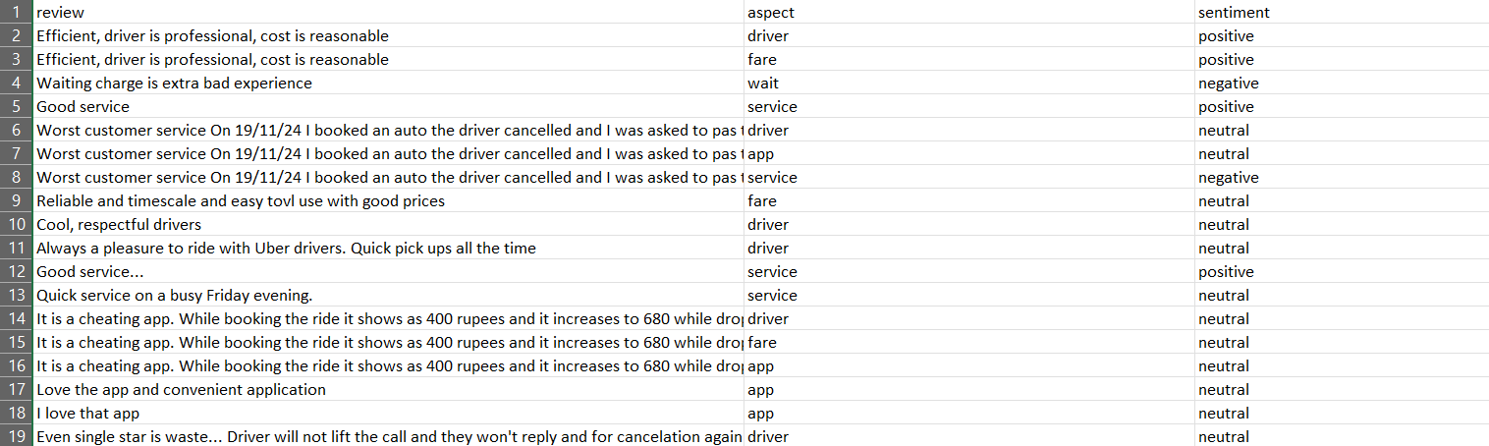
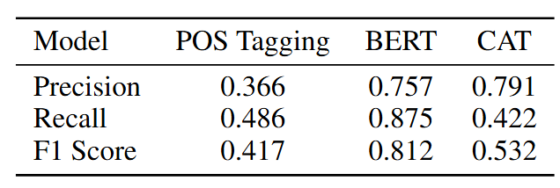


ASPECT EXTRACTION EVALUATION AND COMPARISION
A manually created GOLD STANDARD DATASET (reviews with their manually extracted aspects) was creating to evaluate each model on. BERT performed the best and was the chosen model for aspect based sentiment analysis

Slide 9
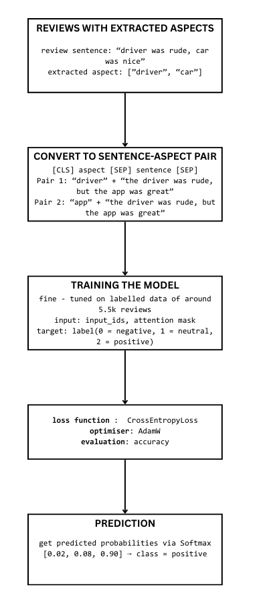
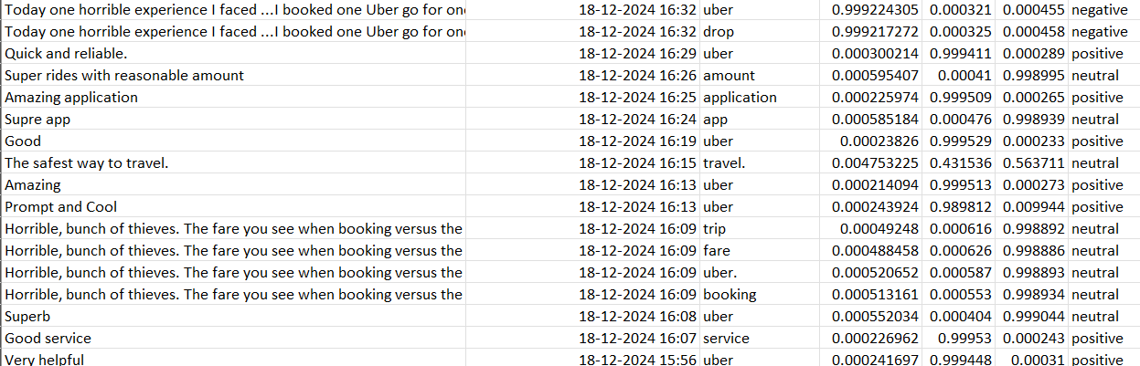
ROBERTA FOR SENTIMENT ANALYSIS ON EXTRACTED ASPECTS USING BERT
DATASET AFTER PERFORMING ABSA WITH SENTIMENT SCORES AND LABELS CORRESPONDING TO ASPECT AND REVIEW:

Slide 10
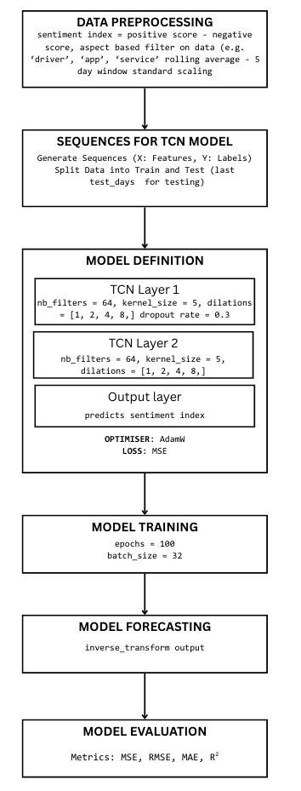
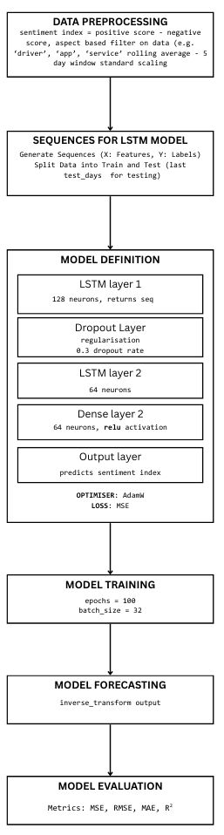
Aspect Based Sentiment Forecasting Model

Slide 11
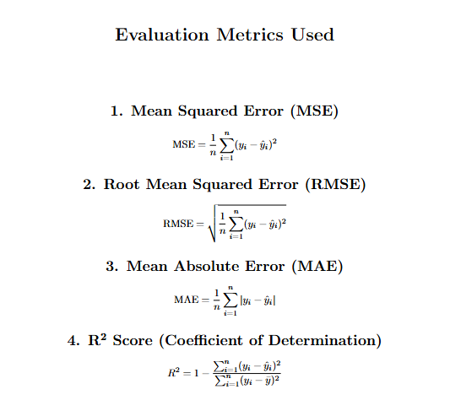

Slide 12
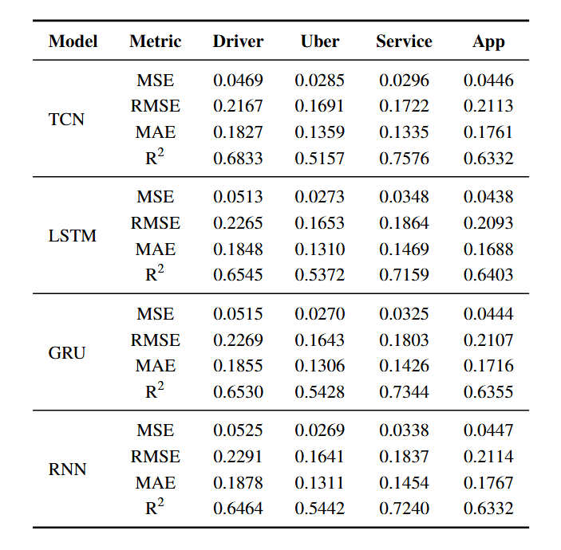
Model Result with 3 different Baseline Models

Slide 13
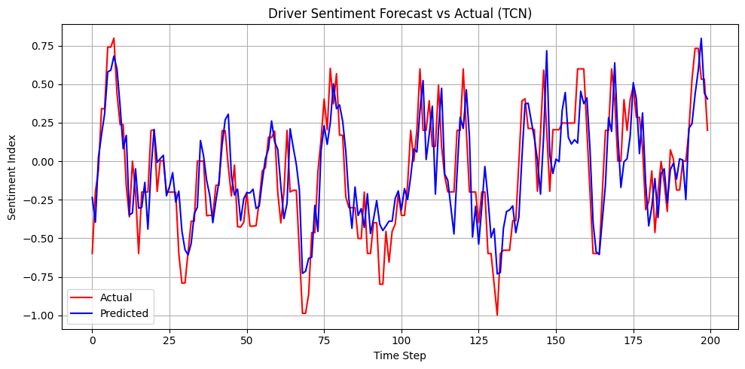
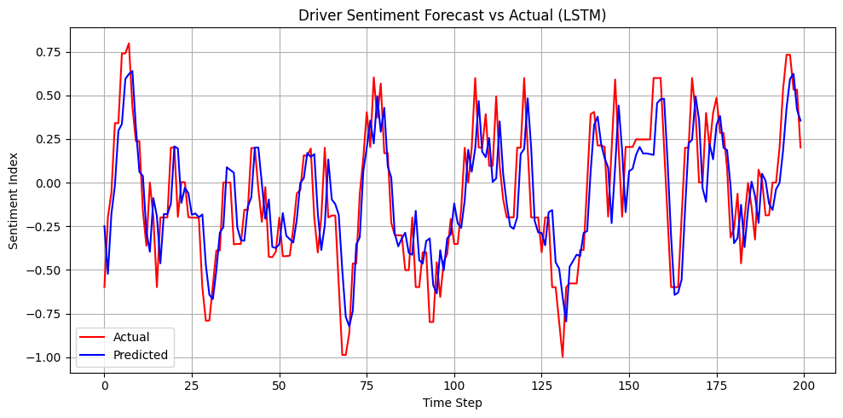
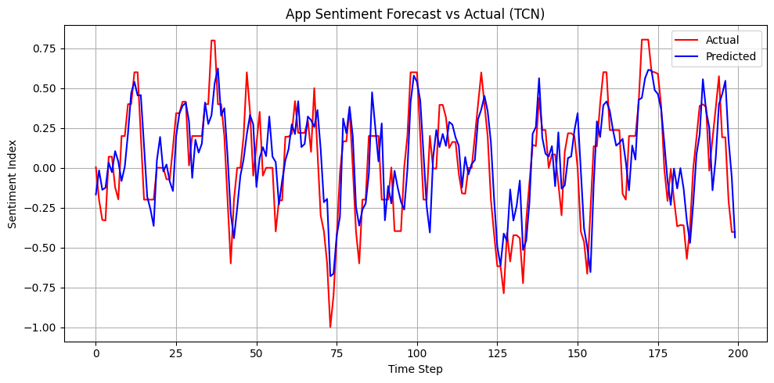
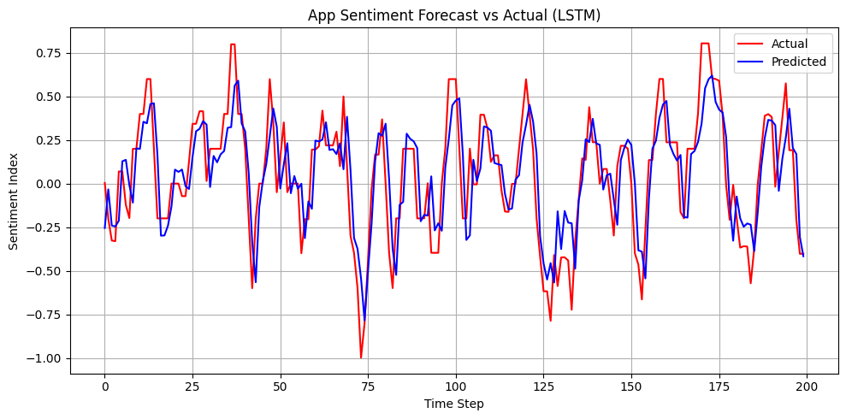
Actual Vs Predicted Plots of our Model and Baseline Model

