Slide 1
OMSE 535
Project 1
Presentation
Visual Assist X
Ben Straub

Slide 2
Tool Overview
What is it?
  Plug-in for Visual Studio
  Package of tools to aid in writing and maintaining code
What is it used for?
  Refactoring
  Navigation
  Accelerated code writing

Slide 3
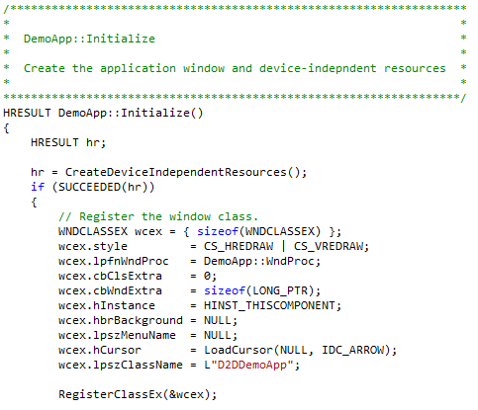
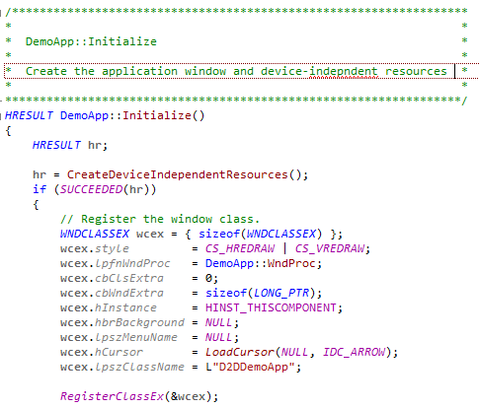
Features
Enhanced syntax highlighting with spell check

Slide 4
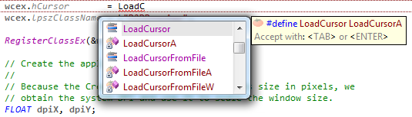
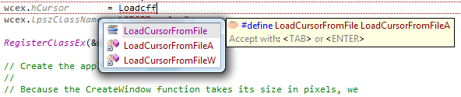
Features
Enhanced Intellisense with suggestions & acronyms

Slide 5
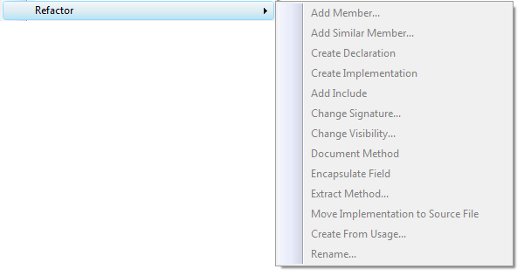
Features
Refactoring tools (even for C++)

Slide 6
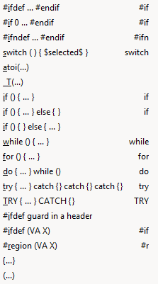
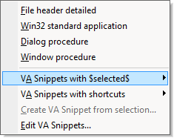
Features
Snippets

Slide 7
Features
Code navigation
  Find References
  Class member visual tree
  Keyboard shortcut to switch to header
  File outline with drag-and-drop reorganization
  Incremental search for filenames and symbols

Slide 8
Benefits
Faster/easier writing of new code
Makes reading code faster
Makes maintenance faster & easier

Slide 9
Drawbacks
Costs money
Indexing of a large project may take some time
  This is still faster than built-in Intellisense indexing

Slide 10
Availability & Cost
Available at http://www.wholetomato.com/
Price:
  $249 for standard license
  $49/year for upgrades
  Discounts for individuals and students

Slide 11
Summary
If you use Visual Studio for native development, there’s no good reason not to use this tool.

Slide 12
Links & References
http://www.wholetomato.com/
Related products
  ReSharper (http://www.jetbrains.com/resharper/)
  CodeRush / Refactor! Pro (http://www.devexpress.com/)

