Slide 1
OMSE 551: Strategic Software Engineering
Stuart Faulk
Week 1: Introduction to SSE

Slide 2
Overview
Oregon Master of Software Engineering: the course in context
Course Goals
What is Strategic Software Engineering?
Notes:
Use bullet #2 here to describe the relationship of this course with the other courses in the curriculum.

Slide 3
Contact Information
Instructor contact
Stuart Faulk
faulk@cs.uoregon.edu
541-346-1350
fax: 6-1395
Computer and Information Science
120 Deschutes Hall
University of Oregon
Eugene, OR 97403
Email works best: use my direct email address (not D2L)
Notes:
Explain our availability

Slide 4
Feedback Loop
Grading (approximate)
Midterm (30%)
On-line discussion participation (10%)
Exercise (15%)
Term Paper & presentation (35%)
Looking for understanding!
Student feedback
Primary source of course improvements
I need to know if:
Homework is unreasonable
The material is unclear
The organization needs work
The exercises miss the mark
etc.
Notes:
Stress the “approximate” here.

Slide 5
Course Context and Goals

Slide 6
OMSE Curriculum Themes
Software Engineering in Context
Recognizes that real software is always developed in a larger context (organizational, business, regulatory)
Must understand non-technical issues to making effective technical decisions
Strategic Software Engineering
Looks beyond development of single systems
Recognizes that we typically build similar systems over time.
Focuses on organizational process improvement, planned reuse, and other strategic issues
Re-integrates issues of software engineering and software engineering management
Notes:
Software engineering and SE management inherently cannot be treated as distinct concerns. Control requires understanding the technical issues

Slide 7
Course Goals I
Gain a broader perspective of software development
Conventional life-cycle view too narrow to encompass solution space for some key problems
Strategic view will allow more problems to be addressed
Achieve a more unified view of software engineering
Tendency to look at SE topics (e.g., phases) in isolation
Necessarily a set of interlocking and interdependent parts
Focus on understanding and exploiting essential relationships to achieve business objectives
Notes:
Overall: What good is it?
Two learning objectives:
1) Give knowledge you can apply at work.
2) Provide a broad base of understanding for long term career growth.

Slide 8
Course Goals II
Use our perspective to think and act strategically when developing software
Forethought is key to a controlled process
Forethought allows work to be leveraged across developments (products and processes)
Learn some principles of meta-software engineering
Learn methods and processes for developing strategic assets
Methods and processes for developing sound methods and processes
E.g., What is the right process for developing a new software development process?

Slide 9
Course Structure
Will run as a seminar
Weekly lectures
Weekly readings
Texts
Papers: seminal SE papers and emerging views
Exercises ground the work
On-line discussion and questions (especially important for on-line-only students
Assignments: process model, system family spec.
Term project
Student chooses area for in-depth exploration
Short paper and in-class (or on-line) presentation

Slide 10
Class Resources
Class web page (D2L site for 2011)
Syllabus
Readings
Assignments
Slides
Lectures (streaming video)
Blackboard
Threaded discussion questions
Email
Announcements and updates

Slide 11
Managing Expectations
What you will get: new ways of thinking about SE
Understanding of how SE is evolving
Gaining a different perspective on SE problems
Caveat: while this isn’t totally unexplored territory, you definitely aren’t in Kansas anymore
All course topics are areas where practical experience exists
SSE focuses on the relationships between conventional SE areas
The SSE viewpoint is unique to this course
A key goal is to understand the questions better
Hint: The reason we often don’t good answers to SE problems is that we are asking the wrong questions.
Notes:
Key idea: As part of the MSE, this is not a training course. It is a course focused on improving the long term capabilities and intellectual capacity (ability to think) in software engineering.
Not trying to teach you how to do something per se, trying to teach you how to think (analogy to the “teach a man to fish” parable).

Slide 12
Questions?

Slide 13
Strategic Software Engineering
What is it?

Slide 14
Overview
“Houston, we have a problem.” – on the nature of the ongoing “software crisis”
No silver bullet – roadblocks to crisis resolution
A road less traveled – going around rather than through the roadblocks
Déjà vu all over again - why we cannot understand the future if we will not understand the past
The Art of War - strategy before tactics

Slide 15
What is Software Engineering?
The purpose of software engineering is to gain and maintain intellectual & managerial control over the products and processes of software development.
Control => ability to plan the work then work the plan
Intellectual control - means that we can make rational choices based on an understanding of the (downstream) effects of those choices
Managerial control – means we can make rational choices concerning software development resources (money, time, personnel)
Discussion: Are we in control now?

Slide 16
The SSE Hypothesis
Effective control of developments in most real companies requires a strategic view of software development
(i.e., one that spans development across multiple products, over multiple development cycles, and across organizational boundaries)
Lemma 1: Necessary control is unobtainable at the project level
Lemma 2: Some key development problems are artifacts of the way we decompose the problem (I.e., the narrow view)

Slide 17
“Houston, we have a problem.”
Have been in “crisis” since the advent of “big” software
What we want for software development
Low risk and predictability
Lower costs and proportionate costs
Faster turnaround
What we have:
High risk, high failure rate
Unpredictable schedule, cost, effort
Characterized by lack of control
cannot plan the work, work the plan
Three road blocks to getting beyond the crisis:
Complex software is essentially difficult
Software development is pre-industrial
Traditional SE processes only look at part of the problem
Notes:
Proportionate: costs are out of proportion to complexity, value of software
Hand crafted => has the virtues and drawbacks of hand-made products

Slide 18
1. Software is Essentially Difficult
In No Silver Bullet Fred Brooks provides a perspective on why we have not been able to resolve the “software crisis”
Identifies two kinds of development difficulties
Essential difficulties - part of the essence of the problem
Accidental difficulties - introduced by imperfect practice
Thesis: developing complex software systems is essentially difficult – but not as difficult as we make it!
“The hard part of building software [is] the specification, design and testing of [its] conceptual constructs, not the labor of representing it and testing the fidelity of the representation”
Lemmas:
Most new SE technology addresses primarily “accidental difficulties”
Improvements here are at the point of diminishing returns
Notes:
Key Ideas:
Brooks notes that there are a number of “essential difficulties” that prevent us from vastly increasing software productivity.
The greatest majority of SE work has addressed accidental difficulties – this is at the point of diminishing returns.
What’s hard about software is building and communicating the conceptual structures – we must make this process faster, easier, and more reliable to resolve the crisis.
One way of doing this is to reuse rather than re-build the conceptual structures (requirements, design, processes)

Slide 19
2. Software is Pre-Industrial
Pre-Industrial
Craftsman builds product
Builds one product at a time
Each product is unique, parts are not interchangeable
Quality depends on craftsman’s skill – product of training, experience
Unbounded opportunities for error
Focus on individual products
Customization is easy
Scaling is difficult
Parts are not interchangeable
No economy of scale
Control problems rise exponentially with product size!
Post-Industrial
Products produced by machines
Quality depends on machines & manufacturing process
Production requires little training or experience
Focus on developing the means of production
Craftsman builds means to build product (tools, factory)
Customization is difficult
Easily scales
Parts are interchangeable
Products are alike
Economies of scale apply
Notes:
Key idea: Pre-industrial processes work fine (actually have advantages) for small products. The problem is that it takes a lot of coordination to manage the interfaces when components must work together. The number of possible interfaces rises non-linearly with the number of components (work assignments) leading to massive control problems.

Slide 20
3. We Only Look at Part of the Problem
Requirements
Analysis
Software
Design
Coding
System Integration
and Testing
Know that choices here
Are affected by prior choices, experience, products
Will affect future capabilities: business, technical
E.g., architecture (architectural business cycle)
Omits critical context information
How do the activities relate to short or long term business goals?
How do the decisions made here affect future products?
Where does information about these issues come from and in what form?
Factors affecting ability to control the process are outside the scope
Factors affecting the process are implicit
Factors affected by the process are nowhere evident
Deployment and Maintenance
Product
Notes:
Problem: the view looking outside the life-cycle is looking through a glass darkly. There are implicit handoffs here in the requirements and “maintenance” side that are very poorly communicated and completely lack the necessary feedback.

Slide 21
What is the “Whole Problem?”
Project
Organization
Organization
Project Process
Standard Process
Project Goals
Business Goals
Legacy Products
Typically treat product development as a distinct concern
Each development is treated relatively independently from other developments
Reuse of products and processes is haphazard
Products and processes developed to meet project goals
In most developments/organizations, neither is nor should be a distinct concern
Everything has a context that cannot be ignored
Necessarily acquires people, products, process, organization from context
Repeats processes, develops similar products over time

Slide 22
Consequence: Merry-Go-Round of Sequential Development
Requirements
Analysis
Knowledge is not institutionalized (tacit)
Doomed to repeat lessons of the past
Software
Design
Coding
System Integration
and Testing
Deployment and Maintenance
Product

Slide 23
Sequential Development Over Time
Requirements
Requirements
Requirements
Design
Design
Design
Code
Code
Code
Test
Test
Test
Deploy/Maintain
Deploy/Maintain
Deploy/Maintain
Product
Product
Product
Time
… a result of “tactical software engineering”
Notes:
Implication is that the development process over time looks like this, i.e., we pretty much start over each time. This doesn’t mean that people do not carry forward experience or occasionally reuse things but that it is not an organized activity (part of a formalized process). Pretty inefficient.

Slide 24

If only we could stop and think…
“Here is Edward Bear, coming downstairs now, bump, bump, bump, on the back of his head, behind Christopher Robin. It is, as far as he knows, the only way of coming downstairs, but sometimes he feels there really is another way, if only he could stop bumping for a moment and think of it”
-- A. A. Milne

Slide 25
A Road Less Traveled
Going around (rather than through) the software productivity barriers

Slide 26
Qualities of a Solution
Essential nature of the problem
Building conceptual structures is essentially difficult
There are inherent control problems in building large, complex systems from hand-crafted parts
Key problems are outside the traditional life cycle scope
=> Cannot solve the problem within traditional life-cycle view
Implied nature of the solution
Change what we build (product) - reuse conceptual structures
Change how we build (process)
Use an industrial model of development
Expand the development scope to encompass the whole problem
Change who does what (organization) – organize to build families of products and processes

Slide 27
The Critical Relationships
ORGANIZATION
PROCESS
PRODUCTS
A three-legged stool
Each necessarily reflects the others
Each necessarily supports (or blocks) the others

Slide 28
I. Change What We Build to Systematically Reuse Conceptual Structures
Observation: sequential development is inefficient
Much of software “development” is really re-development.
Software inevitably exists in many versions
Seldom develop truly new applications
Implication: typically much in common among systems we build … but very little is reused!
Real progress depends on reusing (not re-creating) conceptual structures
Exploit commonality to develop reusable assets for system families
Develop infrastructure to support rapid production of instances of a family from reusable assets
Avoid the essential difficulties of creating conceptual structures by reusing them
Notes:
Why isn’t more stuff reused? Conceptual structures not designed for reuse/change.
Industrial revolution has yet to happen. No interchangeable parts.
Basic idea is that there is a lot of stuff that could be reused but it can’t happen under the current paradigm, need to change the process (to view multiple systems).

Slide 29
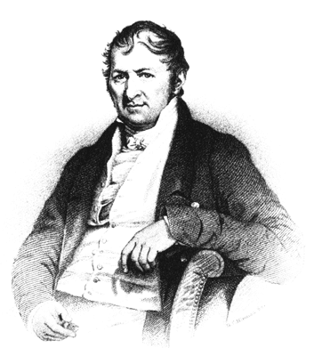
II. Exploit an Industrial Development Model
Pre-Industrial
Post-Industrial
Develop Means of Production
Design Manufacturing process
Design Factory
Build Factory
Build Product (by hand)
Product
Factory (Means of Production)
Historical note: Eli Whitney’s vision and invention transformed the product development process.
Build Products
Product
Notes:
Characterized by investment phase and payback phase.

Slide 30
Product-Line Development
A product-line development strategy sets out to maximize reuse over a family of similar software systems.
Reuse is planned and systematically executed
Common assets are developed as a distinct product
The process focuses on developing means of production before any particular product
Develop Means of Production
Design development process
Design production environment
Build reusable assets
Application Engineering Environment (Means of Production)
Build Applications (Family Members)
Application
A Product-Line Process

Slide 31
Product-Line Development Over Time
PL Requirements
PL Design
Reusable Assets
& Generators
Adapt Assets
Adapt Assets
Adapt Assets
Create Product
Create Product
Create Product
Product
Product
Product
Time
… a result of “strategic” software engineering
Notes:
Implication is that the development process over time looks like this, i.e., we pretty much start over each time. This doesn’t mean that people do not carry forward experience or occasionally reuse things but that it is not an organized activity (part of a formalized process). Pretty inefficient.

Slide 32
III. Extend the Development Scope
Shift from “tactical” to “strategic” view of development
“Tactical” development maximizes local objectives
Focuses on a particular product
Key SE issue: how to make tradeoffs to achieve product-relevant goals (improved quality, reduced cost,)
Concerns outside the project are ignored
“Strategic” development focuses on maximizing global return on investment
Focuses on overall business objectives
Key SE issue: how to make trade-offs to maximize overall return
May trade-off near-term goals to maximize overall return
E.g., pay upfront to develop reusable architecture
One project is viewed as only one part of the business

Slide 33
Components of Strategic Development
Process
Encompasses multiple product developments
Reorganized to evolve software product families
Products
Production environment as product
Processes as product (concurrent engineering)
Organization
Link strategic business goals to technical decisions
Management, marketing, customer come into the loop
Organizational support for strategic asset base
Support common assets independent of any deliverable
Provide budget, schedule, authority, ownership
Capital investment in means of production

Slide 34
Déjà vu all over again…

Slide 35
Meta-Software Engineering
Re-engineering the SE process
Definition: a development process is “strategic” if it considers and invests in work products beyond the scope of the current product development
Focus on intellectual and managerial control over multiple developments over time
Product-line software development is a type of strategic process
Key Question: how do we transition from a “tactical” development approach to a “strategic” one?
Are there principles, processes, and methods supporting strategic software engineering?
Is there a transition path?
Notes:
Pragmatic definition

Slide 36
Existing Technology Suffices
Logical extension of a common set of SE principles
design for ease of change
information hiding
abstraction
separation of concerns
developing programs as families of systems
What differs is how they are applied
Apply to strategic goals
Apply to SE tools and methods themselves (recursively)
Requires no new technology but does require
Deep understanding of SE principles
Thinking differently about SE problems
Notes:
Does not require but can use new technologies.

Slide 37
Summary
Many software development issues can only be addressed in a strategic development context
Must view development work products and the tools used to produce them as capital assets
Must organize around developing and maintaining strategic asset base as a means of achieving strategic business goals
Must view the development process as spanning products over time
Demonstrated results include significantly lower cost, reduced time to market, higher quality
The software engineering foundations already exist but requires understanding existing principles

Slide 38
Strategic Development Case Study Celsius Tech

Slide 39
CelsiusTech
Leading Swedish supplier of command and control systems (now Saab Tech)
Develop SS2000 naval systems
Integrated ship-board system
Command, communications, weapons control
Variety of customers kinds of ships
Swedish, Danish, Finnish, Australian, Pakistani, Omani Navies
Submarines, frigates, patrol vessels
Systems vary in size, function, and hardware
Different kinds of vessels, computers, weapons
Different languages, control systems
Common underlying purpose

Slide 40
Development Problem
Conventional, sequential development model having difficulties
Worked for smaller systems but systems were increasing in size and complexity
Difficulty in predictable and timely integration resulting in cost overruns, and schedule slippage
Critical event: simultaneously awarded two major contracts
Swedish and Danish navies
Even larger system
Clear that they could not satisfy both contracts with current methods
Had neither technology nor personnel
Budget overruns on fixed-price contracts could sink company from excess success

Slide 41
Product-Line Approach
Could build both systems only if they could use much in common
Genesis of new business strategy
Develop systems as members of a family
Technical strategy: create flexible and robust set of building blocks from which new systems could be created
Building blocks become core company asset for rapid, efficient future system development

Slide 42
Technical Approach
Analyzed what remained the same and what differed between different systems (e.g., for different navies)
Defined a common architecture for SS2000 product line
Layered Architecture
Hardware interface layer provides common interface, hides hardware differences
Fundamentals: data base, diagnostics, etc.
Common functions layer
Application specific layer
Organized by increasing likelihood of change
Application specific layer is parameterized, designed for adaptability

Slide 43
Organizational Approach
Reorganized to develop and maintain common architecture
Small team developed initial, common architecture
Central task is no longer to develop systems but to maintain the product line itself
“Externally, Celsius Tech builds ship systems. Internally, they evolve and grow a common asset base that provides the capability to turn out ships systems. This mentality [] might sound subtle, but it manifests itself in the configuration control policies, the organization of the enterprise, and the way that new products are marketed.”
- Software Architecture in Practice, by Len Bass, Paul Clements, and Rick Kazman

Slide 44
Results
Shrinking schedules
Built the two initial systems on time with roughly same staff as for single project
Overall production time dropped steadily (roughly %60)
Recent releases were predictably on schedule
Code reuse
Average of 70-80% of the system code reused verbatim
Reduced staffing
Needed fewer developers and maintainers
More efficient communication, management
Expanding product line
Used common architecture to move quickly into related business areas
E.g., Developed new air defense system for Swedish Air Force by noting that a ground station is a ship whose location doesn’t change very often and whose pitch and roll are constantly zero.

Slide 45
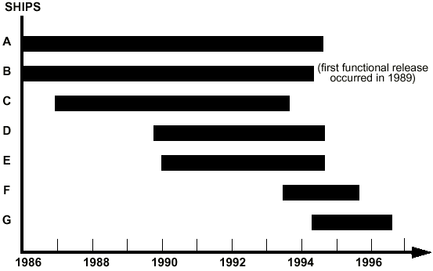
Shrinking Schedules
Figure: Change in end-to-end system development schedules over time
From “A Case Study in Successful Product Line Development, SEI Report SEI-96-TR-016, Clements & Brownsword

Slide 46
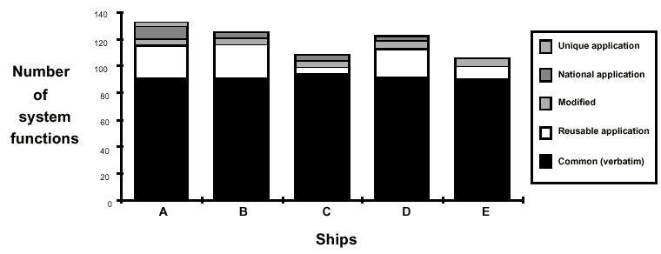
Increasing Reuse
From “A Case Study in Successful Product Line Development, SEI Report SEI-96-TR-016, Clements & Brownsword

Slide 47
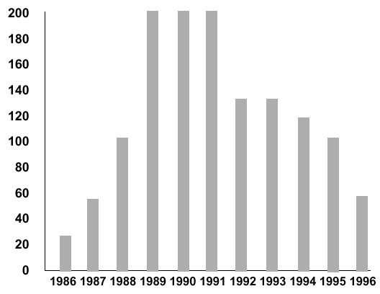
Reduced Staffing Needs
From “A Case Study in Successful Product Line Development, SEI Report SEI-96-TR-016, Clements & Brownsword

Slide 48
Observations from CT Case Study
Celsius-Tech addressed productivity problem
Improved productivity, decreased schedule, increased quality
But had to make substantial changes
Changes to development products
Kinds of products produced
Quality measures
Changes to development process
Activities, Goals, Measures of goodness
Changes to the development organization
Roles
Organizational structure
Notes:
Solution was to reuse as much as possible (the “conceptual structures”)
Had to change:
- View of products
- Processes
- Organizational structure
- Objectives, drivers, and measures of success are different

Slide 49
Lessons from Celsius-Tech
What had to change in their approach?
How did the products change?
Kinds of products produced?
Quality measures?
How did the process change?
Inputs? Outputs? Goals? Measures of goodness?
How did the organization change?
Roles?
Organizational structure?
Relationships?
Write-up for Blackboard discussion

Slide 50
Syllabus Overview
Weeks 2-3: Process modeling and process improvement
Weeks 4-8: Product-line development and related topics
Weeks 9-11: Business context, projects

Slide 51
Questions?

