Slide 1
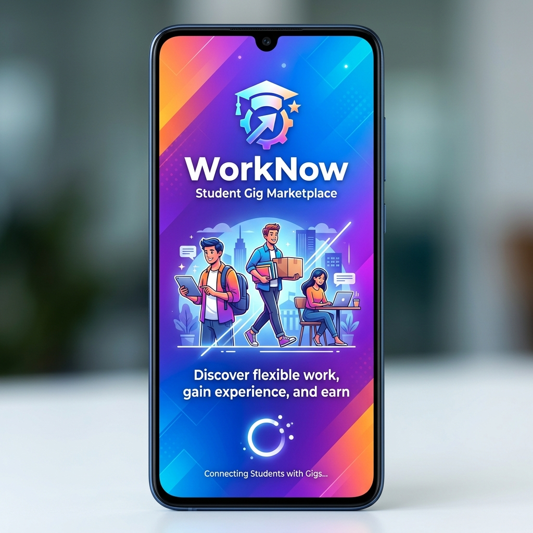
WorkNow
Student Gig Marketplace
Find Work. Find Workers. Instantly.
• Phone OTP Authentication
• Real-Time Location Matching
• Integrated Wallet & Payments
• Push Notifications & KYC

Slide 2
Problem Statement
Students need flexible income — but finding safe, quick gigs is hard.
Small employers need verified local help fast — but hiring is slow and risky.
Current Gaps:
No platform tailored to short-term, hyperlocal student gigs.
Existing platforms (Upwork, Fiverr) are designed for long-term remote work.
No verified identity / KYC for casual workers — safety risk for employers.
No real-time location-based job matching for offline/on-site gigs.
Payment disputes are common with no escrow mechanism.
Students lack a digital work history or rating system to build credibility.
The Need: A trusted, mobile-first marketplace where students can find
hyperlocal gigs instantly, and employers can hire with confidence.

Slide 3
📌 Overview
WorkNow connects student freelancers with local short-term gigs.
👷 Worker (Student)
• Browse nearby jobs on an interactive map
• Apply with one tap and track tasks in real-time
• Get paid directly to an in-app wallet
🏢 Employer
• Post gigs with location, budget & required skills
• Instantly matched with verified students nearby
• Review applicants, hire, and pay securely

Slide 4
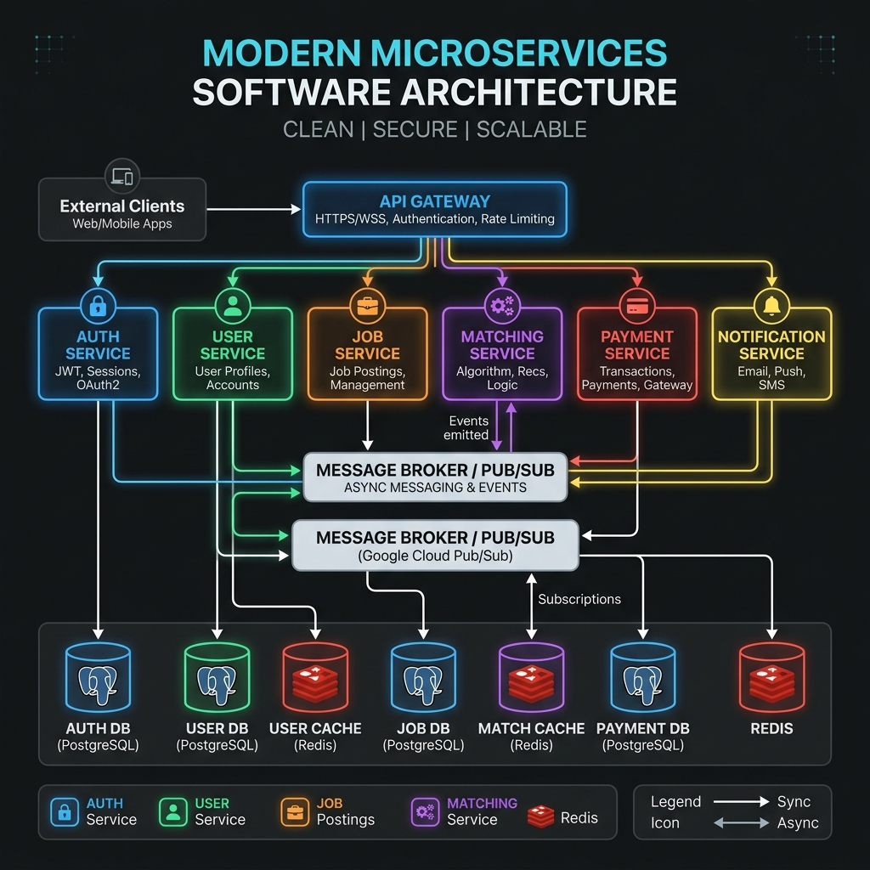
🏗️ Micro-Service Architecture
A production-grade monorepo (Turborepo) with six NestJS microservices.
🔐 Auth Service – OTP login, JWT tokens
👤 User Service – Profiles, KYC, wallet balance
💼 Job Service – Gig CRUD, lifecycle management
📍 Matching Service – Geo-radius + skill-based matching
💳 Payment Service – Razorpay wallet & payouts
🔔 Notification Svc – FCM push & MSG91 SMS
Event-driven: Services communicate via GCP Pub/Sub.

Slide 5
⚙️ Tech Stack
Frontend: Next.js 14, React 18, TypeScript, Tailwind CSS
Maps: React-Leaflet, Google Maps API
Backend: NestJS, TypeScript (6 microservices)
ORM: Prisma ORM
Database: PostgreSQL 15 (one DB per service)
Cache: Redis 7 (OTPs, geo-locations, sessions)
Messaging: Google Cloud Pub/Sub (emulated locally)
Payments: Razorpay (wallet top-up & payouts)
Push Alerts: Firebase Cloud Messaging (FCM)
SMS: MSG91 (OTP delivery)
DevOps: Docker Compose, Turborepo

Slide 6
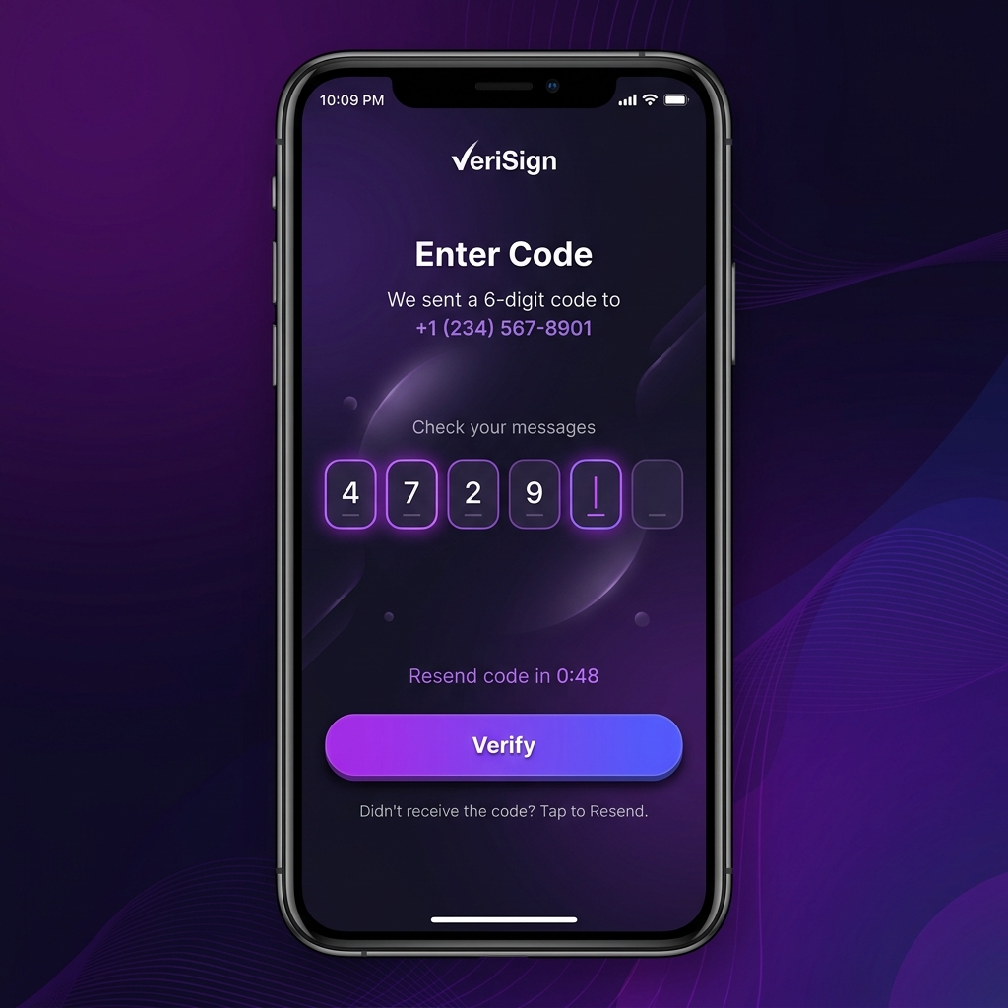
🔐 Feature: Registration & Authentication
Phone-based OTP Login — no password required.
How it works:
1. User enters phone number → Auth Service calls MSG91.
2. 6-digit OTP stored in Redis with 5-minute TTL.
3. User enters OTP → verified → JWT issued.
4. Role selected: WORKER or EMPLOYER.
Security:
• Access Token: 15 min expiry
• Refresh Token: 7 day expiry
• OTP brute-force protected via Redis TTL

Slide 7
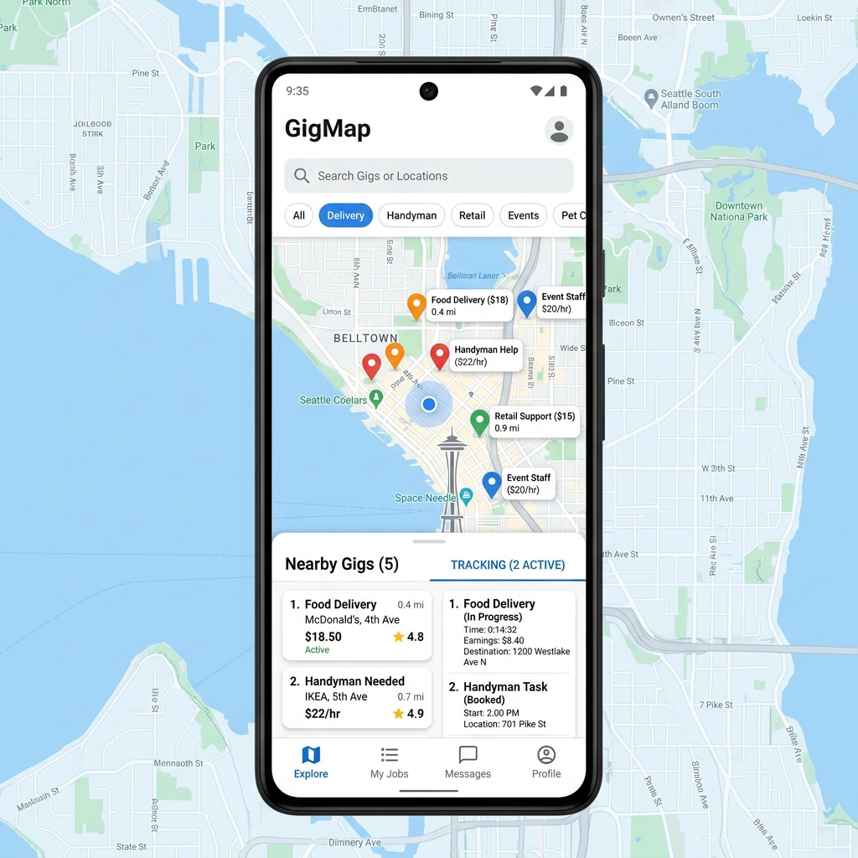
👷 Feature: Worker (Student) Experience
Map-Based Discovery: Live job pins on GPS map (5 km radius).
One-Click Apply: Apply to gigs instantly from the map.
Task Tracker: Monitor active & completed gigs.
KYC Verification: Upload Aadhar/Student ID for 'Verified' badge.
Rating System: Build reputation through successful completions.
Digital Wallet: Receive payout directly to in-app balance.
Push Notifications: Instant alert for every new matching job.

Slide 8

🏢 Feature: Employer Experience
Rapid Job Posting: Set title, location (Google Places), budget & skills.
Automated Matching: Top 10 nearest verified workers notified instantly.
Applicant Review: View profiles, ratings & KYC status before hiring.
Escrow Payments: Funds secured on hire; released on completion.
Task Dashboard: Track jobs — OPEN → ASSIGNED → COMPLETED.
Transaction History: Full log of all wallet movements.
Push Alerts: Notified on every application received.

Slide 9
🔄 System Working: Step 1 & 2 – Post & Match
STEP 1 — Job Creation
• Employer fills form → Frontend sends POST /jobs
• Job Service saves to PostgreSQL
• Publishes 'job.created' event → GCP Pub/Sub
STEP 2 — Geo-Radius Matching
• Matching Service receives 'job.created' event
• Queries Redis for workers within 5 km
• Filters by skill overlap
• Returns ranked list of up to 10 workers
• Notification Service sends FCM push to each worker

Slide 10
🔄 System Working: Step 3 & 4 – Apply & Hire
STEP 3 — Application
• Worker receives push → opens app → views job on map
• Taps 'Apply' → Frontend sends POST /jobs/:id/apply
• Job Service publishes 'application.submitted' event
• Employer receives push: 'New applicant received'
STEP 4 — Hiring
• Employer reviews applicant profiles & ratings
• Selects a worker → PATCH /jobs/:id/hire/:workerId
• Job status → ASSIGNED → IN_PROGRESS
• Employer wallet balance conceptually escrowed

Slide 11
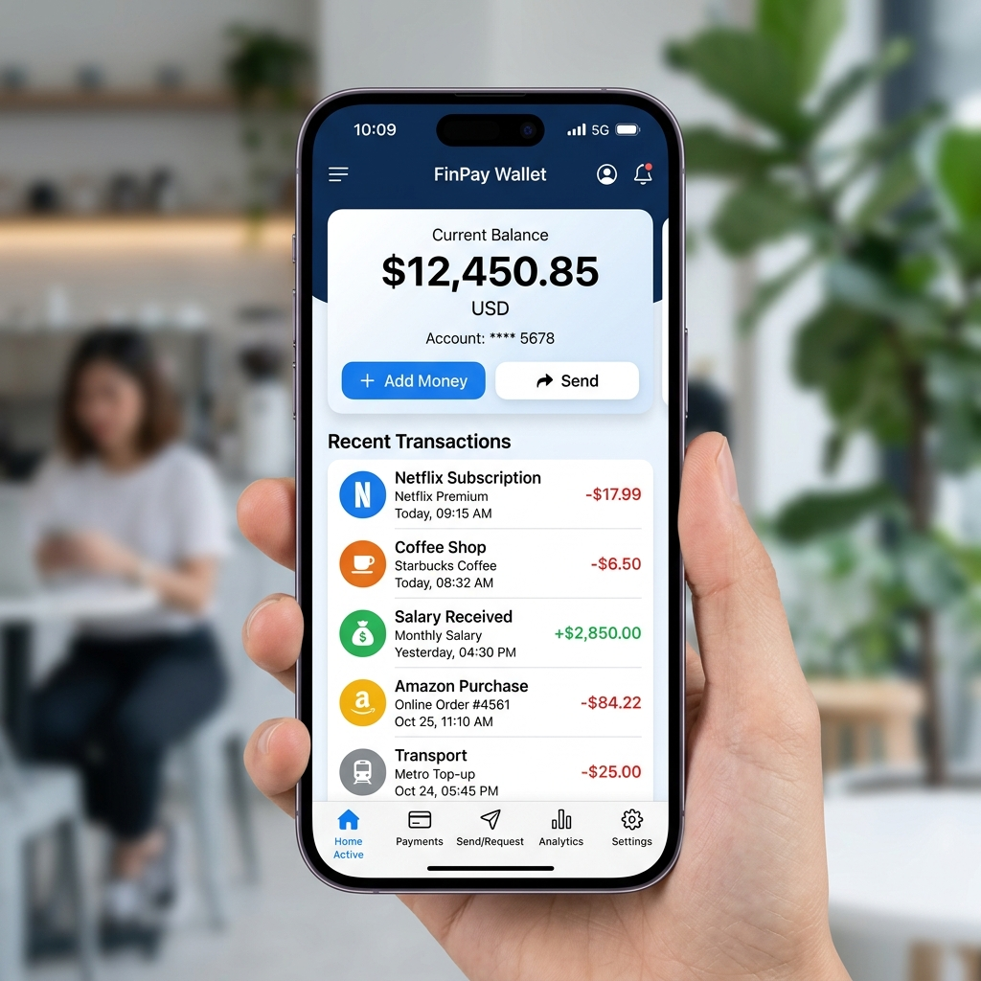
🔄 System Working: Step 5 – Complete & Pay
STEP 5 — Task Completion & Payout
• Worker completes task in real life
• Employer taps 'Mark as Done' → PATCH /jobs/:id/complete
• Job Service publishes 'job.completed' event
• Payment Service transfers funds:
Employer Wallet ──▶ Worker Wallet
• Transaction logged in worknow_payment DB
• Both parties notified via FCM
• Both prompted to rate each other

Slide 12
⚙️ Under the Hood: Technical Flow
Frontend → REST API calls to individual microservices.
Microservices → Async events via GCP Pub/Sub topics.
Redis → Caches OTPs (TTL), worker locations, sessions.
PostgreSQL → Each service owns its own isolated database.
Razorpay Webhooks → Securely verify payments before crediting wallet.
Prisma ORM → Type-safe DB access with migration support.
Turborepo → Parallel builds & dev across all services.
Docker Compose → One command to start Postgres, Redis & Pub/Sub.

Slide 13
Mobile-First Experience
The entire platform is designed mobile-first.
GPS Location: Detects user position automatically.
Map UI: Jobs shown as interactive pins (React-Leaflet).
Push Alerts: Firebase FCM for real-time notifications.
SMS OTP: MSG91 for secure phone verification.
Mobile Wallet: Top-up and check balance on the go.
LAN Access: Dev server binds to 0.0.0.0 for phone testing.

Slide 14
Frontend Deep Dive
Framework: Next.js 14 App Router — React 18, TypeScript
Styling: Tailwind CSS 3 + Material Symbols (icons)
Pages & Routes:
/ – Animated splash screen with gradient blobs
/login – Phone entry + 6-digit OTP verification
/worker/home – Map-based job feed (React-Leaflet + GPS)
/worker/job – Job detail view and application form
/worker/tasks – Active and completed task history
/worker/wallet – Earnings, balance & transaction history
/worker/profile– Profile editor + KYC document upload
/customer/home – Employer dashboard
/customer/post-job – Create a new gig (Google Places API)
/customer/tasks– Manage jobs, review applicants, hire
/customer/wallet– Top-up wallet, payment history
Auth: NextAuth.js session management + Supabase JS

Slide 15
Backend Deep Dive
Framework: NestJS + TypeScript — 6 independent microservices
Each service runs on its own port with its own PostgreSQL DB.
Auth Service (port 3001): OTP via MSG91, JWT access+refresh tokens, Redis TTL
User Service (port 3002): UserProfile, KYC docs (PENDING/VERIFIED/REJECTED), ratings
Job Service (port 3003): Gig CRUD, status: OPEN->ASSIGNED->IN_PROGRESS->COMPLETED
Matching Svc (port 3006): Geo-radius (5km) in Redis, skill filter, top-10 worker rank
Payment Svc (port 3004): Razorpay orders & webhooks, wallet top-up, fund transfers
Notification (port 3005): Subscribes to Pub/Sub, sends FCM push + MSG91 SMS
Database: Prisma ORM — type-safe queries + migration support
Messaging: GCP Pub/Sub — job.created / application.submitted / payment.completed
DevOps: Turborepo (parallel builds), Docker Compose (Postgres + Redis + Pub/Sub)

Slide 16
Thank You
WorkNow — Student Gig Marketplace
Built with ❤️ for students who hustle.
Next.js • NestJS • PostgreSQL • Redis • Razorpay • FCM

