Slide 1
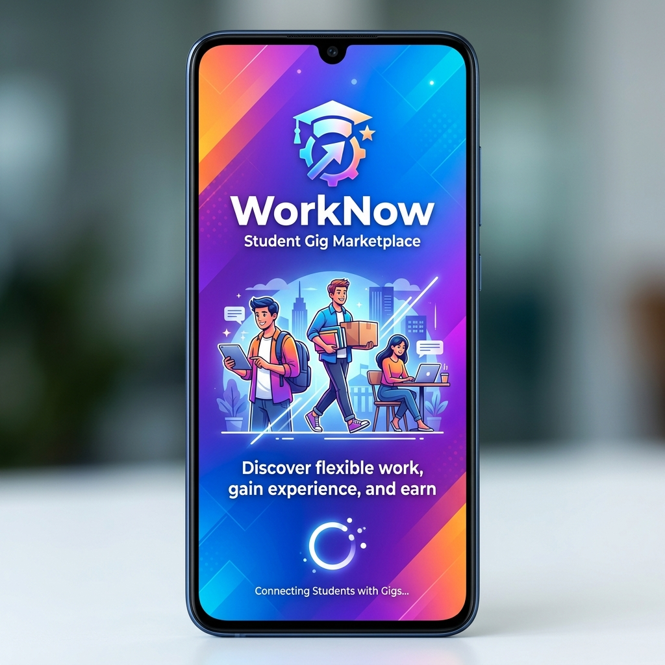
WorkNow: Features & System Working
Deep Dive into Core Capabilities & Workflows

Slide 2
Core Platform Features
WorkNow is designed for speed, security, and seamless gig matching.
Phone-based OTP Authentication (Fast login)
Role-Based Dashboards (Worker vs. Employer)
Real-Time Location Matching (5km radius searches)
Integrated Wallet & Escrow Payments
Automated Push Notifications (FCM) & SMS Alerts

Slide 3
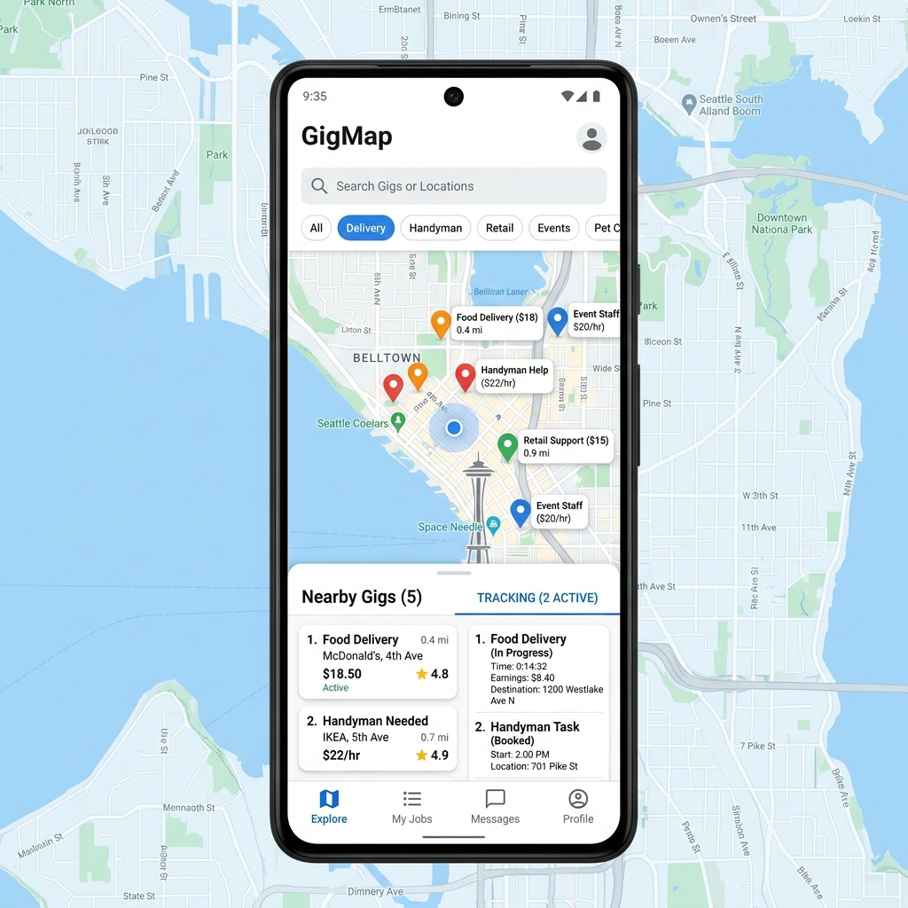
Features for Workers (Students)
Map-Based Discovery: See live jobs pinned on a map based on GPS.
One-Click Applications: Apply to local gigs instantly.
Trust & KYC: Upload student ID/Aadhar to get a 'Verified' badge.
Digital Wallet: Receive payments directly into the app.
Rating System: Build reputation through successful task completions.

Slide 4
Features for Employers
Rapid Job Posting: Create a gig with location, budget, and required skills.
Automated Matching: System automatically notifies the 10 closest qualified workers.
Applicant Review: View worker profiles, ratings, and KYC status before hiring.
Secure Payments: Top-up wallet via Razorpay and pay workers securely.
Task Management: Track jobs from 'Open' to 'In Progress' to 'Completed'.

Slide 5
How it Works: Posting & Matching
Step 1: Job Creation
- Employer submits a gig via the Frontend.
- The Job Service saves it and publishes a 'job.created' event via Pub/Sub.
Step 2: Geo-Radius Matching
- The Matching Service listens to the event.
- It queries Redis for workers within a 5km radius with matching skills.
- Returns a ranked list of up to 10 best workers.

Slide 6
How it Works: Applying & Hiring
Step 3: Notification & Application
- Notification Service pushes FCM alerts to the matched workers.
- Worker clicks the alert, views the map, and applies.
- The Employer receives a push notification about the new applicant.
Step 4: Hiring & Escrow
- Employer selects a worker.
- System conceptually escrows the funds from Employer's wallet.
- Job status updates to 'IN_PROGRESS'.

Slide 7
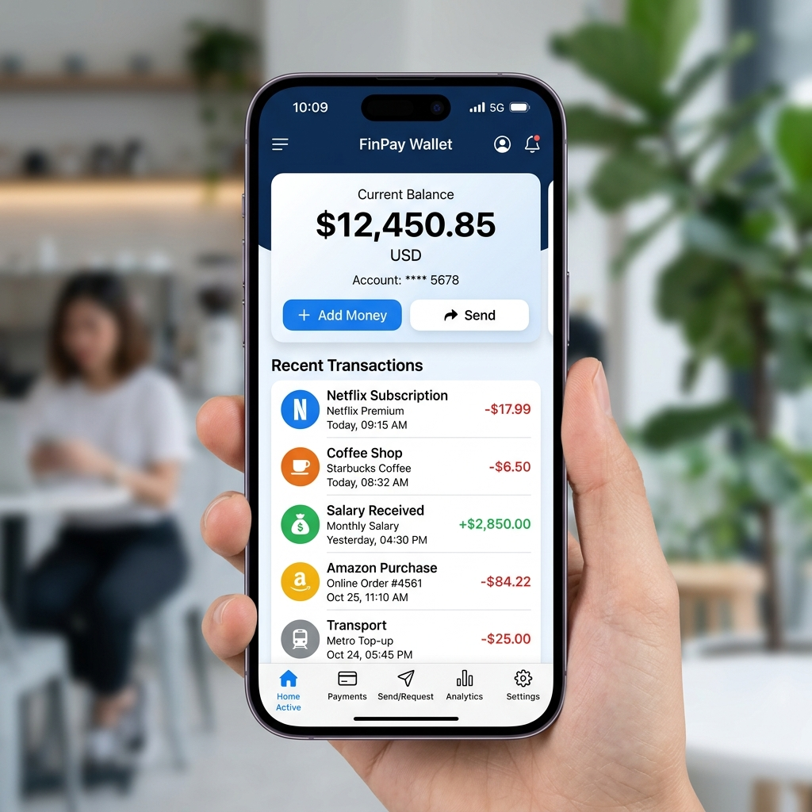
How it Works: Completion & Payment
Step 5: Task Completion & Payout
- Worker completes the task in real life.
- Employer marks the job as 'Completed' in the app.
- Job Service triggers 'job.completed' event.
- Payment Service automatically transfers funds to the Worker's wallet.
- Both parties are prompted to leave a rating.

Slide 8
Under the Hood: Technical Flow
Event-Driven Architecture ensures decoupled, scalable processing.
Frontend -> API Gateway / Microservices (REST).
Microservices communicate asynchronously via GCP Pub/Sub.
Heavy reads (like Worker Locations) are cached in Redis.
Razorpay webhooks securely update Wallet balances in PostgreSQL.

