Slide 1
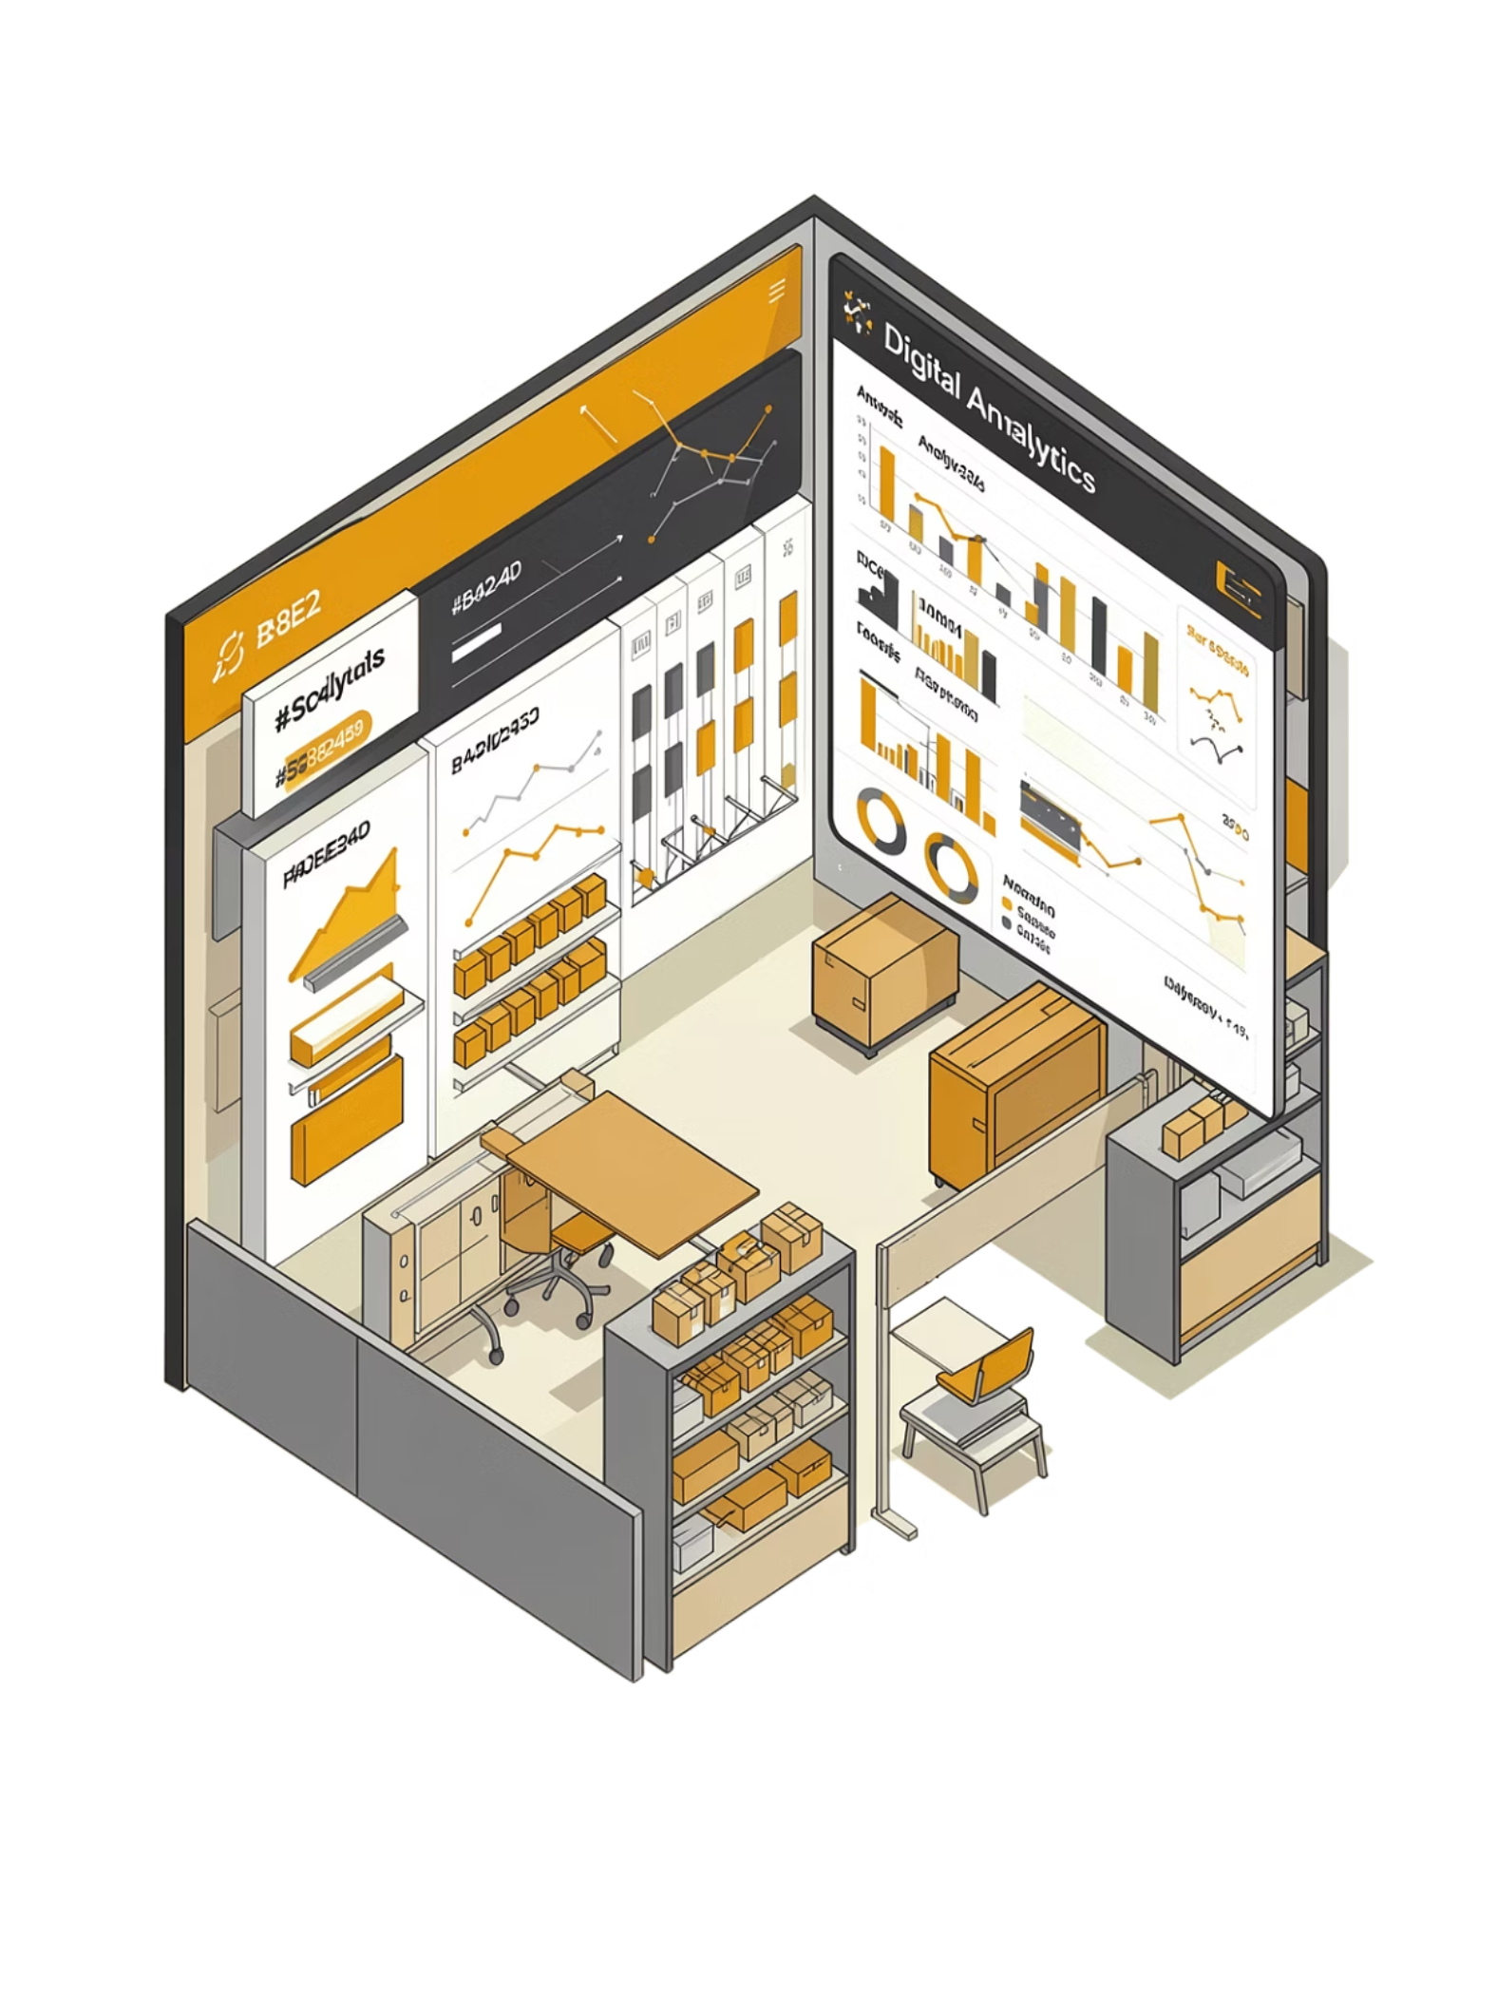

RetailIQ: Smart Retail Demand Forecasting and Analytics System
Web-based retail intelligence platform that combines machine learning, interactive dashboards, and actionable recommendations to help retailers forecast demand and optimize decisions.
Ayesha Khalid | Uma E Rubab

Slide 2
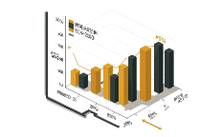
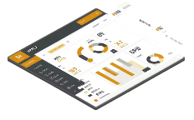


What RetailIQ Does
Sales Forecasting
Interactive Dashboard
Actionable Recommendations
Centralized Analytics
ML-powered demand predictions at SKU and store level.
Real-time charts, trend views, and KPI summaries for quick insights.
Unified store, sales, and feedback data for cross-cutting analysis.
Promotion and stocking suggestions to reduce stockouts and overstocks.

Slide 3





Key Advantages
Accurate Forecasts
Fast Insights
Inventory & Promotion Planning
Ensemble ML models tuned for seasonal and promotional patterns.
Interactive UI surfaces answers within seconds for decision-makers.
Forecast-driven restock and promo suggestions reduce waste.
User-Friendly
Centralized System
Designed for non-technical users with clear workflows and help text.
Single source of truth for cross-store analytics and reporting.

Slide 4

Constraints & Risks
Dependent on dataset quality — noisy or biased data degrades forecasts.
Model performance may vary on unseen patterns (novel events).
Web-based access requires internet connectivity for users.
Limited real-time data integration — near-real-time, not streaming.
Scalability tied to infrastructure (compute, DB, and ML serving).

Slide 5
Non-Functional Requirements (NFRs)
Performance
Usability
System responds within a few seconds; dashboards and API endpoints handle concurrent requests efficiently.
Clear navigation, consistent UI patterns, and accessible controls for non-technical staff.

Slide 6
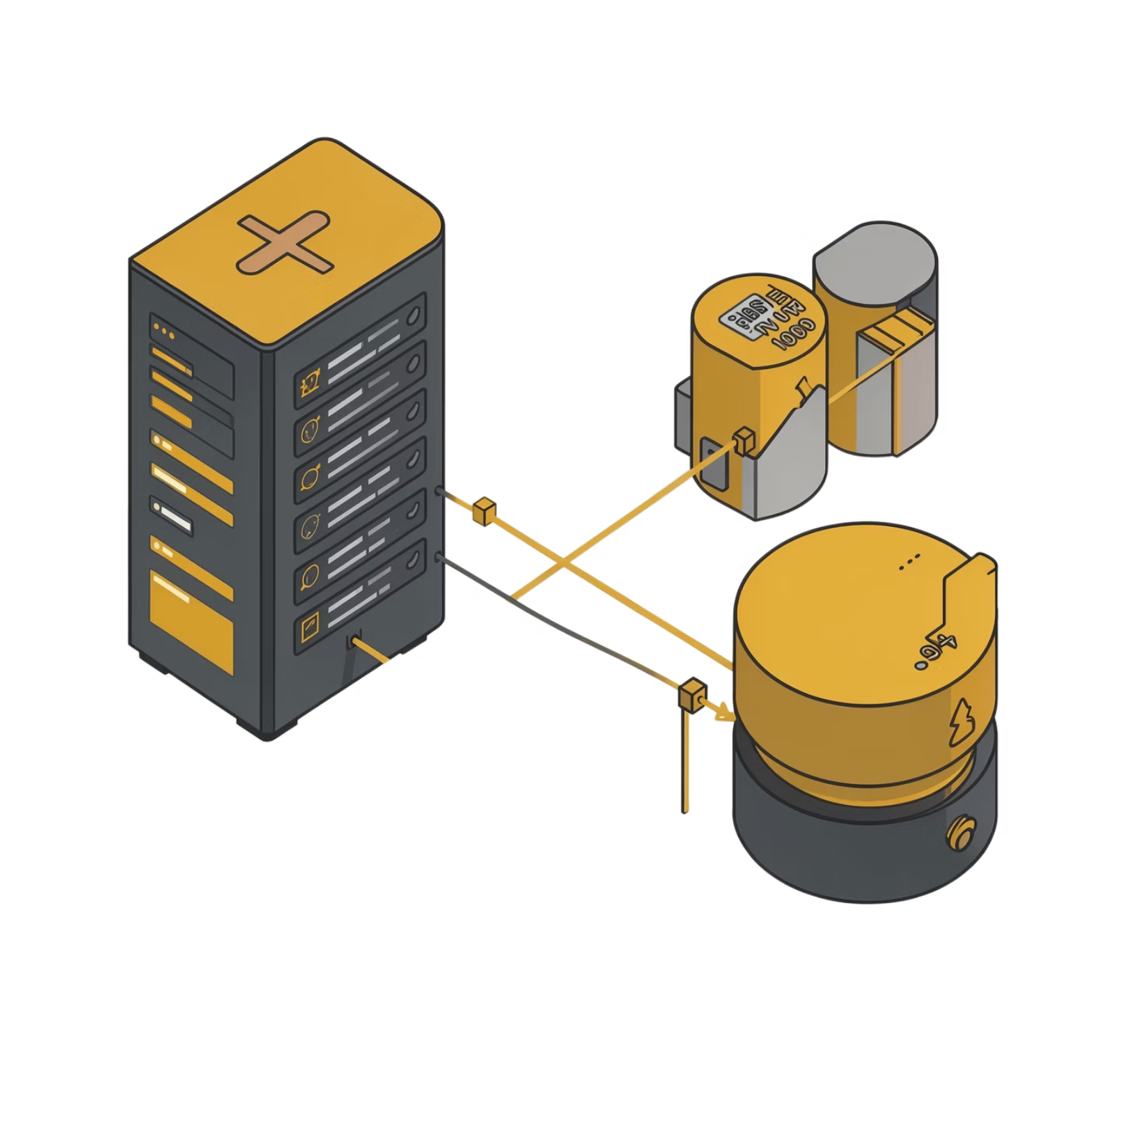
System Design
Modular Components
Frontend (React): dashboards, views, auth
Backend (APIs): business logic & orchestration
ML Services: training, inference, model registry
Database: users, sales, metadata, feedback
Analytics Module: aggregation & feature engineering

Slide 7
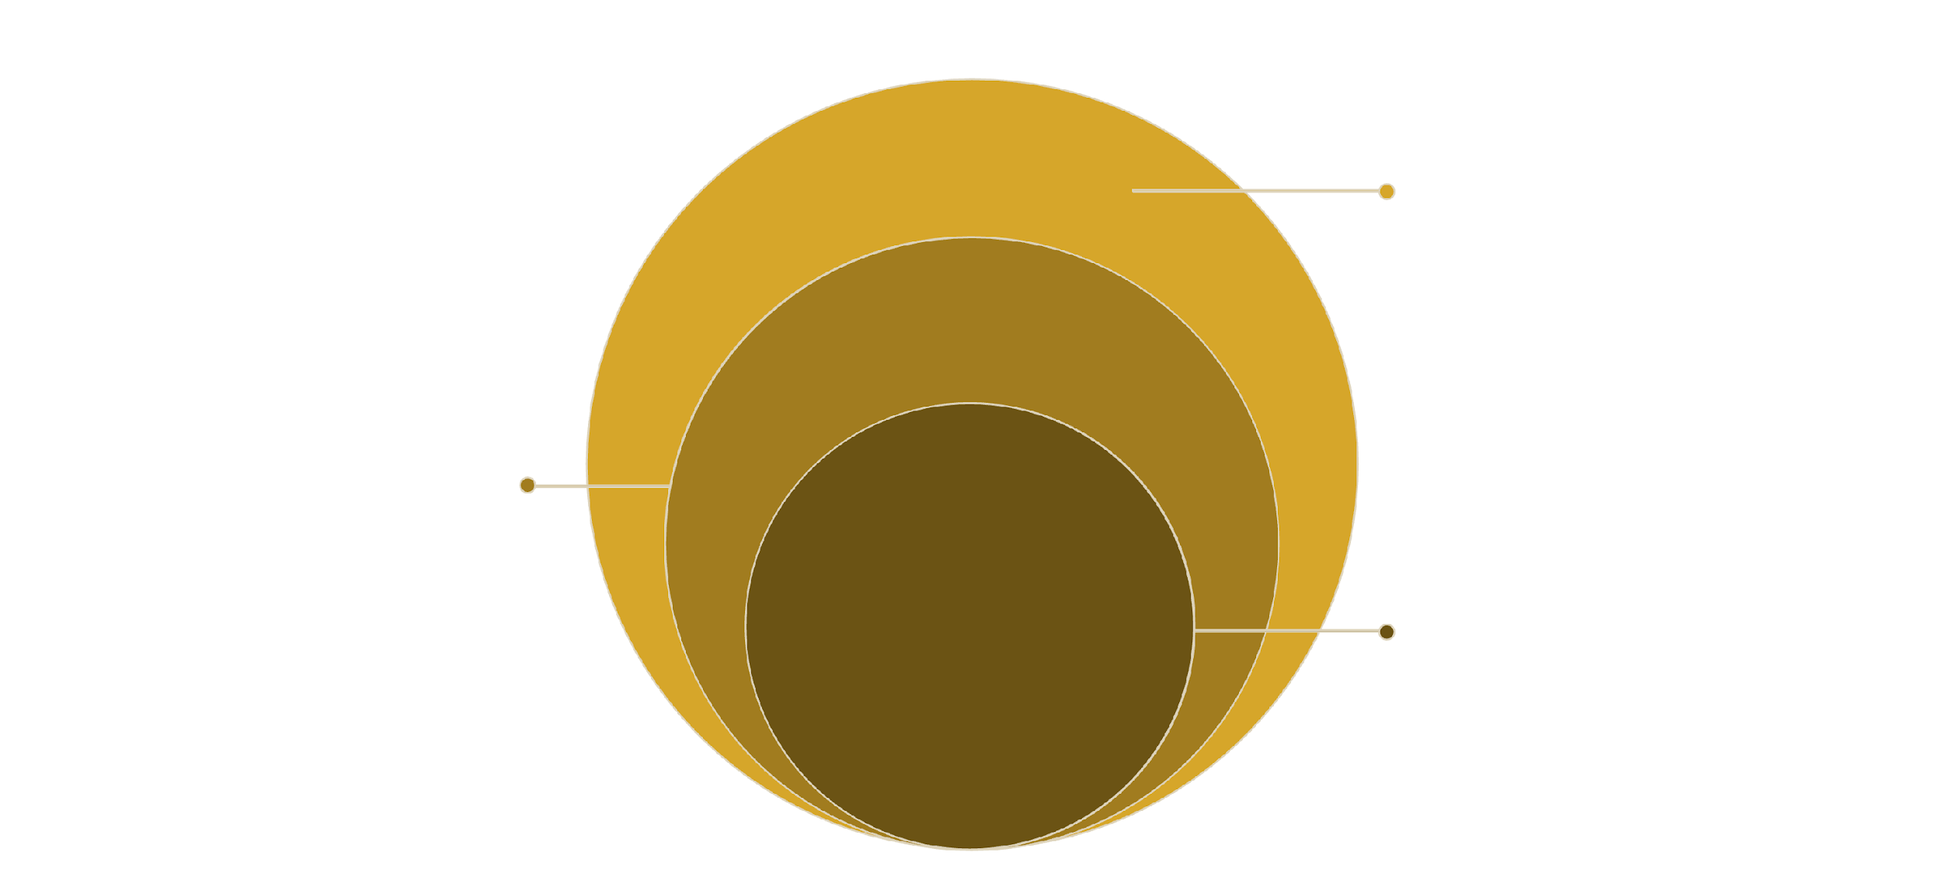
Architecture Overview
Data Layer
Sales, users, and model stores
Backend Services
Business logic and ML processing
Frontend
React UI calling backend APIs
Client-server model with separation of presentation, logic, and data layers to ensure maintainability and horizontal scalability.

Slide 8
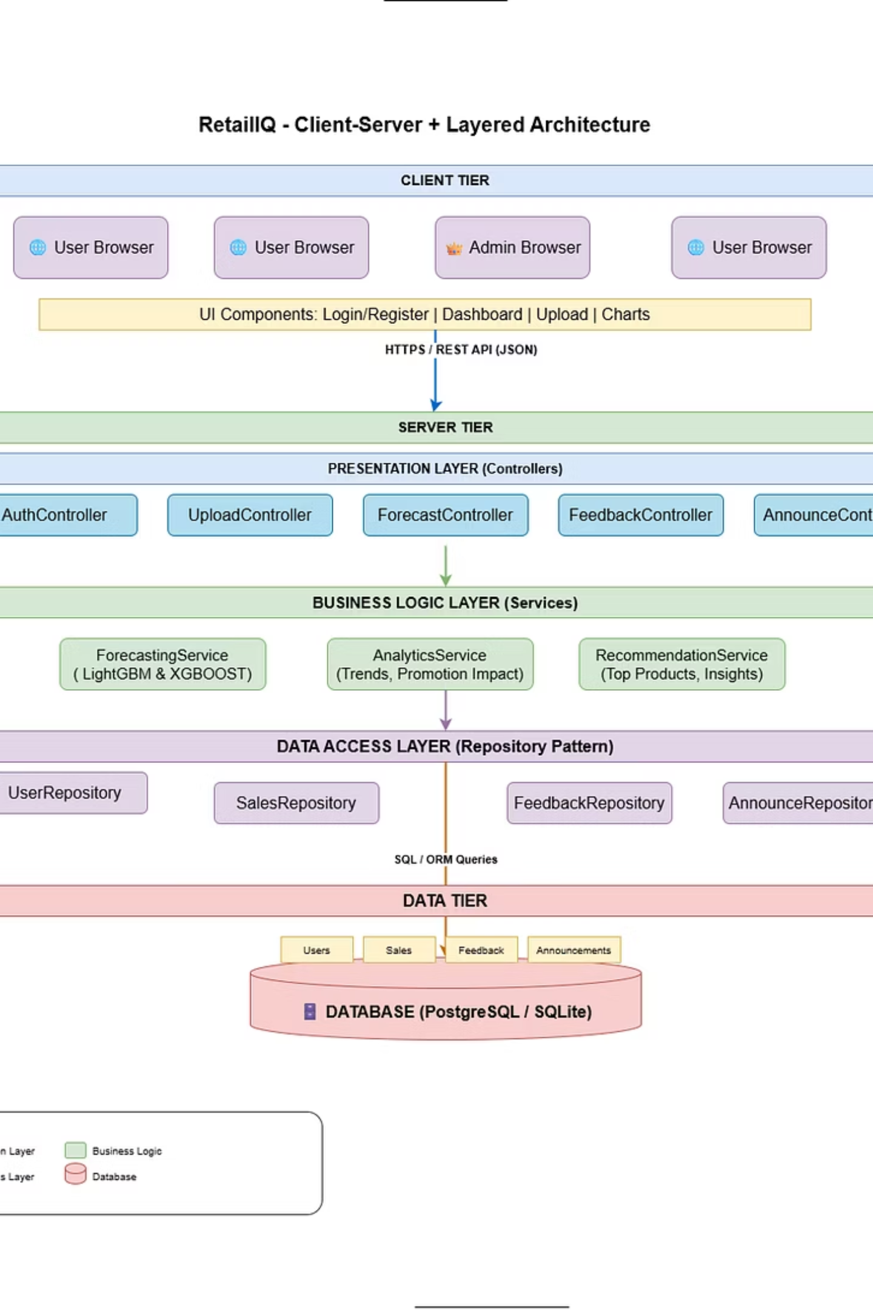
Architecture Style
The RetailIQ system follows a Client-Server Architecture combined with Layered Architecture to ensure modularity, maintainability, and scalability. This architectural approach enables efficient communication between users and the system while organizing the internal functionalities into structured layers.

Slide 9
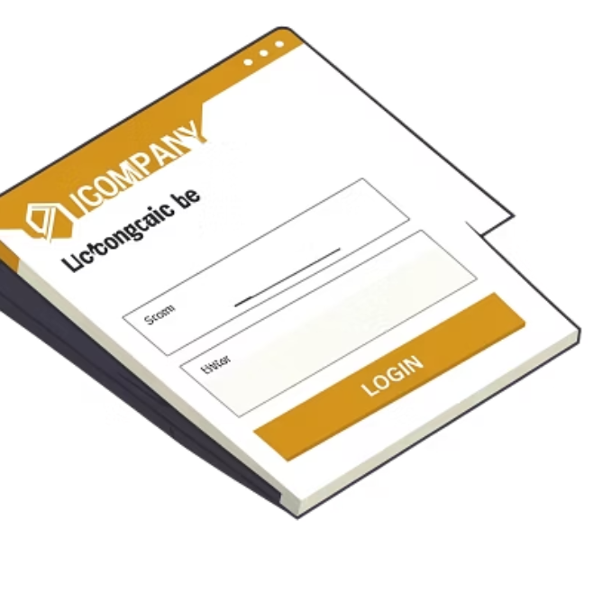
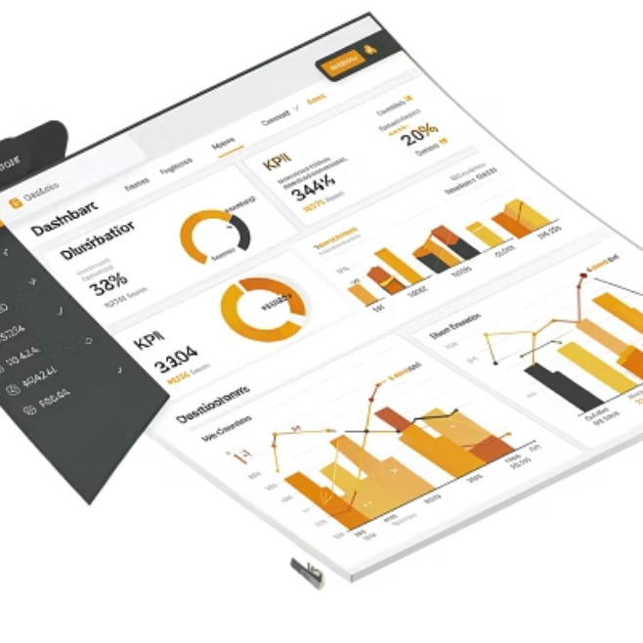
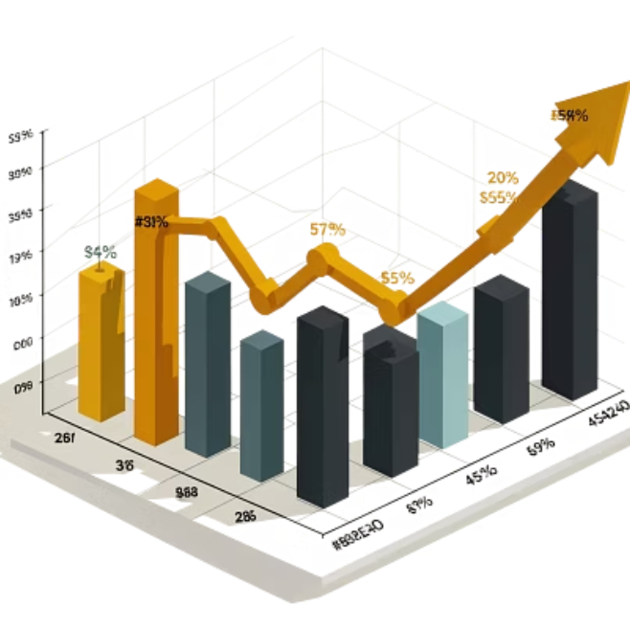
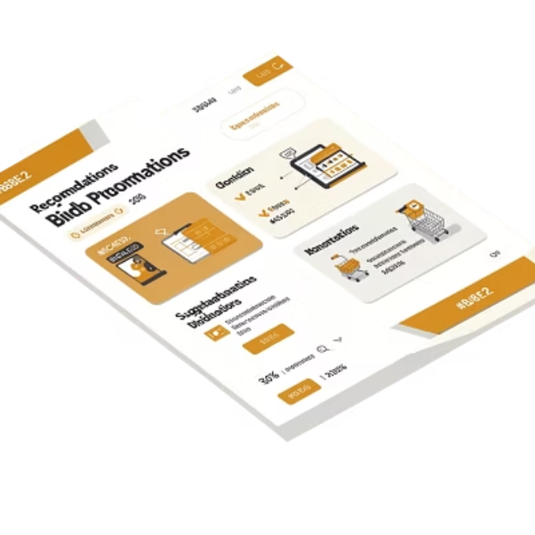
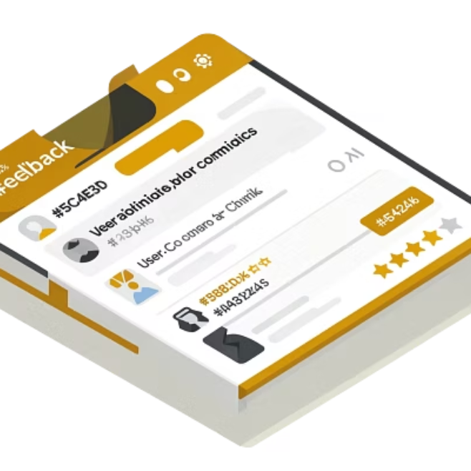
Implementation — Interface Screenshots
Screenshots of implemented system interfaces

Slide 10
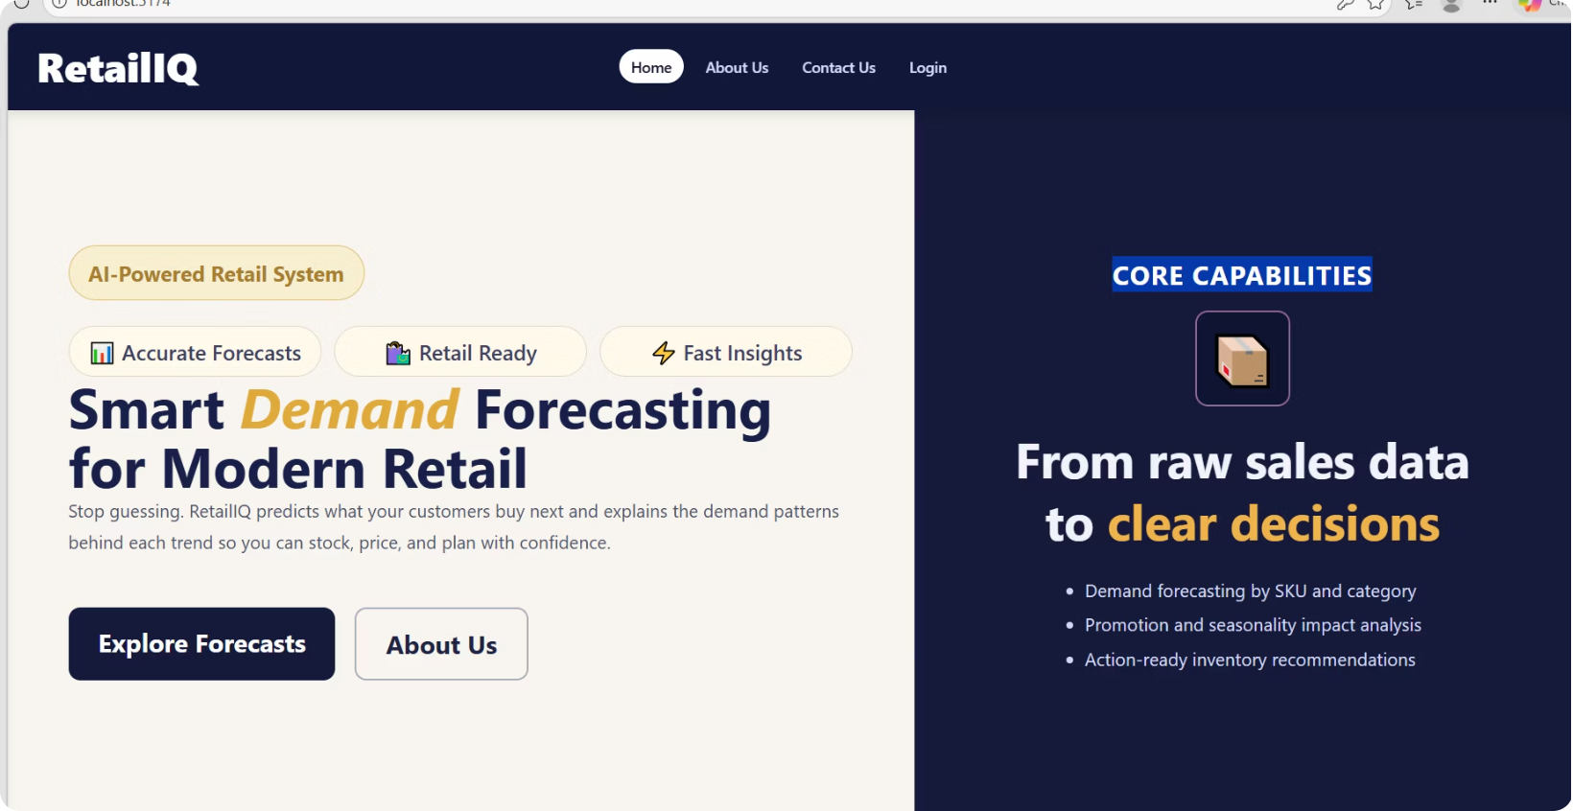
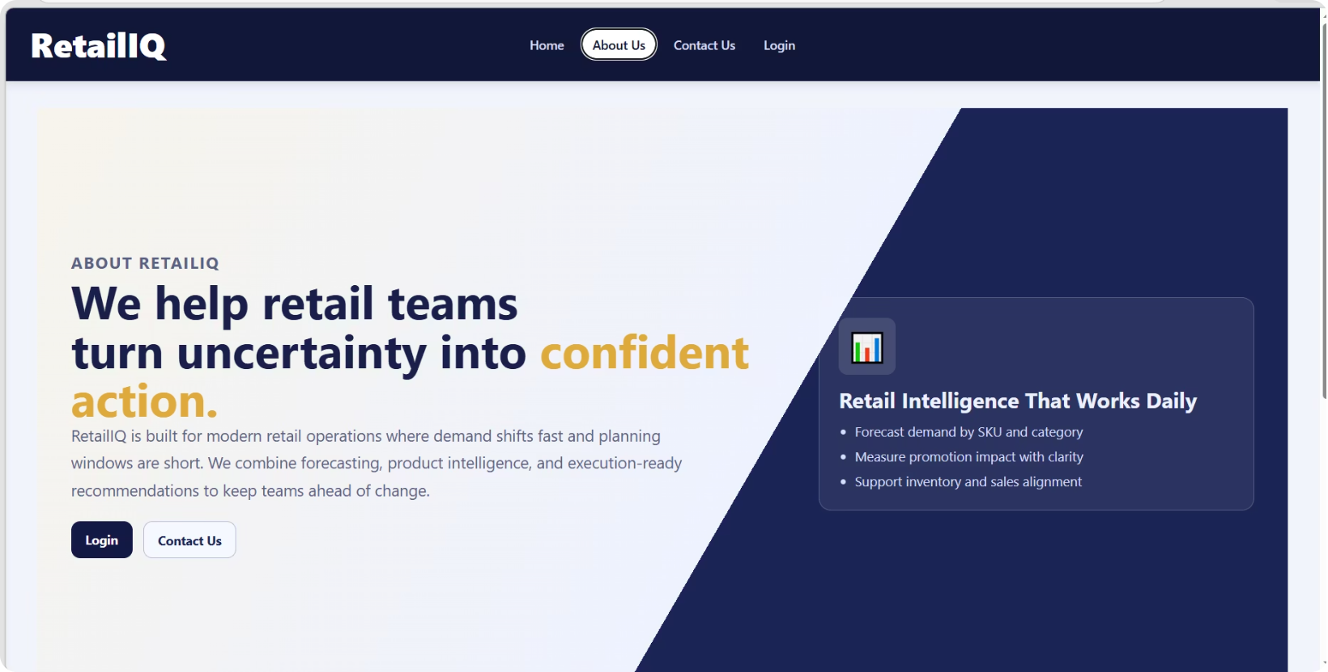
Implmentation
Home Page
About Us

Slide 11
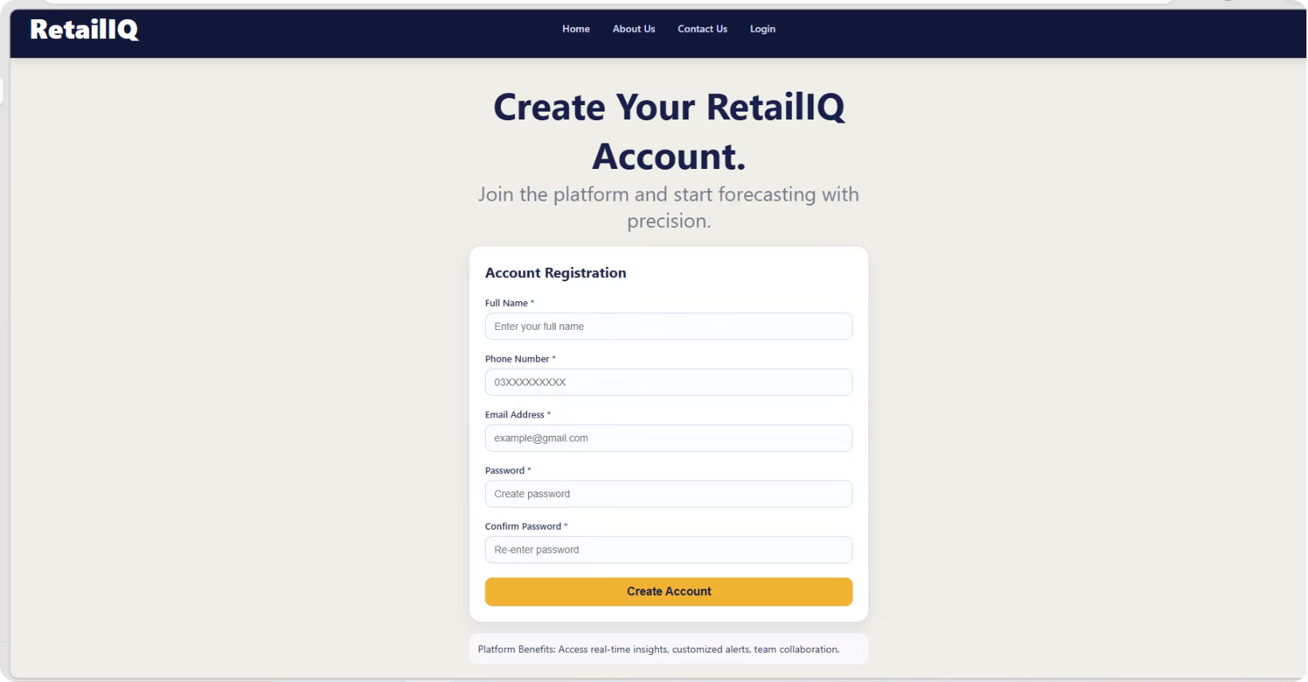
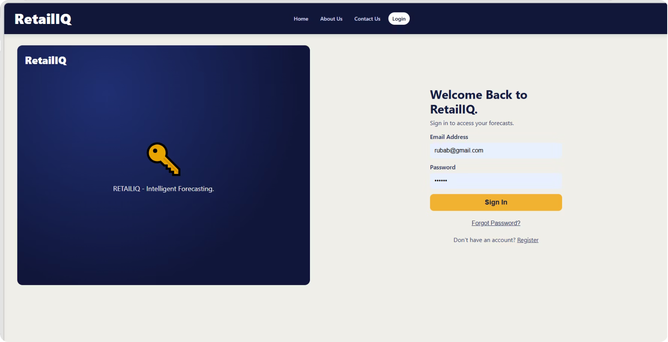
Implementation
Create Account
Login

Slide 12
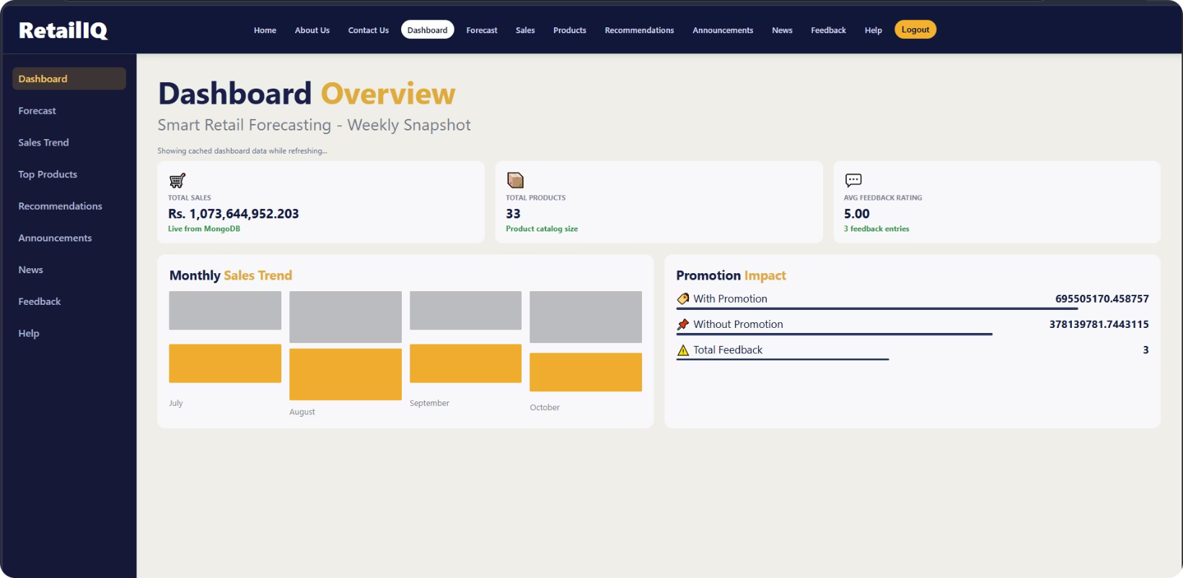
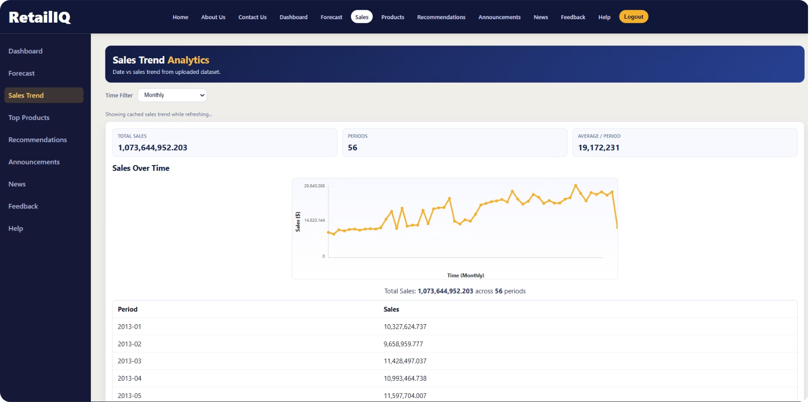
Implementation
Dash Board
Sales

Slide 13
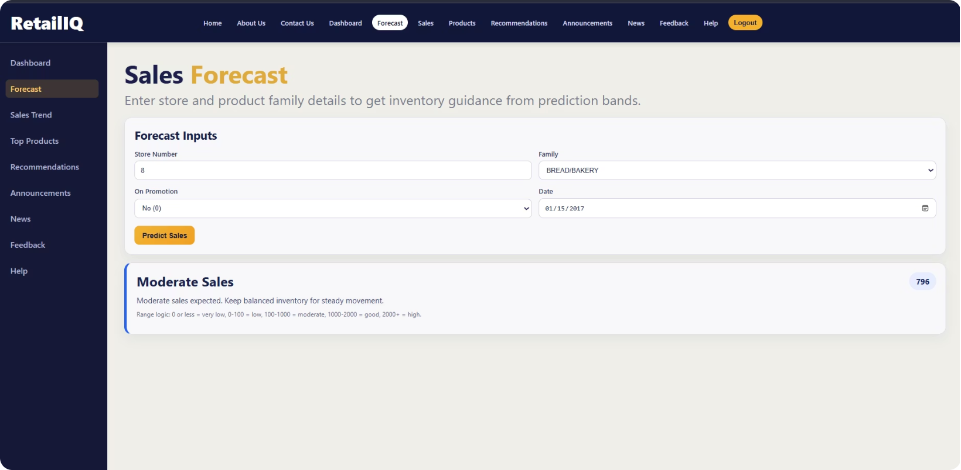
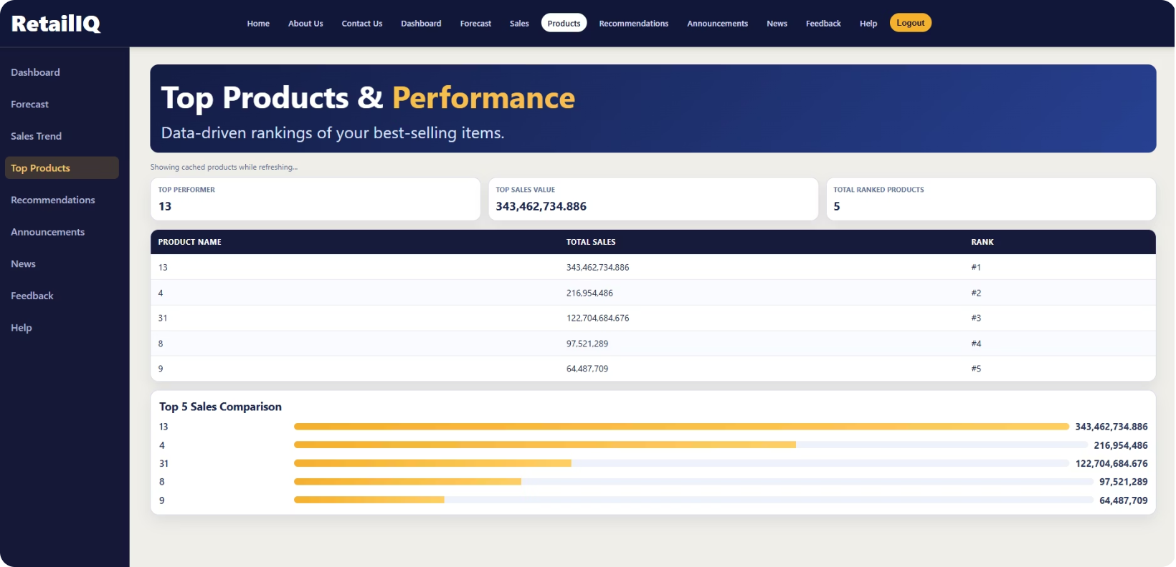
Implementation
Forecasting
Top Products

Slide 14
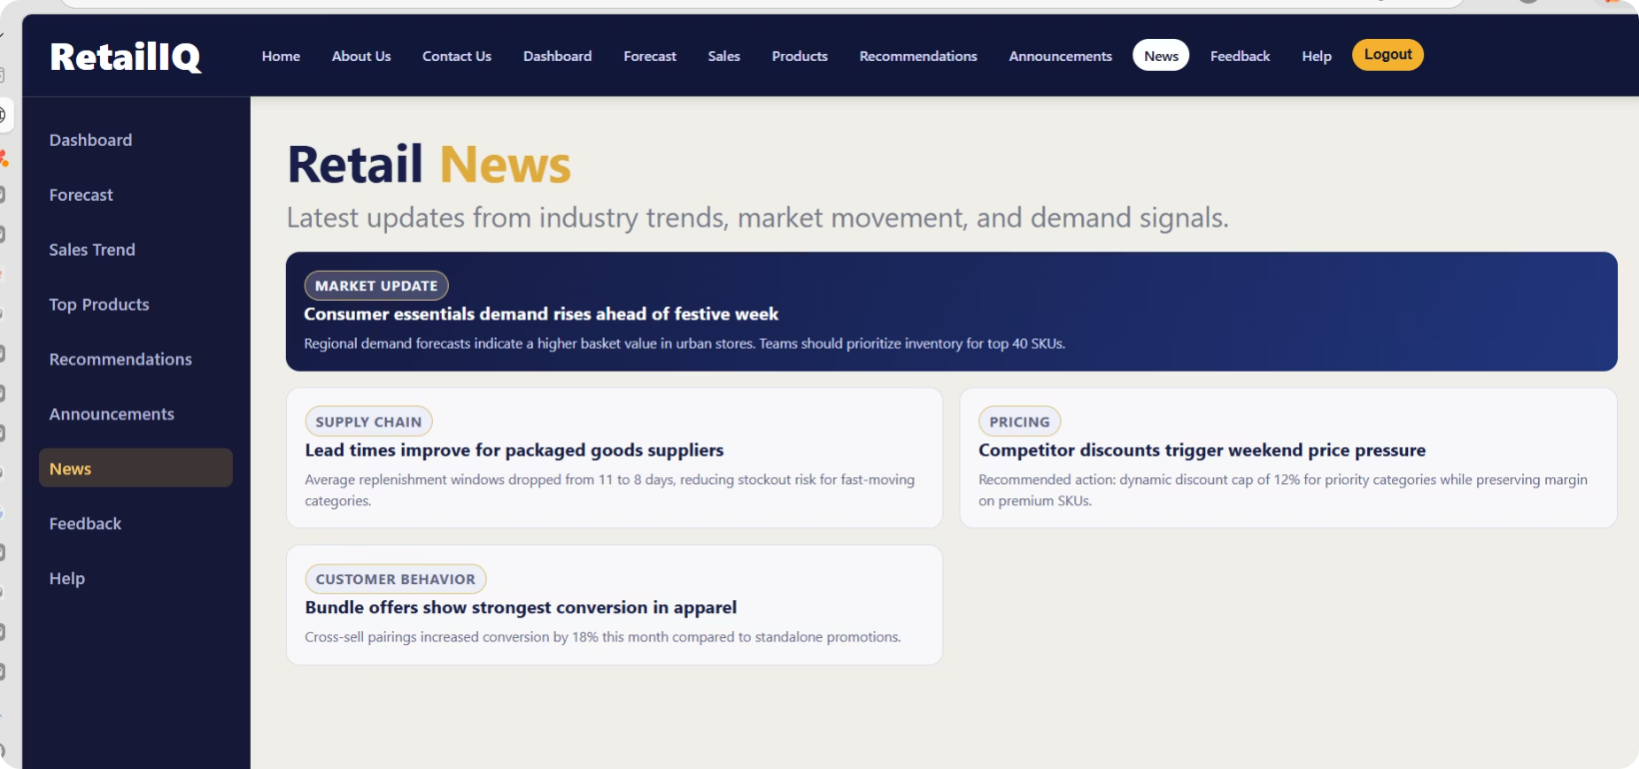
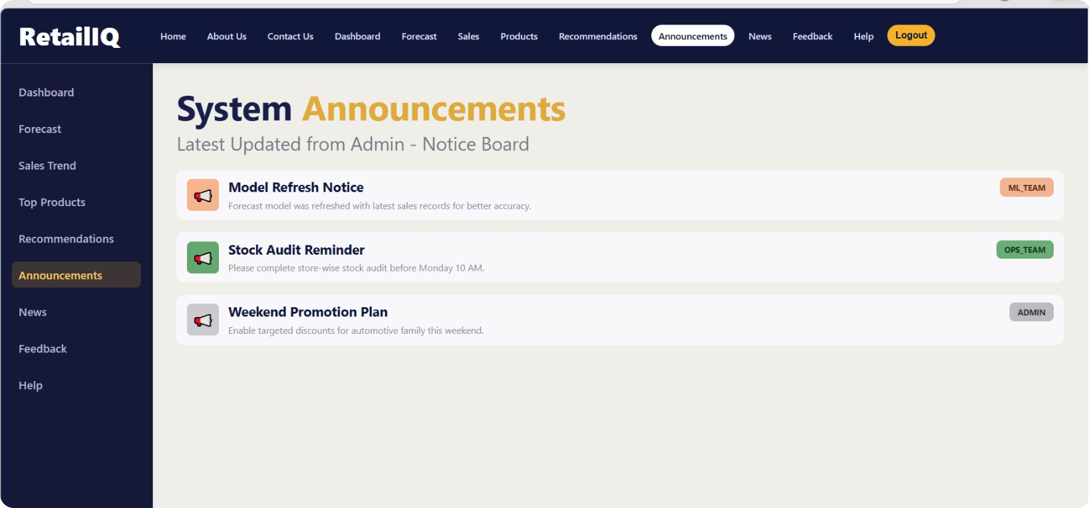
Implementation
News/Insights
Announcements

Slide 15
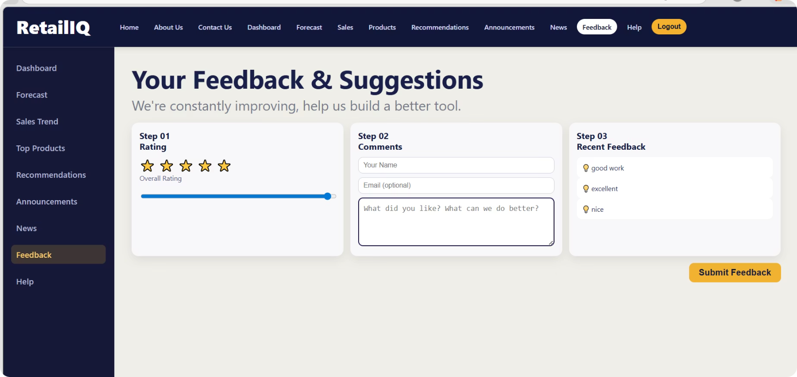
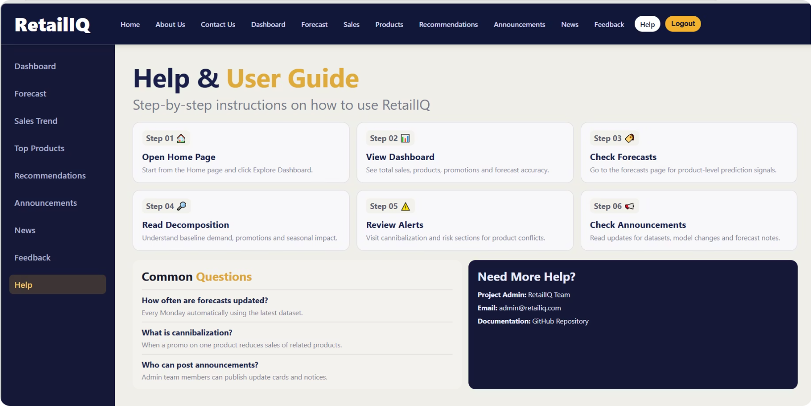
Implementation
Feedback
Help & User Guide

Slide 16
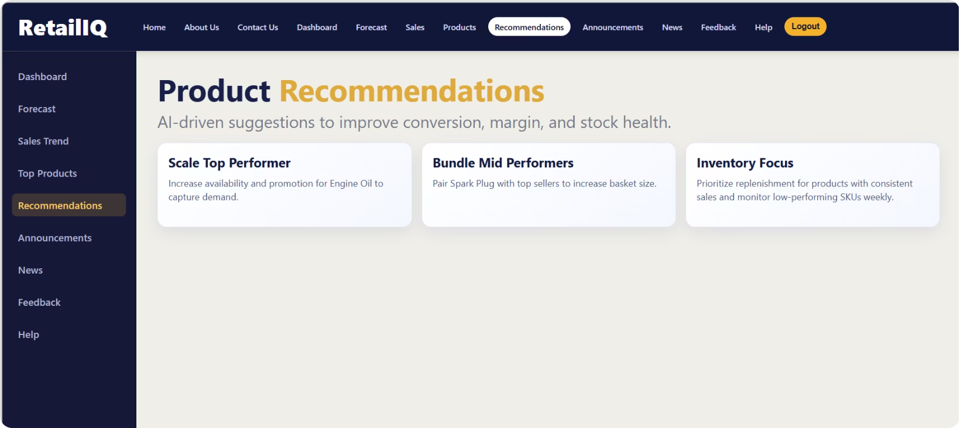
Implementation
The system has been successfully implemented with all core functionalities integrated, resulting in a fully functional and user-friendly RetailIQ platform.
Product Recommendations

Slide 17
Work Division
Ayesha Khalid
Uma E Rubab
Machine Learning: EDA, model training, forecasting
Backend API development
API testing (Postman) & technical documentation
Frontend development (all pages) & UI/UX design
Integration of frontend with backend
System-level testing and user flows

Slide 18
Lessons Learned & Takeaways
Teamwork & Communication
Regular syncs and clear task ownership kept progress steady.
Adaptability
Flexible approaches helped handle data and scope changes.
Division by Strengths
Assigning tasks based on expertise improved quality and speed.
Integration Focus
Early end-to-end testing prevented late-stage integration issues.
Supportive Culture
Empathy and collaboration contributed to project success.
Next steps: pilot with a partner store, monitor model drift, and iterate on automation for near-real-time data ingestion.

Slide 19
Thank You :)

