Slide 1

Marketing plan
Air Conditioner

Slide 2
Marketing Project Team Number: 18 Submitted to Dr./ Amr Ezzat Safwat
Names | Codes
Ahmed Ayman Ahmed Hassan | 1700037
Salma Tarek Elalfy Mohamed | 1700620
Abdelrahman Mohamed Anwar Ahmed | 1700757
Farid Mohamed Farid Ibrahim | 1700985
Yumna Ahmed Mohamed Ghoneim | 1701692

Slide 3


Air Cool company for air conditioning systems
Well-established company with well experienced professional employees
We have been in the Egyptian market since 2013
Our company is well-known because
we worked with the biggest companies
in the country like: Pepsi, Orange and Reebok.

Slide 4
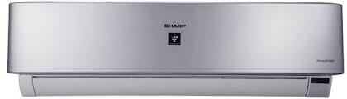
Product
Name: air conditioner
Variety: different power types (1.5 HP, 2.25HP and 3 HP)
Quality: very high quality conform to international specifications

Slide 5

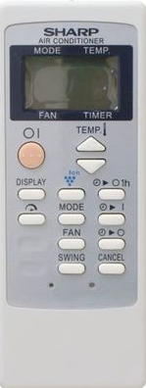
Brand name: sharp
Features:
1) Work at two categories(hot and cold) and save electricity by 20% more than other types
2) Small screen to display the temperature
3) Plasmacluster Ion
4) Lcd Wireless Remote Control With Wide Lcd Display
5) ON/OFF Timer
Colors: white and silver

Slide 6
Price
color/type | 1.5 HP | 2.25 HP | 3 HP
white | 9000 EGP | 11500 EGP | 15000 EGP
silver | 9500 EGP | 12000 EGP | 15500 EGP

Slide 7
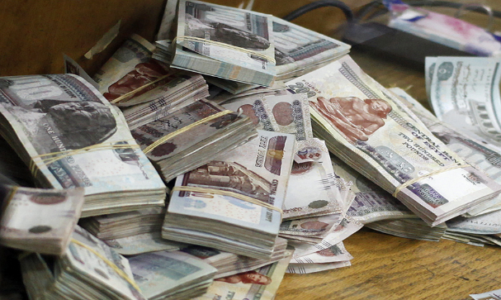
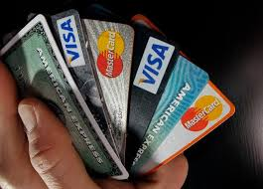
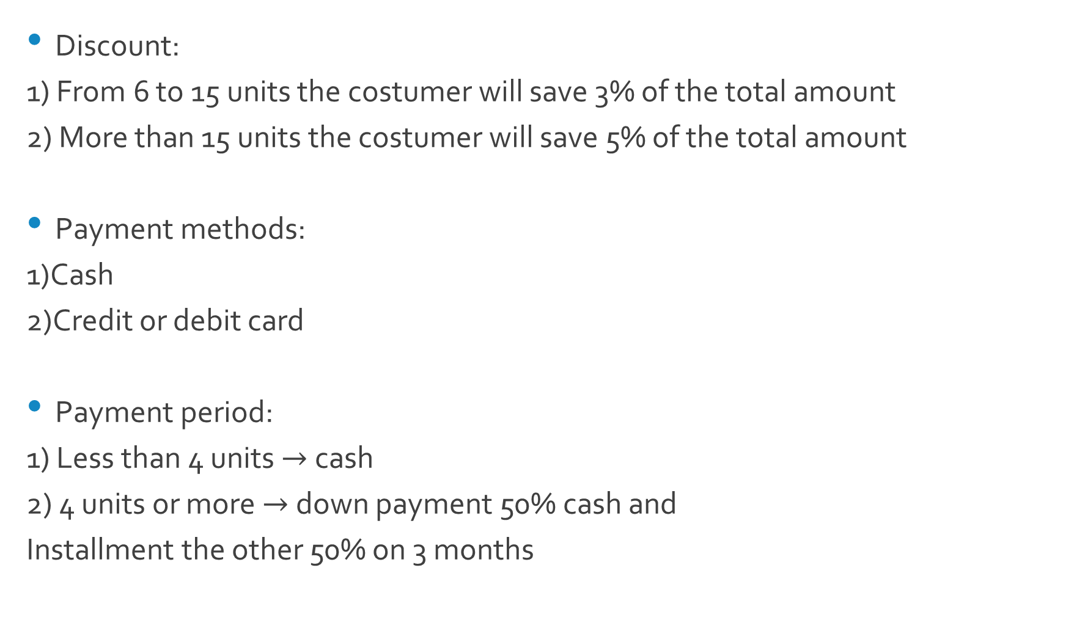
Discount:
1) From 6 to 15 units the costumer will save 3% of the total amount
2) More than 15 units the costumer will save 5% of the total amount
Payment methods:
1)Cash
2)Credit or debit card
Payment period:
1) Less than 4 units $→$cash
2) 4 units or more $→$ down payment 50% cash and
Installment the other 50% on 3 months

Slide 8
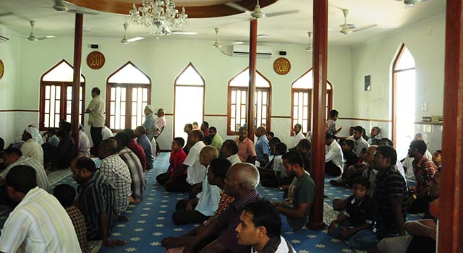
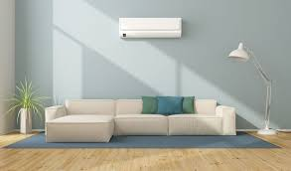
Places that need A/C
Mosque: for the comfort of the
worshipers in the morning
Houses: it can be used at any time of the year

Slide 9

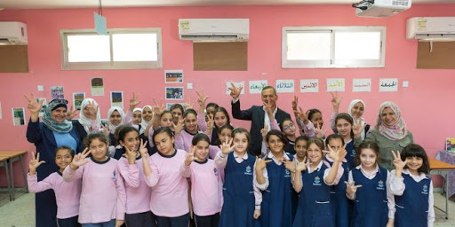

Companies: to give a nice atmosphere
for the staff to work with full power
Schools: to help the students to concentrate
in a great weather
Newly built compounds.

Slide 10

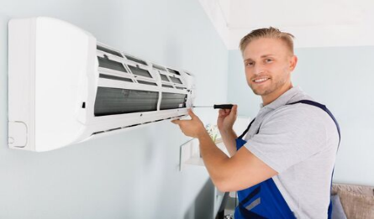
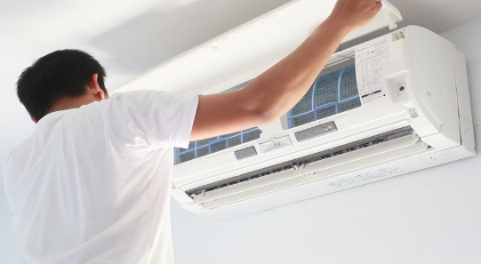

Why would you buy from us not anyone else?
Simply we give our costumers many advantages which no one else have it.
Free transportation inside Cairo
Free installment
Free service after sales for one summer season
Five years full free warranty

Slide 11


How to Contact Us?
Address: St. Ahmed Fouad Naseem - Behind the Workforce - Nasr City – Cairo
Number: (02)22325930
Website: www.aircool.com
Facebook page: Air Cool for A/C

