Slide 1

Air Cool Company
Presented by submitted to group
Ahmed Ayman ahmed prof. amr safwat 30
Salma tarek el alfy
Abdelrahman Mohamed anwar
Farid Mohamed farid Temraz
Yumna ahmed Mohamed ghoneim

Slide 2
overview
Our project is to found and establish air conditioning company that sells and installs air conditioners of various types.
After planning the project we start at 7-March and we expect to end at 26-April according to our project network.

Slide 3

problems
You suffer from high temperature and humidity.
Global warming can contribute to the intensity of heat waves by increasing the chances of very hot days and nights.
And increase body temperature can cause heavy sweating, clammy skin, dehydration, tiredness, headache.

Slide 4

solution
We all love living in comfort, don’t we ??
Well did you know that there are more benefits of air conditioning than just comfort.
Air conditioning can also provide us with safety and better quality of life in our own homes.

Slide 5
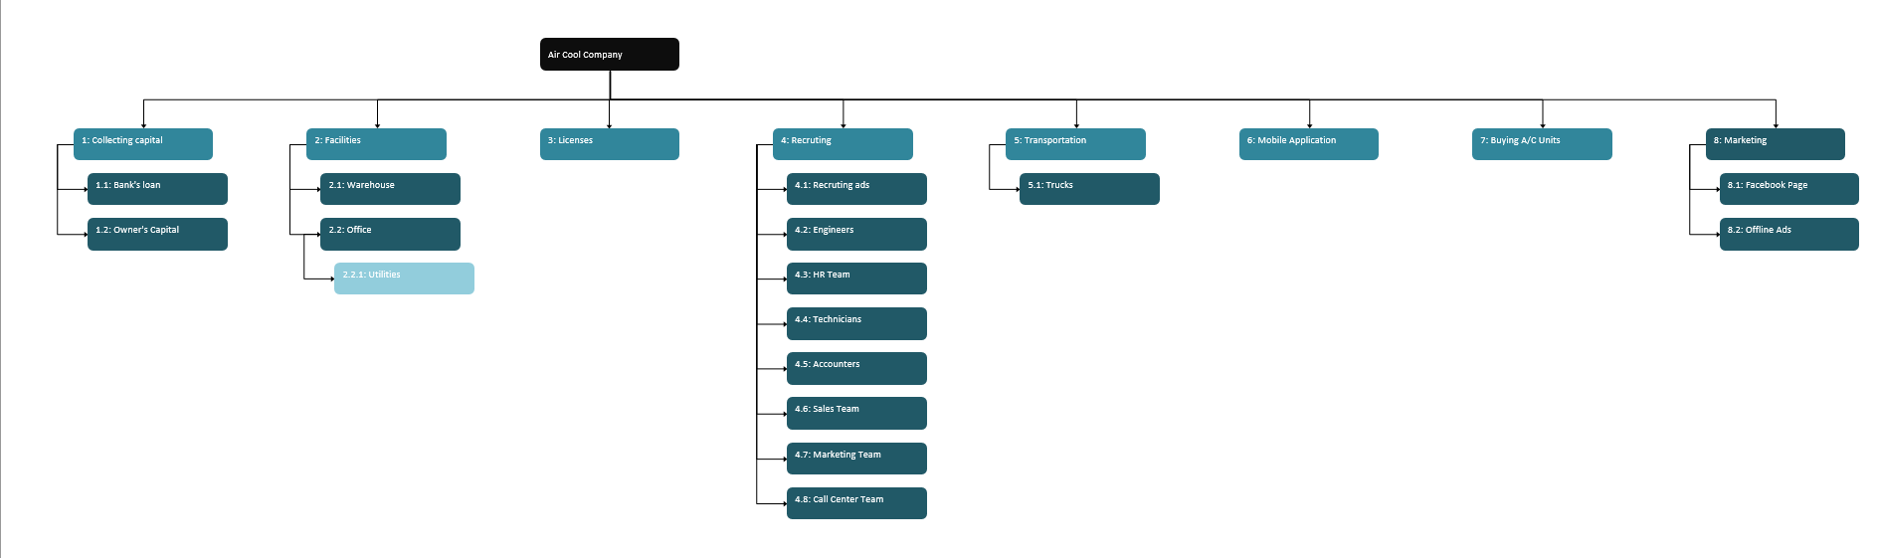
Work breakdown structure (wbs)

Slide 6
Project resources
Accountants
Recruiters
Engineers
Marketers
Technicians
Sales Team
Call Center
Trucks

Slide 7
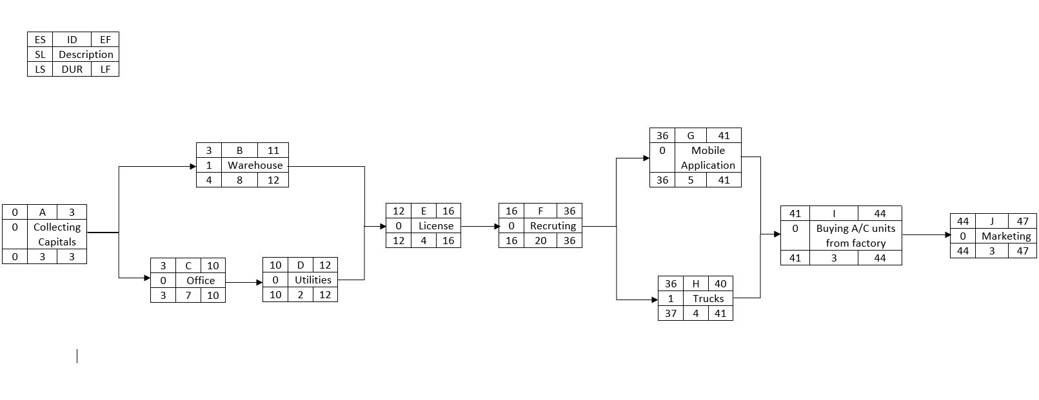
Project network

Slide 8
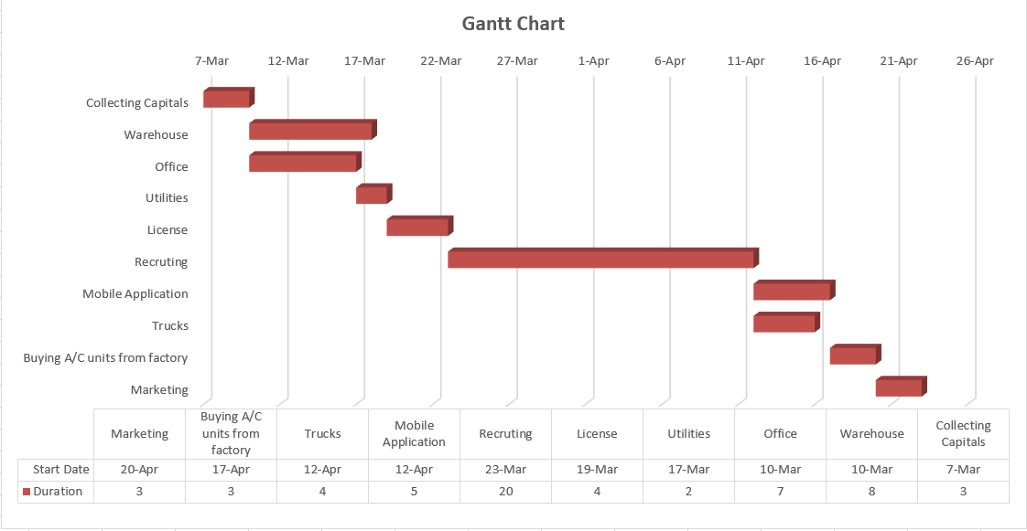
Gantt chart

Slide 9
milestones
Collecting capitals Starts: 7-March
Warehouse / Office Starts: 10-March
Office Utilities Starts: 17-March
Licenses Starts: 19-March
Recruitment Starts: 23-March
Mobile Application / Trucks Starts: 12-April
Buying A/C Units From Factory Starts: 17-April
Marketing Starts: 20-April

Slide 10
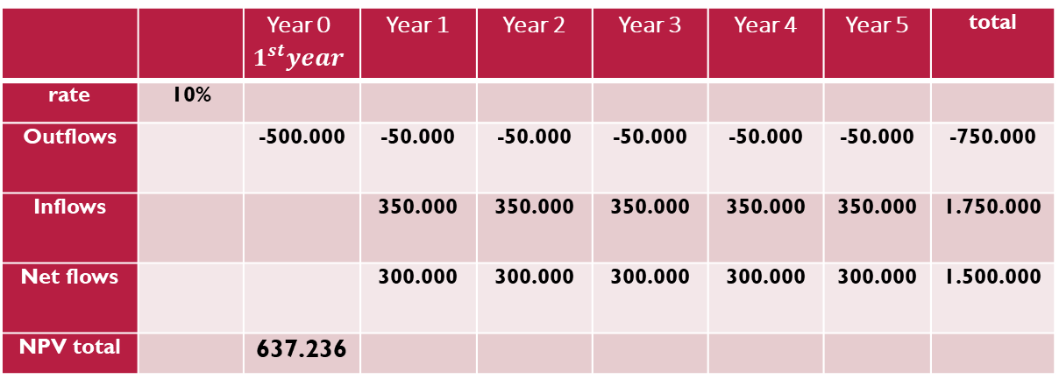
Net Present Value (NPV)
 |  | Year 0 $$1^{st}year$$ | Year 1 | Year 2 | Year 3 | Year 4 | Year 5 | total
rate | 10%
Outflows |  | -500.000 | -50.000 | -50.000 | -50.000 | -50.000 | -50.000 | -750.000
Inflows |  |  | 350.000 | 350.000 | 350.000 | 350.000 | 350.000 | 1.750.000
Net flows |  |  | 300.000 | 300.000 | 300.000 | 300.000 | 300.000 | 1.500.000
NPV total |  | 637.236
Interest rate: 10%
NPV = 637,236 L.E

Slide 11
Return on investment (ROI)
YEAR | (ROI) Value
1st Year ROI Value | -100%
2nd Year ROI Value | -36.36%
3rd Year ROI Value | 16.7%
4th Year ROI Value | 61.5%
5th Year ROI Value | 100%
6th Year ROI Value | 133%

Slide 12
Payback period
Year | Cumulative cost | Cumulative revenue | Cumulative revenue – cumulative cost
0 | 500,000 | 0 | -500,000
1 | 550,000 | 350,000 | -200,000
2 | 600,000 | 350,000*2=700,000 | 100,000
Payback period = 1.2 years = 14 months

