Slide 1
Stock Trade Simulator
Developed by
Abayomi Olowu
Github Link: Project Github link
Email: aayobam@gmail.com

Slide 2
Poblem Statement of Project.
Develop a trading platform where the 10 stock traders of the platform are given deposit of $100 which they can trade with. This platform should also provide visual feature where traders can view the progress or their trades and see how much is being gained or lost in real time. Admins can also keep track of all the traders on their platform and track the progress of their trades in real time using graphs.

Slide 3
Software tools used to achieve this.
Broke down all features into smaller tasks.
Implemented the backend features with python, Django web framework(mvt) , mongoDB, django(client for connecting django project to mongoDb), django-crispy-forms and pyplot library.
Implemented the Visuals with bootstrap, internal css, htmx(for ajax calls and real time trading results).
Implemented asynchronous task schedulling using celery, django-celery-beats and redis.

Slide 4
Implementation and Features.
Registration form for traders to register an account.
Single login form for traders and admins.
User dashboard to view trade charts.
Admin dashboard for admins to keep tracks of traders charts in real time.
Management commands for admin to start and simulate the trades for users.
Management command for admin to auto create 10 users for testing purpose. Note that admins or staffs of the company are automatically excluded for trading.
Documentation on how to run this project on your computer reside on the project’s github repository README.md File.

Slide 5
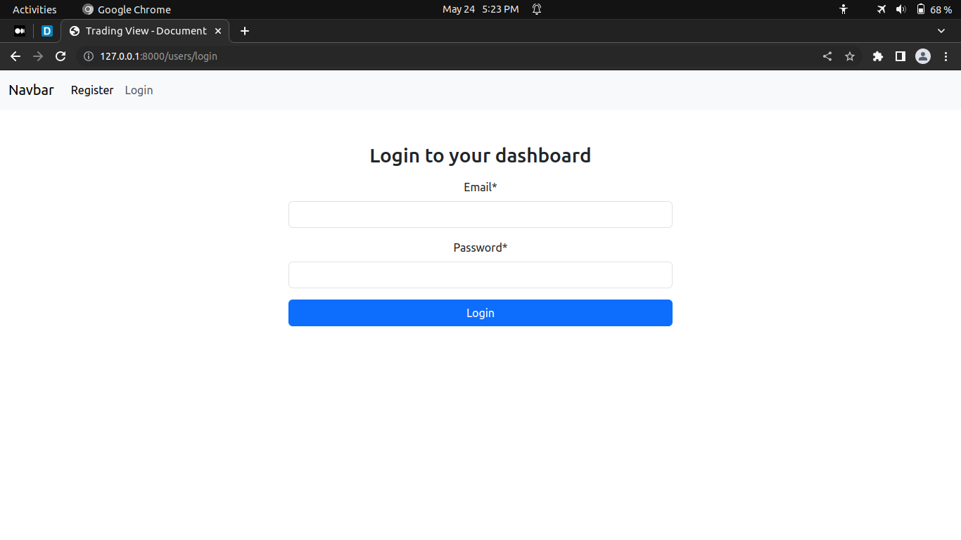
Login view
Image to be here

Slide 6
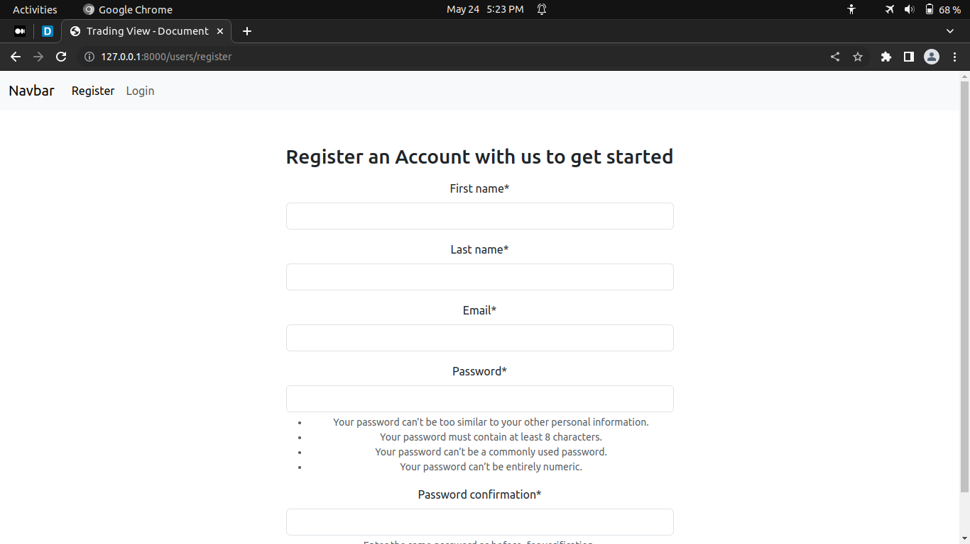
Registration view

Slide 7
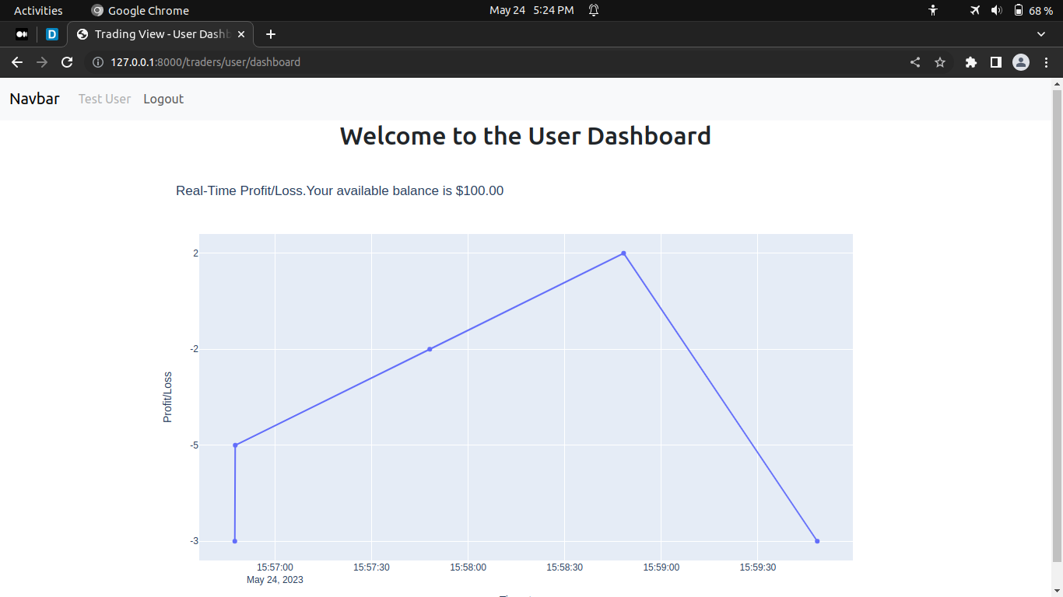
User Dashboard

Slide 8
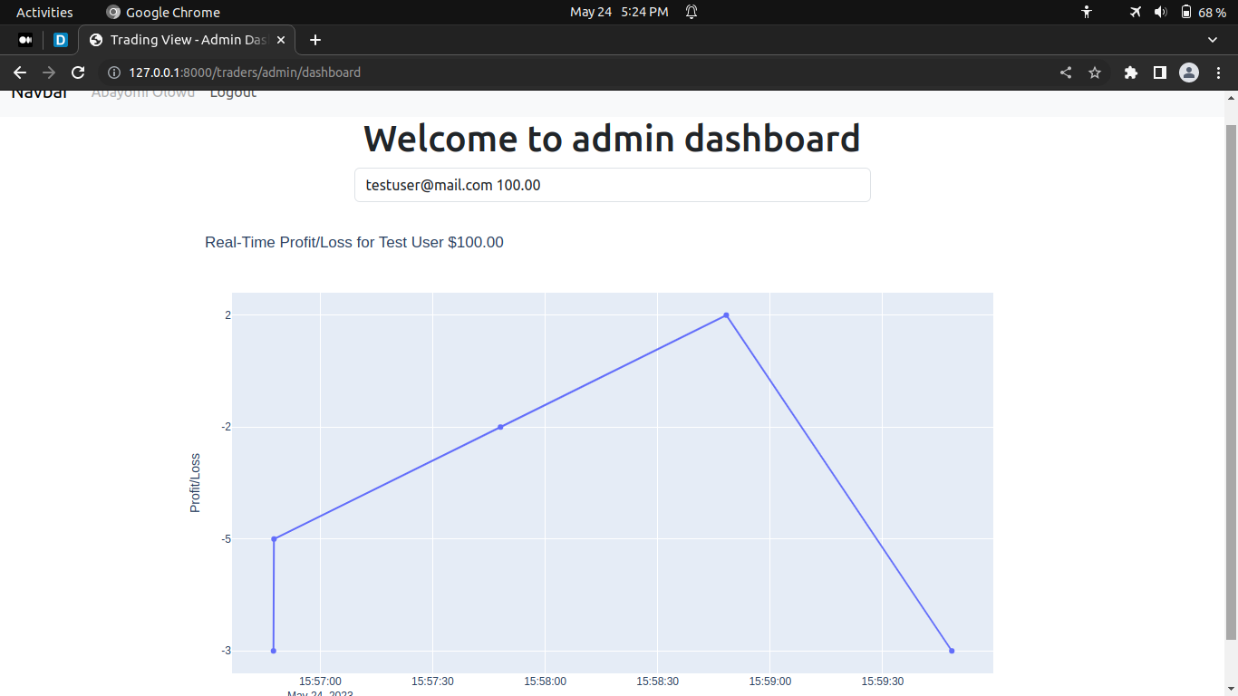
Admin Dashboard

Slide 9
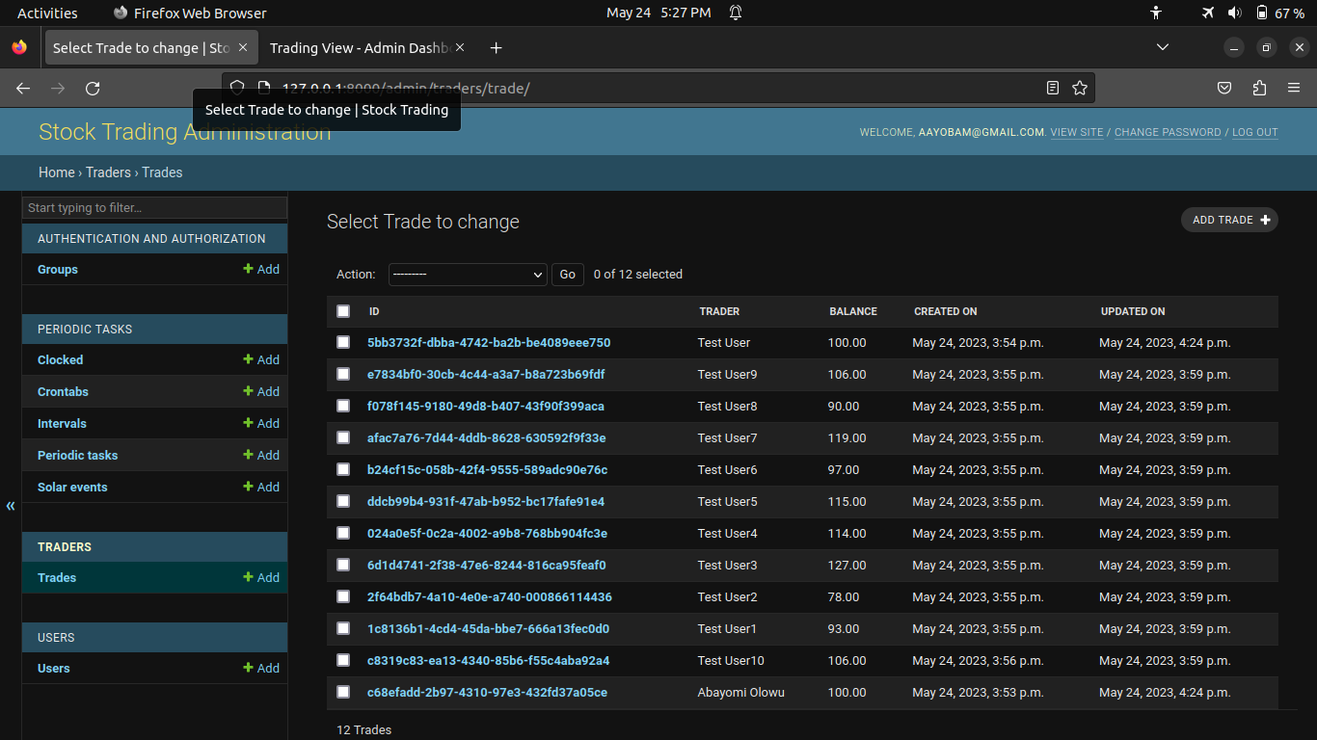
Django Admin Dashboard

Slide 10
Limitations
MongoDb doesnt seem to work well with django as the current version of djongo doesn’t seem to be compatible with the current version of django.
Django datatypes for decimal clashes with that on mongo db.
Django version has to be downgraded to the compatible version og djongo package.

