Slide 1
Accelerating Drug Repurposing with an Agentic AI Platform
Business goal: Move beyond low-margin generics by identifying high-value repurposing opportunities
  Solution: Multi-agent platform integrating market, trials, patents, trade, web and internal data
  Outcome: Reduce early-stage research from months → days; produce auditable PDF reports
Problem
Solution
Outcome
Notes:
Executive summary: problem, approach and outcome. Mention time savings and pilot ask.

Slide 2
Multi-Agent Architecture — Master Agent + Worker Agents
IQVIA Insights
EXIM Trends
Master Agent
(Orchestrator)
Patent Landscape
Clinical Trials
Web Intelligence
Internal Knowledge
Report Generator
Outputs: tables, charts, trial lists, patent expiry timelines, RAG summaries, downloadable PDFs
Notes:
Explain parallel execution and modular worker design. Emphasize plug-in data sources.

Slide 3
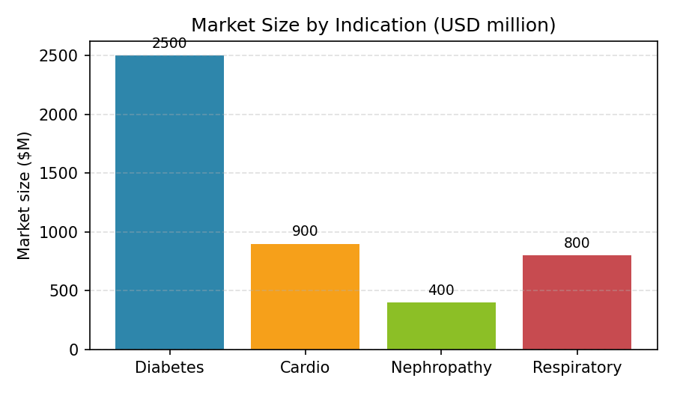
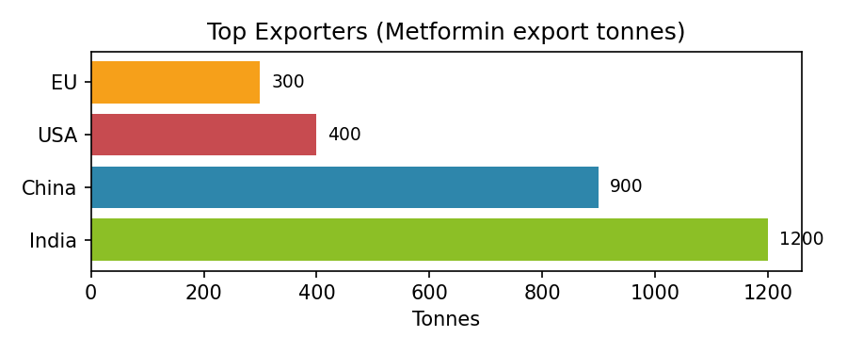
End-to-End Journey — Example: Metformin Repurposing
1) User prompt: Find repurposing opportunities for metformin
2) Master Agent decomposes: market, trials, patents, web, internal
3) Worker outputs: market sizing, trial list, patents, literature snippets
4) Synthesis: prioritized hypothesis + next steps
Notes:
Walk through the steps and point to charts: market size & export volumes.

Slide 4
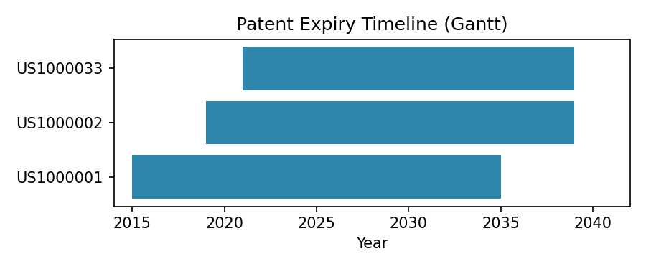
Patent & Risk Assessment → Draft Product Story
Synthesis & Product Story
  - Indication: Metformin sustained-release for diabetic nephropathy
  - Value props: improved adherence, differentiated formulation, cost advantage
  - Risks: IP watch, confirm FTO, regulatory path
Notes:
Highlight how patents and trials drive go/no-go and how a product concept is framed.

Slide 5
Deliverables, Impact & Next Steps
Deliverables
  - Executive PDF report (market, trials, patents, trade, internal insights)
  - 5-slide summary deck (this deck)
  - Pilot: validate 3 priority molecules
Pilot (4-6 wk)
Integrate real APIs (8-12 wk)
Scale & Ops
Notes:
Close with ask: greenlight pilot, provide API access and internal docs, assign data steward.

