Slide 1
Does a Pending-Sector Warning Predict Hard-Drive Failure?
A survival analysis of Backblaze Drive Stats, Q1 2026
Aayush Jha · Ankit Roy · Faaz Noushad
Advanced Statistical Methods II — Group Project (Type I) · ISI · November 2026
Notes:
Introduce the team and the one-line question: does a SMART 197 'pending sector' warning on a fixed day go with a higher chance of the drive being recorded as failed over the next three months?

Slide 2
Question and hypotheses
• Drives report SMART health counters; SMART 197 = Current Pending Sector Count (unreadable sectors awaiting reallocation)
• Question: is a nonzero SMART 197 on 1 Jan 2026 associated with a later recorded failure — after accounting for age?
• H₀: baseline SMART 197 status has no association with the subsequent failure hazard
• Hₐ: baseline SMART 197 status is associated with the subsequent failure hazard
• Survival framing: follow-up lengths differ, most drives never fail (censoring), some leave observation early
2
Notes:
SMART 197 counts sectors the drive could not read and has queued for reallocation. Our approved proposal asked whether a pre-specified SMART indicator is associated with subsequent failure after accounting for drive age. We fix the indicator (SMART 197), the drive model and the cohort before looking at outcomes. Survival analysis is needed because most drives never fail in the window (right censoring) and some leave observation early.

Slide 3
Data: Backblaze Drive Stats, Q1 2026
• Public daily snapshots of every drive: date, serial, model, failure flag (0/1), ~90 SMART pairs
• Q1 2026: 90 daily files, 1 Jan – 31 Mar, 30.6 million drive-days (archive hash and all file checksums verified)
• One drive model only: Seagate ST12000NM0008 (12 TB) — 18,650 drives, 129 failure flags in Q1
  – removes manufacturer / firmware / capacity differences from the comparison
• Outcome = Backblaze's recorded failure flag (definition matters — slide 10)
3
Notes:
Backblaze publishes a daily snapshot of every drive in its data centres. Q1 2026 is 90 daily files, about 30.6 million drive-days. We verified the archive hash and every file's checksum. We restricted to one model so that manufacturer and firmware differences cannot confound the comparison. The failure flag is Backblaze's own definition — we come back to this.

Slide 4
Cohort, outcome and censoring
Baseline SMART 197 | Drives | Failures | Censored 31 Mar | Exits
= 0 | 18,371 | 83 | 18,195 | 93
> 0 | 162 | 28 | 131 | 3
Total | 18,533 | 111 | 18,326 | 96
• Day 0 = 1 Jan 2026; follow-up to day 89
• Excluded: 116 later arrivals, 1 failure on day 0
• Event: first failure flag after day 0
• Unexplained exits are censored, never failures
• Exposure from the 1 Jan row only
• Data checks: no duplicate drive-days, no rows after a failure, no missing baseline SMART 197 / 5 / 9
• 10.2% of drives have an observation gap (22% in the SMART 197 > 0 group)
4
Notes:
Baseline is 1 January. Only drives present that day are in the cohort, giving 18,533 drives and 111 failures. Exposure is taken from the 1 January row only, so it cannot use future information. Drives still present on 31 March are censored there. 96 drives disappeared earlier without a flag: they are censored at their last day and never counted as failures. A later check showed 93 of those 96 reappeared in early April, i.e. they were data gaps.

Slide 5
Methods
• Kaplan–Meier by baseline group; 95% CI by Greenwood, log(−log) scale
• Cox PH: h(t|x) = h₀(t)·exp(βx), Efron ties; Wald test of H₀: β = 0
  – PH check: scaled-Schoenfeld test (Grambsch–Therneau) — reported, not used to change the model
• Sensitivity S1: 93 exits that reappeared in April → censored at day 89
• Sensitivity S2: remove gap days from the risk set (start–stop intervals)
• Age adjustment: + baseline powered years (SMART 9 ÷ 8,766), since install dates are unknown
• Rules and plan committed before looking at failures by group; lifelines results cross-checked in statsmodels
5
Notes:
Kaplan–Meier by group with Greenwood log-log confidence intervals. One Cox model with a single binary covariate, Efron ties, Wald test for H0, and a Grambsch–Therneau proportional-hazards test. Two pre-specified sensitivity analyses and one age-adjusted model using powered-on hours, because installation dates are not published. Importantly, the rule for keeping SMART 197 versus switching to SMART 5, and the full analysis plan, were committed before we looked at failures by group.

Slide 6
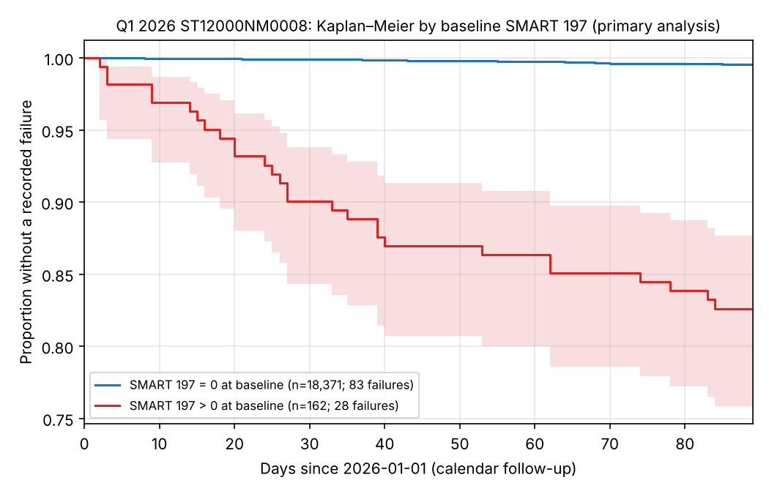
Kaplan–Meier: drives with a pending-sector warning fail far more often
6
Notes:
Blue: the 18,371 drives with zero pending sectors stay near 1 throughout. Red: the 162 drives with a warning drop to about 0.83 by day 89. The drop is steepest in the first month. Shading is the 95% pointwise confidence band — wide for the red group because it is small.

Slide 7
How big is the difference?
Proportion without a recorded failure | Day 30 | Day 60 | Day 89
SMART 197 = 0 (n = 18,371) | 0.9989 | 0.9976 | 0.9955 (0.9944–0.9964)
SMART 197 > 0 (n = 162) | 0.9007 | 0.8635 | 0.8262 (0.7583–0.8766)
• ≈ 17 in 100 warned drives vs < 1 in 200 others had a recorded failure within 3 months
• Warned drives: < 1% of the fleet, but 25% of the failures (28 of 111)
7
Notes:
At 30 days, 90% of warned drives are still without a recorded failure versus 99.9% of the others; at 89 days, 83% versus 99.5%. In absolute terms about 17 in 100 warned drives versus fewer than 1 in 200 unwarned ones. The warned group is under 1% of drives but has a quarter of the failures.

Slide 8
Cox model: reject H₀
Analysis | HR (SMART 197 > 0 vs 0) | 95% CI | Wald p
Primary | 43.2 | 28.1 – 66.3 | 1.7 × 10⁻⁶⁶
S1: exits reclassified | 43.2 | 28.1 – 66.3 | 1.7 × 10⁻⁶⁶
S2: gap days removed | 44.1 | 28.7 – 67.7 | 3.5 × 10⁻⁶⁷
Adjusted for powered years | 43.6 | 28.4 – 66.9 | 9.5 × 10⁻⁶⁷
• Powered years: HR 1.11 per year (0.85–1.43), p = 0.44 — but almost all drives are 5.5–6.2 years
• Decision: reject H₀ — with and without age adjustment
8
Notes:
The hazard ratio is about 43 and the confidence interval is far from 1, so we reject H0 at any conventional level. It hardly moves when exits are reclassified, when gap days are removed, or when we adjust for powered-on age. Powered years themselves show no clear effect, HR 1.11 per year, but nearly all drives are 5.5 to 6.2 powered years old, so we can only adjust within that narrow range.

Slide 9
The risk is front-loaded: proportional hazards fail
• PH test (scaled Schoenfeld): χ² = 7.29, p = 0.0069
• Warned drives: ~10% fail in the first 30 days, then ~4% per 30 days
• HR = 43 is a quarter-average of a ratio that is larger early and smaller later
• We report KM curves and landmark survival alongside the HR; model left as pre-specified
9
Notes:
The Grambsch–Therneau test rejects proportional hazards, p = 0.007. About 10% of warned drives fail in the first 30 days, then about 4% per month. So the hazard ratio of 43 is an average over the quarter — higher early, lower later — and the Kaplan–Meier curves are the more honest summary. We kept the pre-specified model rather than changing it after seeing this.

Slide 10
What the result does — and does not — mean
• Backblaze counts proactive replacements (triggered by SMART stats, FSCK checks …) as failures
  – Q3 2024: 721 of 1,361 failures (53%) were proactive; the public 0/1 flag does not distinguish them
• → part of the association is built into the outcome: strong association, not a causal effect
• Consistent with Pinheiro et al. (Google, 2007): after a first pending-sector count, 16× more likely to fail within 60 days
  – …but > 56% of their failed drives showed no strong SMART signal — not a stand-alone predictor
10
Notes:
Backblaze's own definition: a drive counts as failed when it is removed and replaced, either because it died (reactive) or because SMART stats or file-system checks said failure was highly probable (proactive). In Q3 2024, 53% of their failures were proactive, and the public flag does not say which. So part of our association is the replacement policy reacting to warnings like SMART 197. Google's 2007 study found a 16-fold higher 60-day failure risk after a first pending-sector event, so the direction agrees, but SMART alone misses most failures.

Slide 11
Limitations
• Outcome includes SMART-informed proactive replacements (circularity)
• Prevalent cohort, no install dates; age proxy (powered hours) spans a narrow range
• Daily snapshots: 21 of 44 post-gap failures flagged on the return day
• 4 'exited' drives were flagged as failed in early April — exits not fully uninformative
• 110 of 162 warned drives also had reallocated sectors (SMART 5) — not specific to pending sectors
• One model, one quarter, 28 exposed failures → wide confidence interval
11
Notes:
Run through these quickly; the first is the most important. The others: no installation dates, so only a narrow-range powered-hours proxy; daily snapshots so dates can lag; a few exits were informative; overlap with reallocated-sector warnings; one model, one quarter, 28 exposed failures.

Slide 12
Conclusion
• A nonzero SMART 197 on 1 Jan marks < 1% of drives with a far higher 3-month recorded-failure rate
• HR 43.2 (28.1–66.3); 43.6 after adjusting for powered-on age — H₀ rejected
• Robust to exit and gap handling; excess risk concentrated in the first month
• Interpretation: strong association with recorded removal-or-failure — not causal, not a validated predictor
Thank you — questions?
12
Notes:
Summarise in three sentences: a nonzero pending-sector count on 1 January marks under 1% of drives with a much higher three-month rate of recorded failure, HR about 43, robust to exits, gaps and age. The excess is front-loaded. Because Backblaze counts SMART-informed replacements as failures, it is a strong association with recorded removal or failure, not proof that pending sectors cause failure.

Slide 13
Backup: safeguards and reproducibility
• Commit order: decision rules (e3cf5dd) → group counts (4259dc3) → analysis plan (2b91f38) → results (28cb715)
• Age model: plan (e117f03) committed before fit (714fb97)
• Cohort rebuilt from a re-downloaded, SHA1-verified archive: byte-identical
• lifelines vs statsmodels: coefficients agree to < 10⁻⁶; 49 automated tests pass
• Repository: aayush-0131/backblaze-survival-analysis (no raw or drive-level data committed)
13
Notes:
Only if asked. The decision rule and analysis plan were committed to the repository before the relevant results existed, the cohort was rebuilt independently from a freshly downloaded archive and reproduced byte for byte, and the two software packages agree on every coefficient.

