Slide 1
Implementation For
Indoor WiFi Localisation
Aayush and Aakash

Slide 2
Index
Offline Phase Training
Online Phase Estimation

Slide 3
Offline Phase
In this phase we generate feature-based fingerprints, which utilises weights obtained by deep learning to denote different locations.
This Effectively describes the combination of CSI and RSS values for Each location.
Pretraining : We use an Encoder (With 2 layers) on the raw values to determine the features having most impact on values.
Unrolling : Then we use a Decoder (With 2 layers) to Reconstruct the values from the features, which will give us values with reduced noise.

Slide 4
Online Estimation Phase
N packets are received Each with 90 CSI values.
We then find the variance of CSI values .
Next we obtain reconstructed values using the Eight weights of offline training phase, by recursively multiplying them with raw values.
RBF is then used for computing posteriori probability for every reference location.(detailed Explanation in coming slides)
Next we obtain the estimated position of the mobile device as the weighted average of all reference location.

Slide 5
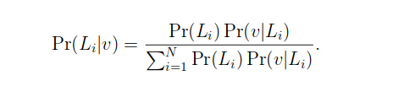
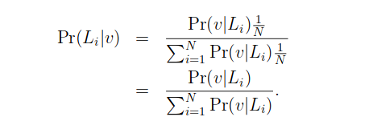
Data Fusion
We used the probability model based on Bayes’ law to determine the location of mobile device.
Li is reference location i, Pr(Li/v) is the posteriori probability, Pr(Li) is the prior probability that the mobile device is determined to be at reference location i, and N is the number of reference locations. In addition, we assume that Pr(Li) is uniformly distributed in the set{1,2,· · ·, N}, and thus Pr(Li) = 1/N

Slide 6
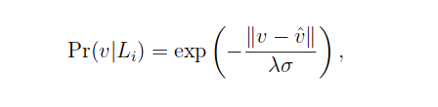
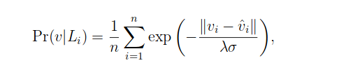
we define Pr(v|Li) as the radial basis function (RBF) in the form of a Gaussian function, which is formulated as
where ⊽ is the reconstruction input data by using deep learning , σ is the variance of the input data , λ is the coefficient of variation (CV) of the input data. In fact, we use multiplepackets to estimate the location of a mobile device, thus improving the indoor localization accuracy. For n packets, we need to compute the average value of RBF, which is given by
where vi and ⊽i are the input data and the reconstruction input data for the i packet , respectively

Slide 7
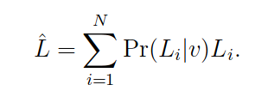
Thus, the position of the mobile device can be estimated as a weighted average of all the reference locations, which is given by

Slide 8
The End

