Slide 1

An Improved WiFi Indoor Localization Method Combining Channel State Information and
Received Signal Strength
Designed and presented by: Aakash and Aayush

Slide 2
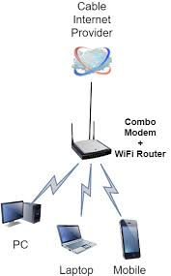
ABSTRACT
WiFi indoor localization has attracted much attention owing to the pervasive penetration of wireless local area net-works (WLANs) and WiFi enabled mobile devices. Traditional WiFi indoor localization systems rely on received signal strength(RSS), which is instability and low space distinguish ability. Recently, channel state information (CSI) has been adopted instead of RSS and proven to be an efficient method. However, CSI raw data is sensitive to environment change. In this paper, we propose an improved WiFi indoor localization system combining CSI and RSS. Firstly, this study applies a time domain filtering method to reduce CSI data dynamic range. Then, we use the coherence bandwidth for CSI dimensional reduction. Afterwards, we extract a robust positioning feature from CSI and RSS. Finally, a Multilayer Perceptron is used to estimate the location. The experiments demonstrate the effectiveness of the proposed system.

Slide 3
Localisation in Wireless Sensor Network
Why?
To determine the physical coordinates of a group of sensor nodes in a wireless sensor network (WSN)
Due to Application Context, use of GPU’s is unrealistic :
3. Services such as routing rely on location information; geographic routing protocols; context-based routing protocols; location-aware services.
GPS can work only outside
GPS receivers are too expensive for wide-range deployement
It cannot work in presence of Obstructions

Slide 4
PRELIMINARY KNOWLEDGE :-
RSS (Received Signal Strength) :
RSS is a measurement of the power present in a received signal. The RSS values are measured in dBm and have typical negative values ranging between 0 dBm (excellent signal) and -110 dBm (extremely poor signal)
Transmission power at the transmitting device (P_{tx}) directly affects the receiving power at the receiving device (P_{rx}).
- Using Friis’s Free Space Transmission equation :
P_{rx}=P_{tx} * G_{tx} * G_{rx} * (𝜆/4πd)²
RSS = 10 * log (P_{rx} / P_{ref} )

Slide 5
Factors affecting Value of RSS :
Antenna of the device that is transmitting
antenna of the node itself
number of walls and other obstructions in proximity of the nodes
material of the objects inside the environment
number of people
RSS varies with the distance from the nodes, calculating the distance based on RSS is a noisy process. The error tends to increase with the distance. So it can be relatively easy to determine when a device transmitting is very close to a node (<1m), but as distance increases the estimates become more and more erratic.

Slide 6
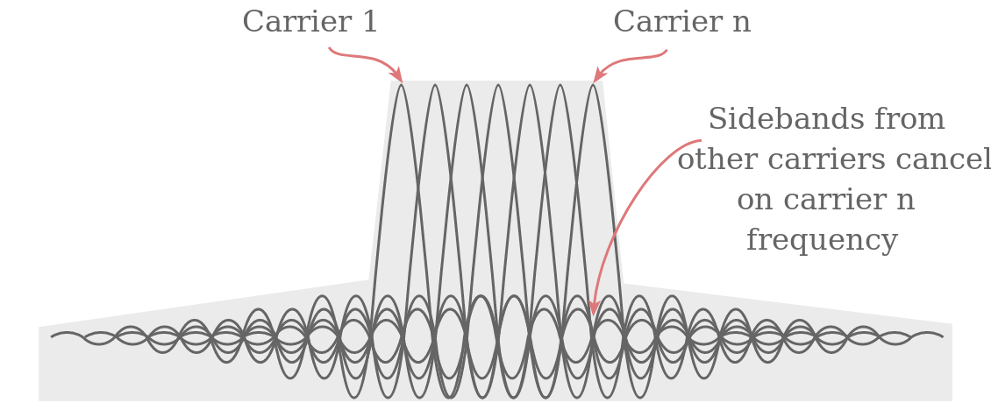
→OFDM (orthogonal frequency-division multiplexing)
OFDM divides a given channel into many narrower subcarriers. The spacing is such that the subcarriers are orthogonal, so they won’t interfere with one another despite the lack of guard bands between them. This comes about by having the subcarrier spacing equal to the reciprocal of symbol time. All subcarriers have a complete number of sine wave cycles that upon demodulation will sum to zero.

Slide 7
Channel State Information
In wireless communications, channel state information (CSI) refers to known channel properties of a communication link. This information describes how a signal propagates from the transmitter to the receiver and represents the combined effect of, for example, scattering, fading, and power decay with distance. The method is called Channel estimation.
Y = H · X + N
where X and Y are transmitted and received signal vector, respectively, matrix N represents additive white Gaussian noise, and matrix H represents the channel state information, which can be estimated from X and Y .

Slide 8
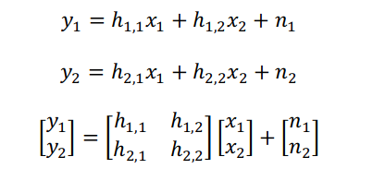

Better View
Moreover, the Estimated CSI for a single sub-carrier can be represented as:

Slide 9
Why CSI
CSI values are stable at a fixed location but exhibit large variability at adjacent locations.
CSI values reflect channel properties in the frequency domain and exhibit great stability over time for the same.
The stability of CSI values is also invariant to indoor environment changes

Slide 10
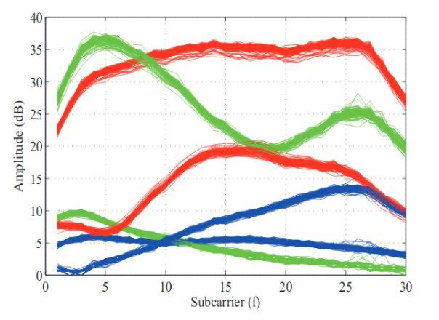
Amplitudes of channel frequency response measured at two positions for 50 received packets (each link is plotted in a different color).

Slide 11
Overview :
CSI raw data and RSS of all the reference location points are collected, whose precise location is known as a label. This is a challenging task in indoors due to radio interference, multipath effects, shadowing, and non-line-of-sight(NLOS) caused by complex environment. After data pre-processing, it is trained on a machine learning algorithm, here Multi Layer Perceptron.
CSI raw data and RSS collected by mobile devices are processed using the same algorithm. Moreover, the trained model is used to estimate the location.

Slide 12
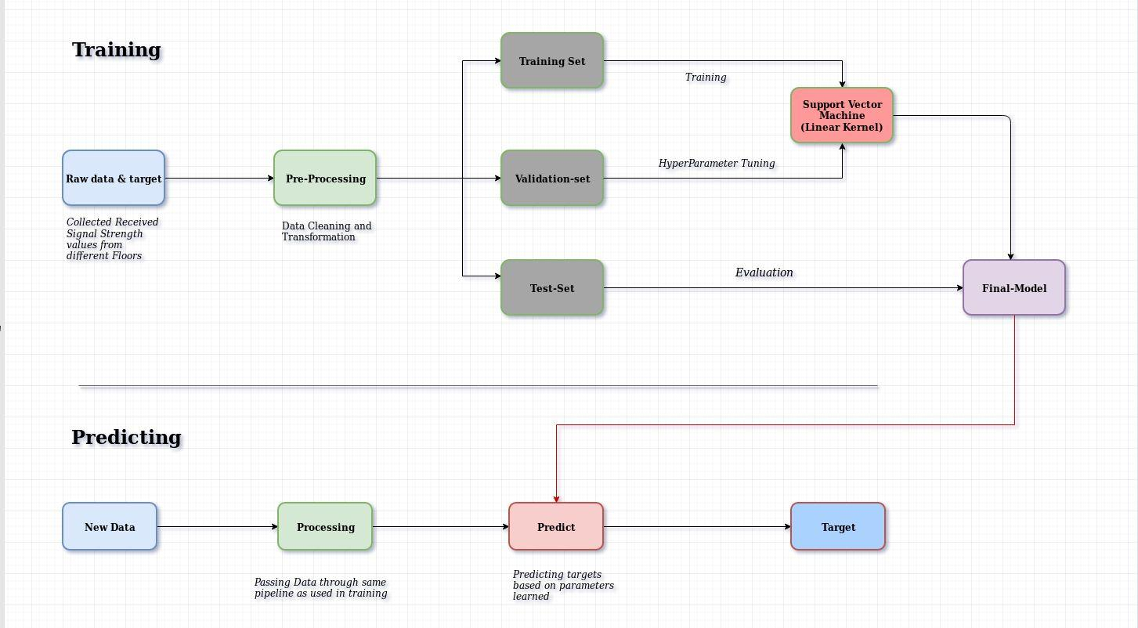
Multi Layer Perceptron

Slide 13
Data Pre-Processing
Indoor environment is often complex, characterized by NLOS of objects, presence of obstacles, environmental changes, wireless signal noise.
The CSI raw value is the dynamic range due to channel interference, noise, and multipath
effects. Additionally, not all the features contribute equally to the system performance, and the high dimension of fingerprint vectors can result in a redundant computational cost
The first step , the system has to normalise the recorded raw CSI data and also design an exponential filter to remove the noise.
Therefore, before generating fingerprint, we need to extract the robust positioning feature by a time domain filtering method, and reduce the dimension of CSI feature.
The RSS value varies significantly over different times. We collect lots of RSS at fix location. Take the average of the RSS, and then the average RSS is utilizing to generate fingerprint.

Slide 14
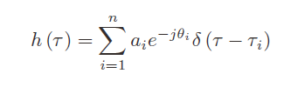
Time Domain Filtering
Filtering in the time domain is done by a convolution operation. Convolution uses a convolution filter also referred to as a convolution mask, an impulse response (IR), or a convolution kernel. There are two commonly-used time-domain convolution filters i.e. FIR filters (finite impulse response) and IIR filters (infinite impulse response).
In general, the longer path of signal propagation is more likely to be interfered. To fully characterize the individual paths, the wireless propagation channel is modeled
as a temporal linear filter, known as Channel Impulse Response which can be described as :
where a_{i}, θ_{i}, and τ_{i} are the amplitude, phase, and time delay of the i^{th} path, respectively. n is the total number of multi-path and δ (τ ) is the Dirac delta function.

Slide 15
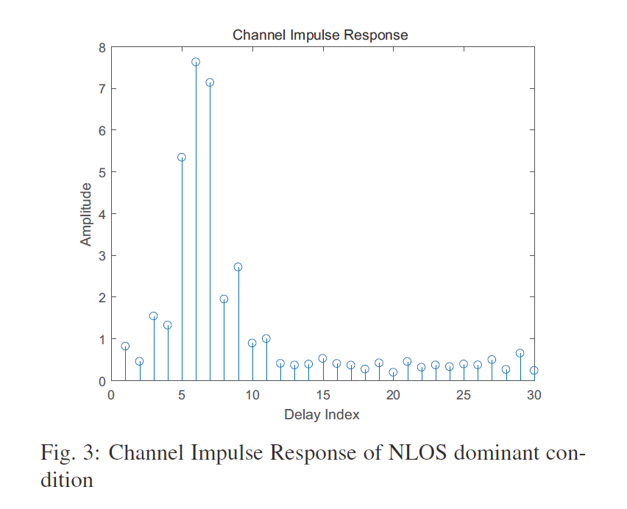

Slide 16
The CSI raw data represent the channel response in frequency domain. We process frequency domain CSI into time domain CIR with inverse fast Fourier transform (IFFT), then an estimation of CIR.
We can observe that the different paths come with different time delay. Generally, the LOS path signal contains higher energy, and arrives at the receiver more quickly than all other reflected paths. Since the first maximal amplitude, record the corresponding index of delay as t, is chosen for LOS path or shortest path NLOS reflection. Considering that there is an
uncertain time lag at the start of measured CIR samples, then we extract the main components of multiple paths by keeping (|t − 2|)th, (|t − 1|)th, (t)th, (t + 1)th, (t + 2)th amplitude, and filter out the residual amplitude. After the time domain filtering, the frequency domain CSI is reacquired using fast Fourier transform (FFT)

Slide 17
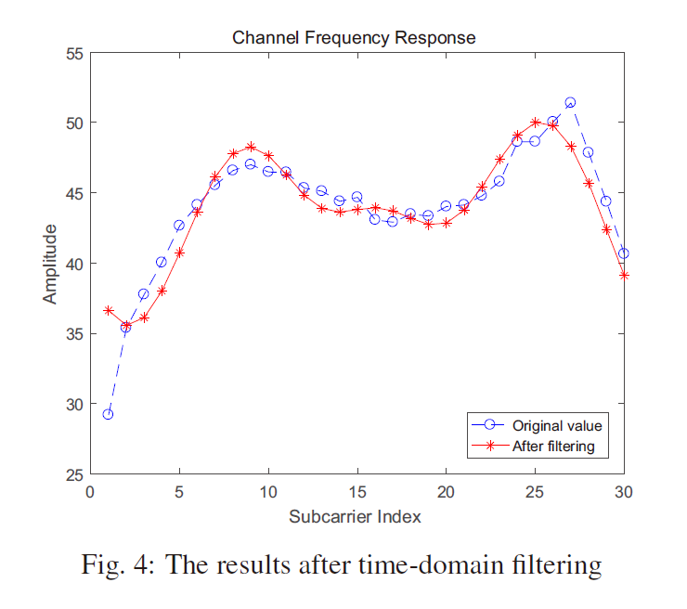
The CSI results after time domain filtering.

Slide 18
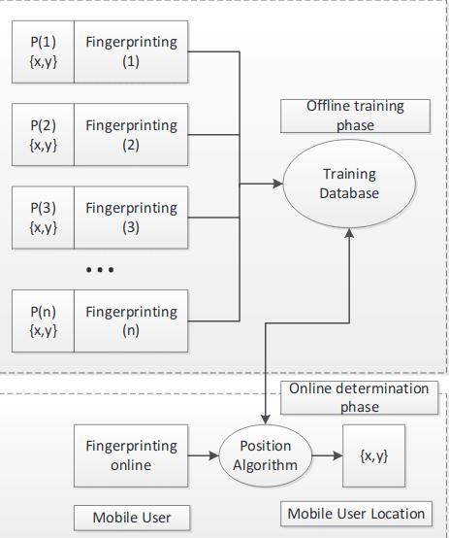

Slide 19
Several Methods can be used for Training phase :
KNN : K-nearest neighbor uses the weighted average of K nearest locations to determine an unknown location.
A limitation of K-nearest-neighbor is that it needs to store all the RSS training values.
Neural Networks: Neural networks utilizes the back-propagation algorithm to train weights, with only considers one hidden layer and needs label data.
SVM : Support vector machine uses kernel functions to solve the
randomness and incompleteness of the RSS values, which has
high computing complexity.

Slide 20
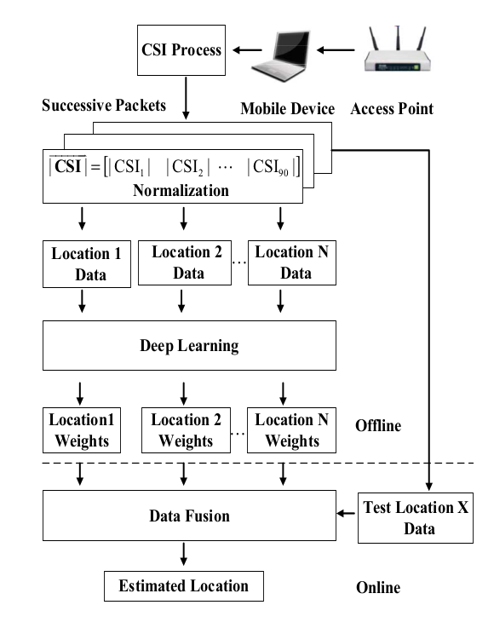
Network Architecture :

Slide 21
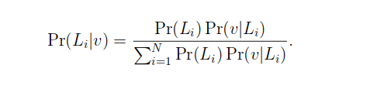
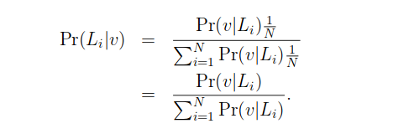
Location Estimation based on Data Fusion :-
We used the probability model based on Bayes’ law to determine the location of mobile device.
Li is reference location i, Pr(Li/v) is the posteriori probability, Pr(Li) is the prior probability that the mobile device is determined to be at reference location i, and N is the number of reference locations. In addition, we assume that Pr(Li) is uniformly distributed in the set{1,2,· · ·, N}, and thus Pr(Li) = 1/N

Slide 22
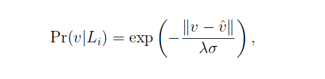
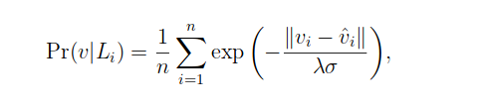
we define Pr(v|Li) as the radial basis function (RBF) in the form of a Gaussian function, which is formulated as
where ⊽ is the reconstruction input data by using deep learning , σ is the variance of the input data , λ is the coefficient of variation (CV) of the input data. In fact, we use multiplepackets to estimate the location of a mobile device, thus improving the indoor localization accuracy. For n packets, we need to compute the average value of RBF, which is given by
where vi and ⊽i are the input data and the reconstruction input data for the i packet , respectively

Slide 23
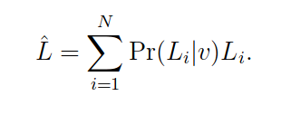
Thus, the position of the mobile device can be estimated as a weighted average of all the reference locations, which is given by

Slide 24
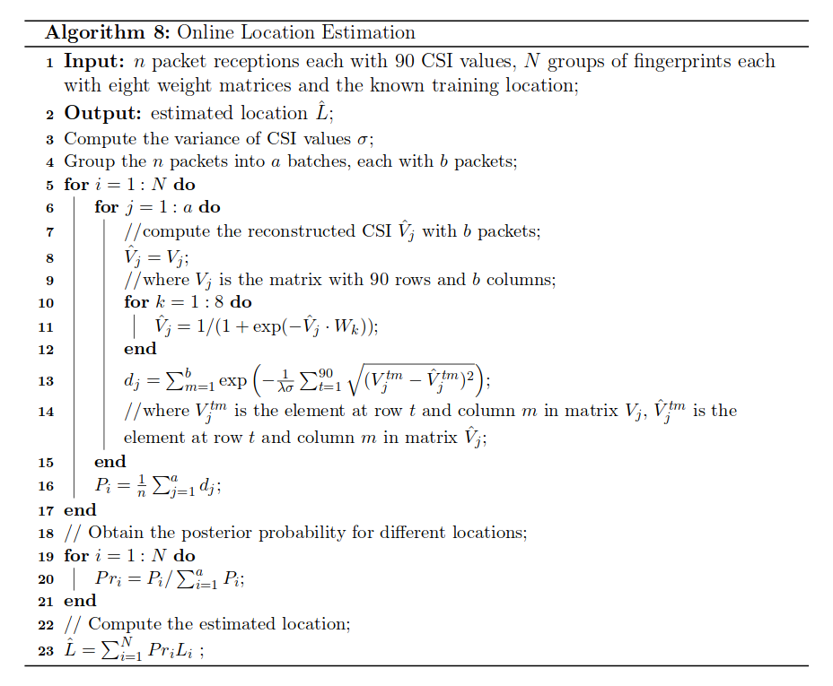
pseudocode for online location estimation with multiply packets

Slide 25
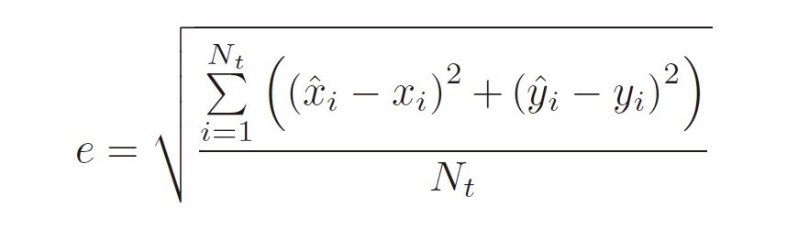
Performance Evaluation :
We adopted the distance error as performance metric, which was evaluated using root-mean-square (RMSE) with the Euclidean distance between the true position and its estimate. Assume the estimated location of unknown mobile device i is (x̄i, ⊽i) and the actual position of the user is (xi, yi). For Nt test point, the RMSE is computed as

Slide 26
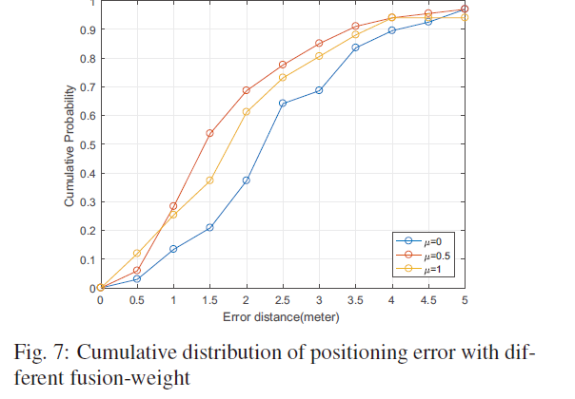

Slide 27
Conclusion :
The main contribution of this paper is not using CSI instead of RSS, but rather the combination of RSS and CSI in an intelligent manner to improve localization performance.
Results indicate that the proposed system is efficient in improving the positioning performance.

