Slide 1
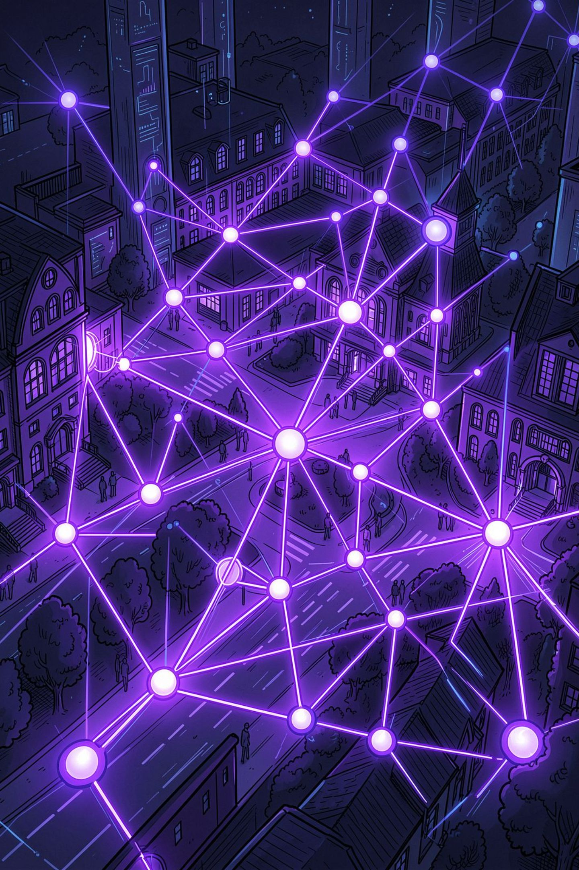
UCS503 Software Engineering Project
CampusConnect
Verified Academic and Social Networking System
A role-aware platform that connects campus communication, course materials, and AI content moderation in one place.

Slide 2
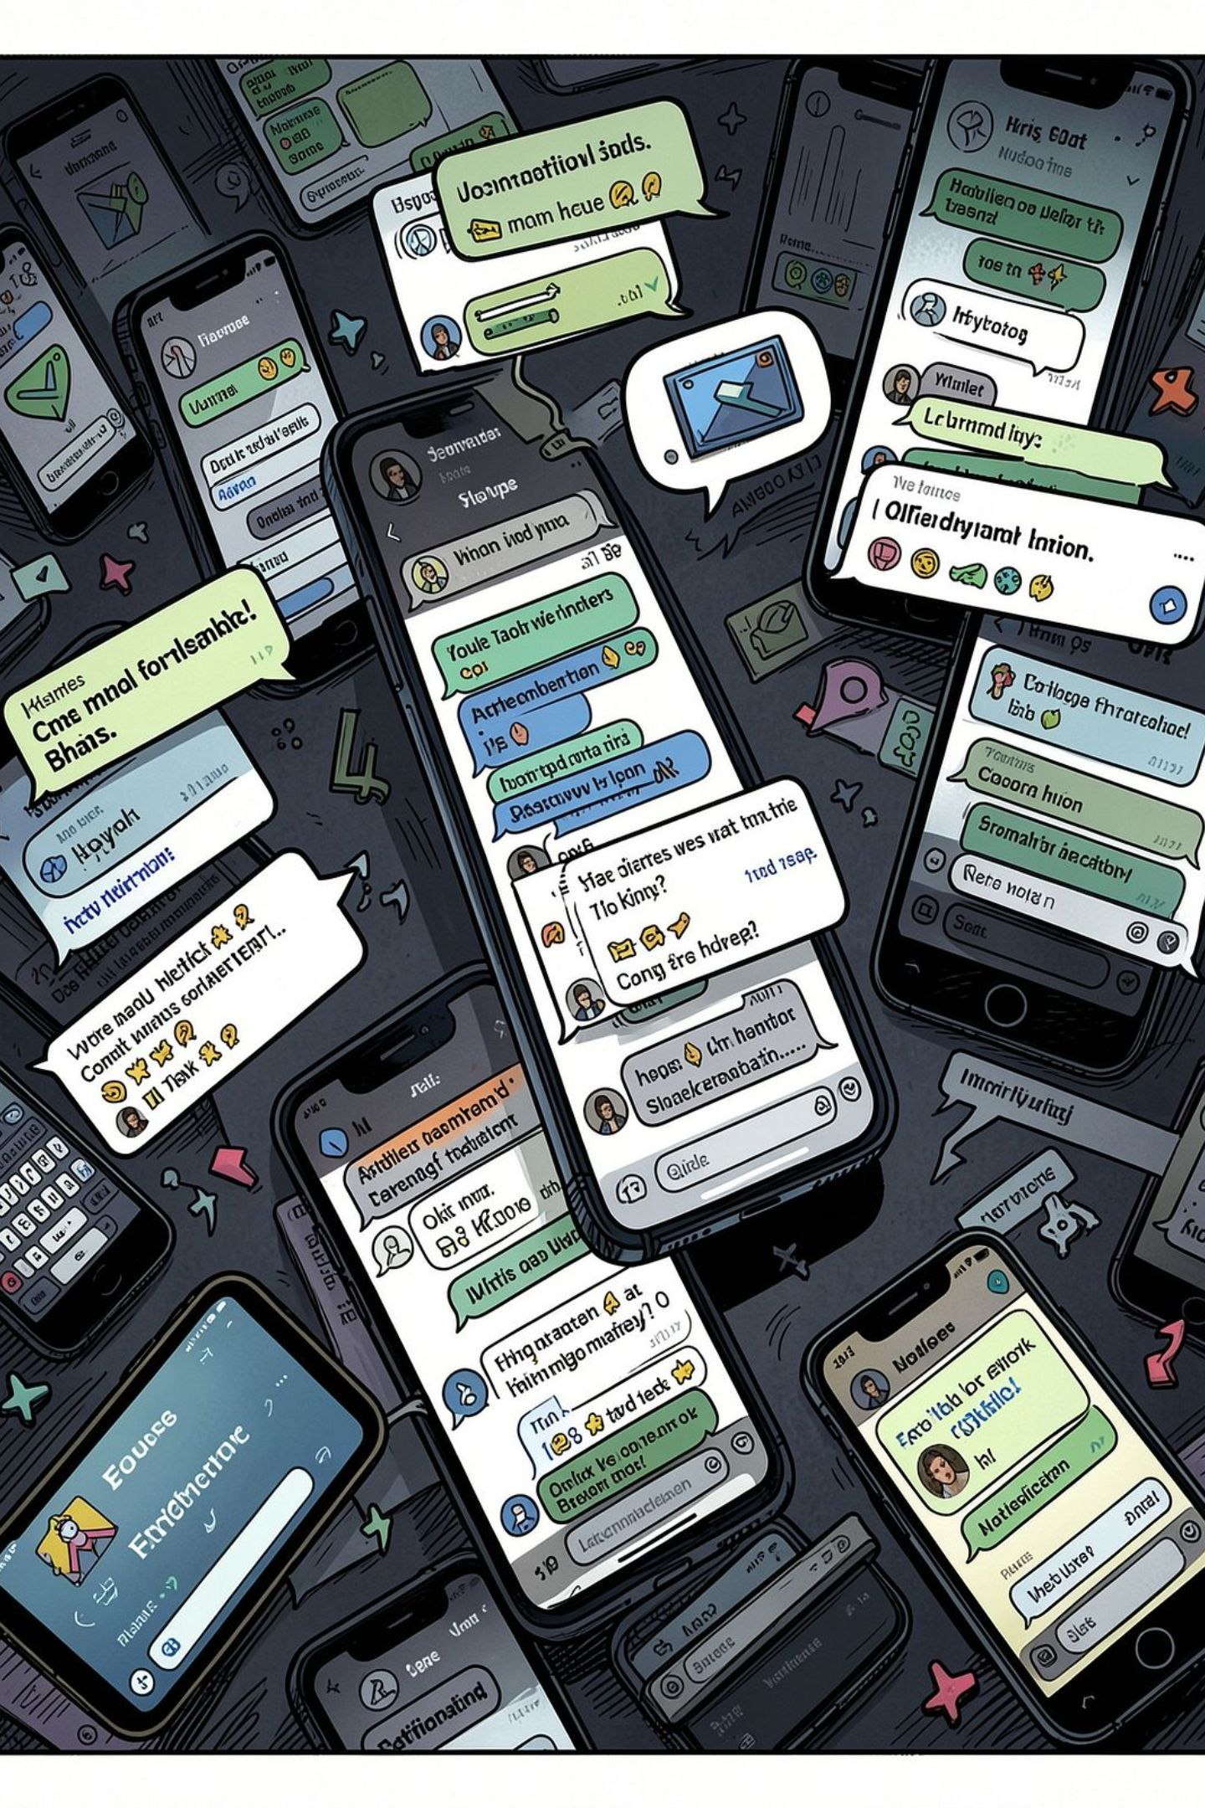

Problem Statement
The Problem with Fragmented Campus Communication
Informal tools like WhatsApp fall short on security, organization, and accountability in educational institutions.
No Identity Verification
Without domain verification, outsiders can join groups, impersonate faculty, and share leaked papers with no accountability.
Information Overload
Course material, lab manuals, and updates get buried in chat threads with no structure or search capability.
No Role-Based Access Control
Teachers end up sharing personal contacts, and students cannot tell official announcements apart from casual messages.
No Governance or Moderation
Institutions have no way to detect or act on harassment, hate speech, or academic dishonesty automatically.

Slide 3
Architecture
Full-Stack System Design and Infrastructure
Designed for type safety, relational integrity, real-time updates, and AI-assisted content safety.
Frontend and UI Layer
Data Layer
Next.js 16 App Router , React 19 Server Components , TypeScript & Tailwind CSS , Radix UI primitives
PostgreSQL on Neon Cloud , Prisma 7 ORM , 14-table relational schema , 7 domain enums , cascade constraints
Media and Real-Time
AI Safety Engine
Cloudinary CDN API , Socket.io WebSocket gateway , instant notifications & live peer feeds
Google Gemini 2.5 Flash , post/comment ingestion pipelines , multi-tier sensitivity classification

Slide 4
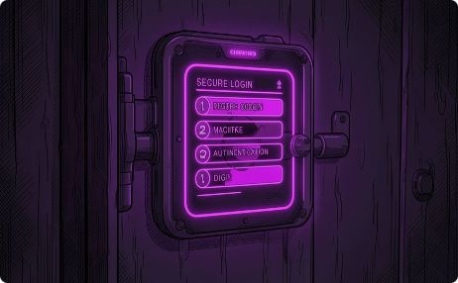
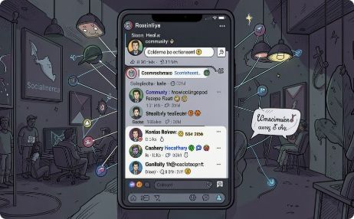

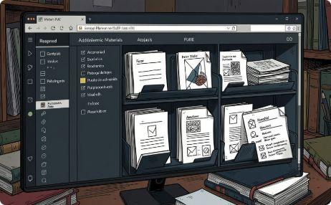
Features
Key Features and Capabilities
Four core modules creating a secure and interactive campus experience.
Verified Auth and Token-Based Invites
Social Feed and Friend Network
Academic Groups and Collaboration
Course Materials and PDF Preview
NextAuth.js with bcrypt hashing. Admin invite tokens are signed, capped by usage, and auto-assign user roles.
Paginated feed with threaded discussions, likes, and content reports. Includes bidirectional friend requests and peer suggestions.
Teachers create groups for subjects, batches, labs, and clubs with member directories and granular role management.
Materials organized into folders: Lectures, Assignments, Lab Notes, Syllabus. Built-in PDF viewer, no download needed.

Slide 5

Roadmap
What We Built and What Comes Next
Implemented and Verified (Phases 0-5)
Up Next (Phases 6-10)
Phases 0-1: Full Prisma schema (14 models), Neon PostgreSQL setup, DB seeding
Phase 2: Prisma, NextAuth, Cloudinary, Gemini AI singletons and route middleware
Phase 3: Login, registration, email verification, token-based invite system
Phase 4: Dashboard, profiles, friend network, community feed, Gemini content flagging
Phase 5: Academic groups, member directory, materials hub, PDF previewer
Phase 6: Interactive academic calendar with color-coded lecture, lab, and exam filters
Phase 7: Real-time 1-on-1 chat with live typing indicators via WebSocket
Phase 8: Admin dashboard for user management, join policies, and moderation
Phase 9: Dynamic Gemini sensitivity tuning and violation reporting
Phase 10: Vercel Edge deployment, DB indexing, and GitHub Actions CI/CD
Full test suite passing. Zero TypeScript errors. Production build verified.

Slide 6
Impact
Value Delivered to Each Stakeholder
Students
Faculty and Educators
Institution Administration
One place to access course material, connect with batchmates, and never miss a deadline.
A dedicated space to share course material and communicate without mixing work with personal contact details.
Complete access control, automated content moderation, and reduced manual administrative work.
100%
14
0
Type-Safe Codebase
DB Models
TS Errors
Strict TypeScript, route guards, and sub-second page loads
Relational schema with cascade constraints
Production build fully validated
Ready for Live Demo and Code Walkthrough
Repository: github.com/aayush-10k/ucs503p-202627odd-CampusConnect

