Slide 1
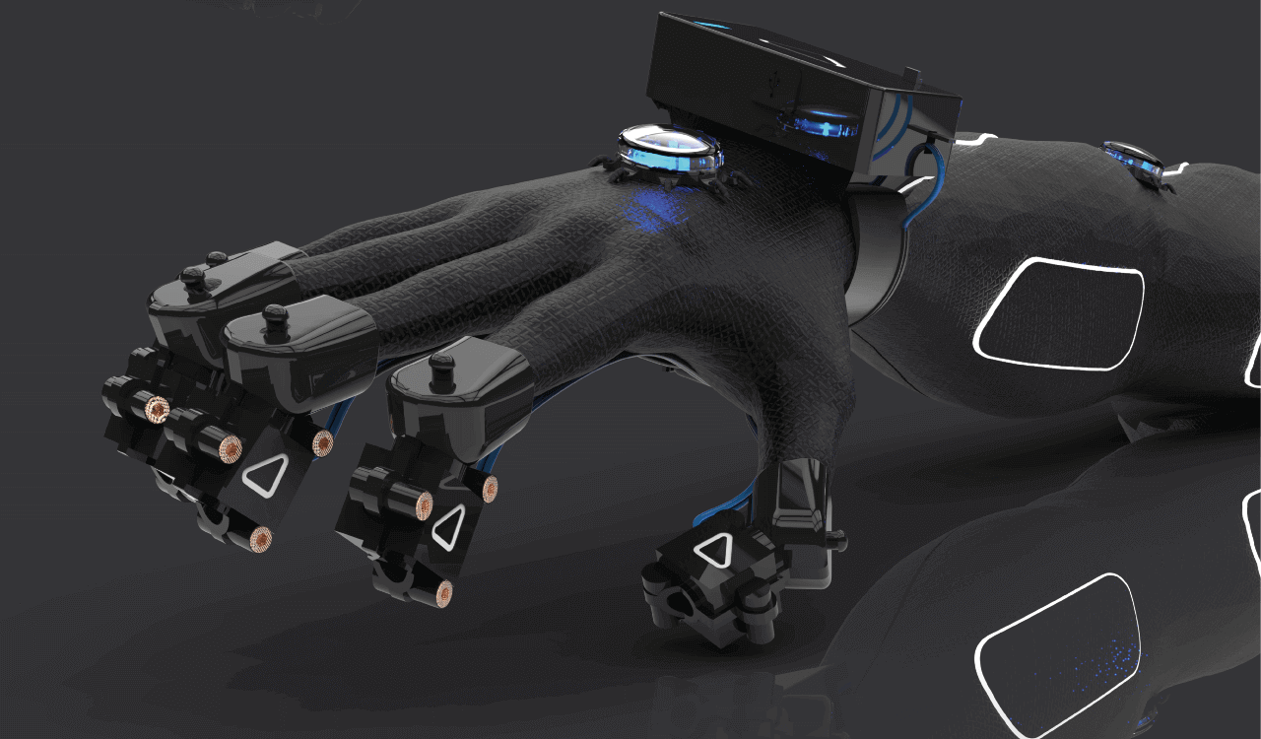
MMO VR GEAR

Slide 2

THE
DESCRIPTION
Motion Simulation of human arm by nodes of sensor tags (GYRO) transmitting data to local Raspberry Pi embedded with body vital sensor transmitting data to server on Unity.

Slide 3
WHAT ARE WE
DOING?
IMPLEMENTATION PLAN
The sensor tag nodes communicate with the primary sensor tag using Zigbee. The data from the primary sensor tag is sent to local RPi using USB/I2C.
The transfer of data from sensor tag to Primary tag is controlled by frequency modulation and thresholding to avoid unnecessary wastage of power.
A sensor tag node is placed on the wrist of the user and another node on the arm to analyze the complete movements of the user's arm.
The human body temperature and heartbeat is also monitored(sensors on raspberry pi)
The sensor data is sent from Raspberry Pi to Unity using UDP.
VR gear sensing human movements and relaying it to unity
To be used in training people of various industries ,services and immersive gaming
Multiple nodes of sensors can detect and simulate the movement in unity
Can also be used by people to master their skills. VR gear gives the reality of training but not the consequences
The system would allow multiple players.

