Slide 1
Walmart Sales & CPI Dashboard
Task 3 - Data Analyst Internship | Aayush Pardeshi

Slide 2
📌 Objective
To design an interactive business dashboard in Power BI using the Walmart Sales dataset, analyzing key performance indicators (KPIs), CPI impact, and store performance trends.

Slide 3
📊 Dataset Used
Dataset: Walmart Weekly Sales (from Kaggle)
Key Columns: Store, Date, Weekly_Sales, CPI, Fuel_Price, Temperature, Holiday_Flag, Unemployment
Time Period: 2010 – 2012
Tool Used: Power BI

Slide 4
📈 Key Metrics and Visuals
Total Revenue Generated
Avg Weekly Sales per Store
Total Number of Stores
Weekly Sales by Store (Bar Chart)
Monthly Sales vs CPI Trend (Line Chart)
Holiday vs Non-Holiday Sales (Pie Chart)
Daily Sales Pattern (Line Chart)
Filters: Year, Holiday Flag

Slide 5
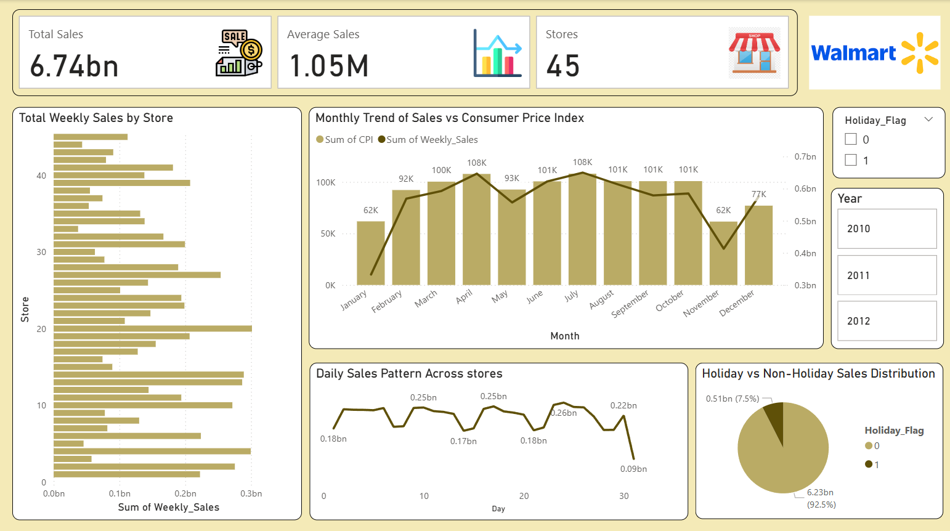
📷 Dashboard Preview

Slide 6
🔍 Key Insights
Sales peak in certain months despite rising CPI
Holiday weeks contribute a smaller portion to overall sales
Stores 20 and 4 generate the highest revenue
Sales trend shows stable demand with mild drops during some high CPI periods

Slide 7
✅ Conclusion
The dashboard helps stakeholders quickly monitor sales, CPI trends, and store-wise performance.
Power BI’s interactive capabilities support data-driven decisions for optimizing store operations.

