Slide 1
Introduction to Japan
Presented by Aayush

Slide 2
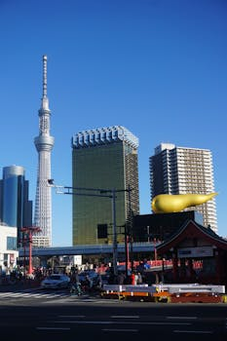
Tokyo - Must-See Attractions
- Tokyo Tower
- Senso-ji Temple
- Shibuya Crossing
- Meiji Shrine
Keyword: Tokyo Attractions

Slide 3
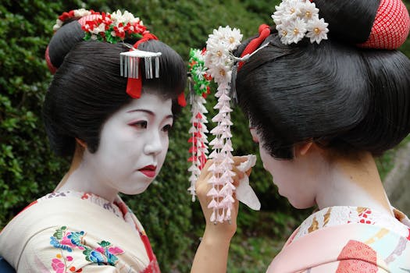
Kyoto - Cultural Wonders
- Fushimi Inari Shrine
- Kinkaku-ji Temple
- Arashiyama Bamboo Grove
- Gion District
Keyword: Kyoto Culture

Slide 4
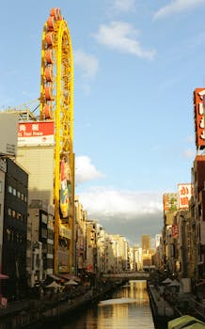
Osaka - Modern & Vibrant
- Dotonbori
- Osaka Castle
- Universal Studios Japan
- Shitenno-ji Temple
Keyword: Osaka Vibrancy

Slide 5
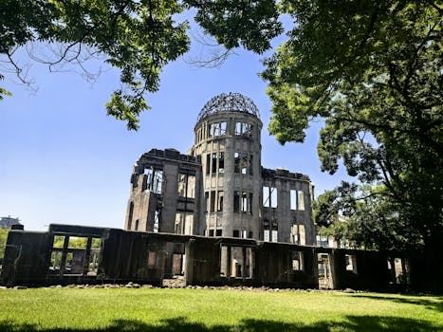
Hiroshima - Historical Landmarks
- Hiroshima Peace Memorial Park
- Itsukushima Shrine (Miyajima)
- Hiroshima Castle
- Shukkeien Garden
Keyword: Hiroshima History

Slide 6
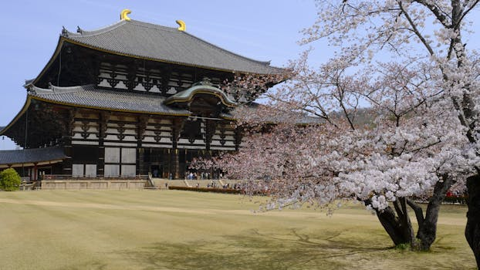
Nara - Ancient Sites & Nature
- Todai-ji Temple
- Nara Park (Deer Park)
- Kasuga Taisha Shrine
- Nara National Museum
Keyword: Nara Ancient

Slide 7
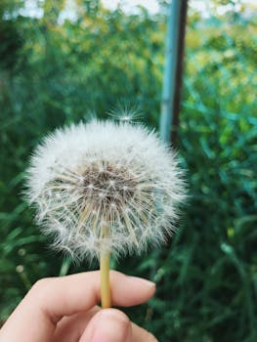
Hokkaido - Natural Beauty
- Sapporo Snow Festival
- Shikotsu-Toya National Park
- Noboribetsu Onsen
- Asahiyama Zoo
Keyword: Hokkaido Beauty

Slide 8
Credits
Images provided by Pexels: https://www.pexels.com

