Slide 1

SMART INDIA HACKATHON 2026
SafeByte CryptoTrace VASP
Problem Statement ID - SIH26182
Problem Statement Title - Automated Attribution of Unknown Cryptocurrency Wallets to Nearest Virtual Asset Service Providers (VASPs) through Blockchain Intelligence APIs
Theme - Blockchain & Cybersecurity
PS Category - Software
Team ID (on portal) - SAFEBYTE
Notes:
Source: SIH 2026 problem statement dataset, SIH26182 and SIH26183. https://raw.githubusercontent.com/Rajkumar-Porandla/SIH-2026-Problem-Statements/main/sih2026_problem_statements.json

Slide 2
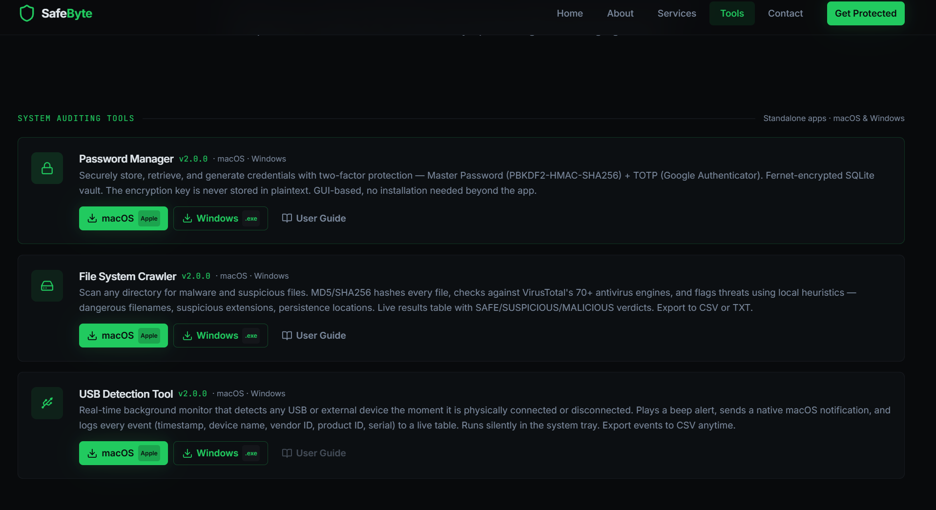
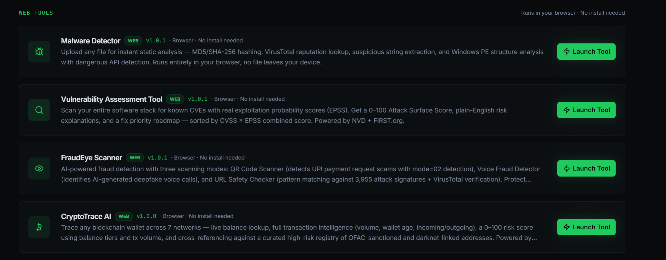
SafeByte
Proposed Solution (Describe your Idea/Solution/Prototype)
WORKING PROTOTYPE
COMPLAINT INTAKE
NCRP, SAHYOG, or manual LEA case reference.
WALLET AND CHAIN DETECTION
Recognises seven wallet address formats.
BLOCKCHAIN EVIDENCE
Live Ethereum and Bitcoin transactions; Tron balance.
FUND-FLOW VIEW
Shows recent incoming and outgoing counterparties.
RISK AND REGISTRY CHECKS
Scores activity and checks known high-risk addresses.
VASP ATTRIBUTION STATUS
Reports a match only when evidence supports it.
Problem
Investigators receive suspect cryptocurrency wallets from fraud complaints, but the nearest exchange or custodial service is often unknown. Manual tracing through intermediary wallets delays evidence preservation, asset freezing, and victim fund recovery.
Proposed Solution
SafeByte CryptoTrace links the complaint to the wallet, detects its chain, collects available blockchain evidence, maps recent fund movement, checks known risky entities, and prepares an attribution record for verified VASP follow-up.

Slide 3
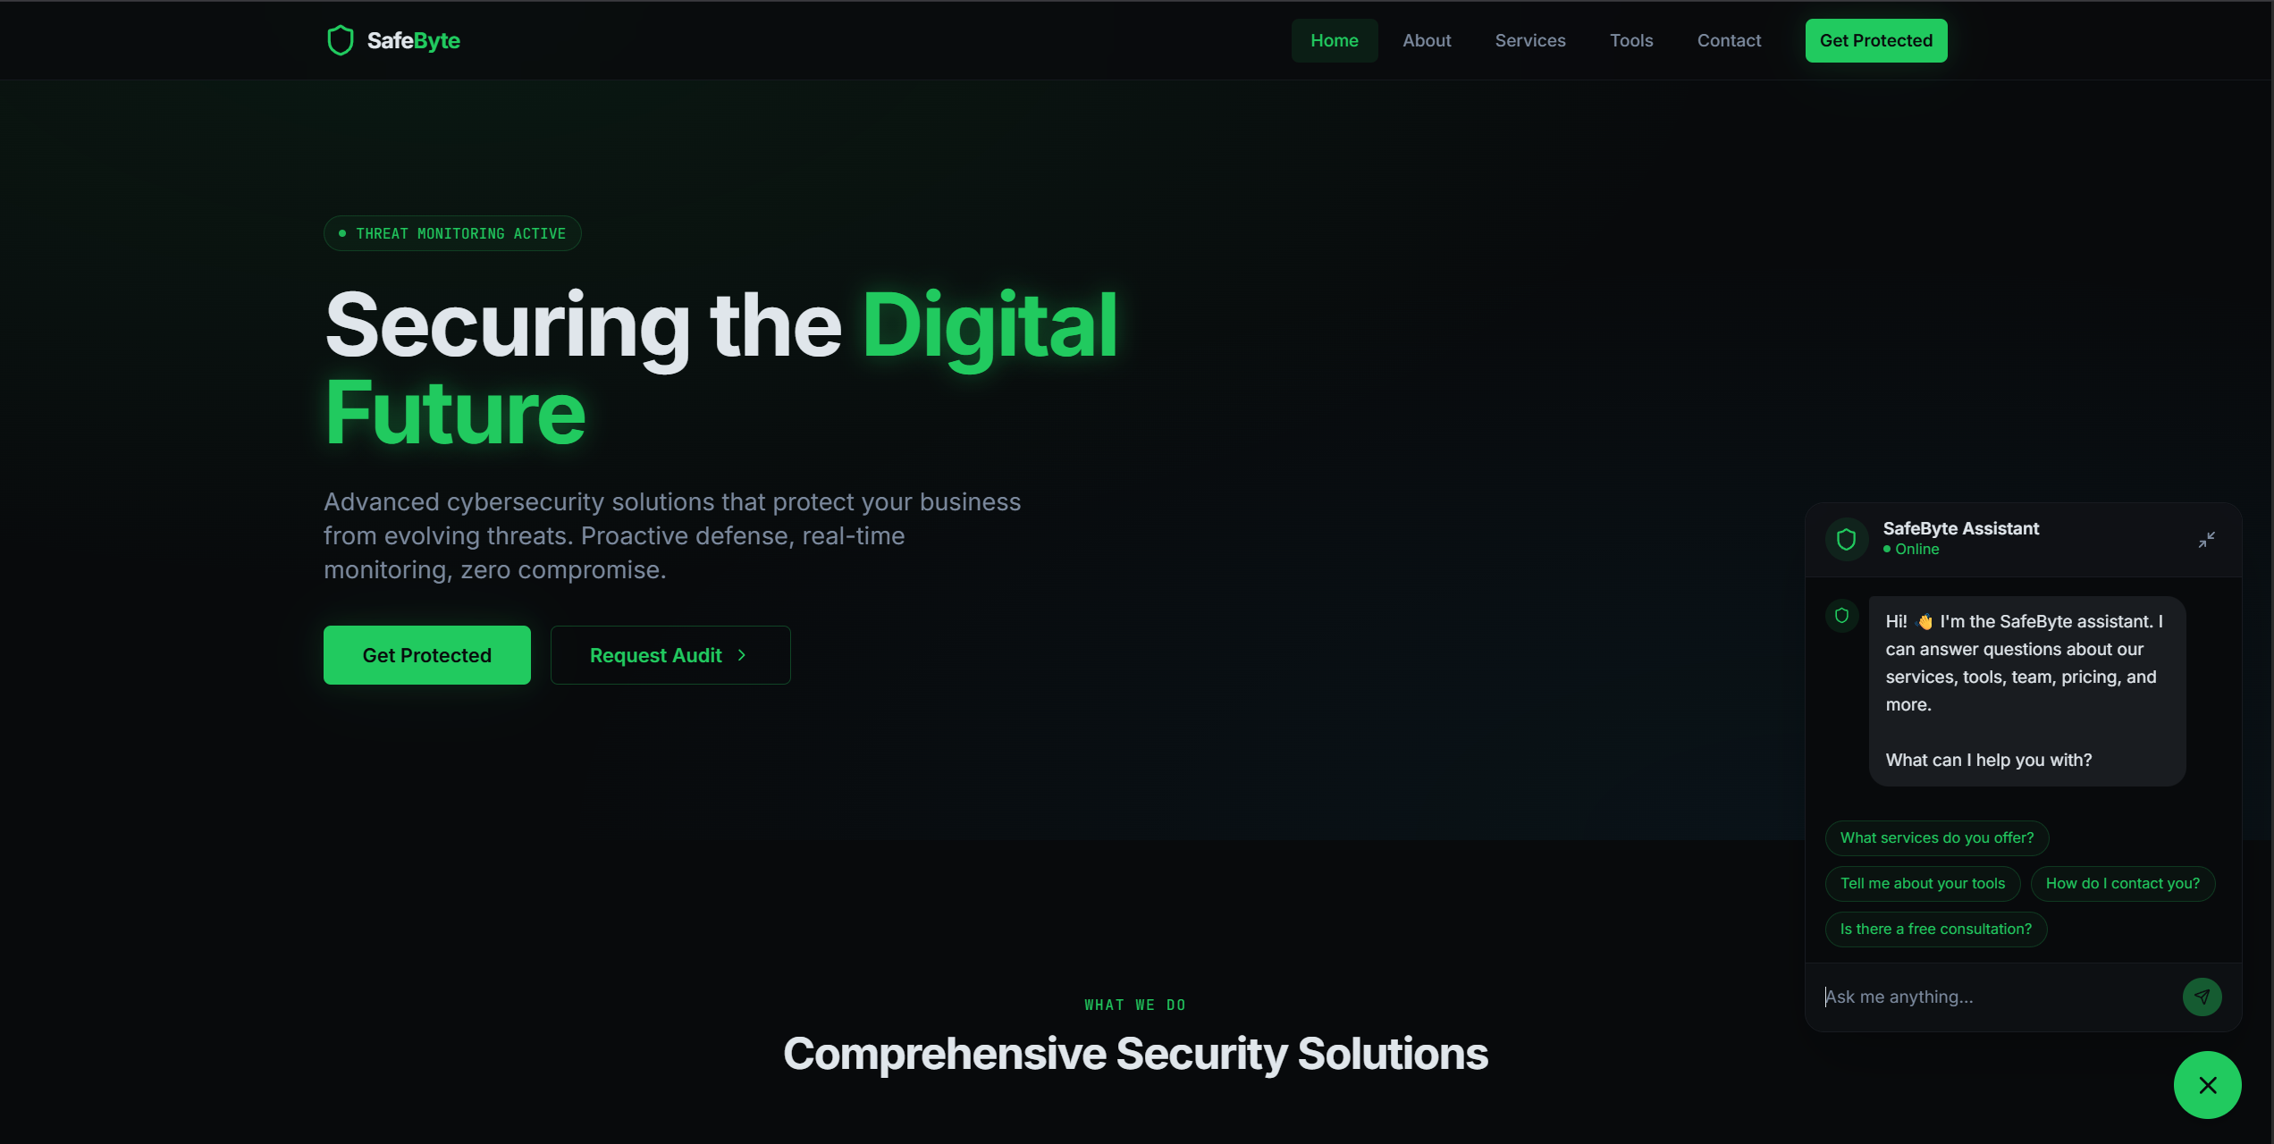
TECHNICAL APPROACH
SafeByte
Layer | Technologies
Frontend | React 18, TypeScript, Vite
Case Intake | NCRP / SAHYOG reference, wallet input
Chain APIs | Etherscan v2, Blockchain.info, TronGrid
Evidence | Transactions, counterparties, JSON export
Analysis | Risk rules, entity registry checks
Attribution | Evidence status, confidence, analyst review
How the Current Prototype Works
Case Intake
Records the complaint source, case ID, and reported wallet.
Network Detection
Identifies Ethereum, Bitcoin, Tron, Litecoin, Dogecoin, XRP, or Cardano format.
Chain Adapters
Queries Etherscan, Blockchain.info, or TronGrid when supported.
Evidence Capture
Stores full transaction hashes, dates, values, and counterparties.
Fund-Flow Analysis
Displays recent one-hop movement around the subject wallet.
Risk Engine
Uses activity, value tiers, linked cases, and registry matches.
Attribution Guardrail
Marks the VASP as inconclusive when evidence is insufficient.
Case Output
Exports findings, attribution basis, actions, and limitations.
Notes:
Prototype sources: https://docs.etherscan.io/ ; https://www.blockchain.com/explorer/api/blockchain_api ; https://developers.tron.network/

Slide 4
FEASIBILITY AND VIABILITY
SafeByte
Implementation Status and Future Scope
Technical Feasibility
React and TypeScript prototype already runs.
Ethereum and Bitcoin transaction lookups are live.
Tron balance lookup is live.
Case-linked JSON evidence export works.
Intended Users
I4C and cybercrime investigators
State and district cyber police units
VASP compliance and response teams
Digital forensic analysts
Current Constraints
Public APIs have rate and coverage limits.
The demonstration registry is small.
Public chain data does not prove ownership.
Analyst validation remains mandatory.
Risk Handling
No VASP match is shown without supporting data.
Every export records sources and limitations.
API failures produce a clear incomplete result.
Lawful action requires analyst confirmation.
Future Scope
Two-hop and three-hop graph tracing
VASP clusters, mixers, bridges, and deposit wallets
BNB Chain, Polygon, Solana, and full Tron tracing
Authenticated NCRP and SAHYOG integration
Signed reports, audit logs, and access control
AI Red Teamer as a separate supporting module
Licensed Windows and macOS investigation app

Slide 5
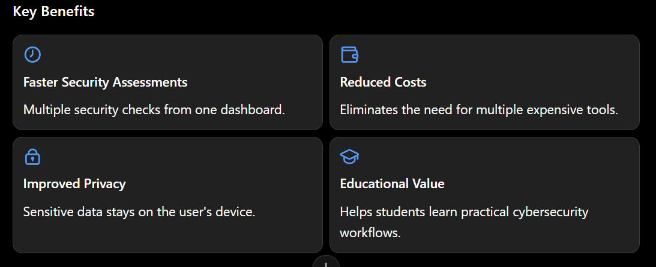
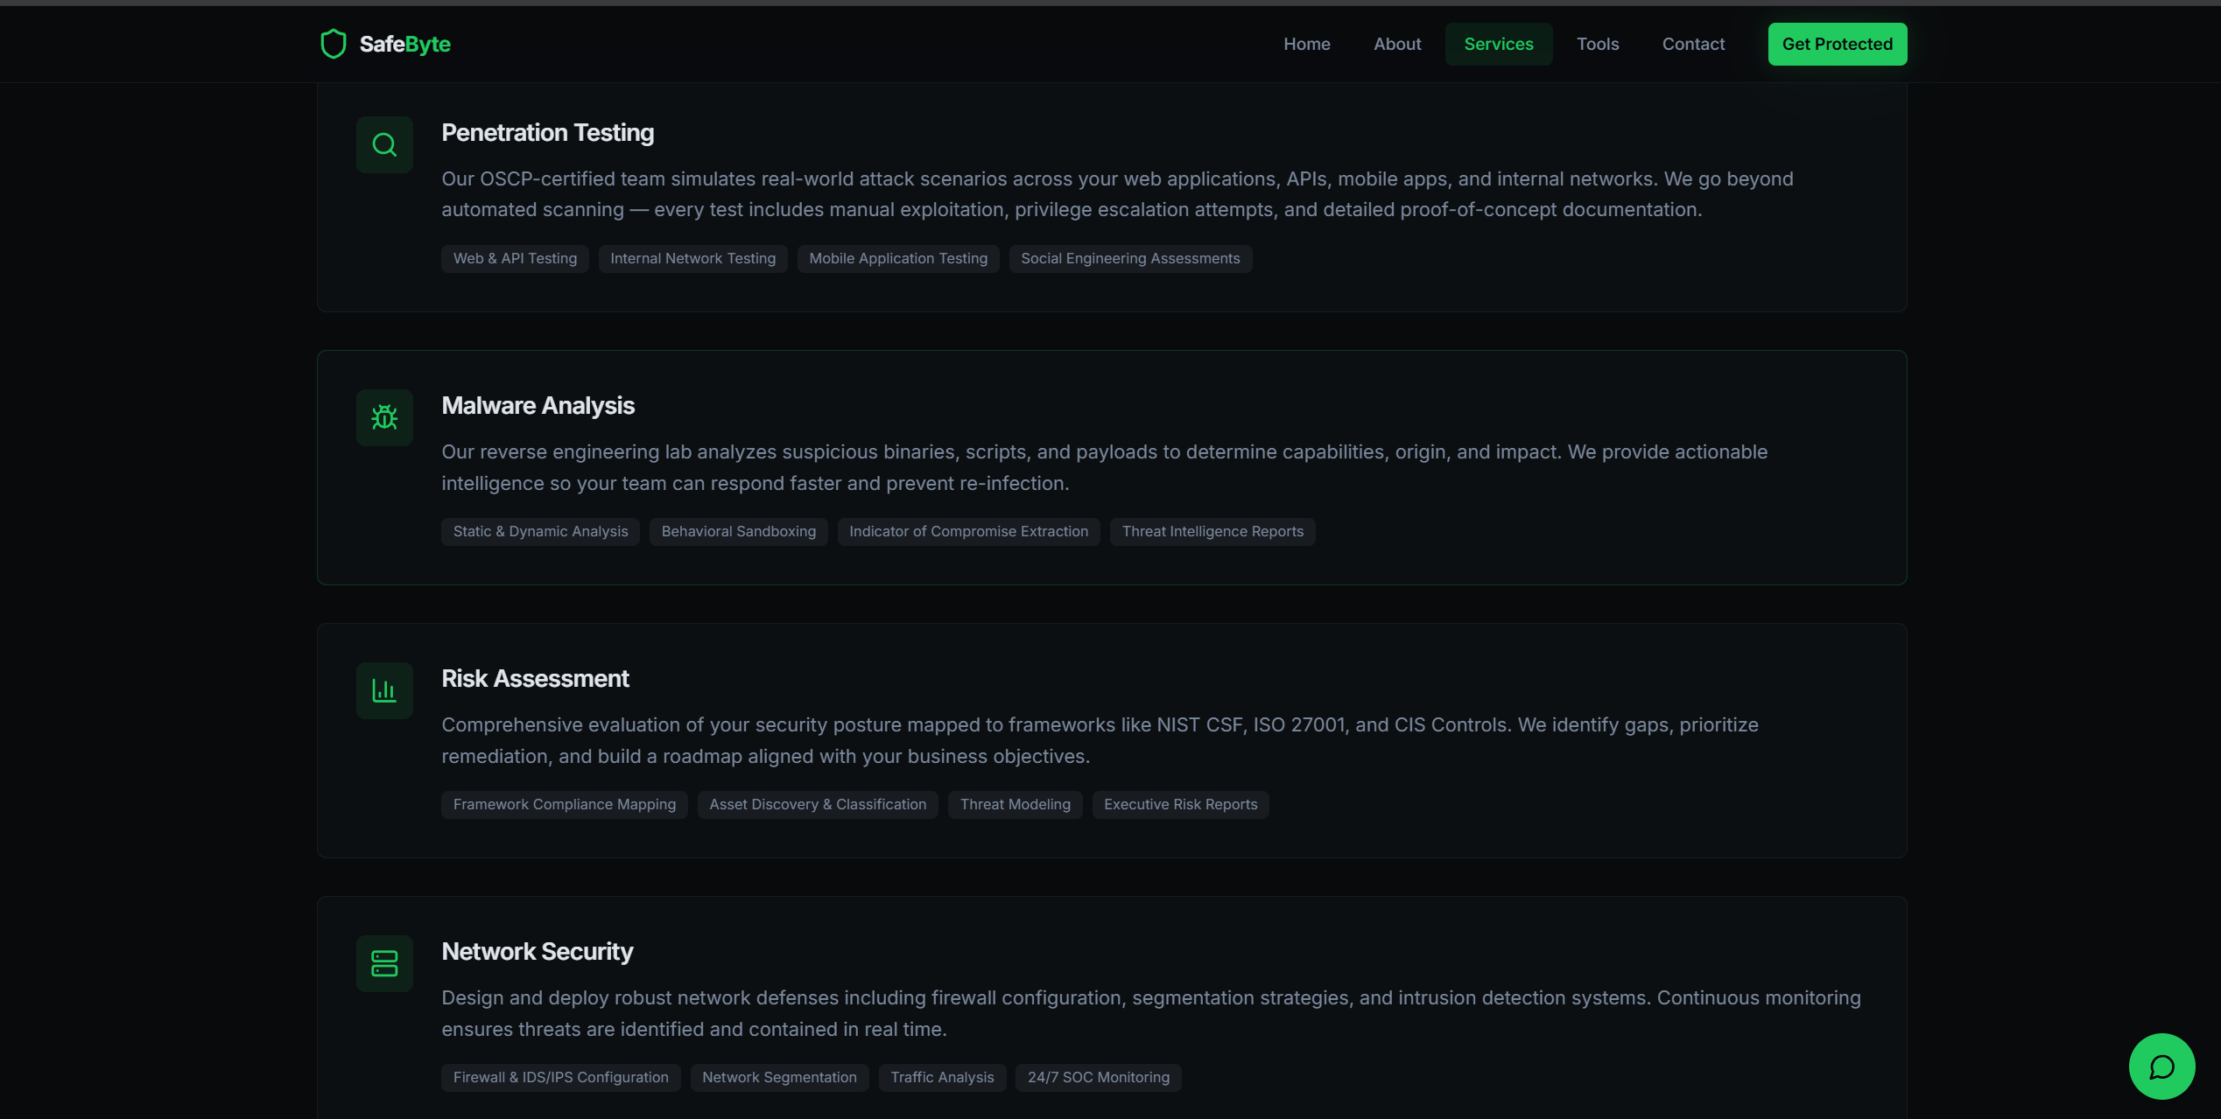
IMPACT AND BENEFITS
SafeByte
Investigation Benefits
Connects the wallet to its complaint record
Reduces the first manual review workload
Preserves transaction identifiers and timestamps
Shows the reason behind each risk finding
Separates verified matches from assumptions
Current Value
Working browser-based intake and wallet trace
Live evidence from three public chain sources
Recent counterparty fund-flow view
High-risk registry check and risk score
Downloadable investigation evidence package
Who Can Use It
Primary users
I4C investigation teams
Cybercrime police units
Digital forensic laboratories
VASP compliance teams
Incident response analysts

Slide 6
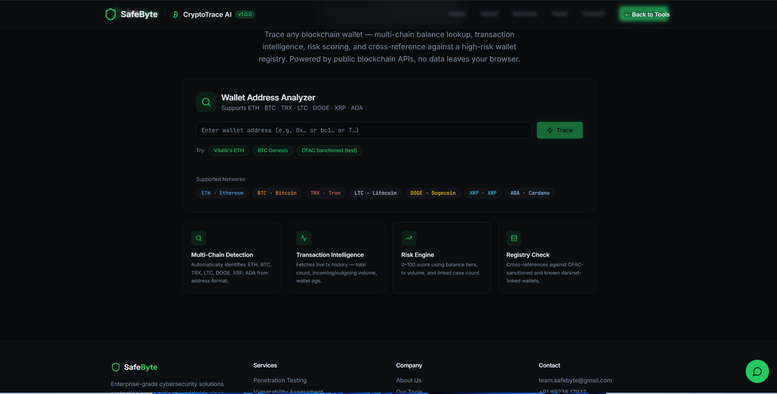
RESEARCH AND REFERENCES
SafeByte
Research and References
The prototype uses the official SIH scope and public blockchain data.
PRIMARY SOURCES
SIH 2026 problem statement SIH26182
Etherscan v2, Blockchain.info, and TronGrid APIs
OFAC sanctions data
METHODS USED
Wallet format and network recognition
Transaction and counterparty extraction
Rule-based risk scoring and exact registry checks
Evidence package generation
PROTOTYPE EVIDENCE
Complaint-linked investigation intake
Live wallet lookups and recent fund-flow display
Cautious VASP attribution status with confidence
JSON case export with recorded limitations
NEXT VALIDATION
Test labelled VASP clusters and multi-hop traces.
Measure attribution precision and investigation time.
Notes:
References: SIH26182 source dataset; Etherscan v2 API; Blockchain.com Explorer API; TronGrid API; OFAC Sanctions List Search.

Slide 7
SafeByte
Crypto Fraud Investigation Workflow
1
2
3
4
5
CASE INTAKE
NCRP or SAHYOG ID
Victim-reported wallet
Complaint time
CHAIN EVIDENCE
Detect wallet network
Balance and activity
Transaction records
FUND FLOW
Recent counterparties
Incoming and outgoing
Multi-hop tracing next
VASP ATTRIBUTION
Entity registry check
Confidence and basis
Analyst validation
CASE ACTION
Evidence package
Preservation request
Freezing follow-up
EVIDENCE RULE: SafeByte records an attribution only when the available registry supports it. Otherwise the result remains inconclusive.
The workflow supports SIH26182 and the victim-reporting use case described in SIH26183.

