Slide 1
Tourist Guide
21DCE062-Nishva Mori
21DCE076-Aayush Patel

Slide 2
Introduction
India is one of the most beautiful location .
Tourist hub welcomes more than 5 million tourists.
Reveal numerous mystic things regarding its culture, art, tradition, history etc.
Attracted towards the cultural diversity of this country from Kashmir to Kanyakumari. Each tradition symbolizes the flavor and aura of the place.

Slide 3
Problem Statement
Internet users are increasing nowadays.
Save time and explore new place.
India is a country where in a few days holiday, you can enjoy a lot.
The problem is that we although having many websites but they offer different kind of services. The customers are enjoying a lot but they are not telling historic tales of that place and their speciality.
There will be many users visiting the portal so we require reliable frontend which can attract the users on our site.
We will be putting an effort to provide the right choice to the people when they plan a holiday and beware of where they are going.

Slide 4
Home Page
List of States
Suggestions of State
About us
Contact us
List of Cities
Suggestions of Cities
Info about City

Slide 5
Building Blocks
Front-end Technology
HTML
CSS
Back-end Technology
JavaScript
Software
Visual Studio

Slide 6
Plan of action
Gathering information.
Separating information.
Making of front-end.
Connection of front-end to back-end.

Slide 7
Functionalities
Website is most beneficial for new visitors in city.
The website gives a choice to the users to access their needed place
without any physical movement.
User can have look over their choices and can get it’s information, address and photos.

Slide 8
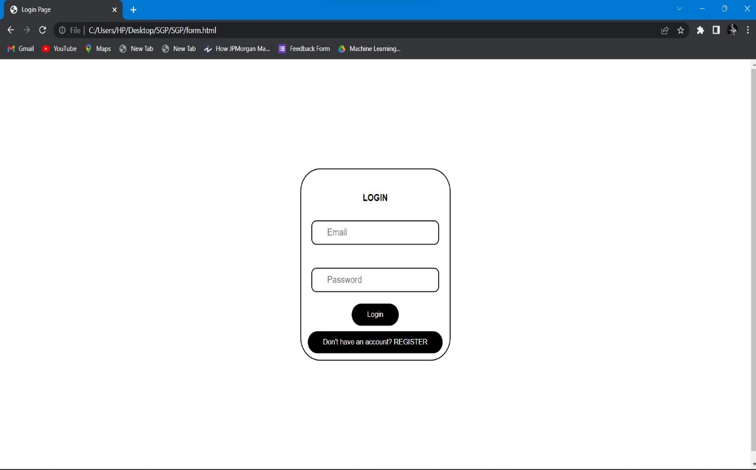
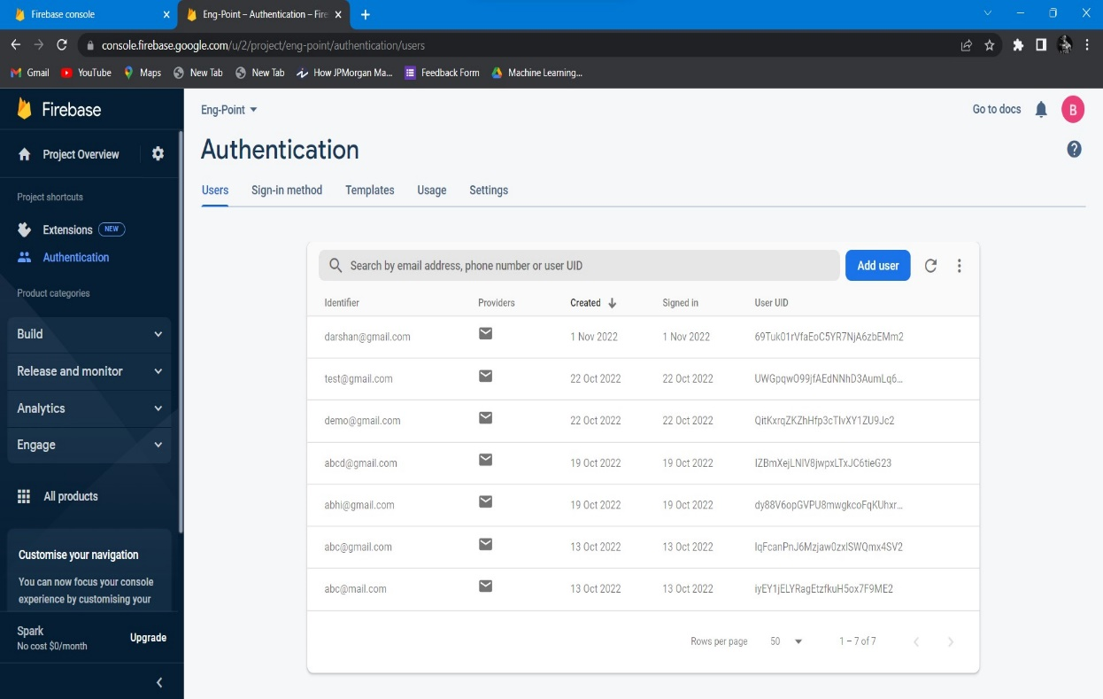
Snapshot of implementation

Slide 9
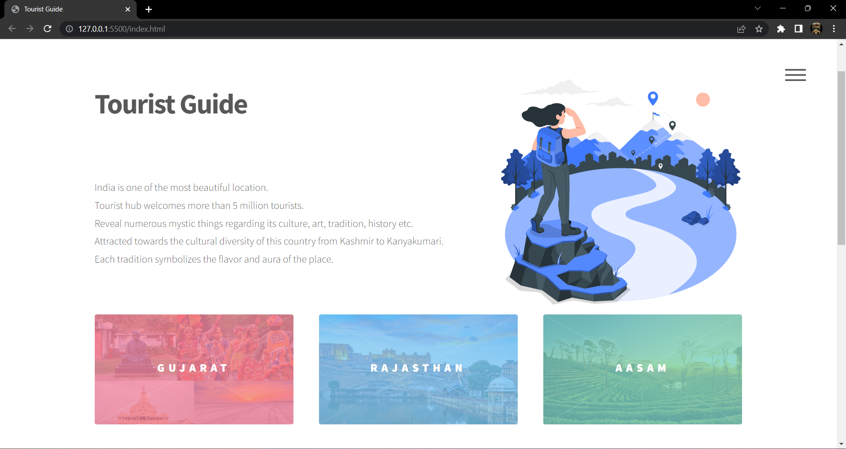
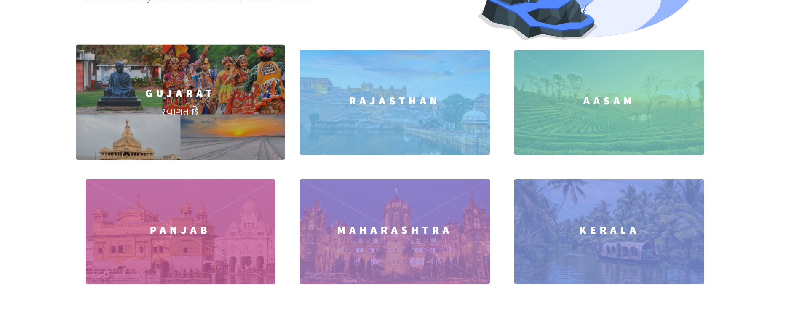

Slide 10
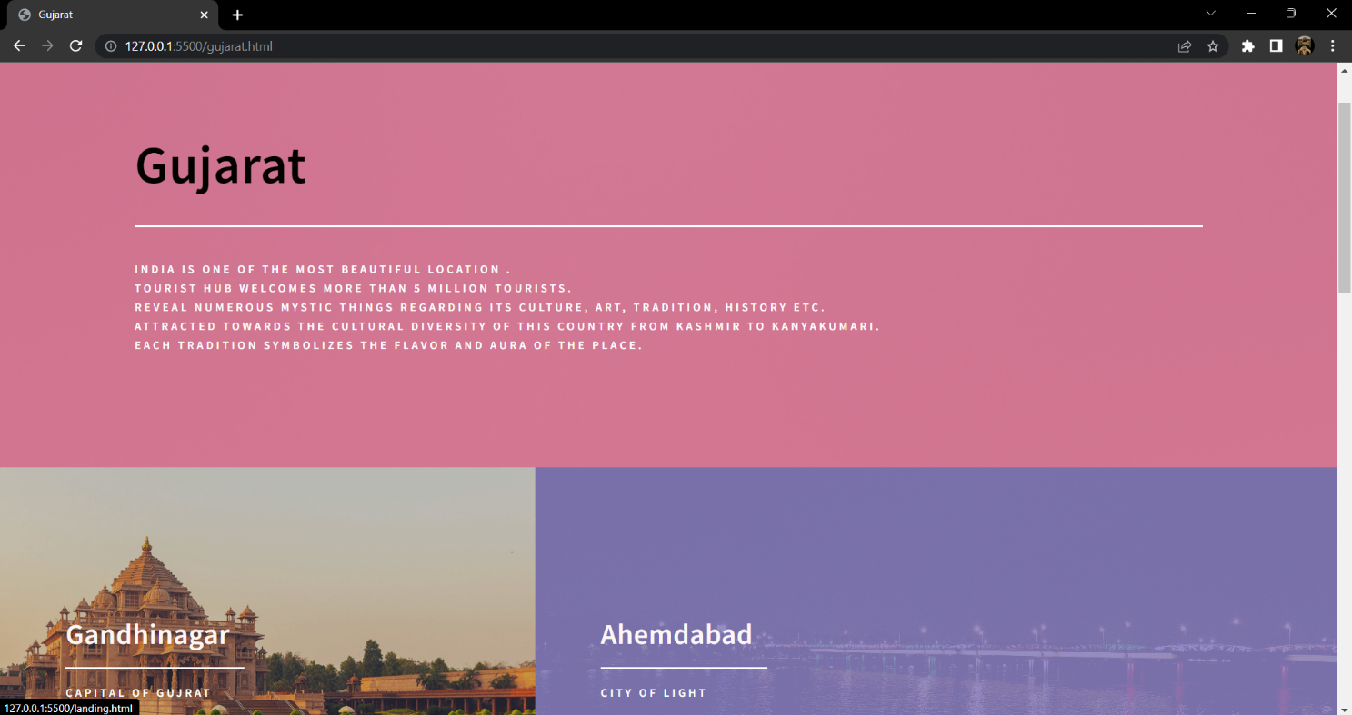
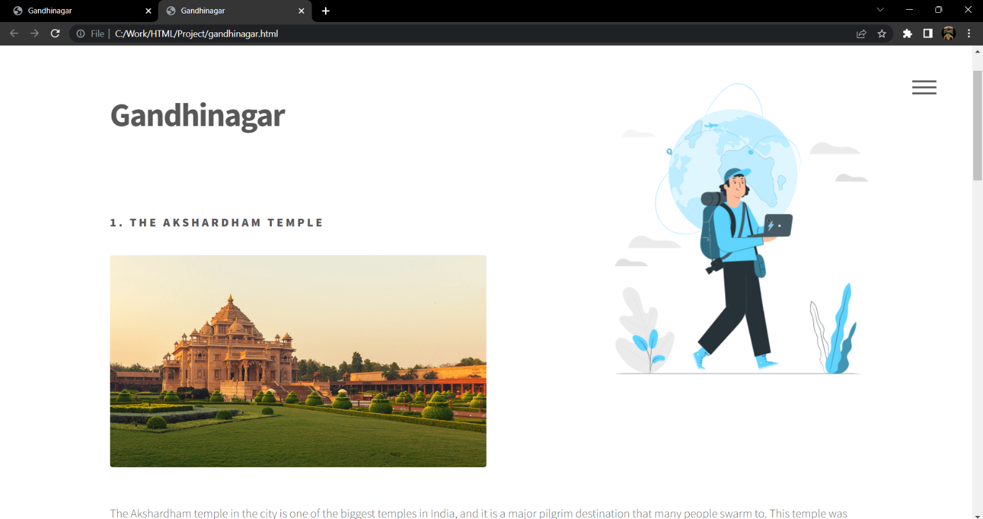

Slide 11
Future Scope
We will include more functionality as per user requirements.
We want to improve our home page, as it is the main thing which attracts all users.
We can also add different countries with it’s states and cities included.
We can also categories like Wildlife , Hill station , Beach tour , Heritage and Trekking.

Slide 12
References
GitHub
HTML, CSS, Javascript documentation
YouTube Videos

Slide 13
Thank you

