Slide 1
PathLight
CODETHECURE 2026 · DETECTION & DIAGNOSIS
Your pathology report, read alongside you.
Free · runs entirely in the browser · checked on 1,548 real reports
Notes:
Hi, I am [name]. I want to start with a notification that millions of people get every year.

Slide 2
The page a patient actually sees
Since the 21st Century Cures Act rules took effect in 2021, it arrives in the patient portal the moment it is signed, often before the doctor calls.
SURGICAL PATHOLOGY REPORT
FINAL DIAGNOSIS:
A. Left breast, lumpectomy:
- Invasive ductal carcinoma,
Nottingham grade 2 (6/9).
- Margins negative for invasive
carcinoma and DCIS.
pT2 pN0(sn)
HER2 (IHC): Negative (Score 1+)
Lymphovascular invasion: Not identified
What would you understand from it?
Synthetic example report.
Notes:
Since the Cures Act this arrives the moment it is signed. Read it as a patient would: pT2, pN0 sn, HER2 negative, score one-plus. What does any of that mean?

Slide 3
Patients want results now, but read them alone
95.7%
16.5%
39.9%
of 8,139 portal users want results immediately, even before their clinician has reviewed them
of those with abnormal results felt more worried reading them before talking to a clinician
searched the internet to understand their results
The options today: search engines (generic and frightening), chatbots (they receive your health record and can make things up), or waiting days for the appointment.
Source: Steitz BD et al. JAMA Netw Open. 2023;6(3):e233572.
Notes:
In a 2023 survey across four academic medical centers nearly everyone wanted immediate access, but one in six people with abnormal results felt more worried, and four in ten went to Google.

Slide 4
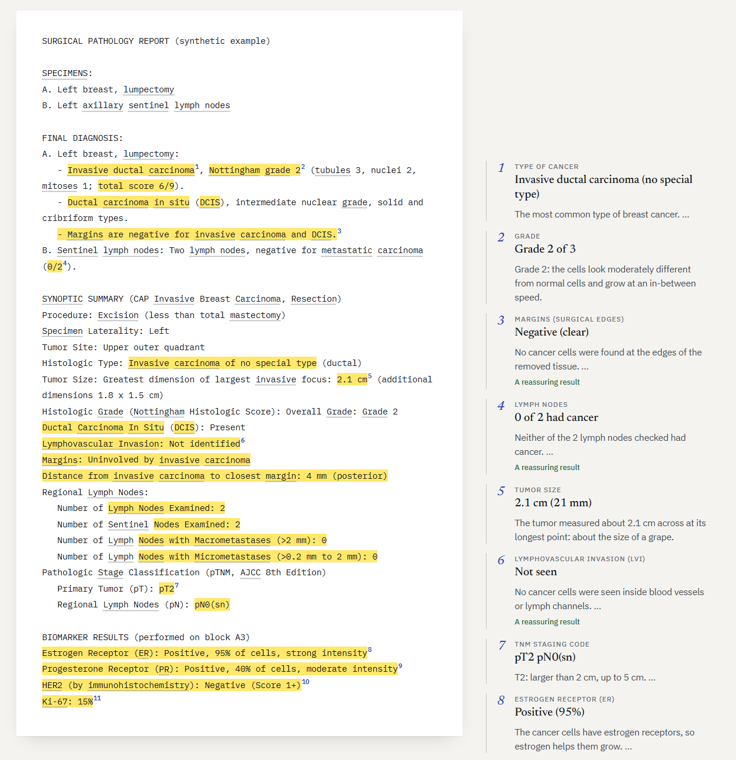
The idea: your own report becomes the interface
1
Marked in the report itself
Each finding is highlighted where it appears and numbered like a footnote.
2
A plain-language note beside it
Margin notes on desktop, footnotes on a phone. Click either side to jump to the other.
3
Checkable, private, humane
Every note cites its words. Nothing leaves the device. A "Before you read" check-in sets the pace.
Notes:
Most tools replace the report with a dashboard. PathLight keeps the patient's own report as the page and annotates it the way a careful reader marks paper: a highlighter, a footnote number, and a note in the margin.

Slide 5
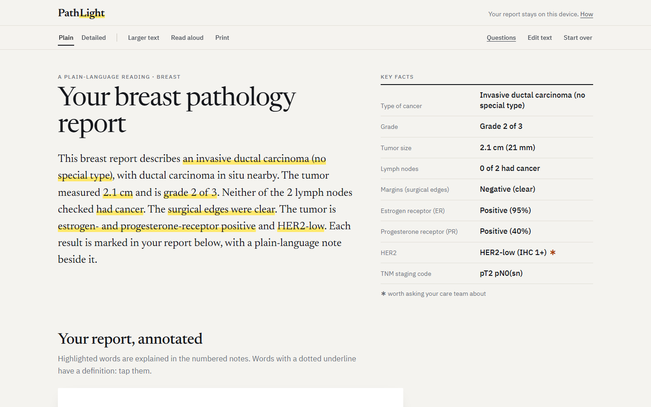
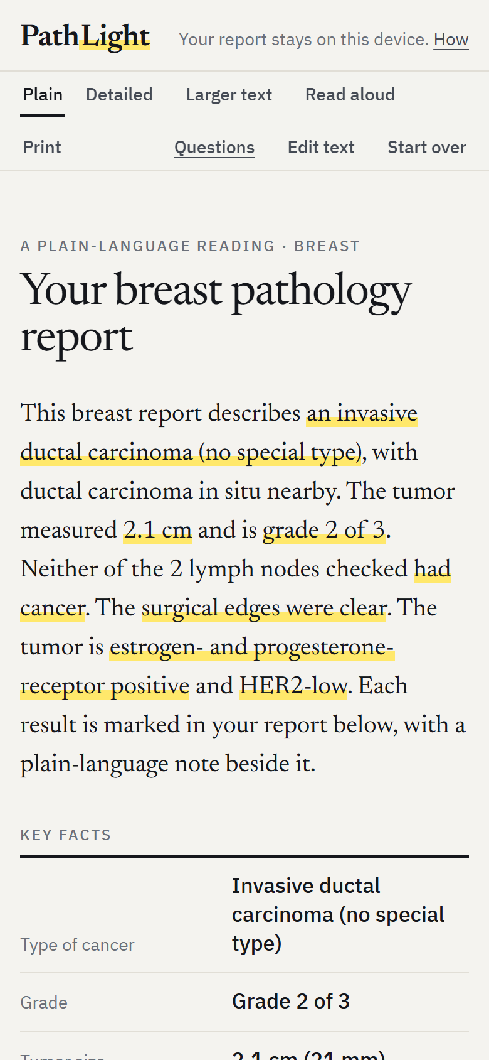
Walkthrough: a summary first, then every detail
Summary written by fixed rules, not AI; each highlighted phrase links to its note.
Notes:
First a plain-English summary and the key facts. Every highlighted phrase links to its note. On a phone the notes become footnotes.

Slide 6
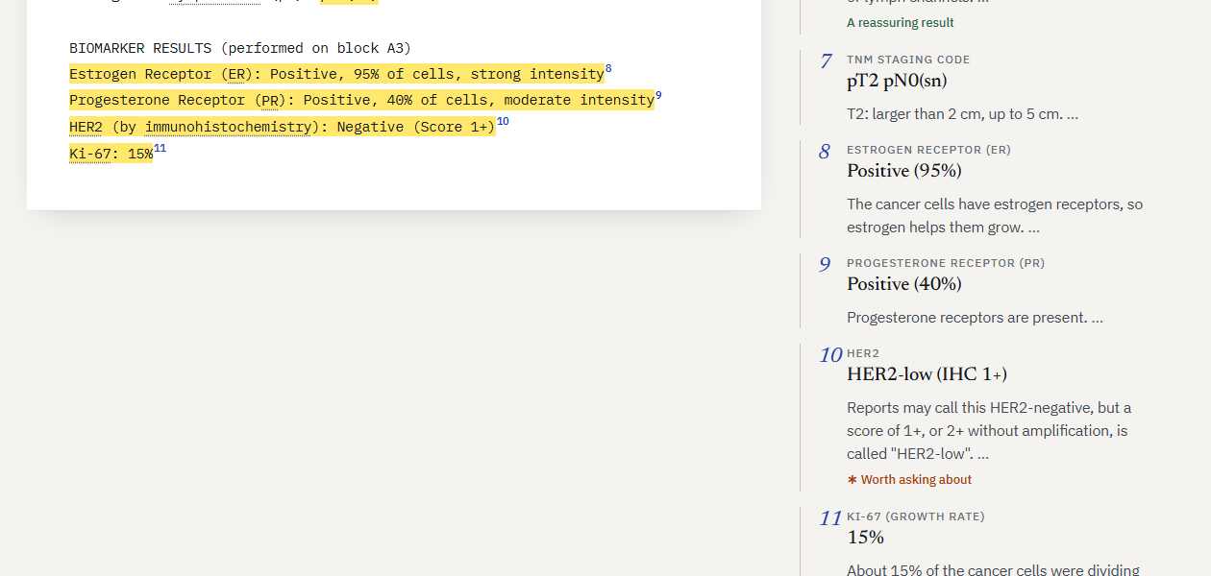
“Negative” is not the whole story
THE REPORT SAYS
HER2 (IHC): Negative (Score 1+)
PATHLIGHT EXPLAINS
HER2-low
A 1+ score is "HER2-low". Since 2022, trastuzumab deruxtecan has been FDA-approved for HER2-low breast cancer that has spread. The word "negative" hides that.
Question added for the patient: "My HER2 result is low. Does that matter for any treatment options now or later?"
Notes:
This report says HER2 negative. But a score of one-plus is now called HER2-low, and a newer medicine is approved for HER2-low cancer that has spread. A patient reading the word negative would never know to ask, so PathLight explains it and adds the question.

Slide 7
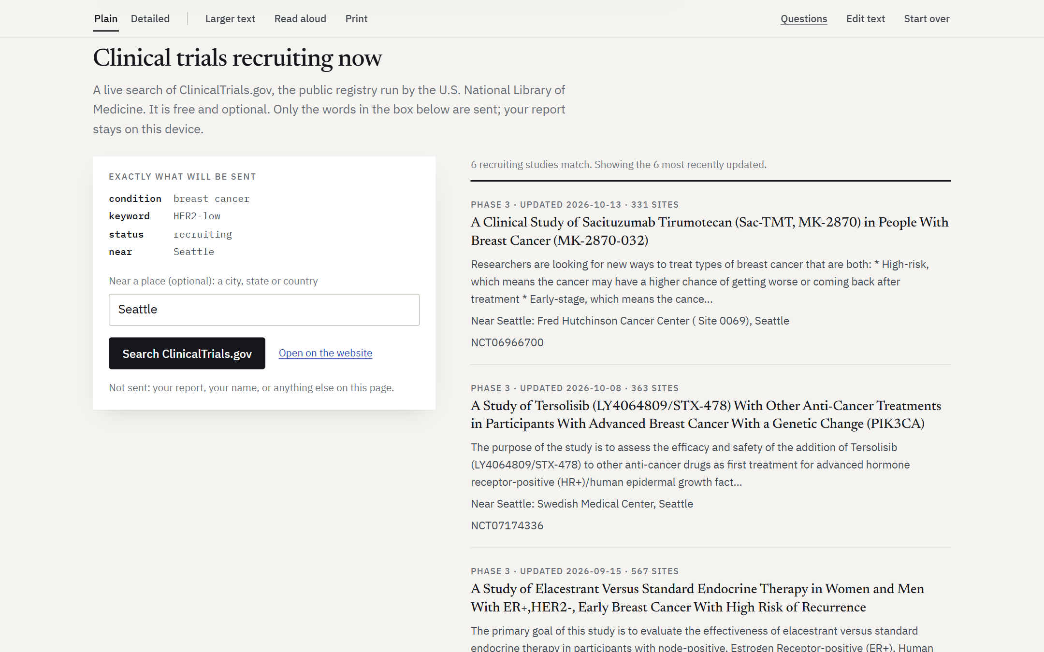
Connected, without giving up privacy
1
Live clinical-trial search
ClinicalTrials.gov API v2, free with no key. It sends a condition, one marker and an optional place, shown before sending.
2
Photos and scans, read on-device
tesseract.js (WebAssembly) and its English model are served by the site. A test photo took about 7 seconds.
3
Enforced by the browser
The Content-Security-Policy allows one outside address. Nothing else can be contacted.
The exact rule shipped with the site, and shown on its landing page.
connect-src 'self' https://clinicaltrials.gov
Notes:
Two connections. A live search of recruiting trials: the patient sees exactly what is sent, a cancer type, one marker and a city. And on-device OCR, so a photo of a paper report works. The browser policy makes privacy a guarantee, not a promise.

Slide 8
Technical architecture
1
2
3
4
5
6
Input
Read
Normalise
Extract
Evidence
Present
Paste, PDF, photo
pdf.js or on-device OCR
OCR fixes: pNO → pN0
20+ extractors, NegEx negation, specimen-aware counts
Every finding keeps its character offsets
Summary, margin notes, questions, trial query
Stack
Why rules, not an LLM
React + TypeScript + Vite, static hosting on GitHub Pages
Pure TypeScript engine: no DOM, no network
118 Vitest tests; CI runs tests and evaluation on every push
Checkable: every note points to its source words
Guideline-encoded: AJCC 8, ASCO/CAP, ISUP
Private and free: no health data to a third party, no API cost
Notes:
Text comes from paste, pdf.js, or on-device OCR. A normaliser fixes common OCR errors. More than twenty extractors run with NegEx-style negation and specimen-aware lymph node counting. Every finding keeps character offsets, which drive the highlights, the margin layout and the summary.

Slide 9
Validated on 1,548 real reports it had never seen
92.6%
of 5,489 values agreed with the curated clinical record (8,150 labeled; 67% answered)
1
Real data
TCGA-Reports: 9,523 OCR'd reports (Kefeli & Tatonetti, 2024), labels from cBioPortal.
2
Honest split
Errors were studied on a dev half only. First version: 89.5% on the same test half.
Notes:
We did not stop at synthetic reports. On 1,548 real held-out pathology reports from The Cancer Genome Atlas, 92.6 percent of the values PathLight reported matched the curated record, up from 89.5 percent before error analysis on a separate development half. When it is unsure it stays silent, which is why it answers about two thirds of the time. HER2 is the weakest field and the next target.

Slide 10
Impact and feasibility
$0 per user, at any scale
PathLight cannot change the result. It can make sure no one has to face that page alone, or confused.
A static site: computing happens on the patient's device, and no server ever holds health data.
Where it reaches people
Links from patient portals and cancer-center education pages; caregivers; low-resource clinics.
How we will measure it
Comprehension and anxiety before and after; quality of the questions patients bring.
Next
Pathologist review of every explanation, Spanish, more organs, an offline app.
Thank you.
Notes:
It costs nothing to run at any scale and holds no health data, which removes the biggest barrier to adoption. Next: a pathologist reviewing every explanation, Spanish, and a comprehension study. A diagnosis is one of the hardest moments in a life. PathLight cannot change the result, but it can make sure no one faces that page alone or confused. Thank you.

