Slide 1
Multithreading
Multithreading in java is a process of executing multiple threads simultaneously.
Thread is basically a lightweight sub-process, a smallest unit of processing. Multiprocessing and multithreading, both are used to achieve multitasking.
Advantage of Multithreading
1) It doesn't block the user because threads are independent and you can perform multiple operations at same time.
2) You can perform many operations together so it saves time.
3) Threads are independent so it doesn't affect other threads if exception occur in a single thread.

Slide 2
Multithreading
Multi threading in java is a process of executing multiple threads simultaneously.
Thread is basically a lightweight sub-process, a smallest unit of processing. Multiprocessing and multithreading, both are used to achieve multitasking.
But we use multithreading than multiprocessing because threads share a common memory area. They don't allocate separate memory area so saves memory, and context-switching between the threads takes less time than process. Java Multithreading is mostly used in games, animation etc.

Slide 3
ADVANTAGE OF JAVA MULTITHREADING
1) It doesn't block the user because threads are independent and you can perform multiple operations at same time.
2) You can perform many operations together so it saves time.
3) Threads are independent so it doesn't affect other threads if exception occur in a single thread.
MULTITASKING
Multitasking is a process of executing multiple tasks simultaneously. We use multitasking to utilize the CPU. Multitasking can be achieved by two ways:
Process-based Multitasking(Multiprocessing)
Thread-based Multitasking(Multithreading)
WHAT IS THREAD IN JAVA
A thread is a lightweight sub process, a smallest unit of processing. It is a separate path of execution.
Threads are independent, if there occurs exception in one thread, it doesn't affect other threads. It shares a common memory area.

Slide 4
PROCESS-BASED MULTITASKING (MULTIPROCESSING)
Each process have its own address in memory i.e. each process allocates separate memory area.
Process is heavyweight.
Cost of communication between the process is high.
Switching from one process to another require some time for saving and loading registers, memory maps, updating lists etc.
2) THREAD-BASED MULTITASKING (MULTITHREADING)
Threads share the same address space.
Thread is lightweight.
Cost of communication between the thread is low.

Slide 5
LIFE CYCLE OF A THREAD (THREAD STATES)
Life cycle of a thread
  New
  Runnable
  Running
  Non-Runnable (Blocked)
  Terminated
A thread can be in one of the five states. According to sun, there is only 4 states inthread life cycle in java new, runnable, non-runnable and terminated. There is no running state.
But for better understanding the threads, we are explaining it in the 5 states.
The life cycle of the thread in java is controlled by JVM. The java thread states are as follows:
New
Runnable
Running
Non-Runnable (Blocked)
Terminated

Slide 6
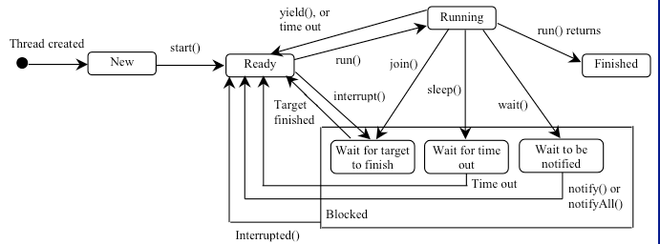
Thread State Diagram
A thread can be in one of five states: New, Ready, Running, Blocked, or Finished.

Slide 7
HOW TO CREATE THREAD
There are two ways to create a thread:
By extending Thread class
By implementing Runnable interface.
Thread Class:
Thread class provides various methods to create and perform operations on thread. It extends object class and implements runnable interface.

Slide 8
COMMONLY USED METHODS OF THREAD CLASS:
public void run(): is used to perform action for a thread.
public void start(): starts the execution of the thread.JVM calls the run() method on the thread.
public void sleep(long miliseconds): Causes the currently executing thread to sleep (temporarily cease execution) for the specified number of milliseconds.
public void join(): waits for a thread to die.
public void join(long miliseconds): waits for a thread to die for the specified miliseconds.
public int getPriority(): returns the priority of the thread.
public int setPriority(int priority): changes the priority of the thread.
public String getName(): returns the name of the thread.
public void setName(String name): changes the name of the thread.
public Thread currentThread(): returns the reference of currently executing thread.
public int getId(): returns the id of the thread.
public Thread.State getState(): returns the state of the thread.
public boolean isAlive(): tests if the thread is alive.
public void yield(): causes the currently executing thread object to temporarily pause and allow other threads to execute.
public void suspend(): is used to suspend the thread(depricated).
public void resume(): is used to resume the suspended thread(depricated).
public void stop(): is used to stop the thread(depricated).
public boolean isDaemon(): tests if the thread is a daemon thread.
public void setDaemon(boolean b): marks the thread as daemon or user thread.
public void interrupt(): interrupts the thread.
public boolean isInterrupted(): tests if the thread has been interrupted.
public static boolean interrupted(): tests if the current thread has been interrupted.

Slide 9
RUNNABLE INTERFACE:
The Runnable interface should be implemented by any class whose instances are intended to be executed by a thread. Runnable interface have only one method named run().
public void run(): is used to perform action for a thread.
STARTING A THREAD:
start() method of Thread class is used to start a newly created thread. It performs following tasks:
A new thread starts(with new callstack).
The thread moves from New state to the Runnable state.
When the thread gets a chance to execute, its target run() method will run.

Slide 10
BY EXTENDING THREAD CLASS:
class Multi extends Thread
{
public void run()
{
System.out.println("thread is running...");
}
public static void main(String args[])
{
Multi t1=new Multi();
t1.start();
}
}
WHO MAKES YOUR CLASS OBJECT AS THREAD OBJECT?
Thread class constructor allocates a new thread object. When you create object of Multi-class, your class constructor is invoked(provided by Compiler) from where Thread class constructor is invoked. So your Multi class object is thread object now.

Slide 11
BY IMPLEMENTING THE RUNNABLE INTERFACE:
class Multi3 implements Runnable
{
public void run()
{
System.out.println("thread is running...");
}
public static void main(String args[])
{
Multi3 m1=new Multi3();
Thread t1 =new Thread(m1);
t1.start();
}
}
If you are not extending the Thread class,your class object would not be treated as a thread object.So you need to explicitely create Thread class object.We are passing the object of your class that implements Runnable so that your class run() method may execute.

Slide 12
THREAD SCHEDULER IN JAVA
Thread scheduler in java is the part of the JVM that decides which thread should run.
There is no guarantee that which runnable thread will be chosen to run by the thread scheduler. Only one thread at a time can run in a single process.
The thread scheduler mainly uses preemptive or time slicing scheduling to schedule the threads.
DIFFERENCE BETWEEN PREEMPTIVE SCHEDULING AND TIME SLICING
Under preemptive scheduling, the highest priority task executes until it enters the waiting or dead states or a higher priority task comes into existence. Under time slicing, a task executes for a predefined slice of time and then reenters the pool of ready tasks. The scheduler then determines which task should execute next, based on priority and other factors.
SLEEP METHOD IN JAVA
The sleep() method of Thread class is used to sleep a thread for the specified amount of time.
SYNTAX OF SLEEP() METHOD IN JAVA
The Thread class provides two methods for sleeping a thread:
public static void sleep(long miliseconds)throws InterruptedException
public static void sleep(long miliseconds, int nanos)throws InterruptedException

Slide 13
EXAMPLE OF SLEEP METHOD IN JAVA
class TestSleepMethod1 extends Thread
{
public void run()
{
for(int i=1;i<5;i++)
{
try{Thread.sleep(500);}catch(InterruptedException e){System.out.println(e);}
System.out.println(i);
}
}
}
public static void main(String args[])
{
TestSleepMethod1 t1=new TestSleepMethod1();
TestSleepMethod1 t2=new TestSleepMethod1();
t1.start();
t2.start();
}
}

Slide 14
CAN WE START A THREAD TWICE
No. After starting a thread, it can never be started again. If you does so, an IllegalThreadStateException is thrown. In such case, thread will run once but for second time, it will throw exception.
Let's understand it by the example given below:
public class TestThreadTwice1 extends Thread
{
public void run()
{
System.out.println("running...");
}
public static void main(String args[])
{
TestThreadTwice1 t1=new TestThreadTwice1();
t1.start();
t1.start();
}
}

Slide 15
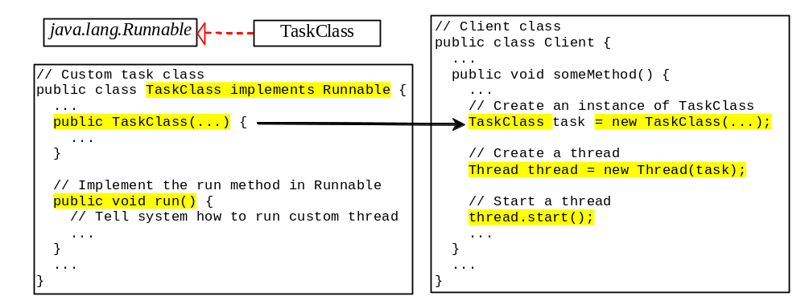
Creating Tasks and Threads

Slide 16
Thread Priority
Each thread is assigned a default priority of the thread that spawned it. The priority of the main thread is Thread.NORM_PRIORITY. You can reset the priority using setPriority(int priority).
Some constants for priorities include Thread.MIN_PRIORITY : 1
Thread.MAX_PRIORITY : 10
Thread.NORM_PRIORITY : 5

Slide 17
package javaapplication36;
class TestMultiPriority1 extends Thread{
public void run(){
System.out.println("running thread name is:"+Thread.currentThread().getName());
System.out.println("running thread priority is:"+Thread.currentThread().getPriority());
}
public static void main(String args[]){
}
}
public class JavaApplication36
{
public static void main(String[] args) throws Exception
{
System.out.println(Thread.currentThread().getPriority());
TestMultiPriority1 m1=new TestMultiPriority1();
TestMultiPriority1 m2=new TestMultiPriority1();
m1.setPriority(Thread.MIN_PRIORITY);
m2.setPriority(Thread.MAX_PRIORITY);
m1.start();
m2.start();
}
}

Slide 18
class ThreadExample implements Runnable
{
public void run()
{
System.out.println("Running");
}
}
public class Test
{
public static void main(String[] args)
{
ThreadExample te=new ThreadExample();
Thread t=new Thread(te);
t.start();
}
}

Slide 19
package javaapplication34;
class ThreadDemo extends Thread
{
private Thread t;
private String threadName;
ThreadDemo(String name)
{
threadName=name;
System.out.println("Creating "+threadName);
}
public void run()
{
System.out.println("Running :"+threadName);
try
{
for(int i=4;i>0;i--)
{
System.out.println("Thread : "+threadName+","+i);
Thread.sleep(50);
}
}
catch(Exception e)
{
System.out.println("Thread : "+threadName+"Interrupted");
}
System.out.println("Thread "+threadName+"existing");
}
public void start()
{
System.out.println("Starting "+threadName);
if(t==null)
{
t=new Thread(this,threadName);
t.start();
}
}
}

Slide 20
public class JavaApplication34
{
public static void main(String[] args)
{
ThreadDemo th1=new ThreadDemo("Thread");
th1.start();
ThreadDemo th2=new ThreadDemo("Thread");
th2.start();
}
}

Slide 21
SYNCHRONIZATION IN JAVA
Synchronization in java is the capability to control the access of multiple threads to any shared resource.
Java Synchronization is better option where we want to allow only one thread to access the shared resource.
WHY USE SYNCHRONIZATION
The synchronization is mainly used to
To prevent thread interference.
To prevent consistency problem.
TYPES OF SYNCHRONIZATION
There are two types of synchronization
Process Synchronization
Thread Synchronization

Slide 22
UNDERSTANDING THE PROBLEM WITHOUT SYNCHRONIZATION
Class Table{
void printTable(int n){//method not synchronized
for(int i=1;i<=5;i++){
System.out.println(n*i);
try{
Thread.sleep(400);
}catch(Exception e){System.out.println(e);}
}
}
}
class MyThread1 extends Thread
{
Table t;
MyThread1(Table t) {
this.t=t;
}
public void run(){
t.printTable(5);
}
}
class MyThread2 extends Thread{
Table t;
MyThread2(Table t){
this.t=t;
}
public void run(){
t.printTable(100);
}
}
class TestSynchronization1{
public static void main(String args[]){
Table obj = new Table();//only one object
MyThread1 t1=new MyThread1(obj);
MyThread2 t2=new MyThread2(obj);
t1.start();
t2.start();
}
}

Slide 23
JAVA SYNCHRONIZED METHOD
class Table{
synchronized void printTable(int n){//synchronized method
for(int i=1;i<=5;i++){
System.out.println(n*i);
try{
Thread.sleep(400);
}catch(Exception e){System.out.println(e);}
}
}
}
class MyThread1 extends Thread{
Table t;
MyThread1(Table t){
this.t=t;
}
public void run(){
t.printTable(5);
}
}
class MyThread2 extends Thread{
Table t;
MyThread2(Table t){
this.t=t;
}
public void run(){
t.printTable(100);
}
}
public class TestSynchronization2{
public static void main(String args[]){
Table obj = new Table();//only one object
MyThread1 t1=new MyThread1(obj);
MyThread2 t2=new MyThread2(obj);
t1.start();
t2.start();
}
}

Slide 24
EXAMPLE OF SYNCHRONIZED BLOCK
class Table{
void printTable(int n){
synchronized(this){//synchronized block
for(int i=1;i<=5;i++){
System.out.println(n*i);
try{
Thread.sleep(400);
}catch(Exception e){System.out.println(e);}
}
}
}//end of the method
}
class MyThread1 extends Thread{
Table t;
MyThread1(Table t){
this.t=t;
}
public void run(){
t.printTable(5);
}
}
class MyThread2 extends Thread{
Table t;
MyThread2(Table t){
this.t=t;
}
public void run(){
t.printTable(100);
}
}
public class TestSynchronizedBlock1{
public static void main(String args[]){
Table obj = new Table();//only one object
MyThread1 t1=new MyThread1(obj);
MyThread2 t2=new MyThread2(obj);
t1.start();
t2.start();
}
}

Slide 25
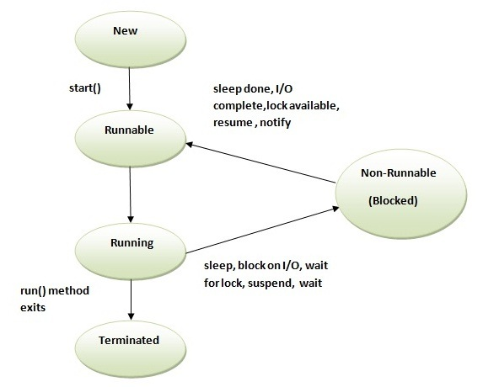
Life cycle of a Thread (Thread States)
The life cycle of the thread in java is controlled by JVM. The java thread states are as follows:
New
Runnable
Running
Non-Runnable (Blocked)
Terminated

Slide 26
There are two ways to create a thread:
By extending Thread class
By implementing Runnable interface.
class Multi extends Thread{
public void run(){
System.out.println("thread is running...");
}
public static void main(String args[]){
Multi t1=new Multi();
t1.start();
}
}
class Multi3 implements Runnable{
public void run(){
System.out.println("thread is running...");
}
public static void main(String args[]){
Multi3 m1=new Multi3();
Thread t1 =new Thread(m1);
t1.start();
}
}

Slide 27
class RunnableDemo implements Runnable {
private Thread t;
private String threadName;
RunnableDemo( String name){
threadName = name;
System.out.println("Creating " + threadName );
}
public void run() {
System.out.println("Running " + threadName );
try {
for(int i = 4; i > 0; i--) {
System.out.println("Thread: " + threadName + ", " + i);
// Let the thread sleep for a while.
Thread.sleep(50);
}
} catch (InterruptedException e) {
System.out.println("Thread " + threadName + " interrupted.");
}
System.out.println("Thread " + threadName + " exiting.");
}
public void start ()
{
System.out.println("Starting " + threadName );
if (t == null)
{
t = new Thread (this, threadName);
t.start ();
}
}
}
public class TestThread {
public static void main(String args[]) {
RunnableDemo R1 = new RunnableDemo( "Thread-1");
R1.start();
RunnableDemo R2 = new RunnableDemo( "Thread-2");
R2.start();
}
}

Slide 28
Thread Priority :
      class TestMultiPriority1 extends Thread{
      public void run(){
      System.out.println("running thread name is:"+Thread.currentThread().getName());
      System.out.println("running thread priority is:"+Thread.currentThread().getPriority());
      }
      public static void main(String args[]){
      TestMultiPriority1 m1=new TestMultiPriority1();
      TestMultiPriority1 m2=new TestMultiPriority1();
      m1.setPriority(Thread.MIN_PRIORITY);
      m2.setPriority(Thread.MAX_PRIORITY);
      m1.start();
      m2.start();
      }
      }

