Slide 1
Angular
AJ

Slide 2

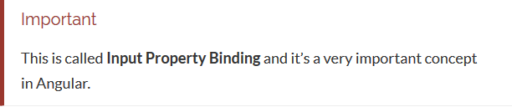
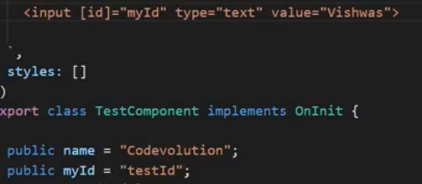
Property or Attribute Binding
A few things:
1. We wrapped the attribute with a [], more on that later.
2. We made the attribute equal to true, if we made it equal to false it shows the element.
We say we have bound the value true to the property called hidden.

Slide 3
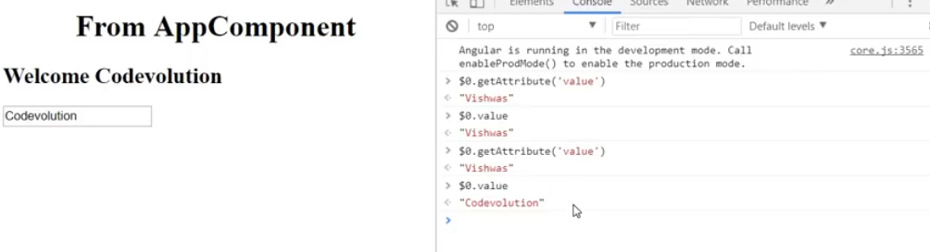
Property Binding
The target inside [] is the name of the property. In the example above the target is the hidden DOM property.
The text to the right of = is javascript code that gets executed and the resulting value is assigned to the target.

Slide 4
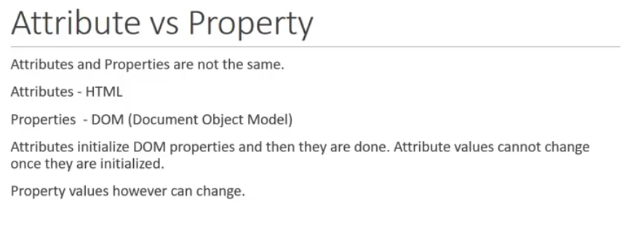

Slide 5
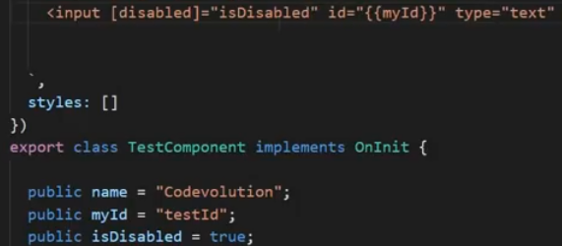
Example of Property Binding

Slide 6

Attribute, Class, and Style Bindings in Angular

Slide 7
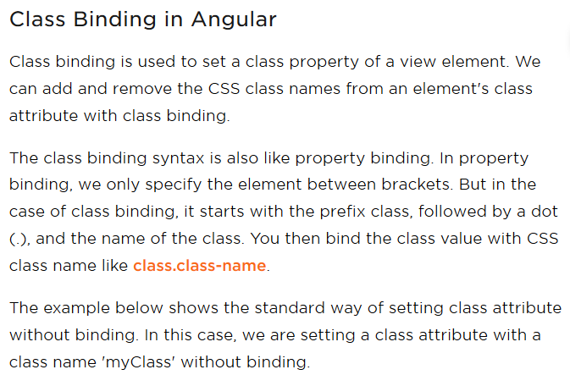

Slide 8
Class Binding in Angular
1 <div class="myClass">Setting class without binding</div>
The example below shows setting all the class values with binding. In this case, we are binding class "myClassBinding" with class binding.
1 <div class="myClass" [class]="myClassBinding">Setting all classes with binding</div>
Whenever the template expression evaluates to true, Angular binds that class name to the class binding. It removes the class when the template expression evaluates to false.
Let's see another example where we are binding a specific class name with class binding. In this case, if 'isTrue' value evaluates to true then it will bind the 'myClass' to a class property. If it evaluates to false, then it will not bind the 'myClass' to a class property.
File Name: example.component.ts

Slide 9
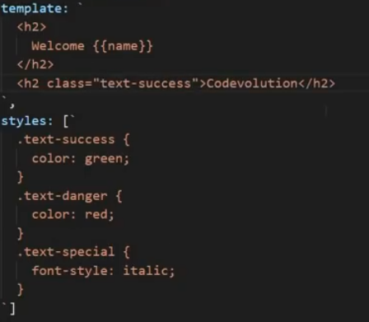
Class Binding in Angular
import { Component } from "@angular/core";
@Component({
selector: 'app-example',
template: ` <div> <h1 [class.myClass]="isTrue">This class binding is for true value</h1> <h1 [class.myClass]="!isTrue">This class binding is for false value</h1> </div> ` })
export class ExampleComponent {
isTrue: boolean = true;
}
While the class binding is a fine way of binding, the ngClass directive is preferred for handling multiple class names at the same time.

Slide 10
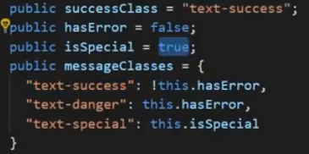
Class Binding in Angular
ngClass directive

Slide 11
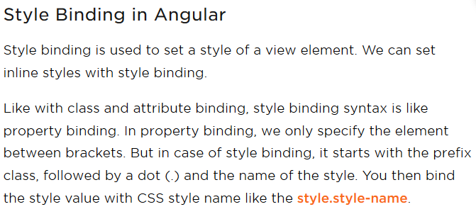

Slide 12
Style Binding in Angular
Let's consider an example of style binding. In this example, we are binding a color style to the 'h1' element. It will display the text within the h1 tags in a blue color.
File Name: example.component.ts
import { Component } from "@angular/core"; @Component({
selector: 'app-example',
template: ` <div> <h1 [style.color]="blue">This is a Blue Heading</h1> </div> ` })
export class ExampleComponent { }

Slide 13
Style Binding in Angular
Style bindings will also have the unit. In the example below, we are setting style font size in "px" and "%" units.
template: ` <div> <span [style.font-size.px]="isTrue? 20 : 12">This style binding is set for true value</span> <span [style.font-size.%]="!isTrue : 120 : 30">This style binding is set for false value</span> </div> ` })
export class ExampleComponent { isTrue: boolean = true; }

Slide 14
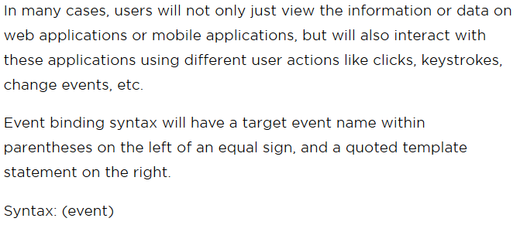
Event Binding in Angular

Slide 15
Event Binding in Angular
import { Component } from "@angular/core"; @Component({
selector: 'app-example',
template: ` <div> <button (click)="onClick()">Click me!</button> </div> ` })
export class ExampleComponent {
onClick(){ alert("You Clicked Me!");
}
}

Slide 16
Event Binding in Angular
Target Event Binding
The target event is identified by the name within the parenthesis, ex: (click), which represents the click event. In the example, above we saw the target click event bound to the 'onClick()' method, which will listen to the button's click event
<button (click) = "onClick()">Click me!</button>
We can also use the prefix on-, in event binding this is known as canonical form.
<button on-click = "onClick()">Click me!</button>
If the name of the target event does not match with the element's event, then Angular will throw an error "unknown directive".

