Slide 1

Design for Web using Markup Language and Style sheet
Design By AJ

Slide 2




How the Web Works?
WWW use classical client / server architecture
HTTP is text-based request-response protocol
HTTP
Page request
HTTP
Server response
Server running Web Server Software (IIS, Apache, etc.)
Client running a Web Browser
2

Slide 3




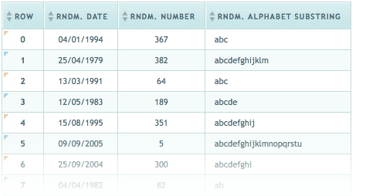

HTML Basics
Text, Images, Tables

Slide 4

Comment in HTML

Slide 5
Comments: <!-- --> Tag
Comments can exist anywhere between the <html></html> tags
Comments start with <!-- and end with -->
<!–- Telerik Logo (a JPG file) -->
<img src="logo.jpg" alt=“Telerik Logo">
<!–- Hyperlink to the web site -->
<a href="http://telerik.com/">Telerik</a>
<!–- Show the news table -->
<table class="newstable">
...
5

Slide 6
Text formatting in HTML

Slide 7
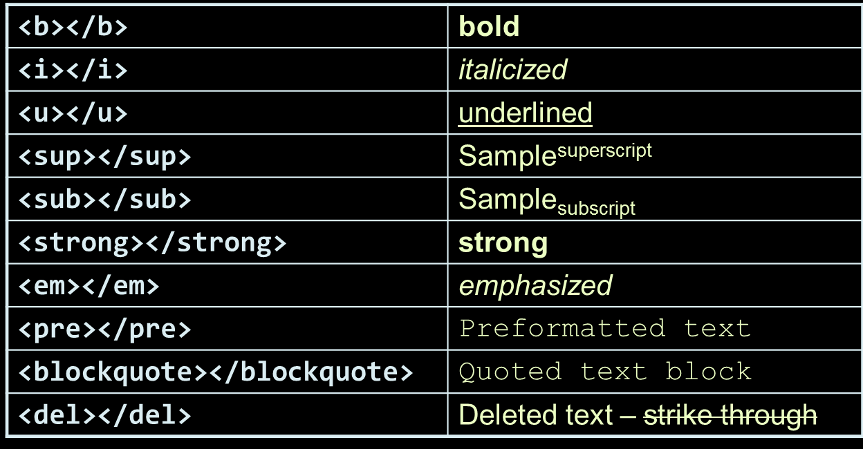
Text Formatting
Text formatting tags modify the text between the opening tag and the closing tag
Ex. <b>Hello</b> makes “Hello” bold
7

Slide 8
Pragraph in HTML

Slide 9
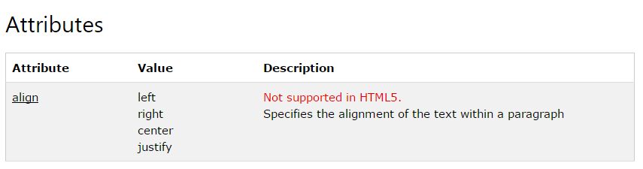
Paragraph <p>
HTML paragraphs are defined with the <p> tag:
<p>This is a paragraph.</p> <p>This is another paragraph.</p>

Slide 10
Image in HTML

Slide 11
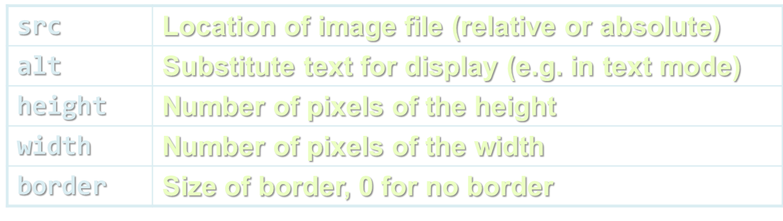
Images: <img> tag
Inserting an image with <img> tag:
Image attributes:
Example:
<img src="/img/basd-logo.png">
<img src="./php.png" alt="PHP Logo" />
11

Slide 12
Miscellaneous Tag in HTML

Slide 13
Miscellaneous Tags
<hr />: Draws a horizontal rule (line):
<center></center>: Deprecated!
<font></font>: Deprecated!
<hr size="5" width="70%" />
<center>Hello World!</center>
<font size="3" color="blue">Font3</font>
<font size="+4" color="blue">Font+4</font>
13

Slide 14
List in HTML

Slide 15
Ordered Lists: <ol> Tag
Create an Ordered List using <ol></ol>:
Attribute values for type are 1, A, a, I, or i
<ol type="1">
<li>Apple</li>
<li>Orange</li>
<li>Grapefruit</li>
</ol>
Apple
Orange
Grapefruit
Apple
Orange
Grapefruit
Apple
Orange
Grapefruit
Apple
Orange
Grapefruit
Apple
Orange
Grapefruit
15

Slide 16
Ordered Lists: <ol> Tag
Create an Ordered List using <ol></ol>:
Attribute values for type are 1, A, a, I, or i
<ol type="1">
<li>Apple</li>
<li>Orange</li>
<li>Grapefruit</li>
</ol>
Apple
Orange
Grapefruit
Apple
Orange
Grapefruit
Apple
Orange
Grapefruit
Apple
Orange
Grapefruit
Apple
Orange
Grapefruit
16

Slide 17
Defination List in HTML

Slide 18
Definition lists: <dl> tag
Create definition lists using <dl>
Pairs of text and associated definition; text is in <dt> tag, definition in <dd> tag
Renders without bullets
Definition is indented
<dl>
<dt>HTML</dt>
<dd>A markup language …</dd>
<dt>CSS</dt>
<dd>Language used to …</dd>
</dl>
18

Slide 19
Special Character in HTML

Slide 20
HTML Special Characters/ Entites
Symbol Name
HTML Entity
Symbol
Copyright Sign
&copy;
©
Registered Trademark Sign
&reg;
®
Trademark Sign
&trade;
™
Less Than
&lt;
<
Greater Than
&gt;
>
Ampersand
&amp;
&
Non-breaking Space
&nbsp;
Em Dash
&mdash;
—
Quotation Mark
&quot;
"
Euro
&#8364;
€
British Pound
&pound;
£
Japanese Yen
&yen;
¥
20

Slide 21
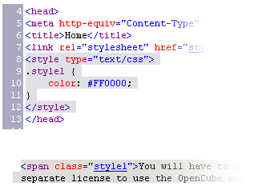

Using <DIV> and <SPAN> Block and Inline Elements

Slide 22
Block and Inline Elements
Block elements add a line break before and after them
<div> is a block element
Other block elements are <table>, <hr>, headings, lists, <p> and etc.
Inline elements don’t break the text before and after them
<span> is an inline element
Most HTML elements are inline, e.g. <a>
22

Slide 23
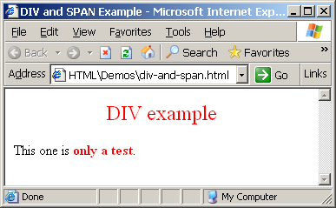
The <div> Tag
<div> creates logical divisions within a page
Block style element
Used with CSS
Example:
div-and-span.html
<div style="font-size:24px; color:red">DIV example</div>
<p>This one is <span style="color:red; font-weight:bold">only a test</span>.</p>
23

Slide 24
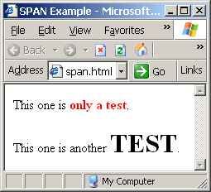
The <span> Tag
Inline style element
Useful for modifying a specific portion of text
Don't create a separate area (paragraph) in the document
Very useful with CSS
span.html
<p>This one is <span style="color:red; font-weight:bold">only a test</span>.</p>
<p>This one is another <span style="font-size:32px; font-weight:bold">TEST</span>.</p>
24

Slide 25
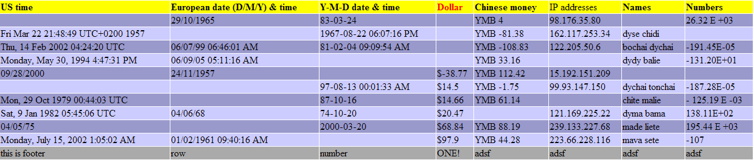
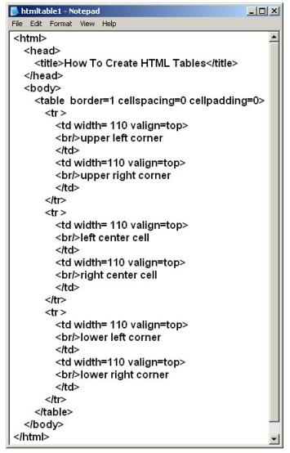
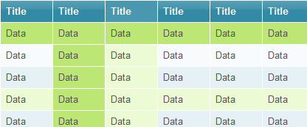
HTML Tables

Slide 26
HTML Tables
Tables represent tabular data
A table consists of one or several rows
Each row has one or more columns
Tables comprised of several core tags: <table></table>: begin / end the table <tr></tr>: create a table row <td></td>: create tabular data (cell)
Tables should not be used for layout. Use CSS floats and positioning styles instead
26

Slide 27
HTML Tables (2)
Start and end of a table
Start and end of a row
Start and end of a cell in a row
<table> ... </table>
<tr> ... </tr>
<td> ... </td>
27

Slide 28
Complete HTML Tables
Table rows split into three semantic sections: header, body and footer
<thead> denotes table header and contains <th> elements, instead of <td> elements
<tbody> denotes collection of table rows that contain the very data
<tfoot> denotes table footer but comes BEFORE the <tbody> tag
<colgroup> and <col> define columns (most often used to set column widths)
28

Slide 29
Complete HTML Table: Example
<table>
<colgroup>
<col style="width:100px" /><col />
</colgroup>
<thead>
<tr><th>Column 1</th><th>Column 2</th></tr>
</thead>
<tfoot>
<tr><td>Footer 1</td><td>Footer 2</td></tr>
</tfoot>
<tbody>
<tr><td>Cell 1.1</td><td>Cell 1.2</td></tr>
<tr><td>Cell 2.1</td><td>Cell 2.2</td></tr>
</tbody>
</table>
columns
header
th
footer
Last comes the body (data)
29

Slide 30
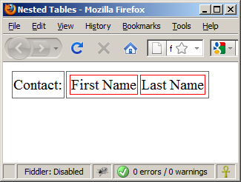
Nested Tables
Table data “cells” (<td>) can contain nested tables (tables within tables):
nested-tables.html
<table>
<tr>
<td>Contact:</td>
<td>
<table>
<tr>
<td>First Name</td>
<td>Last Name</td>
</tr>
</table>
</td>
</tr>
</table>
30

Slide 31
Cell Spacing and Padding
Tables have two important attributes:
cellspacing
Defines the empty space between cells
cellpadding
Defines the empty space around the cell content
cell
cell
cell
cell
cell
cell
cell
cell
31

Slide 32
Cell Spacing and Padding – Example
table-cells.html
<html>
<head><title>Table Cells</title></head>
<body>
<table cellspacing="15" cellpadding="0">
<tr><td>First</td>
<td>Second</td></tr>
</table>
<br/>
<table cellspacing="0" cellpadding="10">
<tr><td>First</td><td>Second</td></tr>
</table>
</body>
</html>
32

Slide 33
Column and Row Span
Table cells have two important attributes:
colspan
Defines how many columns the cell occupies
rowspan
Defines how many rows the cell occupies
colspan="1"
colspan="1"
rowspan="2"
rowspan="1"
cell[1,1]
cell[1,2]
cell[1,1]
cell[1,2]
cell[2,1]
cell[2,1]
colspan="2"
rowspan="1"
33

Slide 34
Column and Row Span – Example
table-colspan-rowspan.html
<table cellspacing="0">
<tr class="1"><td>Cell[1,1]</td>
<td colspan="2">Cell[2,1]</td></tr>
<tr class=“2"><td>Cell[1,2]</td>
<td rowspan="2">Cell[2,2]</td>
<td>Cell[3,2]</td></tr>
<tr class=“3"><td>Cell[1,3]</td>
<td>Cell[2,3]</td></tr>
</table>
34

Slide 35
Column and Row Span – Example (2)
table-colspan-rowspan.html
<table cellspacing="0">
<tr class="1"><td>Cell[1,1]</td>
<td colspan="2">Cell[2,1]</td></tr>
<tr class=“2"><td>Cell[1,2]</td>
<td rowspan="2">Cell[2,2]</td>
<td>Cell[3,2]</td></tr>
<tr class=“3"><td>Cell[1,3]</td>
<td>Cell[2,3]</td></tr>
</table>
Cell[1,1]
Cell[2,1]
Cell[1,2]
Cell[2,2]
Cell[3,2]
Cell[1,3]
Cell[2,3]
35

