Slide 1
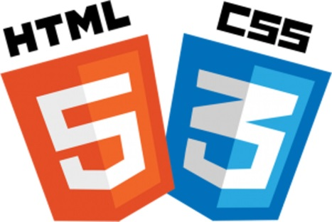
Design for Web using Markup Language and Style sheet
Design By AJ

Slide 2

Cascading Style Sheets (CSS)
Cascading-Style Sheet or CSS is not a programming language. It is a mark up language used with HTML to design the user interface of a website (the style is applied to the mark up language through out the same sections of similar parts.
The CSS Working Group began tackling issues that had not been addressed with CSS level 1, resulting in the creation of CSS level 2 on November 4, 1997. It was published as a W3C Recommendation on May 12, 1998. CSS level 3, which was started in 1998, is still under development as of 2019.

Slide 3
Cascading Style Sheets (CSS)
What is CSS?
CSS stands for Cascading Style Sheets
CSS describes how HTML elements are to be displayed on screen, paper, or in other media
CSS saves a lot of work. It can control the layout of multiple web pages all at once
External stylesheets are stored in CSS files.
CSS (Cascading Style Sheets) allows us to apply formatting and styling to the HTML that builds our web pages.
CSS can control many elements of our web pages: colors, fonts, alignment, borders, backgrounds, spacing, margins, and much more.

Slide 4
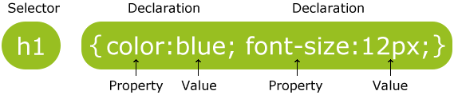
Cascading Style Sheets (CSS)
CSS Syntax

Slide 5
CSS Types
External style sheet
<link rel="stylesheet" type="text/css" href="mystyle.css">
Internal style sheet
<head> <style> body { background-color: linen; } </style> </head>
Inline style
<h1 style="color:blue;margin-left:30px;">This is a heading.</h1>

Slide 6
CSS Selector

Slide 7
CSS Selector
The Universal Selectors
Rather than selecting elements of a specific type, the universal selector quite simply matches the name of any element type:
* {
color: #000000;
}
Tag Selectors
Rather than selecting elements of a specific type, the universal selector quite simply matches the name of any element type:
h1 {
color: #000000;
}

Slide 8
CSS Selector
The Class Selectors
You can define style rules based on the class attribute of the elements. All the elements having that class will be formatted according to the defined rule.
.black {
color: #000000;
}
The ID Selectors
You can define style rules based on the id attribute of the elements. All the elements having that id will be formatted according to the defined rule.
#black {
color: #000000;
}

Slide 9
What is the difference between ID and class?
IDs and classes function the same way – they can both provide the same styling functionality to an HTML element, however…
IDs are unique; each element can only have one ID, and that ID can only be on the page once.
Classes are not unique; an element can have multiple classes, and multiple elements can have the same class.
What does that mean?
IDs can be used to style elements that are different from anything else on the page.
Classes can be used to style multiple elements on a single page that have things in common, like font size, color, or style.

Slide 10
CSS Selector
Grouping Selectors
You can apply a style to many selectors if you like. Just separate the selectors with a comma, as given in the following example:
h1, h2, h3 {
color: #36C;
font-weight: normal;
letter-spacing: .4em;
margin-bottom: 1em;
text-transform: lowercase;
}
The Descendant Selectors
Suppose you want to apply a style rule to a particular element only when it lies inside a particular element. As given in the following example, the style rule will apply to <em> element only when it lies inside the <ul> tag.
div h3 {
color: #000000;
}

Slide 11
CSS Selector
The Child Selectors
You have seen the descendant selectors. There is one more type of selector, which is very similar to descendants but have different functionality. Consider the following example:
body > p {
color: #000000;
}
The Attribute Selectors
You can also apply styles to HTML elements with particular attributes. The style rule below will match all the input elements having a type attribute with a value of text:
input[type="text"]{
color: #000000;
}

