Slide 1

Angular JS
Instructor: AJ

Slide 2
SESSION 3 – Part 2

Slide 3
AngularJS - HTML DOM
Sr.No. | Name | Description
1 | ng-disabled | disables a given control.
2 | ng-show | shows a given control.
3 | ng-hide | hides a given control.
4 | ng-click | represents a AngularJS click event.
5 | ng-include | embedding html pages within html page

Slide 4
AngularJS - HTML DOM
ng-disabled directive
Add ng-disabled attribute to a HTML button and pass it a model. Bind the model to an checkbox and see the variation.
The ng-disabled directive binds AngularJS application data to the disabled attribute of HTML elements.

Slide 5
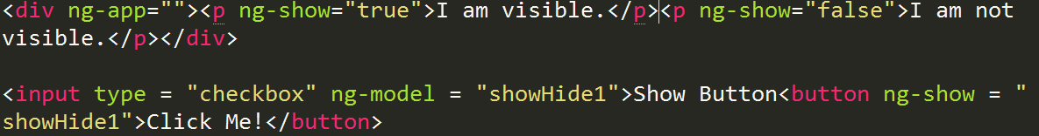
AngularJS - HTML DOM
ng-show directive
Add ng-show attribute to a HTML button and pass it a model. Bind the model to a checkbox and see the variation.
The ng-show directive shows or hides an HTML element.
AngularJS Example

Slide 6
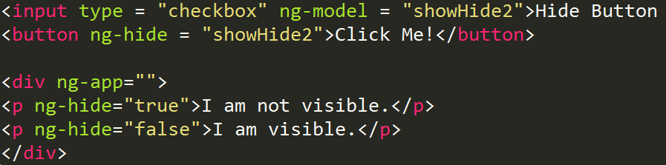
AngularJS - HTML DOM
ng-hide directive
Add ng-hide attribute to a HTML button and pass it a model. Bind the model to a checkbox and see the variation.
The ng-hide directive hides or shows an HTML element.
AngularJS Example

Slide 7
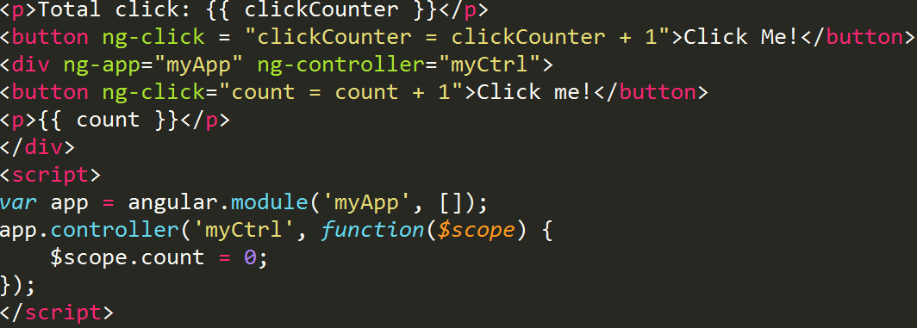
AngularJS - HTML DOM
The ng-click Directive
The ng-click directive defines AngularJS code that will be executed when the element is being clicked.
Add ng-click attribute to a HTML button and update a model. Bind the model to html and see the variation.
Example

Slide 8
AngularJS – HTML DOM
The ng-include Directive
HTML does not support embedding html pages within html page. To achieve this functionality following ways are used −
Using Ajax − Make a server call to get the corresponding html page and set it in innerHTML of html control.
Using Server Side Includes − JSP, PHP and other web side server technologies can include html pages within a dynamic page.
With AngularJS, you can include HTML content using the ng-include directive:

Slide 9
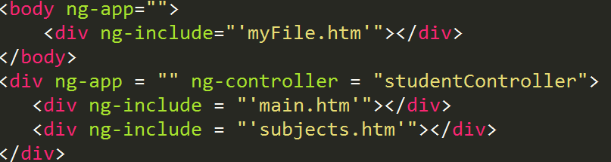
AngularJS – HTML DOM
The ng-include Directive
Using AngularJS, we can embed HTML pages within a HTML page using ng-include directive.

Slide 10
Routing

Slide 11
AngularJS – Routing
The ngRoute module helps your application to become a Single Page Application.
What is Routing in AngularJS?
If you want to navigate to different pages in your application, but you also want the application to be a SPA (Single Page Application), with no page reloading, you can use the ngRoute module.
The ngRoute module routes your application to different pages without reloading the entire application.

Slide 12
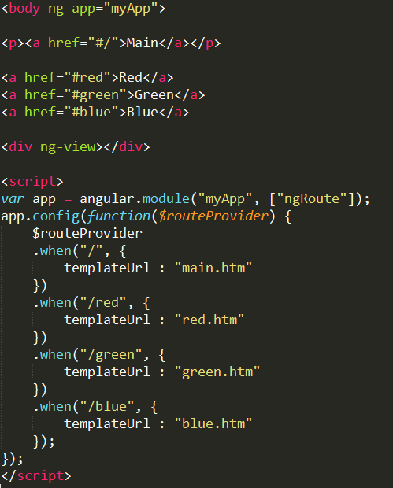
AngularJS – Routing
Example:
Navigate to "red.htm",
"green.htm",
and "blue.htm":
What do you Need?
To make your applications ready for routing, you must include the AngularJS Route module:
<script src="https://ajax.googleapis.com/ajax/libs/angularjs/1.4.8/angular-route.js"></script>

Slide 13
AngularJS – Routing
Then you must add the ngRoute as a dependency in the application module:
var app = angular.module("myApp", ["ngRoute"]);
Now your application has access to the route module, which provides the $routeProvider
Use the $routeProvider to configure different routes in your application:

Slide 14
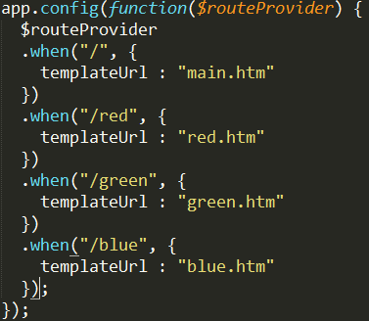
AngularJS – Routing
Then you must add the ngRoute as a dependency in the application module:
var app = angular.module("myApp", ["ngRoute"]);
Now your application has access to the route module, which provides the $routeProvider
Use the $routeProvider to configure different routes in your application:

Slide 15
AngularJS – Routing
Where Does it Go?
Your application needs a container to put the content provided by the routing.
This container is the ng-view directive.
There are three different ways to include the ng-view directive in your application:
Example:
<div ng-view></div>
Example:
<ng-view></ng-view>
Example:
<div class="ng-view"></div>
Applications can only have one ng-view directive, and this will be the placeholder for all views provided by the route.

Slide 16
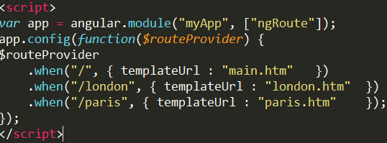
AngularJS – Routing
$routeProvider
With the $routeProvider you can define what page to display when a user clicks a link.
Example:
Define a $routeProvider:
Define the $routeProvider using the config method of your application. Work registered in the config method will be performed when the application is loading.

Slide 17
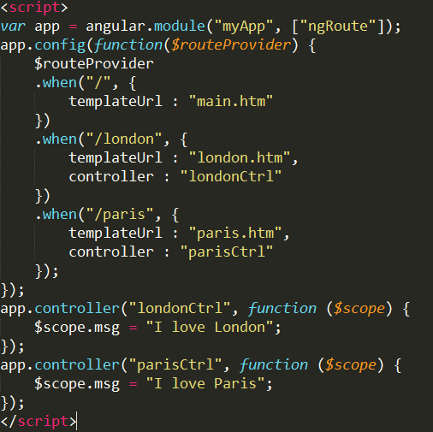
AngularJS – Routing
Controllers
With the $routeProvider you can also define a controller for each "view".
Example:
Add controllers:

Slide 18
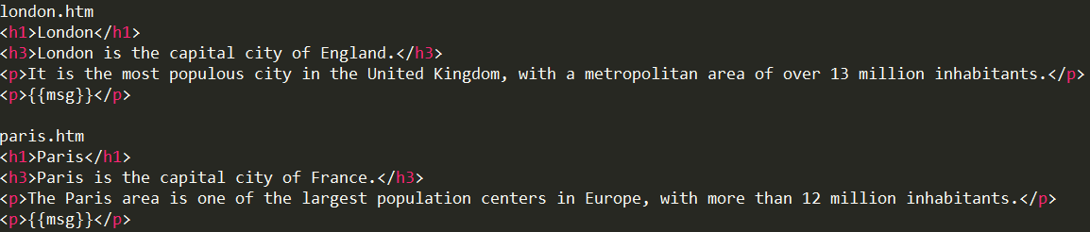
AngularJS – Routing
The "london.htm" and "paris.htm" are normal HTML files, which you can add AngularJS expressions as you would with any other HTML sections of your AngularJS application.
The files looks like this:

Slide 19
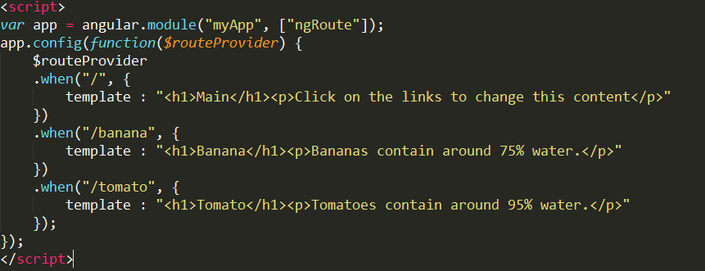
AngularJS – Routing
Template
In the previous examples we have used the templateUrl property in the $routeProvider.when method.
You can also use the template property, which allows you to write HTML directly in the property value, and not refer to a page.
Example:
Write templates:

