Slide 1
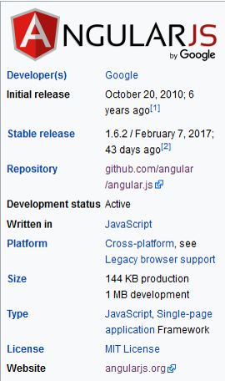
Angular JS
Single Page Application (SPA)
Instructor: AJ
Arena Animation Gurgoan

Slide 2
Session 1

Slide 3
What is AngularJS
1. AngularJS extends HTML with new attributes.
2. AngularJS is perfect for Single Page Applications (SPAs).
3. AngularJS is a JavaScript framework. It can be added to an HTML page with a <script> tag.
4. AngularJS extends HTML attributes with Directives, and binds data to HTML with Expressions
AngularJS is an open source web application framework. It was originally developed in 2009 by Misko Hevery and Adam Abrons. It is now maintained by Google. Its latest version is 1.6.3 Tuesday, March 14, 2017.

Slide 4
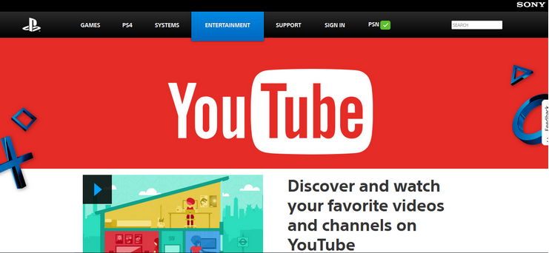

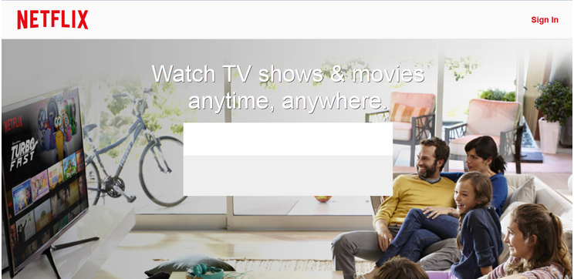
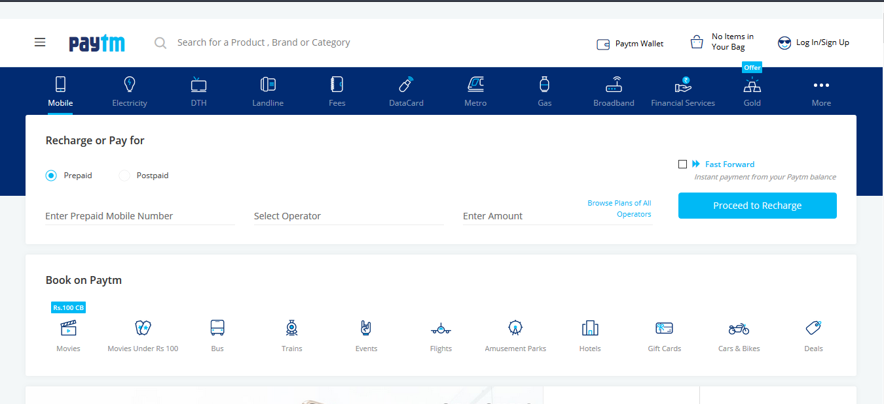
Made with AngularJS

Slide 5
Angular JS Feature
Features
AngularJS is a powerful JavaScript based development framework to create RICH Internet Application(RIA).
AngularJS provides developers options to write client side application (using JavaScript) in a clean MVC(Model View Controller) way.
Application written in AngularJS is cross-browser compliant. AngularJS automatically handles JavaScript code suitable for each browser.
AngularJS is open source, completely free, and used by thousands of developers around the world. It is licensed under the Apache License version 2.0.

Slide 6
AngularJS Advantages
AngularJS provides capability to create Single Page Application in a very clean and maintainable way.
AngularJS provides data binding capability to HTML thus giving user a rich and responsive experience
AngularJS code is unit testable.
AngularJS uses dependency injection and make use of separation of concerns.
AngularJS provides reusable components.
With AngularJS, developer write less code and get more functionality.
In AngularJS, views are pure html pages, and controllers written in JavaScript do the business processing.

Slide 7
AngularJS Disadvantages
Not Secure − Being JavaScript only framework, application written in AngularJS are not safe. Server side authentication and authorization is must to keep an application secure.
Not degradable − If your application user disables JavaScript then user will just see the basic page and nothing more.

Slide 8

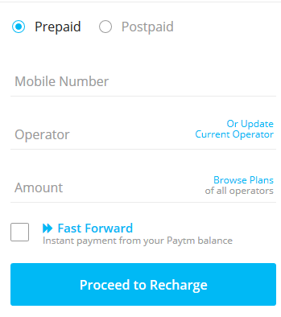

AngularJS MVC
Model
Model View Controller or MVC as it is popularly called, is a software design pattern for developing web applications. A Model View Controller pattern is made up of the following three parts −
1. Model − It is the lowest level of the pattern responsible for maintaining data.
2. View − It is responsible for displaying all or a portion of the data to the user.
3. Controller − It is a software Code that controls the interactions between the Model and View.
View
Controller

Slide 9
Thank You
See you on Session 2

