Slide 1

Instructor: AJ

Slide 2
Session 2

Slide 3
The AngularJS Components
The AngularJS framework can be divided into following three major parts −
ng-app − This directive defines and links an AngularJS application to HTML.
ng-model − This directive binds the values of AngularJS application data to HTML input controls.
ng-bind − This directive binds the AngularJS Application data to HTML tags.

Slide 4
Steps to create AngularJS Application
Step 1 − Load framework
Being a pure JavaScript framework, It can be added using <Script> tag.
<script src = "https://ajax.googleapis.com/ajax/libs/angularjs/1.3.14/angular.min.js">
</script>
Step 2 − Define AngularJS Application using ng-app directive
<div ng-app = "">
...
</div>
Step 3 − Define a model name using ng-model directive
<p>Enter your Name: <input type = "text" ng-model = "name"></p>
Step 4 − Bind the value of above model defined using ng-bind directive.
<p>Hello <span ng-bind = "name"></span>!</p>

Slide 5
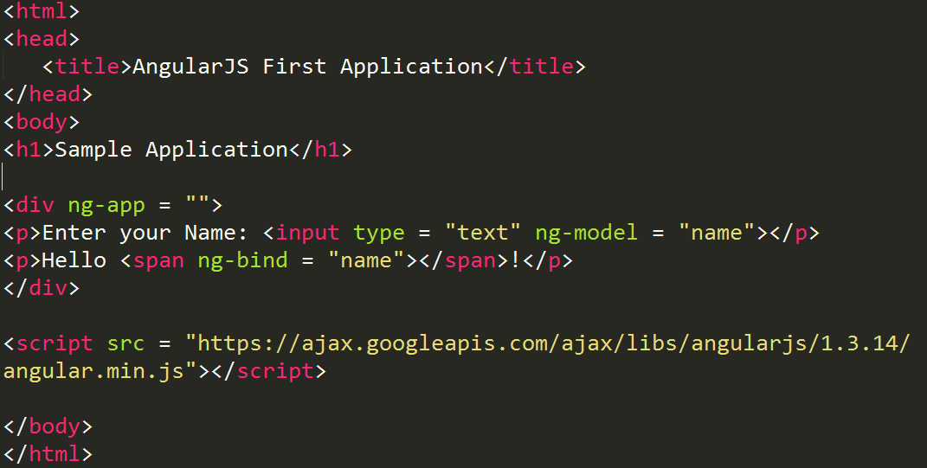
Steps to run AngularJS Application
Use above mentioned three steps in an HTML page.
myFirstApp.html

Slide 6
How AngularJS integrates with HTML
ng-app directive indicates the start of AngularJS application.
ng-model directive then creates a model variable named "name" which can be used with the html page and within the div having ng-app directive.
ng-bind then uses the name model to be displayed in the html span tag whenever user input something in the text box.
Closing</div> tag indicates the end of AngularJS application.

