Slide 1
AngularJS
Instructor: AJ

Slide 2
Session 3

Slide 3
AngularJS Directives
AngularJS directives are used to extend HTML. These are special attributes starting with ng- prefix. We're going to discuss following directives −
ng-app − This directive starts an AngularJS Application.
ng-init − This directive initializes application data.
ng-model − This directive defines the model that is variable to be used in AngularJS.
ng-repeat − This directive repeats html elements for each item in a collection.

Slide 4
ng-app directive
ng-app directive starts an AngularJS Application. It defines the root element. The ng-app directive also tells AngularJS that the <div> element is the "owner" of the AngularJS application.
<div ng-app = "">
...
</div>

Slide 5
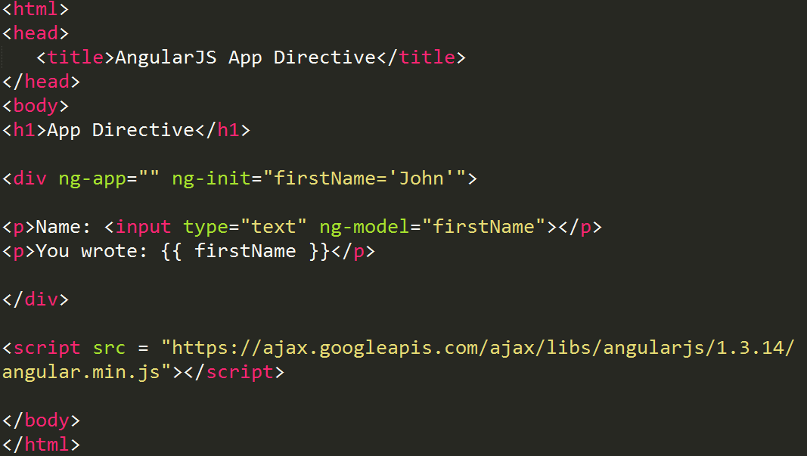
ng-app directive

Slide 6
ng-init directive
ng-init directive initializes an AngularJS Application data. It is used to put values to the variables to be used in the application.
In following example, we'll initialize an array of countries. We're using JSON syntax to define array of countries.
<div ng-app = "" ng-init = "countries = [{locale:'en-US',name:'United States'}, {locale:'en-GB',name:'United Kingdom'}, {locale:'en-FR',name:'France'}]">
...
</div>

Slide 7
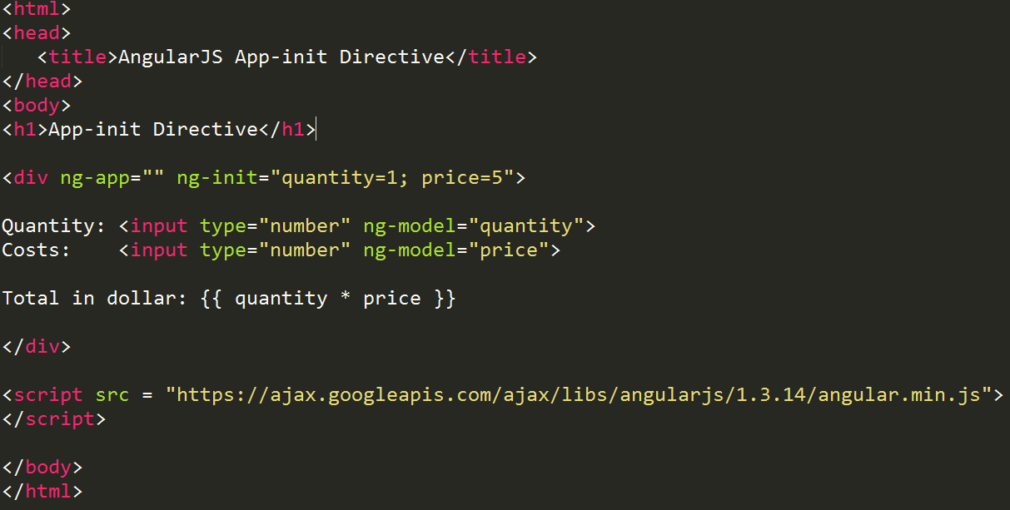
ng-init directive

Slide 8
ng-model directive
ng-model directive defines the model/variable to be used in AngularJS Application. In following example, we've defined a model named "name".
<div ng-app = "">
...
<p>Enter your Name: <input type = "text" ng-model = "name"></p>
</div>

Slide 9
ng-model directive
The ng-model directive binds the value of HTML controls (input, select, textarea) to application data.
The ng-model directive can also:
• Provide type validation for application data (number, email, required).
• Provide status for application data (invalid, dirty, touched, error).
• Provide CSS classes for HTML elements.
• Bind HTML elements to HTML forms.

Slide 10
ng-repeat directive
ng-repeat directive repeats html elements for each item in a collection. In following example, we've iterated over array of countries.
<div ng-app = "">
...
<p>List of Countries with locale:</p>
<ol>
<li ng-repeat = "country in countries">
{{ 'Country: ' + country.name + ', Locale: ' + country.locale }}
</li>
</ol>
</div>

Slide 11
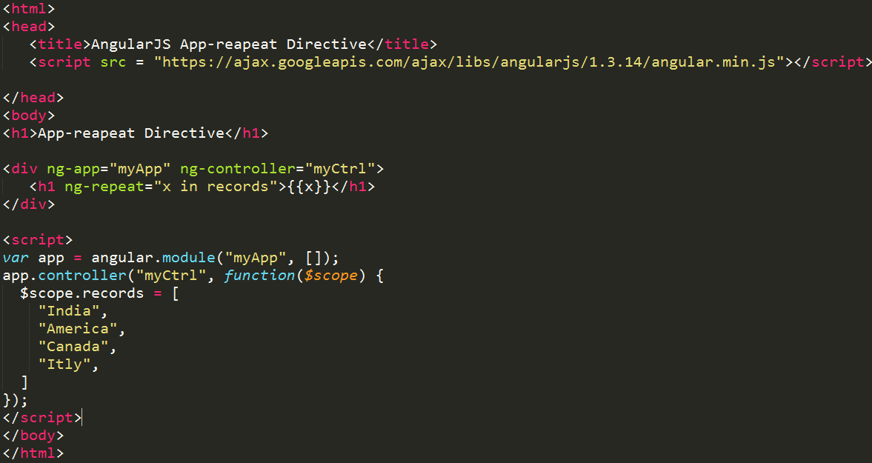
ng-repeat directive

Slide 12
AngularJS - Filters
Filters are used to change modify the data and can be clubbed in expression or directives using pipe character. Following is the list of commonly used filters.
Sr.No. | Name | Description
1 | uppercase | converts a text to upper case text.
2 | lowercase | converts a text to lower case text.
3 | currency | formats text in a currency format.
4 | filter | filter the array to a subset of it based on provided criteria.
5 | Orderby | orders the array based on provided criteria.

Slide 13
AngularJS - Filters
uppercase filter
Add uppercase filter to an expression using pipe character. Here we've added uppercase filter to print student name in all capital letters.
Enter first name:<input type = "text" ng-model = "student.firstName">
Enter last name: <input type = "text" ng-model = "student.lastName">
Name in Upper Case: {{student.fullName() | uppercase}}

Slide 14
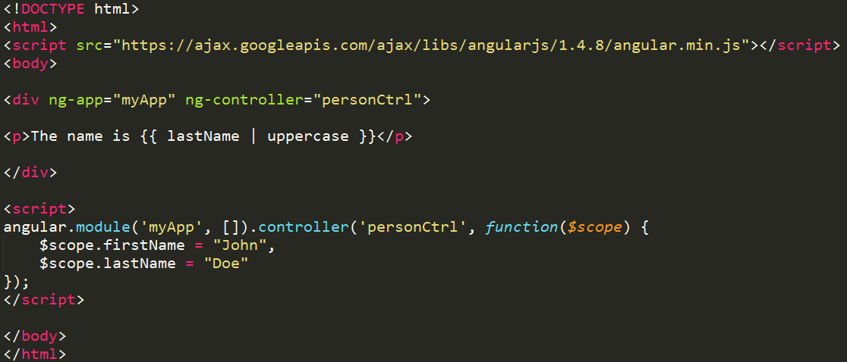
AngularJS - Filters
Uppercase

Slide 15
AngularJS - Filters
lowercase filter
Add lowercase filter to an expression using pipe character. Here we've added lowercase filter to print student name in all lowercase letters.
Enter first name:<input type = "text" ng-model = "student.firstName">
Enter last name: <input type = "text" ng-model = "student.lastName">
Name in Lower Case: {{student.fullName() | lowercase}}

Slide 16
AngularJS - Filters
currency filter
Add currency filter to an expression returning number using pipe character. Here we've added currency filter to print fees using currency format.
Enter fees: <input type = "text" ng-model = "student.fees">
fees: {{student.fees | currency}}

Slide 17
AngularJS - Filters
filter filter
To display only required subjects, we've used subjectName as filter.
Enter subject: <input type = "text" ng-model = "subjectName">
Subject:
<ul>
<li ng-repeat = "subject in student.subjects | filter: subjectName">
{{ subject.name + ', marks:' + subject.marks }}

Slide 18
AngularJS - Filters
orderby filter
To order subjects by marks, we've used orderBy marks.
Subject:
<ul>
<li ng-repeat = "subject in student.subjects | orderBy:'marks'">
{{ subject.name + ', marks:' + subject.marks }}
</li>
</ul>

