Slide 1
ANGULAR JS
Instructor: AJ

Slide 2
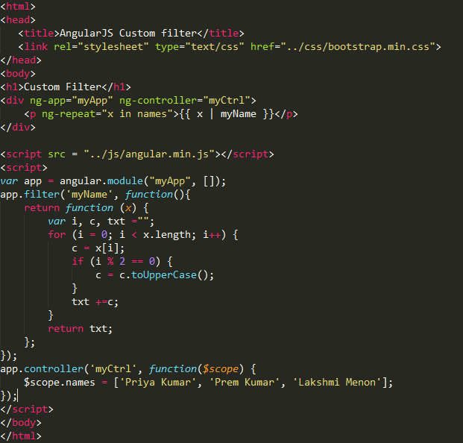
Custom Filter
The built-in filters are useful for many common use cases such as formatting dates, currencies, cases or limiting the number of items displayed and so on.
AngularJS gives us an API for creating a filter.

Slide 3
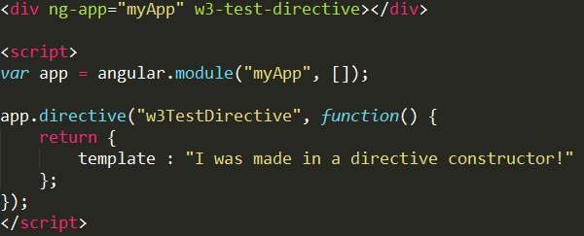
Custom Directive
AngularJS has a set of built-in directives which you can use to add functionality to your application.
New directives are created by using the .directive function.
You can invoke a directive by using:
Element name
Attribute
Class
Comment

Slide 4
Custom Directive
Element name
<w3-test-directive></w3-test-directive>
Attribute
<div w3-test-directive></div>
Class
<div class="w3-test-directive"></div>
Comment
<!-- directive: w3-test-directive -->
Restrictions
You can restrict your directives to only be invoked by some of the methods.
Example
By adding a restrict property with the value "A", the directive can only be invoked by attributes:
var app = angular.module("myApp", []); app.directive("w3TestDirective", function() { return { restrict : "A", template : "<h1>Made by a directive!</h1>" }; });

Slide 5
Custom Directive
The legal restrict values are:
E for Element name
A for Attribute
C for Class
M for Comment
By default the value is EA, meaning that both Element names and attribute names can invoke the directive.
Understanding Custom Directive
Define custom html tags.
<student name = "Mahesh"></student><br/> <student name = "Piyush"></student>

Slide 6
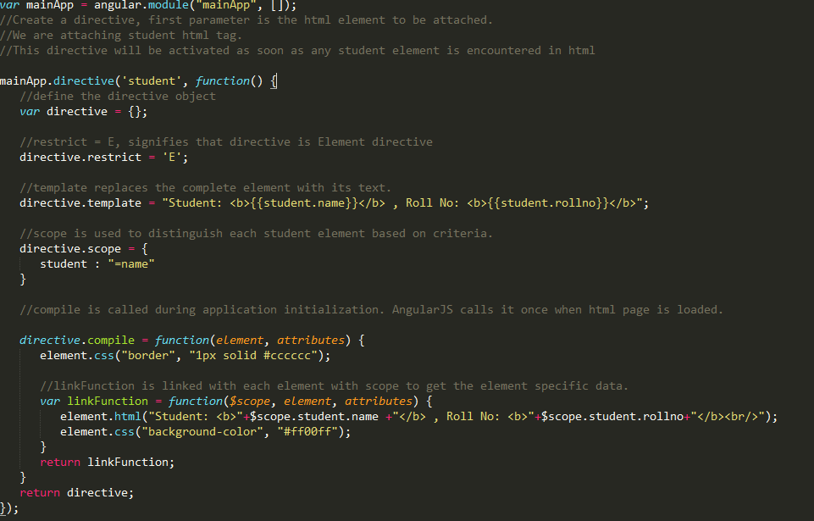
Custom Directive

Slide 7
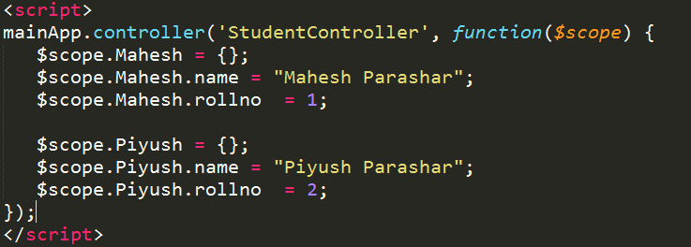
Custom Directive
Define controller to update the scope for directive. Here we are using name attribute's value as scope's child.

Slide 8
SCOPES

Slide 9
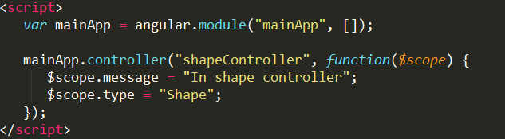
AngularJS Scopes
Scope is a special javascript object which plays the role of joining controller with the views. Scope contains the model data. In controllers, model data is accessed via $scope object.
The scope is the binding part between the HTML (view) and the JavaScript (controller).
The scope is an object with the available properties and methods.
The scope is available for both the view and the controller.

Slide 10
SERVICES

Slide 11
AngularJS Services
In AngularJS you can make your own service, or use one of the many built-in services.
In AngularJS, a service is a function, or object, that is available for, and limited to, your AngularJS application.
AngularJS has about 30 built-in services. One of them is the $location service.
Services are javascript functions and are responsible to do a specific tasks only.
AngularJS provides many inbuilt services for example, $http, $route, $window, $location etc. Each service is responsible for a specific task for example, $http is used to make ajax call to get the server data. $route is used to define the routing information and so on. Inbuilt services are always prefixed with $ symbol.
There are two ways to create a service.
factory
service

Slide 12
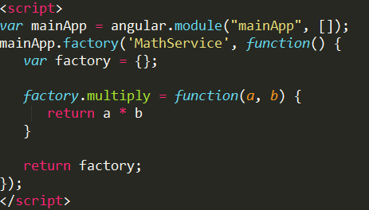
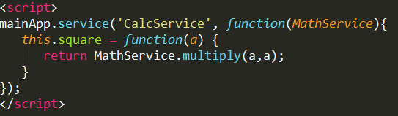
AngularJS Services
Using factory method
Using factory method, we first define a factory and then assign method to it.
Using service method
Using service method, we define a service and then assign method to it. We've also injected an already available service to it.

