Slide 1
ANGULARJS
Instructor: AJ

Slide 2
AngularJS Form Validation
AngularJS can validate input data.
AngularJS offers client-side form validation.
Form / Input fields have the following states:
$untouched The field has not been touched yet
$touched The field has been touched
$pristine The field has not been modified yet
$dirty The field has been modified
$invalid The field content is not valid
$valid The field content is valid
They are all properties of the input field, and are either true or false.

Slide 3
AngularJS Form Validation
The following classes are added to, or removed from, input fields:
ng-untouched The field has not been touched yet
ng-touched The field has been touched
ng-pristine The field has not been modified yet
ng-dirty The field has been modified
ng-valid The field content is valid
ng-invalid The field content is not valid
ng-valid-key One key for each validation. Example: ng-valid-required, useful when there are more than one thing that must be validated
ng-invalid-key Example: ng-invalid-required

Slide 4
AngularJS Form Validation
The following classes are added to, or removed from, forms:
ng-pristine No fields has not been modified yet
ng-dirty One or more fields has been modified
ng-valid The form content is valid
ng-invalid The form content is not valid
ng-valid-key One key for each validation. Example: ng-valid-required, useful when there are more than one thing that must be validated
ng-invalid-key Example: ng-invalid-required
The classes are removed if the value they represent is false

Slide 5
AngularJS Form Validation
Custom Validation
To create your own validation function is a bit more tricky. You have to add a new directive to your application, and deal with the validation inside a function with certain specified arguments.
Example
Create your own directive, containing a custom validation function, and refer to it by using my-directive.
The field will only be valid if the value contains the character "e":

Slide 6
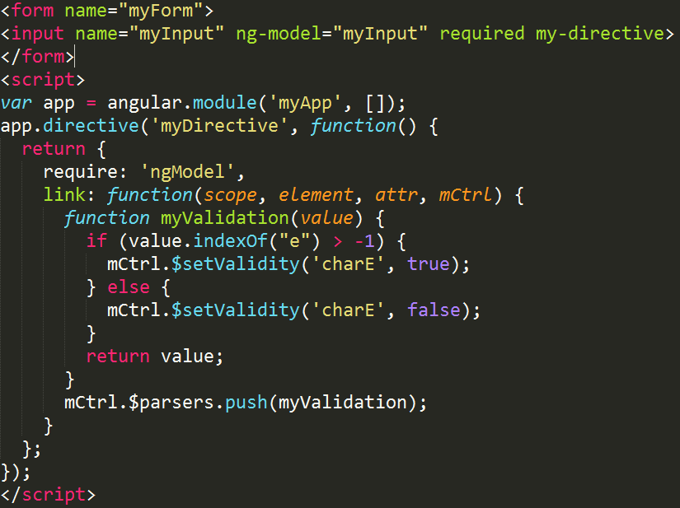
AngularJS Form Validation

Slide 7
AngularJS Animation

Slide 8
AngularJS Animation
The directives in AngularJS who add/remove classes are:
ng-show
ng-hide
ng-class
ng-view
ng-include
ng-repeat
ng-if
ng-switch

Slide 9
AngularJS Animation
CSS Transitions
CSS transitions allows you to change CSS property values smoothly, from one value to another, over a given duration:
Example:
When the DIV element gets the .ng-hide class, the transition will take 0.5 seconds, and the height will smoothly change from 100px to 0:

Slide 10
AngularJS Extra

Slide 11
AngularJS Extra Topic
AngularJS Expressions
AngularJS expressions can be written inside double braces: {{ expression }}.
AngularJS expressions can also be written inside a directive: ng-bind="expression".
Example {{ 5 + 5 }} or {{ firstName + " " + lastName }}
AngularJS Numbers
AngularJS numbers are like JavaScript numbers:
Example
<div ng-app="" ng-init="quantity=1;cost=5"> <p>Total in dollar: {{ quantity * cost }}</p> </div>

Slide 12
AngularJS Extra Topic
AngularJS Strings
AngularJS strings are like JavaScript strings:
Example
<div ng-app="" ng-init="firstName='John';lastName='Doe'"> <p>The name is {{ firstName + " " + lastName }}</p> </div>
AngularJS Objects
AngularJS objects are like JavaScript objects:
Example
<div ng-app="" ng-init="person={firstName:'John',lastName:'Doe'}"> <p>The name is {{ person.lastName }}</p> </div>

Slide 13
AngularJS Extra Topic
AngularJS Arrays
AngularJS arrays are like JavaScript arrays:
Example
<div ng-app="" ng-init="points=[1,15,19,2,40]"> <p>The third result is {{ points[2] }}</p> </div>

Slide 14
AngularJS Extra Topic
myApp.js
var app = angular.module("myApp", []);
The [] parameter in the module definition can be used to define dependent modules.
Without the [] parameter, you are not creating a new module, but retrieving an existing one.
myCtrl.js
app.controller("myCtrl", function($scope) { $scope.firstName = "John"; $scope.lastName= "Doe"; });

Slide 15
AngularJS Extra Topic
Data Binding
The {{ firstName }} expression, in the example above, is an AngularJS data binding expression.
Data binding in AngularJS binds AngularJS expressions with AngularJS data.
{{ firstName }} is bound with ng-model="firstName".
In the next example two text fields are bound together with two ng-model directives:
Example
<div ng-app="" ng-init="quantity=1;price=5"> Quantity: <input type="number" ng-model=""> Costs: <input type="number" ng-model="priquantityce"> Total in dollar: {{ quantity * price }} </div>
Using ng-init is not very common. You will learn how to initialize data in the chapter about controllers.

Slide 16
AngularJS Extra Topic
AngularJS AJAX - $http
$http is an AngularJS service for reading data from remote servers.
AngularJS $http
The AngularJS $http service makes a request to the server, and returns a response.
Example
Make a simple request to the server, and display the result in a header:

Slide 17
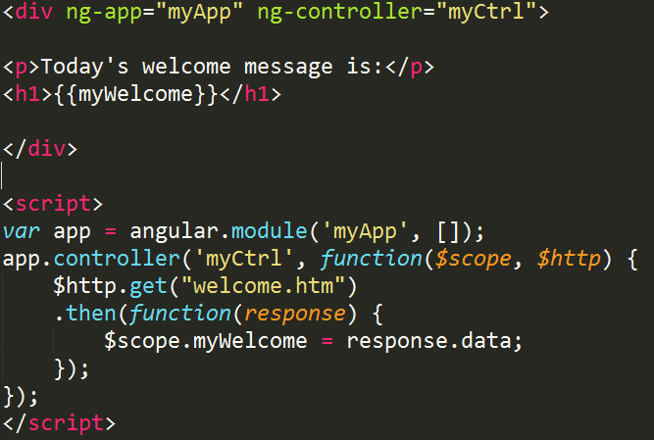
AngularJS Extra Topic

Slide 18
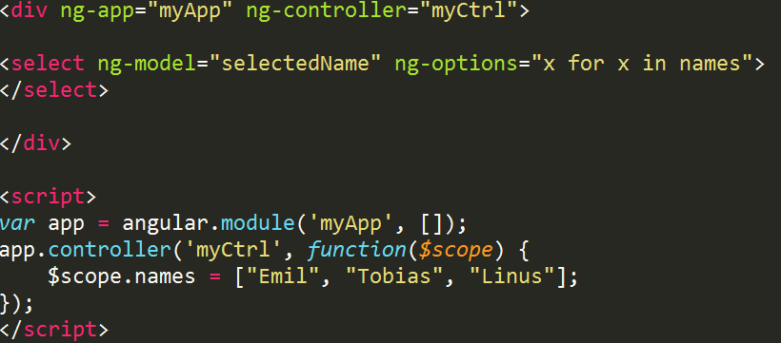
AngularJS Extra Topic
AngularJS Select Boxes
AngularJS lets you create dropdown lists based on items in an array, or an object.
Creating a Select Box Using ng-options
If you want to create a dropdown list, based on an object or an array in AngularJS, you should use the ng-options directive:

Slide 19
AngularJS Events
AngularJS has its own HTML events directives.
You can add AngularJS event listeners to your HTML elements by using one or more of these directives:
ng-blur
ng-change
ng-click
ng-copy
ng-cut
ng-paste
ng-dblclick
ng-focus
ng-keydown
ng-keypress
ng-keyup
ng-mousedown
ng-mouseenter
ng-mouseleave
ng-mousemove
ng-mouseover
ng-mouseup

Slide 20
AngularJS Events
Mouse Events
Mouse events occur when the cursor moves over an element, in this order:
ng-mouseenter
ng-mouseover
ng-mousemove
ng-mouseleave
Or when a mouse button is clicked on an element, in this order:
ng-mousedown
ng-mouseup
ng-click

Slide 21
AngularJS API
API | Description
angular.lowercase() | Converts a string to lowercase
angular.uppercase() | Converts a string to uppercase
angular.isString() | Returns true if the reference is a string
angular.isNumber() | Returns true if the reference is a number

Slide 22
THANK YOU

