Slide 1
Law Keyword Prediction
Aayush Singhal, N277
Kashish Tiwhan, N292

Slide 2
Introduction
Tags have been a relevant part of information retrieval system. They help the system to get relevant information in most effective way.
These tags have been generated manually by human annotators and makes the system more expensive for the clients.
The only way to make these technologies affordable is to find a way to automatically generate tags that resembles to human annotations

Slide 3
Problem Statement
We are provided with a legal text document in Training set documents.
In Training Tag documents, the relevant tags have been manually created by human annotators respectively to the files of Training set documents.
The aim of this project is to create a solution that automatically generate tags for the Testing set legal text document.

Slide 4
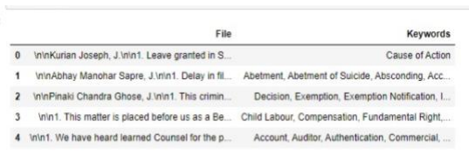
Data Pre-processing
Since the data was present in individual text files, the first task was to store the data from an individual text file into a single data frame. On performing the required code, the following was obtained:

Slide 5
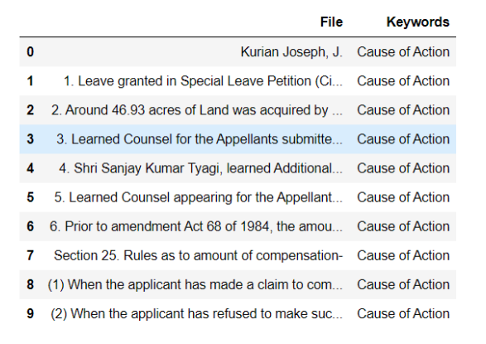
Data Cleaning
As it is visible from the above image, the data in the “File” column contains \n, which can affect the accuracy of the model. Hence, “\n” was replaced and the final outcome of the dataset is as follows:

Slide 6
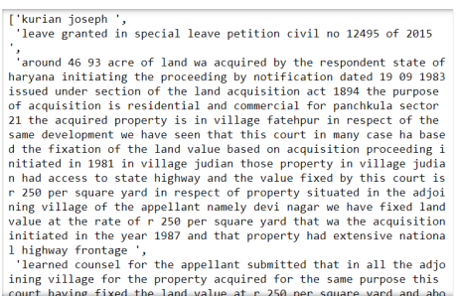
Data Lemmatization:
The “File” column of the data frame contains a lot of stop words and words which are irrelevant for model creation. The unnecessary elements have been removed to produce an accurate model, using Lemmatization.

Slide 7
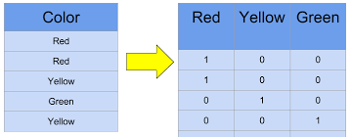
Data Vectorization:
Since our model needs numeric data, we need to transform the processed sentences into vectors.
To convert the above processed text into vectors, TF-IDF vectorizer is preferred over Bag Of words (since TF-IDF is more accurate, especially when dealing with a project in which keyword generation is the key objective to be achieved.)

Slide 8
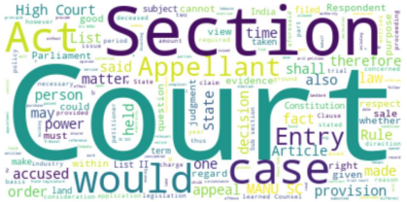
Data Visualization:
From the below visualization, we can see that the most common words used in the file column of the dataset are:
Court
Section
Act
Appellant
Case

Slide 9
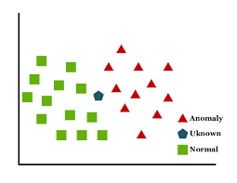
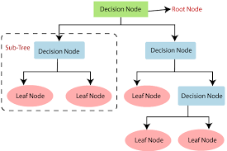
Model Fitting
These are the algorithms used in this project:
Bernoulli’s Naive Bayes
Support Vector Machine
Passive Aggressive Classifier
k-Nearest Neighbour
Multinomial Naive Bayes classifier
Decision Trees

Slide 10
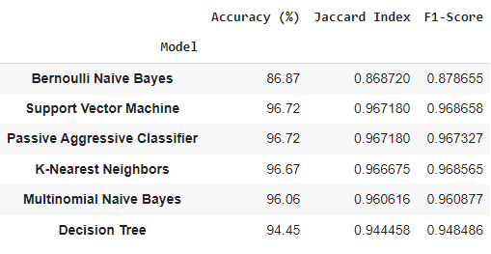
Result

Slide 11
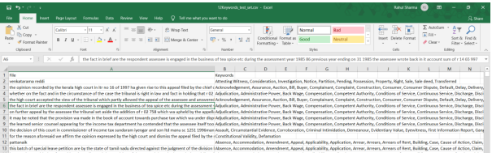
Prediction:
The same SVM model is used for the prediction of the test set’s keywords.
The data from the text set cleaned, lemmatized, vectorized and then passed in the model.
The generated keywords are then exported to a separate excel file.

Slide 12
References
https://www.kaggle.com/datasets/shivamb/legal-citation-text-classification
https://iq.opengenus.org/bernoulli-naive-bayes/
https://scikit-learn.org/stable/modules/generated/sklearn.linear_model.PassiveAggressiveClassifier.html
https://scikit-learn.org/stable/modules/generated/sklearn.naive_bayes.MultinomialNB.html
https://scikit-learn.org/stable/modules/svm.html
https://scikit-learn.org/stable/modules/neighbors.html
https://scikit-learn.org/stable/modules/tree.html#:~:text=Decision%20Trees%20(DTs)%20are%20a,as%20a%20piecewise%20constant%20approximation.

Slide 13
THANK YOU!

