Slide 1
I-way(information super highway)and its component

Slide 2
Introduction
Electronic commerce needs a network infrastructure to transport the content- data, audio, visual, text, animation and so on. This network infrastructure is provided by what is known as the I-way or information super highway.
The information super highway may be defined as a high capacity, electronic pipeline to a consumer or business premise that is capable of simultaneously supporting a large number of e-commerce applications and providing interactive connectivity between users and services. The I-way has emerged as the basic network infrastructure for all types of e-commerce activities due to its capability to provide integrate voice, data and video services.

Slide 3
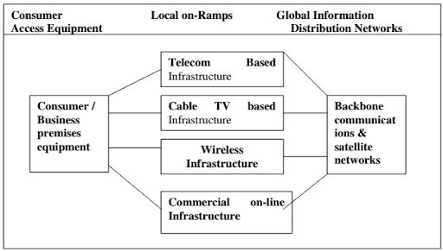
Components of the I-way

Slide 4
Components of the I-way
Network access equipment
Access road or media
Global information distribution networks

Slide 5
Network access equipment
which is at the consumer end and enables the consumer to access the network. It consists of the hardware such as computers, modems, routers, switches for computer networks, set-top boxes for television networks and software platforms such as browsers and operating systems.

Slide 6
Access road or media
provide the communication backbone for the transmission of data and information. The access providers may be differentiate into four categories: telecom based, cable TV based, wireless based or computer based on-line systems.
The access roads is the way in which the consumer homes and work places are linked with the backbone of the network infrastructure for e-commerce. These can be categorized into four major types;
Telecom based
Cable TV based
Wireless based
Internet, intranet and extranet based

Slide 7
Telecom based
The telecom industry provides both long distance and local telephone services for e-commerce applications. The telecom companies provide a high speed pipeline capable for carrying high volumes of interactive voice, data and video to homes and businesses connect these to the global information distribution networks, the backbone of the i-way.
The telecom networks has become the primary foundation for the I-way mainly for two reasons:
It is capable of handling millions of simultaneous calls.
It provides accurate usage tracking and billing.

Slide 8
Cable TV based
The cable TV network provides a popular media for pushing high speed data to homes. Statistics have shown that cable runs through 90 percent of the US homes today and still has a lot of unutilized capacity.
The cable TV based networks may be wired or wireless.

Slide 9
Wireless based
The wireless operators are typically radio based i.e. cellular, paper and specialized mobile radio (SMR) based. The wireless based systems have revolutionized the ways of thinking about information delivery. Technology is the most important factor. The rapid growth in technology has impacted the wireless industry in a number of ways:
Apart from the voice calls
Internet connectivity using the cellular networks

Slide 10
The internet
The internet forms a well known component of the global information distribution network. It targets a wide range of e-commerce applications such as video on demand, home shopping, e-mail, edi, information publishing, information retrieval, video conferencing and many more. All the components of the I-way together provide a network infrastructure for the e-commerce activities.

Slide 11
Global information distribution networks
The global information distribution networks consist of the infrastructure crossing the countries and continents. They include the long distance telephone lines, satellite networks, and the internet.
Long distance telephone connectivity is provided through cable by the inter-exchange carriers. Long distance cellular networks are using the wireless technologies to connect the consumers worldwide.
Satellite networks play a vital role in the communication industry. satellite networks they can provide broad band digital services to many points without the cost of acquiring wire/cable installation.

Slide 12
Thank you
Prepared by:
Aayush Humagain
Samir karki

