Slide 1
Airline Reservation Management System
developed by :-

Slide 2
proJECT PROFILE
Project Title : Airline Reservation Management System
Developed By : Shah Meet , Shah Aayush , Poriya Maharsh
Front-end : HTML5, CSS3, Bootstrap4
Back End : My SQL Workbench 8.0CE, Java 16.0 Server Apache

Slide 3
Introduction
Airline reservation System is a computerized system used to store and retrieve information and conduct transactions related to air travel. The project is aimed at exposing the relevance and importance of Airline Reservation Systems .
It contains information on schedules and fares and contains a database of reservations (or passenger name records) and of tickets booked if applicable) also can download the ticket and view it in his/her email.
Customers can search flights, book flights etc. Admin can add routes to which the flights will fly, also he/she will add flight schedules for the distinct routes, as well as fares for different flight schedules according to the type of the ticket (Economy, Business and First class). Admin can also generate report date wise

Slide 4
PURPOSE
The proposed system ensures the complete freedom for users where user at his own machine/computer can login to this website and can book his/her ticket.
Our proposed system allows only registered users to book the tickets, view timings and cancel their tickets.
The future enhancements can be done by adding a couple of more modules in it, which allows the user to not only book airline but also hotel booking, bus booking, train booking making it a complete one stop destination for the users to manage their travel itinerary from one place with much of hassle.

Slide 5
Core Components
User :
Login
Registration
Forgot password
Search Flights
Manage Profile
Book Flight Tickets
View offers
Make Payment
View Booking History
Download Ticket
Cancel Booking
Logout
Admin :
• Login
• Manage Flight Schedule
• View Payments
• Generate Reports
• Manage Airlines
• Manage Route
• Manage Offers
• Logout
Guest User :
• View flights
• Search flights

Slide 6
Data dictionary
Admin
Airline
Cities
Feedback
Flight
Pasenger_profile
Payment
Ticket
Users

Slide 7
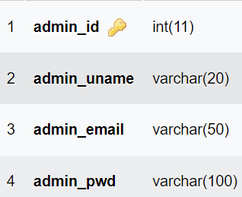
Structure of Admin

Slide 8
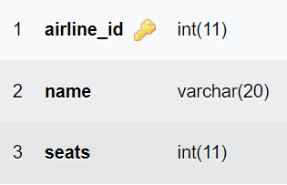
Structure of Airline

Slide 9

Structure of Cities

Slide 10
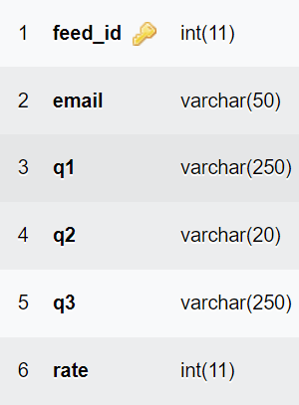
Structure of Feedback

Slide 11
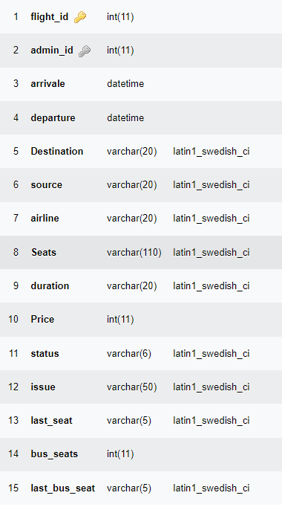
Structure of Flight

Slide 12
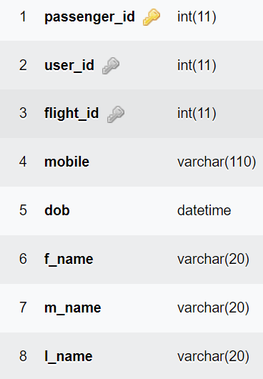
Structure of Passenger_profile

Slide 13
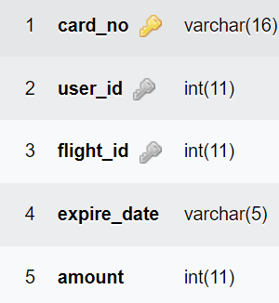
Structure of Payment

Slide 14
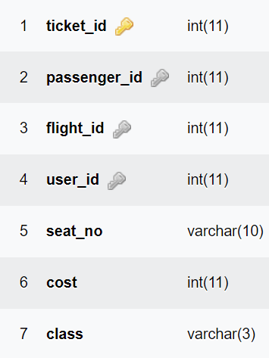
Structure of Ticket

Slide 15
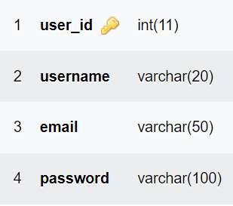
Structure of Users

Slide 16
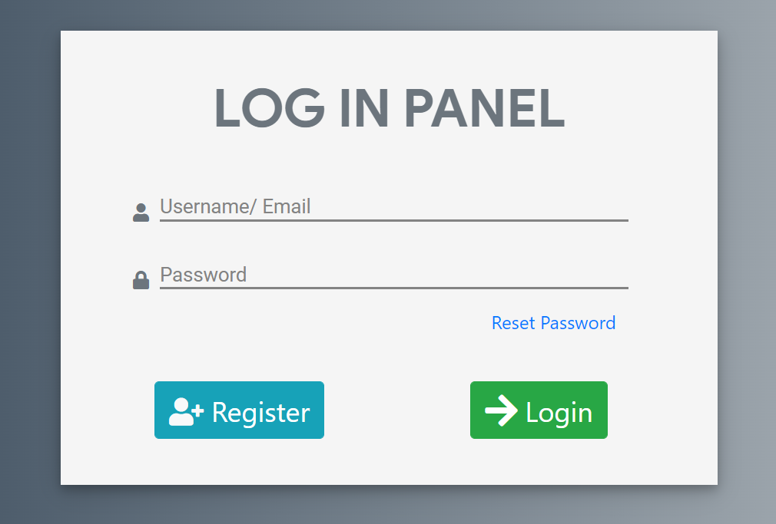
Screenshots of our system
Passenger Login

Slide 17
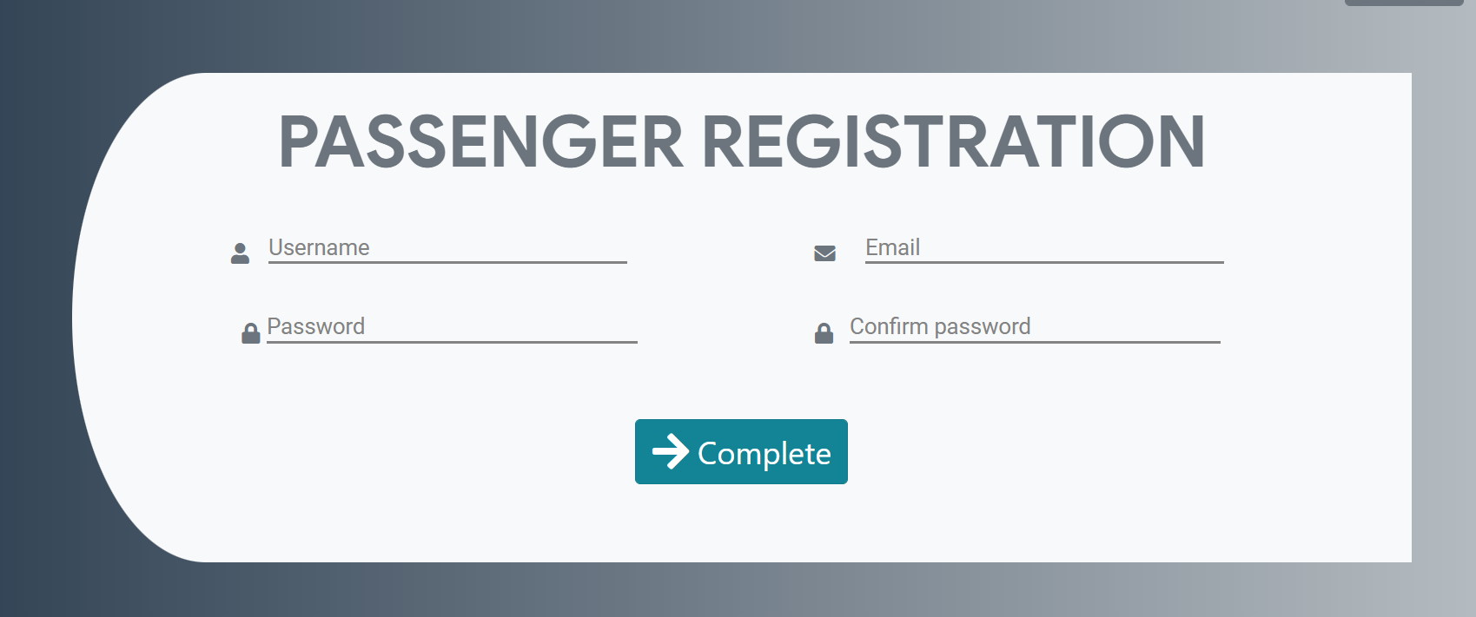
Passenger Registration

Slide 18
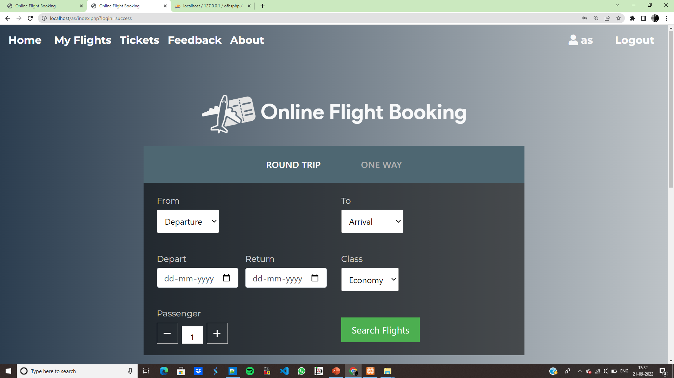
Dashboard

Slide 19
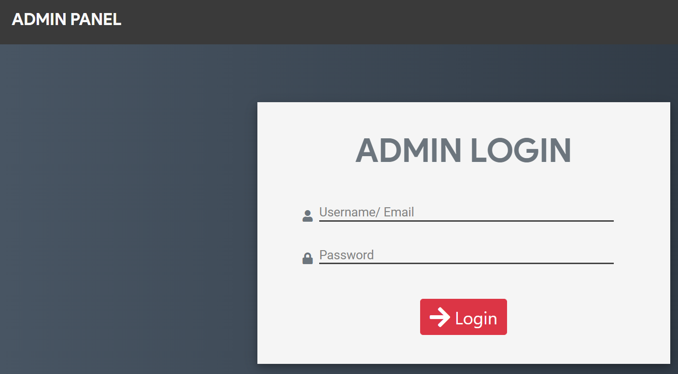
Admin Login

Slide 20
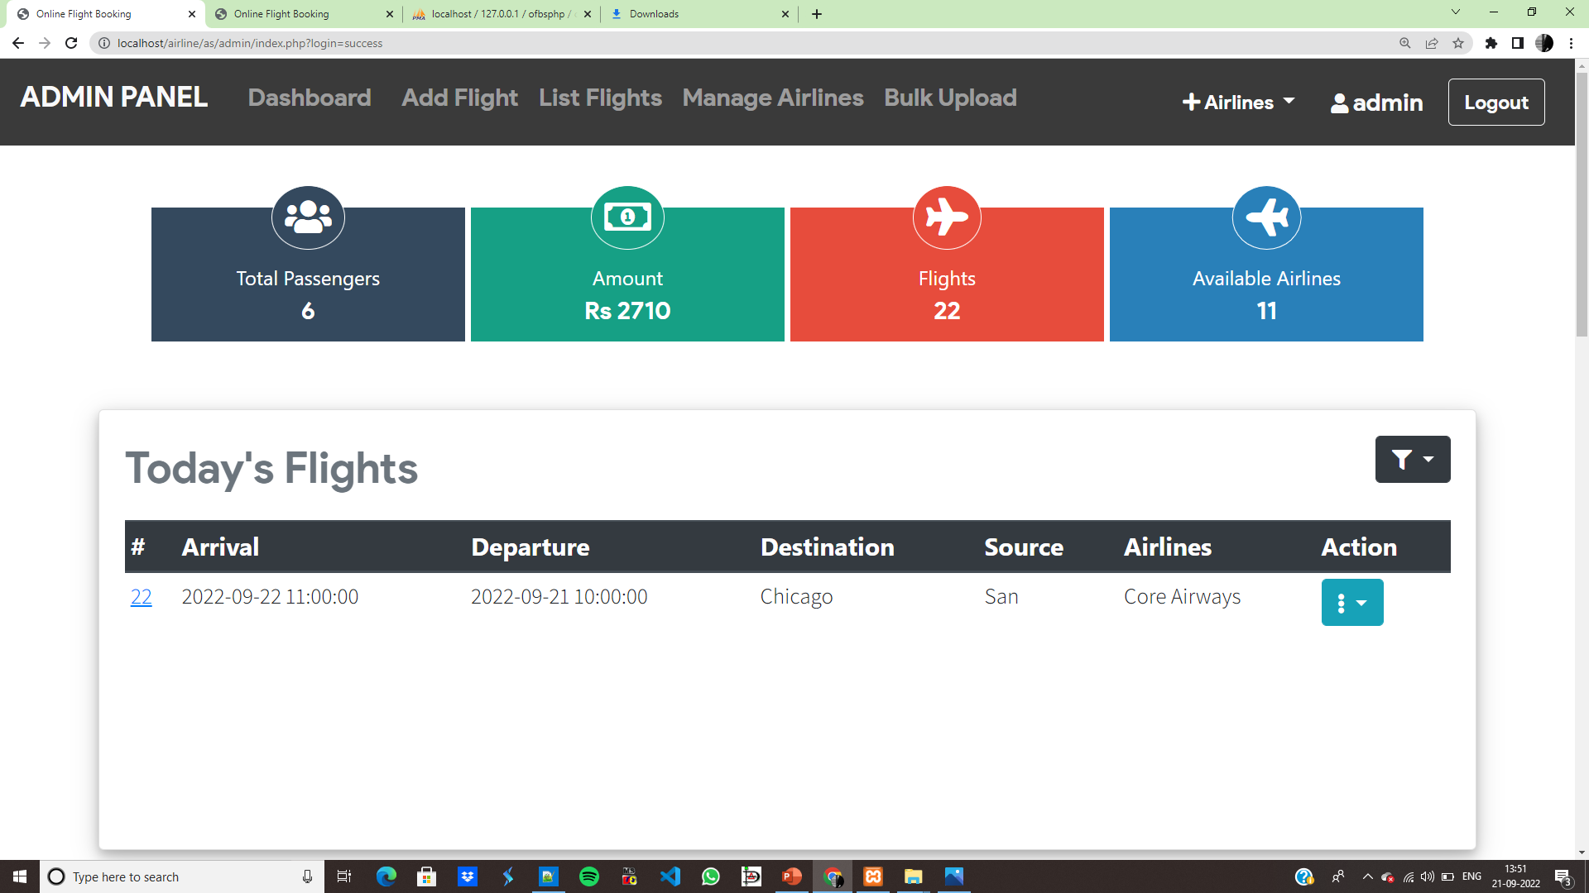
Admin Dashboard

Slide 21
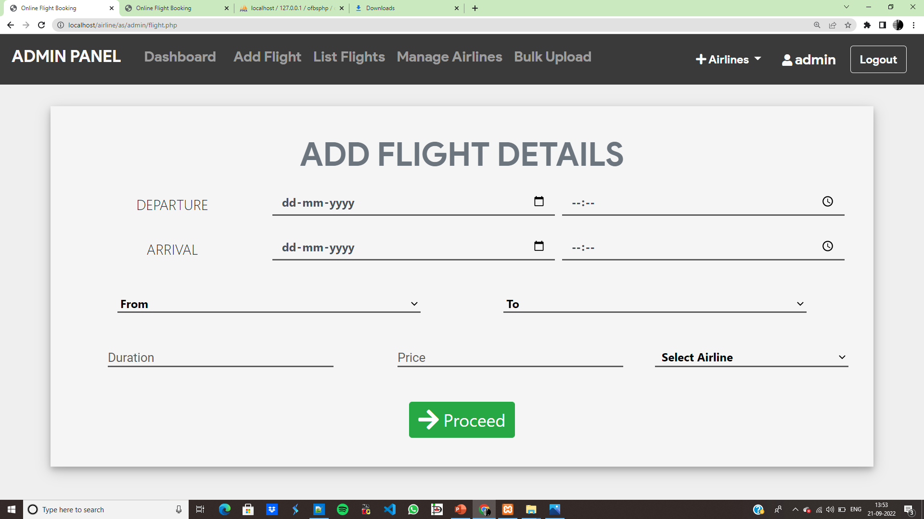
Add Flight by Admin

Slide 22
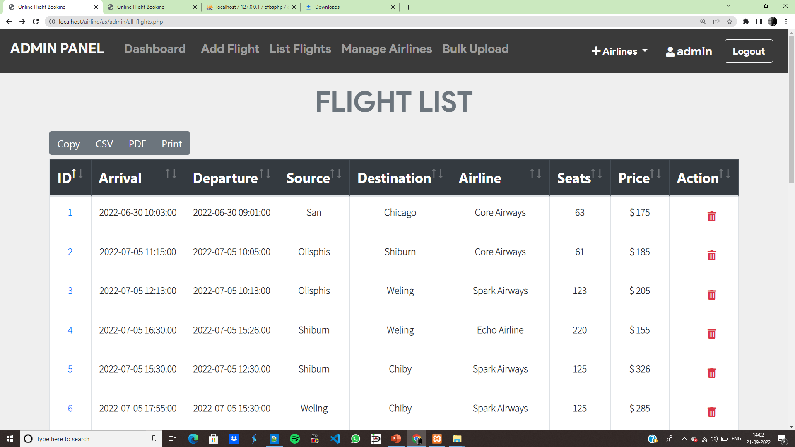
List Flight

Slide 23
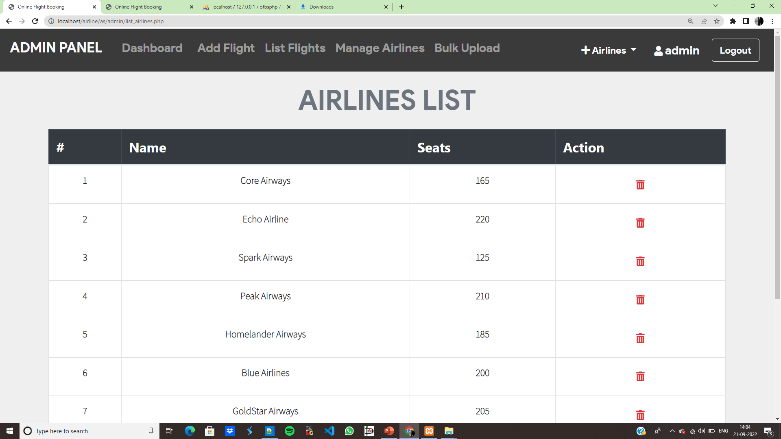
Manage Airlines

Slide 24
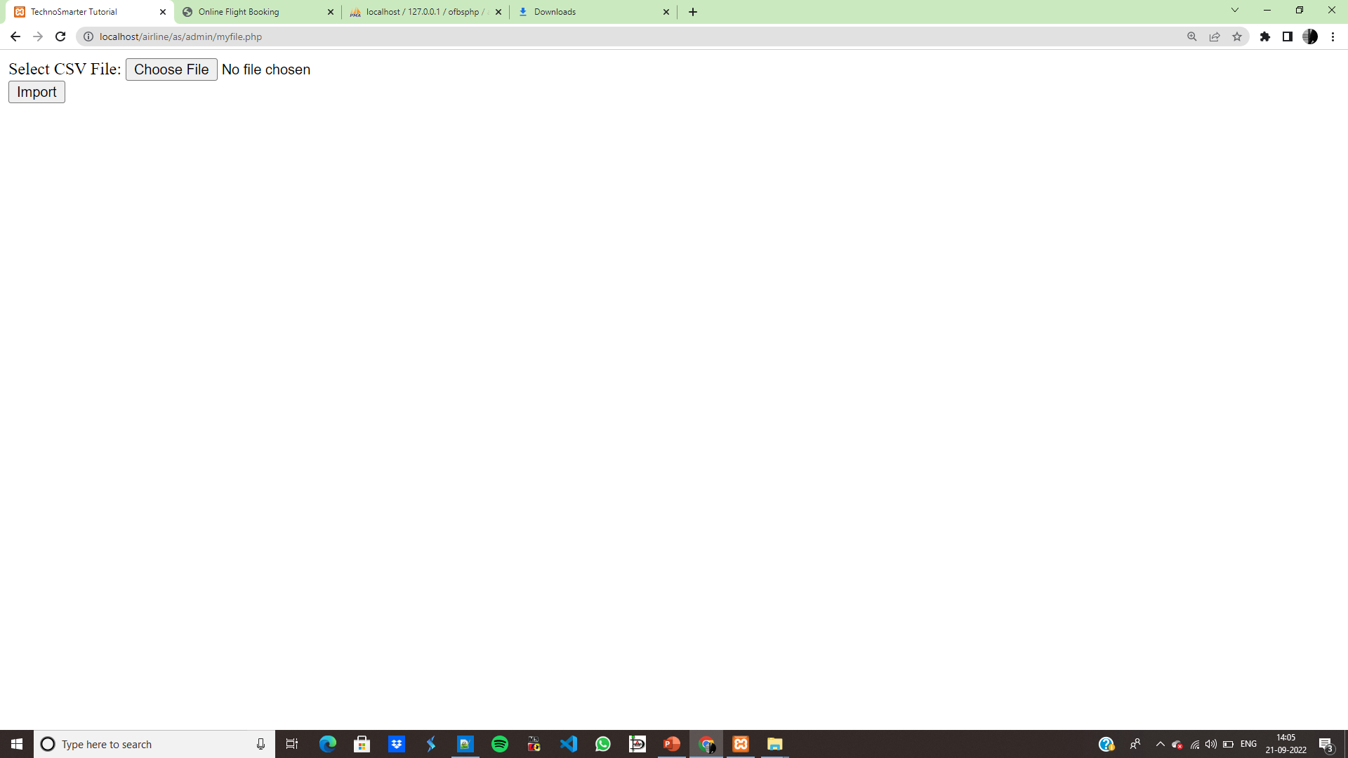
Bulk Upload

Slide 25
THANK YOU

