Slide 1

Memristor equivalent model of full- bridge rectifier with LLC converter
Visvesvaraya National Institute of Technology
Nagpur, M.S. – 440010, India
“Department of Electrical Engineering”
Presenter-
Guided by-
Aayush Mhaisgawali
B.tech Electrical Engineering
Dr. Jay Prakash Singh
Department of electrical engineering
JD college of engineering and management
Visvesvaraya National Institute of Technology

Slide 2
Abstract
This work presents a memristor-based equivalent circuit model for the full-bridge rectifier in an LLC resonant converter, commonly used in wireless power transfer systems. The model incorporates the nonlinear, time-dependent behavior of switching devices more accurately than traditional approaches.
The memristive load is mathematically formulated as a function of output voltage and current difference, replacing the conventional fixed resistive load with a dynamic, state-dependent element that reflects memory and hysteresis effects.
Comparative analysis between non-memristive and memristive models demonstrates that the memristive approach provides smoother and more realistic waveforms, enhancing the understanding of nonlinear dynamics and improving system modeling fidelity.

Slide 3



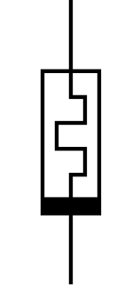
Introduction
The memristor was first proposed 1971 by Leon Chua as a the theoretical concept based on mathematical reasoning.
In 2008 Hewlet Packard(HP) labs built the first physical model proving Leon Chua’s theoretical concept into reality.
There are three fundamental passive components i.e., Resistor, Capicator, and Inductor are used to build electronic circuits.
The fourth one is Memristor, It is a two terminal passive element whose resistance depends on the magnitude, direction and duration of applied voltage.
Memristor can remember its most recent resistance when the voltage was turned off until the next time it is turned ON
Resistor
Capacitor
Inductor
Memristor

Slide 4
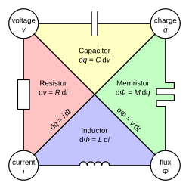
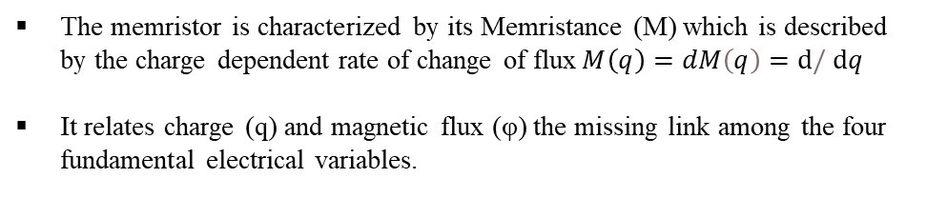
Introduction
The memristor is characterized by its Memristance (M) which is described by the charge dependent rate of change of flux$M\left(q\right)=dM\left(q\right)=ⅆ/ⅆq$
It relates charge (q) and magnetic flux (φ) the missing link among the four fundamental electrical variables.
Types
Molecular and ionic thin film memristor
Spin based and magnetic memristor
Titanium dioxide memristor (Tio2)
Polymeric or ionic memristor
Resonant tunnelling diode memristor
Manganite memristor
Spintronic memristor
Spin-transfer torque memristor

Slide 5
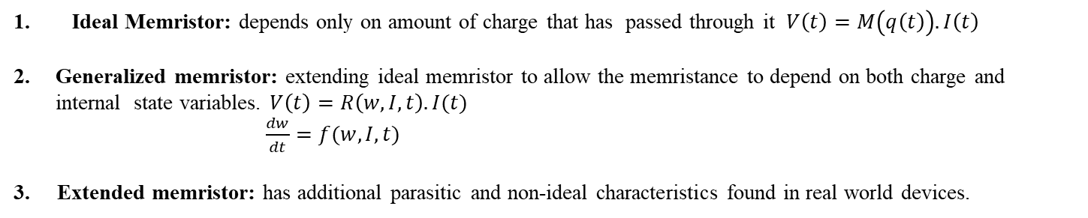
Introduction
Categories of memristor:
Ideal Memristor: depends only on amount of charge that has passed through it $V\left(t\right)=M\left(q\left(t\right)\right).I\left(t\right)$
Generalized memristor: extending ideal memristor to allow the memristance to depend on both charge and internal state variables. $V\left(t\right)=R\left(w,I,t\right).I(t)$
$\frac{dw}{dt}=f(w,I,t)$
3. Extended memristor: has additional parasitic and non-ideal characteristics found in real world devices.
Properties of memristor:
Pinched hysteresis:
i. when voltage is increasing current follows a path.
ii. When voltage is decreasing current does not follows the same path, memory effect forces the loop to get pinch at origin.
2. Dynamical negative resistance:
i. when Voltage increase the current decrease.

Slide 6
Applications
Modeling non-linear loads:
circuits like bridge rectifier exhibits memristive behaviour
Memristors help model voltage-current characteristics of such nonlinear and memory-dependent components
Compact Memory-Enabled Controllers:
1. Used in control circuits with memory functions and smart converters
Enables adaptive feedback and learning-based control in converters.
Enhanced Power Converter Design:
Used to design compact, high-efficiency, and self-adaptive converters.

Slide 7
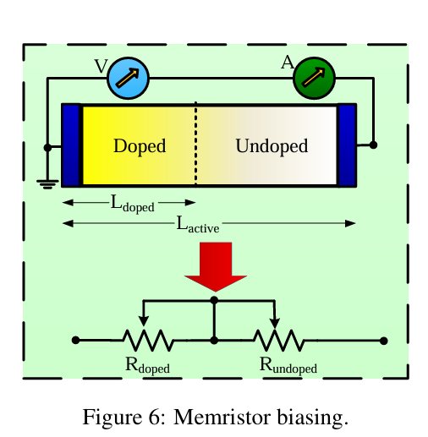
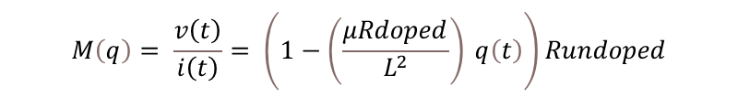

Methodology
Titanium dioxide thin film memristor:
TiO2 + x provides charge carriers when voltage is applied across top/bottom electrodes, charge flows towards active TiO2 layer this changes resistance of the TiO2 layer (decrease resistance).
If current is in reverse direction then excess charge carriers go from TiO2 (undoped) layer move towards TiO2+x (increases resistance).
Ti/pt
TiO2 + x active
TiO2 active
Ti/pt
Silicon substrate
Applying Kirchhoff’s voltage law (KVL) on the equivalent circuit of the memristor the following expression is obtained:
V(t)=$( Rdpoed\left(\frac{Ldoped\left(t\right)}{Lactive}\right)+Rundoped\left(1−\frac{Lundoped \left(t\right)}{Lactive}\right)$
$$Ldoped\left(t\right)= μ\left(\frac{V\left(t\right)}{Lactive}\right)\left(\frac{q\left(t\right)}{i\left(t\right)}\right)$$
$$M\left(q\right)= \frac{v\left(t\right)}{i\left(t\right)}= \left(1−\left(\frac{μRdoped}{L^{2}}\right) q\left(t\right)\right)Rundoped$$

Slide 8
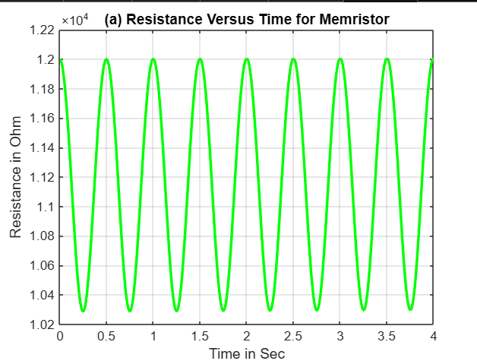
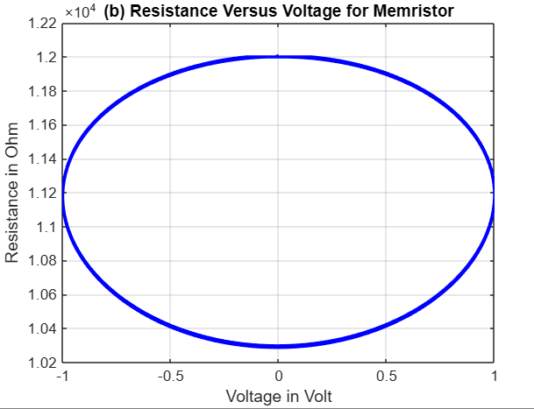
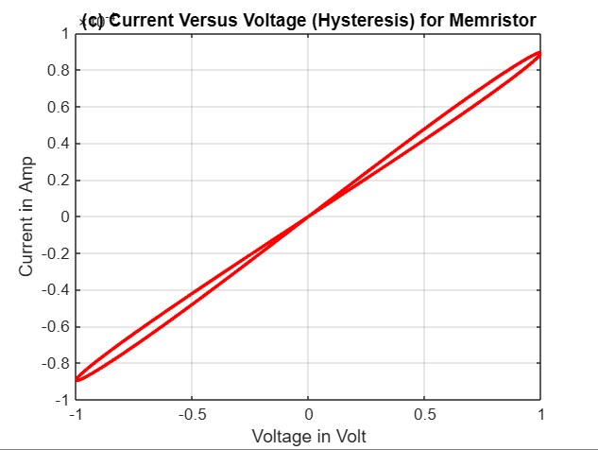
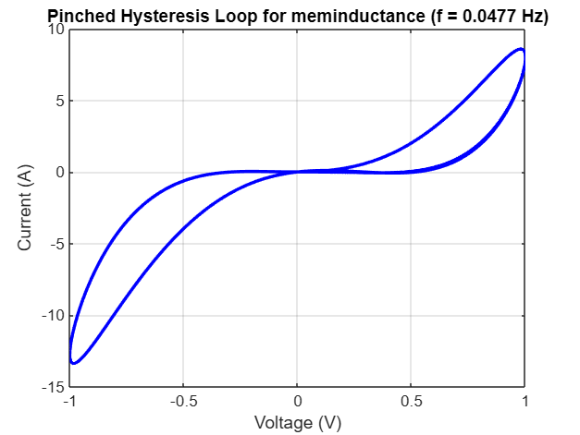
Graphical representation
Resistance vs time
For sine wave input
Resistance vs voltage
Follows sin² function
Current vs voltage
Mamrestive synapse

Slide 9
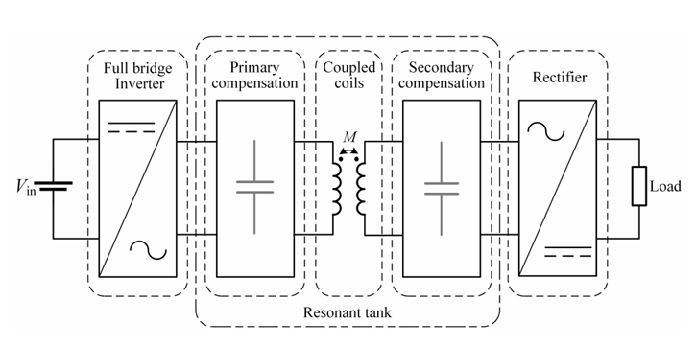
Memristive behaviour in power electronics
Memristive behavior in Inductive wireless power transfer system
IWPT systems uses bridge rectifiers with passive filters for AC-DC conversion.
These stages exhibit voltage-current characteristics similar to memristor
especially: a) non linearity,
b) memory effect
c) hysteresis in switching devices
Modeling techniques used in IWPT systems
FHA(fundamental harmonic approximations): simplifies the analysis of resonant power converters by assuming all signals are sinusoidal.
GSSA(generalized state space averaging): instead of looking at on/off states in detail GSSA helps by creating a smooth averaged model that behaves like the average.
EDF(extend describing memristor): used for small-signal modeling of non-linear switching circuits.

Slide 10
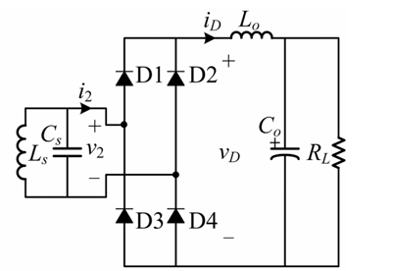
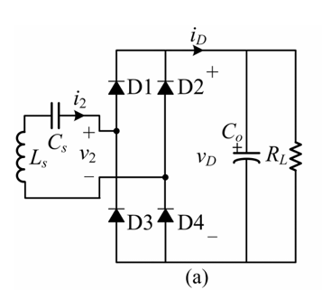
IWPT system
Four fundamental compensation structures
S-S(series-series)
S-P (series-parallel)
P-S→ (parallel-series)
P-P→ (parallel-parallel)
IWPT uses full bridge rectifier circuit and type of low pass filter depends on the compensation topology of the receiving end.
Receiving end using parallel topology
Receiving end using series topology

Slide 11
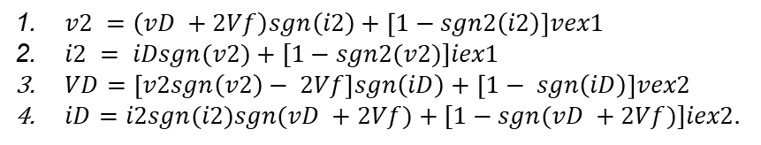
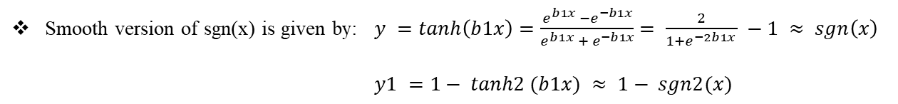
Memristive Rectifier Modeling
Four operational modes of full bridge rectifier circuit:
Mode 1: D1 & D4 ON → i₂ > 0, v₂ = v_D + 2V_f
Mode 2: D2 & D3 ON → i₂ < 0, v₂ = -v_D - 2V_f
Mode 3: All OFF → i₂ = 0, current flow stops
Mode 4: All ON → v₂ = 0, input shorted
Relationship between terminal voltage and current for rectifier bridge across its four operational modes
$v2 =\left(vD +2Vf\right)sgn\left(i2\right)+\left[1−sgn2\left(i2\right)\right]vex1$
$i2 = iDsgn(v2)+[1−sgn2(v2)]iex1$
$VD=\left[v2sgn\left(v2\right)− 2Vf\right]sgn\left(iD\right)+\left[1− sgn\left(iD\right)\right]vex2$
$iD=i2sgn(i2)sgn(vD +2Vf)+[1−sgn(vD +2Vf)]iex2.$
Smooth version of sgn(x) is given by: $y =tanh\left(b1x\right)=\frac{e^{b1x} −e^{−b1x}}{e^{b1x} + e^{−b1x}}= \frac{2}{1+e^{−2b1x }} −1 ≈ sgn\left(x\right)$
$$y1 =1− tanh2 (b1x) ≈ 1− sgn2(x)$$

Slide 12
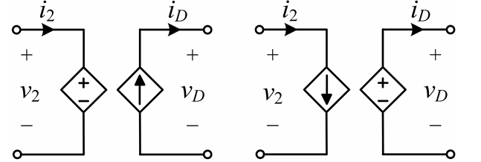
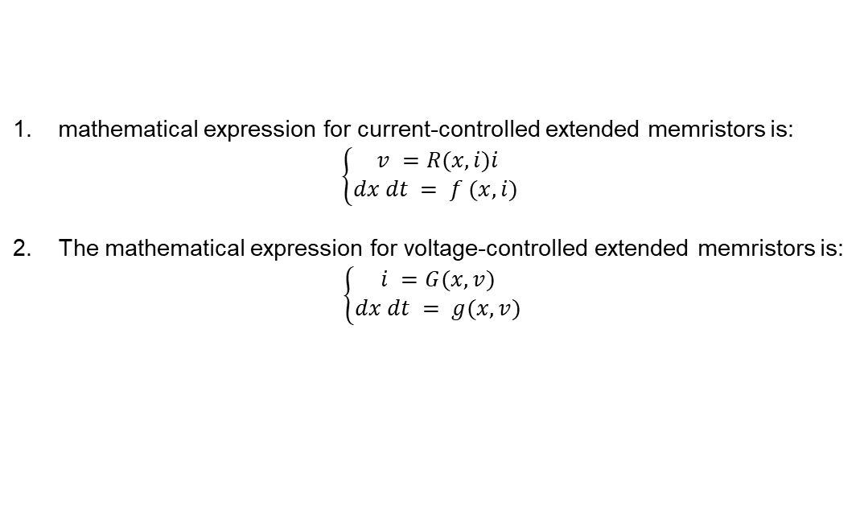
Memristive Rectifier Modeling
Tan sigmoid expression for equivalent controlled sources
1. Input terminal
$$v2​≈\left(vD​+2Vf​\right)tanh\left(b1​i2​\right)+\left[1−tanh2\left(b1​i2​\right)\right]vex1​$$
$$iD​≈i2​tanh\left(b1​i2​\right)tanh+\left[1−tanh\left(b1​\left(vD​+2Vf​\right)\right)\right]iex2​$$
2. Output terminal
Equivalent crcuit of rectifier bridge
$$\text{​}$$
$$i2​≈iD​tanh\left(b1​v2​\right)+\left[1−tanh2\left(b1​v2​\right)\right]iex1​$$
$$vD​≈\left[v2​tanh\left(b1​v2​\right)−2Vf​\right]tanh\left(b1​iD​\right)+\left[1−tanh2\left(b1​iD​\right)\right]vex2​$$
mathematical expression for current-controlled extended memristors is:
$$\left\{\begin{aligned}v =R(x, i)i \\ dx dt = f (x, i) \end{aligned}\right.$$
The mathematical expression for voltage-controlled extended memristors is:
$$\left\{\begin{aligned}i =G(x, v) \\ dx dt = g(x, v)\end{aligned}\right.$$

Slide 13
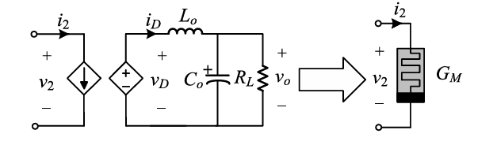
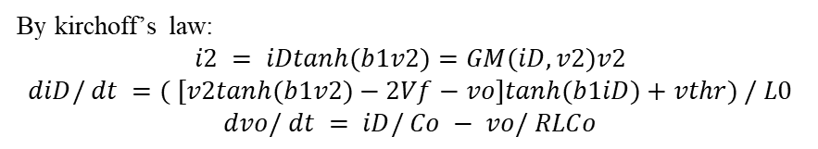
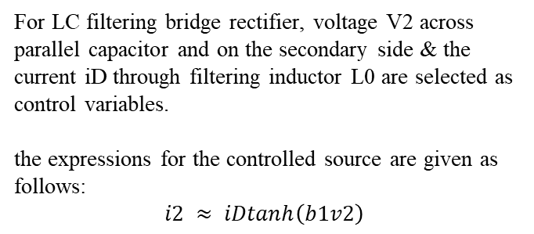
Memristive Rectifier Modeling
For LC filtering bridge rectifier, voltage V2 across parallel capacitor and on the secondary side & the current iD through filtering inductor L0 are selected as control variables.
the expressions for the controlled source are given as follows:
$$i2 ≈ iDtanh\left(b1v2\right)$$
Memristor Model With Tan-Sigmoid Function for LC-Filtering Bridge Rectifier Circuit.
$$vD ≈[v2tanh(b1v2) − 2Vf]tanh(b1iD) +[1−tanh(b1iD)]vex2.$$
By kirchoff’s law:
$$i2 = iDtanh(b1v2)=GM(iD,v2)v2$$
$$diD/ dt =( [v2tanh(b1v2)−2Vf−vo]tanh(b1iD)+vthr) / L0$$
$$dvo/ dt = iD/ Co − vo/ RLCo$$
Vthr is a threshold term it is added because if the simulation starts from quiescent point V2 = iD = V0 = 0 all right hand side term becomes zero.

Slide 14
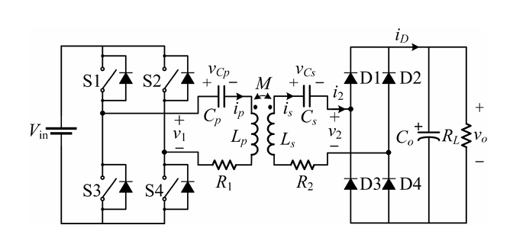
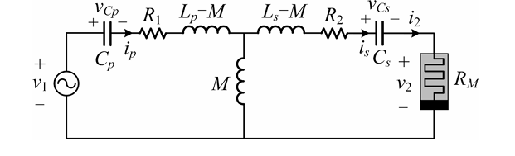
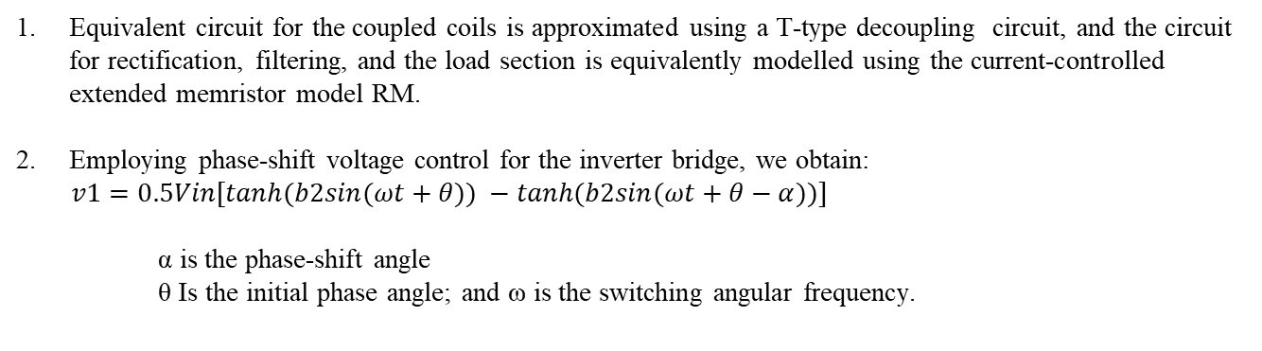
Memristive Rectifier Modeling
Equivalent S-S type IWPT system
S-S type IWPT system
Equivalent circuit for the coupled coils is approximated using a T-type decoupling circuit, and the circuit for rectification, filtering, and the load section is equivalently modelled using the current-controlled extended memristor model RM.
Employing phase-shift voltage control for the inverter bridge, we obtain:
$v1=0.5Vin[tanh(b2sin(ωt+θ)) −tanh(b2sin(ωt+θ−α))]$
α is the phase-shift angle
θ Is the initial phase angle; and ω is the switching angular frequency.

Slide 15







Memristive Rectifier Modeling
The state-space equation for the system can be derived using and KCL.
$$\frac{dip}{dt}=\frac{Ls}{∆}\left(v1−ipR1−vcp\right)−\frac{M}{∆}(isR2 −vcs+isRm)$$
$$\frac{dis}{dt}=\frac{M}{∆}\left(v1 −ipR1 −vcp\right)− \frac{Lp}{∆}(isR2+vcs+isRm)$$
$$\frac{dVcp}{dt}=\frac{1}{Cp}ip$$
$$∆=LpLs−M^{2}$$
$$\frac{dVcs}{dt}=\frac{1}{Cs}is$$
$$Rm=\left[\left(Vo+2Vf\right)\tanh\left(b1is\right)\right]/is$$
$$\frac{dVo}{dt}=\frac{1}{Co}(is\tanh\left(b1is\right)− \frac{Vo}{Rl}$$

Slide 16
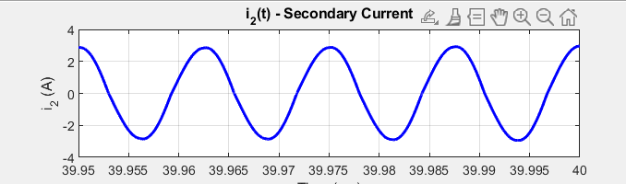
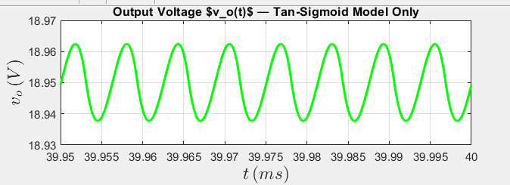
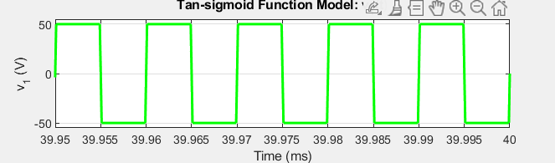
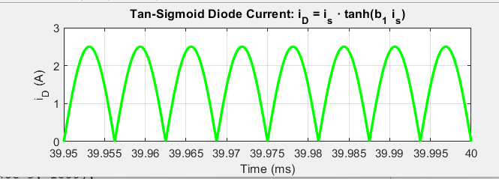
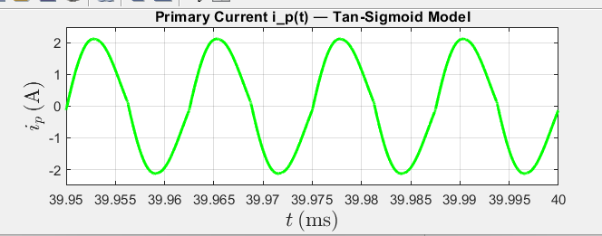
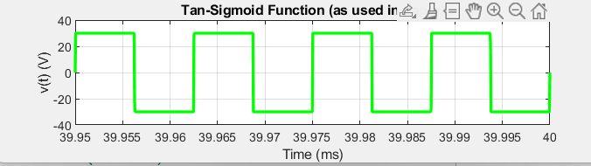
Memristive Rectifier Modeling
I2(A)
Vo(V)
V1(V)
ID(A)
Ip(A)
V2(V)

Slide 17
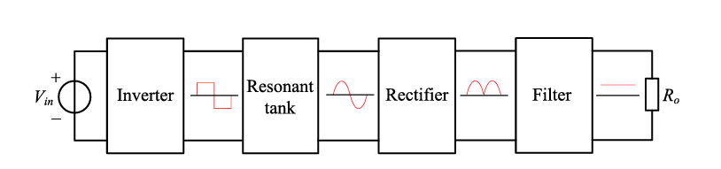
Full bridge LLC converter
A resonant converter is a power electronic circuit that uses resonance between inductors and capacitors to shape the voltage or current waveforms this allows switching devices to turn ON/OFF when voltage or current is zero that reduces losses and electromagnetic interference.
They achieve soft switching by turning ON/OFF the switching elements at zero voltage or zero current thereby minimizing switching losses during circuit resonance.
3. It is assumed that the inverters operate in 180˚ conduction mode i.e., the duty cycle is 0.5 i.e., 50%

Slide 18
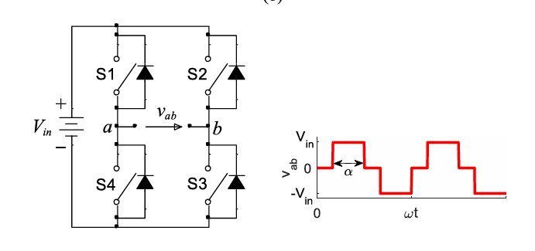
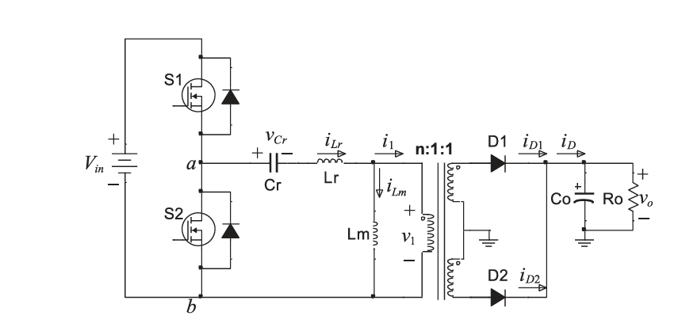
Full bridge LLC converter
Width of the output voltage pulse of the full bridge inverter can be adjusted by shifting the phase.
Alpha Is the deadtime.
$$Vab=0.5Vin[\tanh\left(bsin\left(ωt+θ\right)\right)−\tanh\left(bsin\left(ωt+θ−α\right)\right)]$$
Alpha = phase shift between the diagonal
Voltage source square wave inverter full-bridge
Asymmetrical half bridge LLC resonant converter

Slide 19
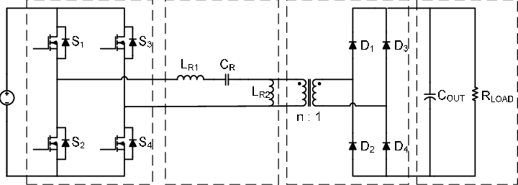
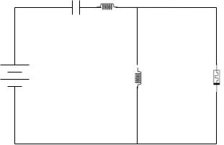





Full bridge LLC converter
Non-memristive circuit
Memristive circuit
$$\frac{diLm}{dt}=\frac{n}{Lm}. vo\left(t\right).tanh⁡(b\left(iLr\left(t\right)−iLm\left(t\right)\right))$$
$$\frac{diLm}{dt}=\frac{n}{Lm}. vo\left(t\right).tanh⁡(b\left(iLr\left(t\right)−iLm\left(t\right)\right))$$
$$\frac{diLr}{dt}=\frac{1}{Lr}(−vcr−nvo\left(t\right).\tanh\left(b\left(iLr\left(t\right)−iLm\left(t\right)\right)\right)+vab(t)$$
$$\frac{diLr}{dt}=\frac{1}{Lr}(−vcr−nvo\left(t\right).\tanh\left(b\left(iLr\left(t\right)−iLm\left(t\right)\right)\right)+vab(t)$$
$$\frac{dvcr}{dt}=\frac{1}{Cr}.iLr(t)$$
$$\frac{dvcr}{dt}=\frac{1}{Cr}.iLr(t)$$
$$\frac{dvo}{dt}=\frac{n}{Co}.\left(iLr\left(t\right)−iLm\left(t\right)\right).\tanh\left(b\left(iLr\left(t\right)−iLm\left(t\right)\right)\right)−\frac{vo(t)}{RoCo}$$
$$\frac{dvo}{dt}=\frac{n}{Co}.\left(iLr\left(t\right)−iLm\left(t\right)\right).\tanh\left(b\left(iLr\left(t\right)−iLm\left(t\right)\right)\right)−\frac{vo(t)}{Co.Rm(t)}$$

Slide 20
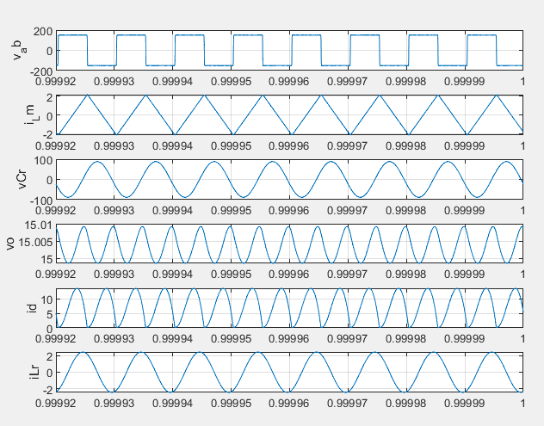
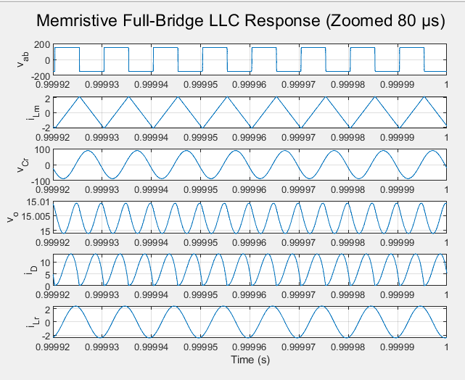

End Results
$$Rm\left(t\right)=\frac{\left(vo\left(t\right)+2Vf\right).tanh⁡(b1.\left(iLr\left(t\right)−iLm\left(t\right)\right))}{\left(iLr\left(t\right)−iLm\left(t\right)\right)+ε}$$
Non-memristive full bridge LLC converter
memristive full bridge LLC converter

Slide 21
Thank You!

