Slide 1
SKY BOMBER

Slide 2
Team Members
Aayush Acharya (074BCT501)
Anjil Bishowkarma (074BCT505)
Nirajan Basnet (074BCT522)

Slide 3
Objectives
Learning to work in groups and being introduced to work division and working together.
Understanding and being familiar with OOP Concepts and its features
Being introduced to External Libraries For Desirable program creations.
To gain GUI Programming Skill with SFML.
Entertaining User with the Game story.

Slide 4





SFML 2.5.1
Cross-Platform Software Development Library
Visual Studio 2017
IDE for the Program
What We Used?
GitHub
Source Code Management and Version Control using Git
Discord
Team Communication

Slide 5
What we did?
User Friendly GUI
User Friendly Controls. ‘W’ , ‘S’ , ‘Q’ , ’R’ , ‘Escape’ , ‘Space’
Game Design
Reduces Boredom with exciting Effects.

Slide 6
What we did?
Animation and Sound Effects
Gaming Environment Creation with Background Music
Intro Music, In Game Music, Main Menu Music
Animation for Explosion.

Slide 7
What we did?
Game Story
World War II., Boeing b-29 superfortress, which is our main
Game Object.
- An environment where plane and tanks have to combat.
Survival For Existence ( Fuel Status )
Wave Based Game Loop

Slide 8
Flow of the Game

Slide 9
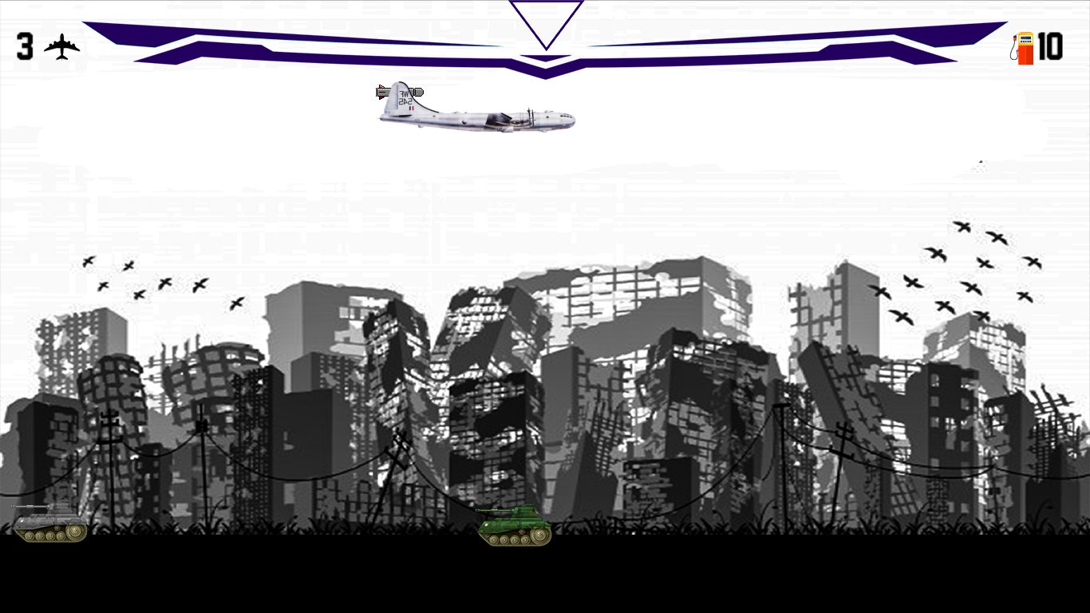
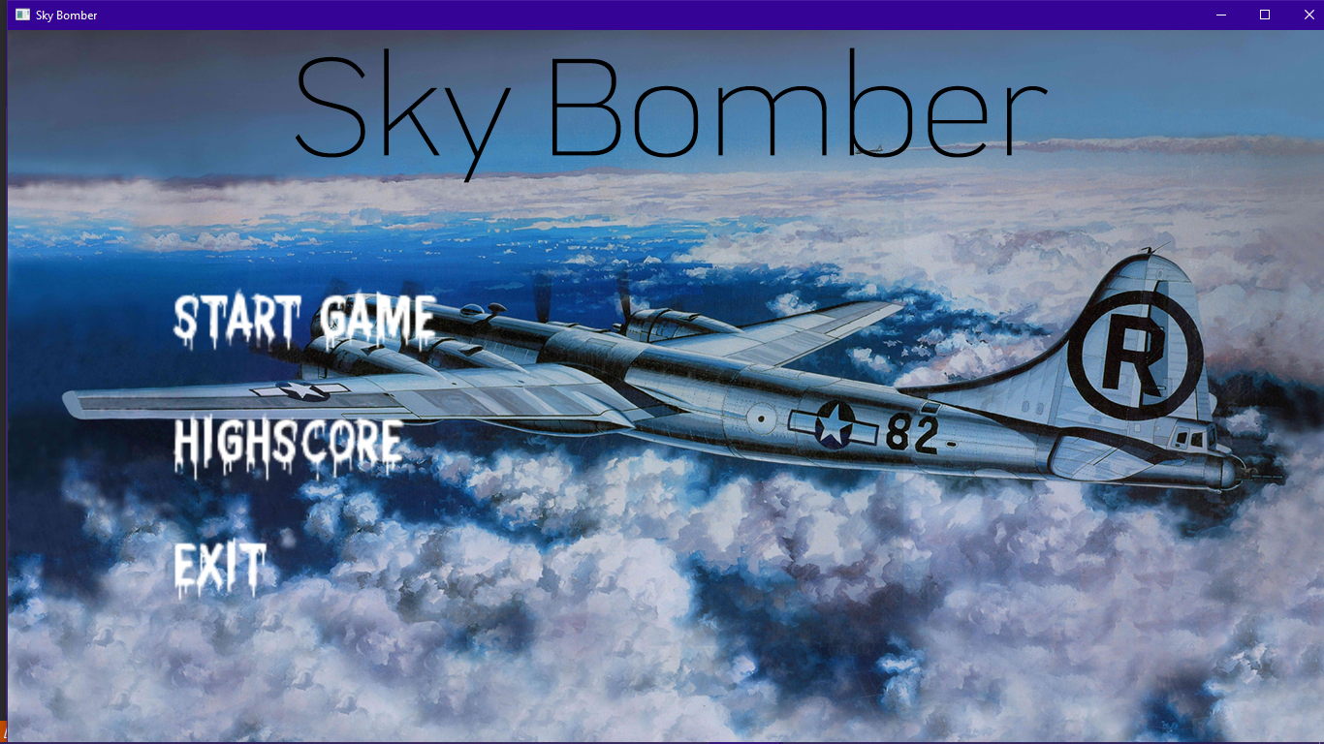
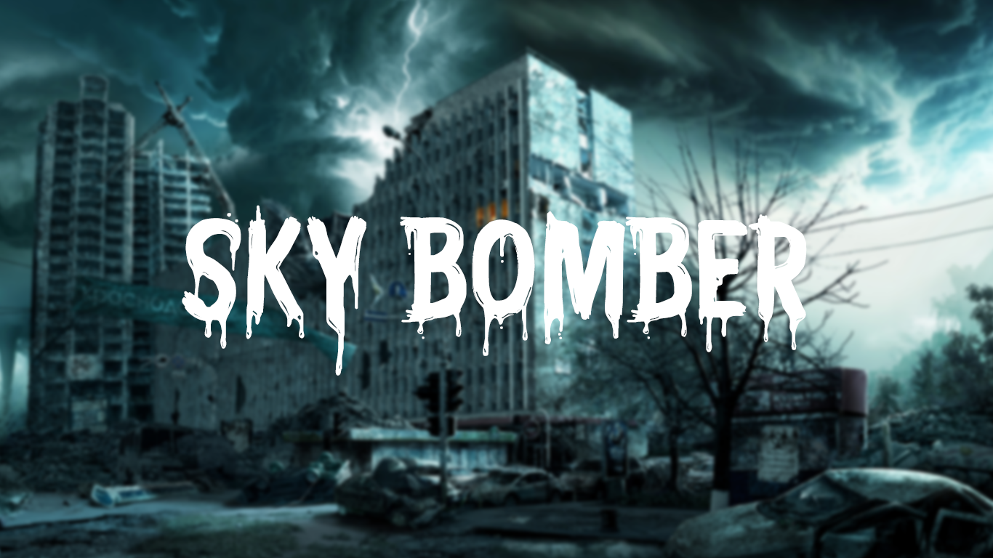


Game Play | Snapshot
Splash Screen with a music for 6 sec
Main Menu where you can select Different Options
Game Window

Slide 10
Limitations and Future Enhancement
Due to Many factors game obviously have some limitations in our case, game is slightly laggy, Some Glitches, etc.
Will imply Both Attack and Defense Features (Now its attack Only)
Can add More Levels and New Skins for Plane and tanks
Multiplayer Mode
Better Control Over Plane.
Notes:
55 53 58
65 186 167
86 85 80

Slide 11
Conclusion
We learn Project Management.
Notes:
55 53 58
65 186 167
86 85 80

Slide 12
Thank You !!

