Slide 1
COLLABORATIVE EDITOR USING CRDT
Cloud Computing (COL733) course project
Submitted By:
Aayush Agarwal (2018CS10322)

Slide 2
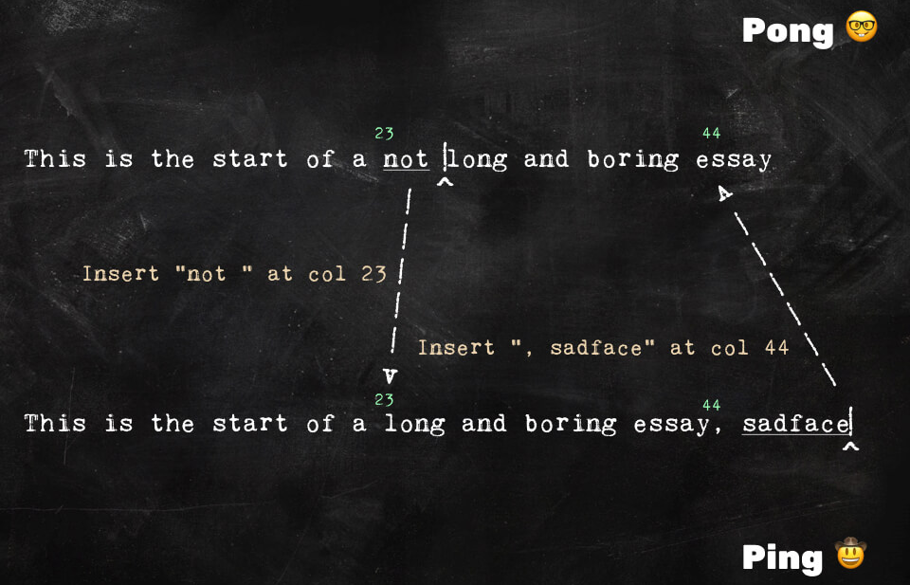
Problem of Synchronization
Reference: https://digitalfreepen.com/2017/10/06/simple-real-time-collaborative-text-editor.html

Slide 3
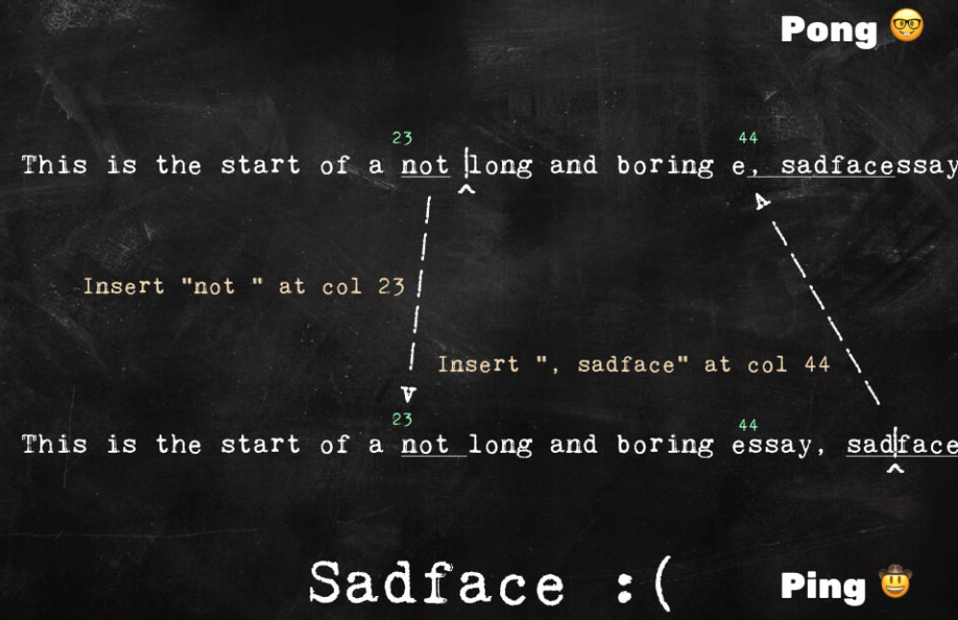
Problem of Synchronization
Reference: https://digitalfreepen.com/2017/10/06/simple-real-time-collaborative-text-editor.html

Slide 4
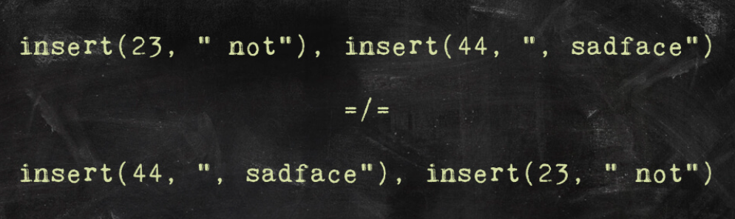
Problem of Synchronization
Reference: https://digitalfreepen.com/2017/10/06/simple-real-time-collaborative-text-editor.html

Slide 5
Problem of Synchronization
Reference: https://digitalfreepen.com/2017/10/06/simple-real-time-collaborative-text-editor.html
Commute + idempotent => synchronize

Slide 6
solution : unique dense identifier space
Identifiers should have total ordering (since string is sequential)
Identifier once set should not be changes again later.

Slide 7
solution : unique dense identifier space
Identifiers should have total ordering (since string is sequential)
Identifier once set should not be changes again later.
There should be infinite possible identifiers between i1 and i2.
Even same characters entered by 2 different clients parallelly at same position should have different unique identifier

Slide 8
solution : unique dense identifier space
Identifiers should have total ordering (since string is sequential)
Identifier once set should not be changes again later.
There should be infinite possible identifiers between i1 and i2.
Even same characters entered by 2 different clients parallelly at same position should have different unique identifier
They should not be interleaving. (eg client1 : “after “->”after class” & client2: “after ” -> “after math”, synced result: “after classmath”/”after mathclass” and not “after cmatlassh”

Slide 9
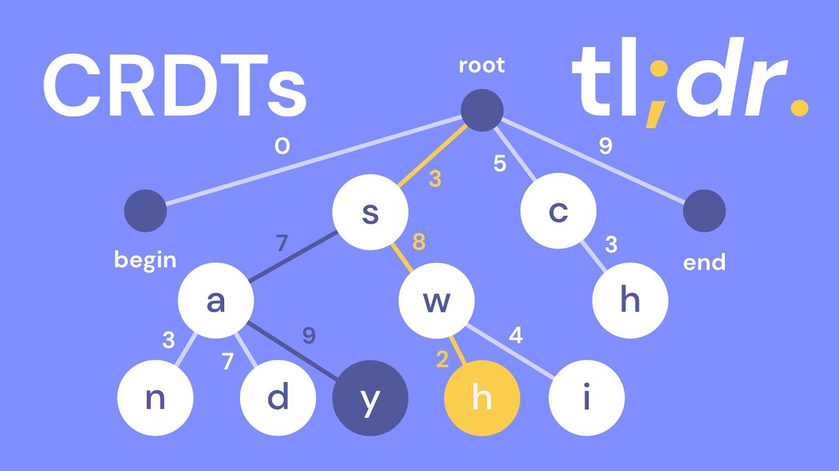
Consider an example below…
sandwhich
TREEDOC

Slide 10
Consider an example below…
Insert ‘t’ b/w ‘h’(3,8,3) & ‘i’(3,8,4)
t

Slide 11
Consider an example below…
Delete ‘h’
TOMBSTONE

Slide 12
DEMO

Slide 13
Future work and optimisation
Keeping Tree Balanced
Garbage collection
Integrating this data structure in a server-hosted html text field
Option of undo and redo for each individual client

