Slide 1


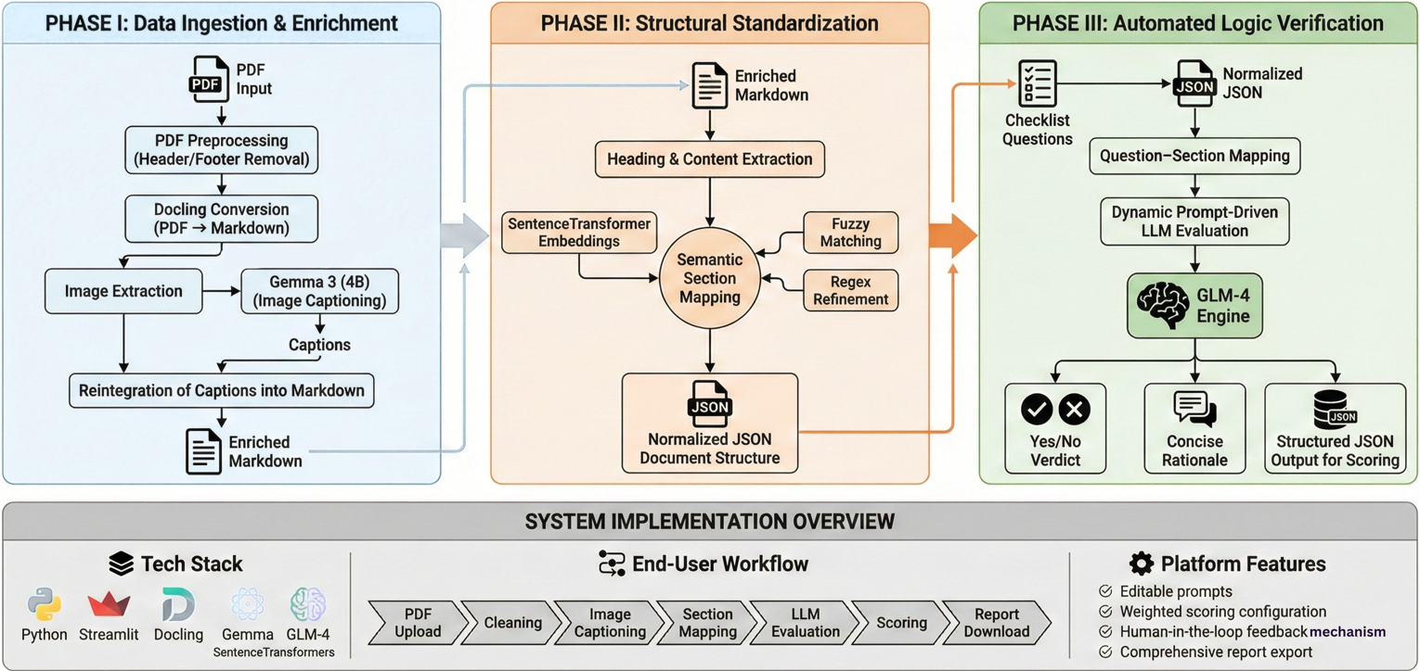
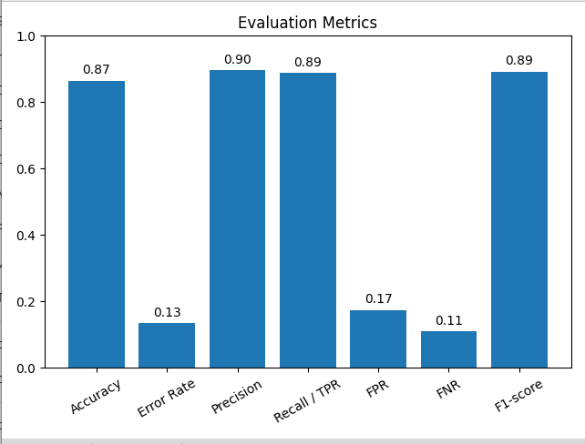
LLM Based Web Application For SQAG Document’s Verification
Aayush Anand, M.B Sai Charan (Sci-C), A.Kalidasu (Sci-E)
Directorate of Artificial Intelligence & Visualization
Software Quality Assurance Group (SQAG) under DRDO reviews a large number of technical documents such as SRS, SDD, ICD, and test plans.
Many incoming documents suffer from incorrect templates, missing sections, irrelevant content, and unclear diagrams, making manual review slow and inconsistent.
This project proposes an AI-assisted initial screening and verification system to reduce reviewer burden and improve standardization.
Overview
Problem Statement
Objectives
Problem Statement
Manual verification of Software Requirement Specification (SRS) documents within SQAG is time-consuming due to inconsistent formats, non-standard terminology, and structural variations. Many submissions contain missing or poorly defined sections that do not follow prescribed templates, complicating systematic review. Embedded images and vector diagrams are not machine-readable and often lack descriptive context which increasing reviewer workload. These issues result in longer review cycles and reduced verification efficiency.
The Software Quality Assurance Group (SQAG) under DRDO reviews multiple technical documents such as SRS, SDD, and ICD. Many submissions suffer from incorrect templates, missing sections, and unclear diagrams, making manual review slow and inconsistent. This project proposes an AI-assisted initial screening system to reduce reviewer burden and improve standardization.
Manual verification of SRS documents within SQAG is time-consuming due to inconsistent formats, non-standard terminology, and missing or poorly structured sections.
Additionally, embedded images and vector diagrams are not machine-readable, increasing reviewer workload and leading to longer review cycles and reduced verification efficiency.
Develop an LLM-based web application for SRS verification
Design a modular Document AI pipeline.
Automate PDF pre-processing and image interpretation
Perform semantic mapping to SQAG templates
Enable prompt-driven compliance evaluation
Provide a Streamlit dashboard with scoring and reports
Objective
Develop an LLM-based web application for SRS verification
Build a modular AI pipeline with independent components
Automate PDF pre-processing and image understanding
Perform semantic section mapping to SQAG templates
Enable prompt-driven compliance checking.
Provide a Streamlit dashboard with scoring, feedback and reports.
System Architecture
Phase I: Data Ingestion & Enrichment
PDF pre-processing (header/footer removal)
PDF → Markdown conversion using Docling
Image extraction and captioning using Gemma 3 (4B)
Reintegration of captions into Markdown
Phase II: Structural Standardization
Heading & content extraction
Semantic section mapping using:
  SentenceTransformer embeddings
  Fuzzy matching & Regex refinement
Normalized JSON document structure
Phase III: Automated Logic Verification
Checklist question–section mapping
Dynamic prompt-driven LLM evaluation
GLM-4 generates:
  Yes/No verdict
  Concise rationale
Structured JSON output for scoring
RESULTS & EVALUATION
CHALLENGES
Irregular SRS templates
Complex diagrams and multi-part figures
Semantic variation in section names
LLM prompt sensitivity
Preventing hallucination and ensuring grounding
Challenges
Irregular SRS Formats
Complex Diagrams & Figures
LLM Prompt Sensitivity & Grounding
CONCLUSION
The project presents an LLM-based system for SRS verification that reduces manual review effort and enables structured, explainable compliance evaluation. It demonstrates the effective use of multimodal LLMs and modular AI pipelines for intelligent document processing in defense workflows..
FUTURE SCOPE
Support for SDD, ICD, STR documents
Automatic template detection User authentication & access control
Improved UI/UX and feedback-driven learning

